Slide 1

Racism, Migration and the NHS
ria, Bethan and Ellie

Slide 2
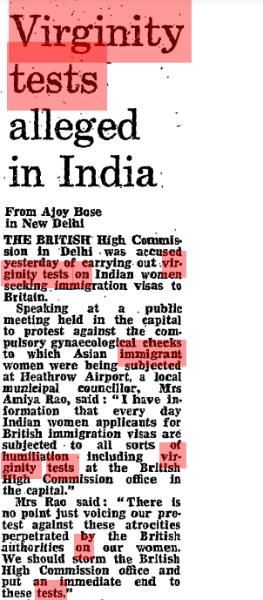
Virginity tests alleged in India Bose, Ajoy The Guardian (1959-2003); Feb 7, 1979; ProQuest Historical Newspapers: The Guardian and The Observer pg. 7

Slide 3
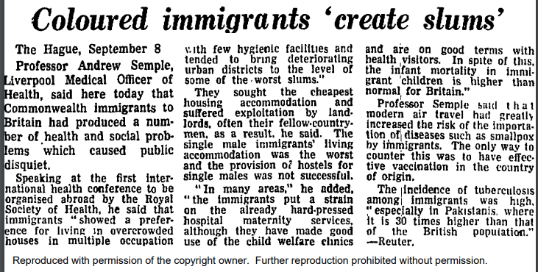
"Coloured immigrants 'create slums' " - The Guardian (1959-2003); Sep 9, 1966; ProQuest Historical Newspapers: The Guardian and The Observer pg. 11
Notes:
This article was published in 1966 in the Guardian and The observer
It argues that immigrants that are people of colour ‘create slums’.
It focuses on the fact that they are making the health of the country worse and are taking from stretched resources, but it blames the immigrants for this, because they have ‘a preference for living in overcrowded houses. This is something that Enoch Powell will later use in his speech 'rivers of blood' in 1968 (two years after this article) specifically the idea that migrants leach on society, so its useful in understanding the common discourse of the time, this wasn't a new idea from Enoch Powell but a continuation of the discourse.
It recognises the role of landlords, but it blames it on the migrants themselves stating ‘they suffered exploitation often by their fellow countrymen’.
It encourages racist discourse because it pushes the idea that they are putting stress on 'the already hard-pressed hospital maternity services.'
It focuses on the disease that they will bring specifically smallpox- yet they don’t recognise that their own vaccination system is failing, because Britain doesn’t vaccinate, instead they want to keep vaccination to ‘the country of origin’ as its easier to blame migrants than the own vaccination system in Britain.

Slide 4
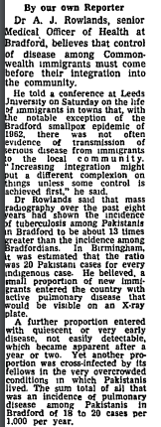
Integration--but control of disease first Our own Reporter The Guardian (1959-2003); Mar 22, 1965; ProQuest Historical Newspapers: The Guardian and The Observer pg. 2
Notes:
Describes how control of disease must come before integration.
But the instances of disease were very small – increasingly a way to other individuals and restrict entry into Britain.
Played on anxieties about migrants as disease carries and potentially also burdens on the NHS.
Here, the anxieties about migrants bringing in illness are contrasted with the reality of the case numbers.
This article also describes the “overcrowded conditions” which contributed to tuberculosis infection. Here, the immigrants were not bringing disease into Britain but contracting it due to poverty and a lack of access to welfare services.

Slide 5
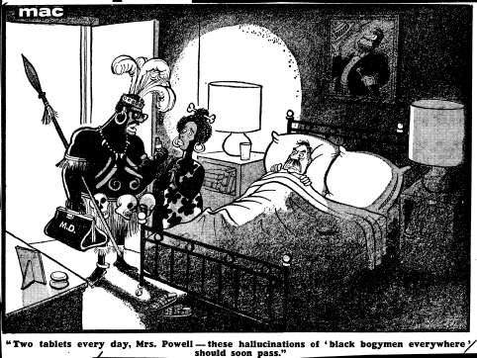
"Two tablets every day, Mrs. Powell - these hallucinations of 'black bogymen everywhere' should soon pass."
17 Feb 1971
News: 16 February: The Times headline: Coloured population four million by 1985, says Mr Powell. "If the prospects are to be averted there is one means only: a massive, albeit voluntary, repatriation." Speech addressing Carshalton and Banstead Young Conservatives.
Notes:
Here, migrants are caricatured as “black bogeymen” and the article suggests that repatriation is necessary.
The doctor is portrayed as a “witch doctor” and plays on African racial stereotypes – contrasting ideas of “voodoo” with a bottle of “tablets” to create irony and attempt to generate humour.
While the other article focuses on the idea of immigrants bringing disease, the idea of “two tablets” portrays the immigrants as a disease – reinforcing ideas of British supremacy and perpetuating a racialised discourse.
The name “Mrs Powell” – strong English origins. The fact that the doctor is addressing someone who is also dressed in traditional African attire is meant to be humorous?
John Enoch Powell was a Conservative MP and was minister for health 1960-1963. He promoted anti-immigration rhetoric.
Images like this revealed assumptions which were often not made explicit.
Highlights the ironic nature of racism as the doctor is described as a “bogeyman”, the negative connotations contrasting the essential role that immigrants had in supporting the NHS.
However, it also demonstrates how immigrant doctors and nurses are essential to maintaining the NHS service.
There is a juxtaposition between the perhaps
The idea of light is also interesting here – the more conservative depiction of the white middle class man is in shadow and the light is shining on the immigrant workers.
Mr Powell is shown to be cowering.

Slide 6
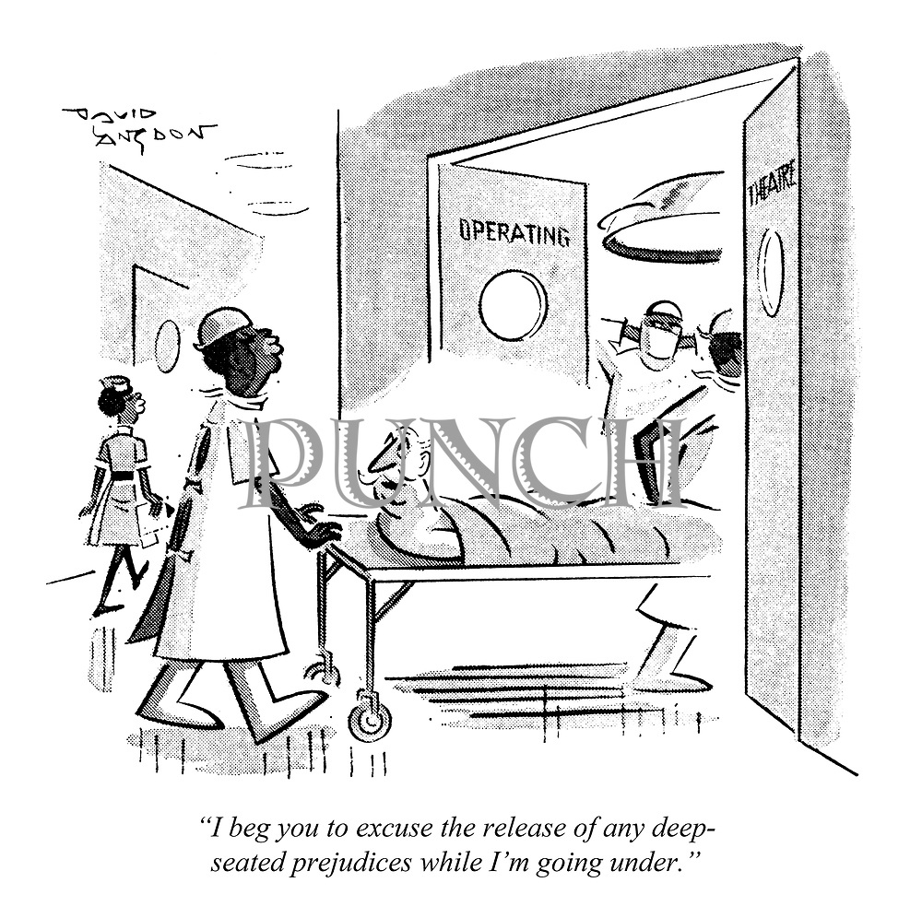
'I beg you to excuse the release of any deep-seated prejudices while I'm going under '.
Published in 1970
By David Langdon
Published in Punch Magazine
Notes:
The caption reads- 'I beg you to excuse the release of any deep-seated prejudices while I'm going under '.
The image shows a white man being wheeled into the operating theatre by Black nurses and doctors, the man is obviously concerned because of his previous prejudices against people of colour, ultimately this is a kind of reversal of previous power structures, as it is the white man who is at the mercy of the doctors where previously the white man has had the power.
It shows the irony of the racism in Britain, as now the people are heavily reliant on people of colour, particularly in the NHS.
However, does this push the idea of the ‘good migrant’ being someone who aids society. Especially considering that the NHS is such a controversial topic of conversation even now. Racist rhetoric accusing migrants of benefiting from welfare such as the NHS, but not contributing to it, making them appear as though they are draining the country. Whilst this image shows the reality is that migrants aid the NHS, does this push the narrative that they have to in order to be accepted? This can have an alienating and negative effect on migrants who don’t go into the NHS and can cause a hierarchy in migrants.

Slide 7
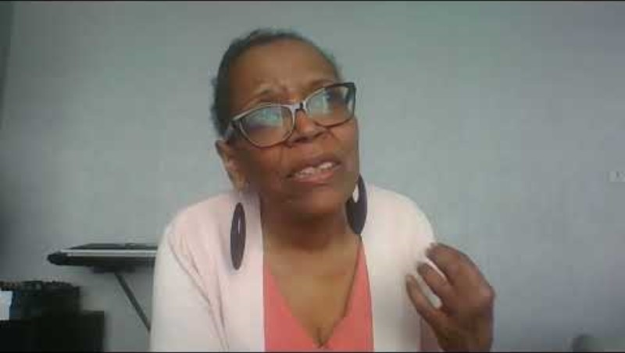
Windrush and the NHS: Sherill Gregory on career progression in the NHS

