Slide 1
Foreign Bodies and National Myths
Professor Roberta Bivins
Centre for the History of Medicine
University of Warwick
peopleshistorynhs.org

Slide 2
So, I have laryngitis today…
As a result, we are going to do quite a bit of work in groups today, playing with different kinds of sources and archives.
We are also going to ‘talk’ about the short essay, since I know you may have questions! But I will do my ‘talking’ on-screen.

Slide 3
A bit of terminology:
Last week’s readings talked about two key phenomena:
    Transnationalism, and
    The invention of the ‘immigrant’ (remember that some of our authors even argued that inventing ‘immigration’ was a key aspect of inventing the nation state!)
So how and when DID ‘immigration’ (rather than just ‘human mobility’) begin?
Migrant, immigrant, expatriate, refugee: which word is it? Why does it matter? Talk to each other for a moment!

Slide 4
Discussion
Ask your neighbours:
How do all the different terms for humans who move relate to the ideas of transnationalism we talked about last week?
Did/does state regulation of borders ‘work’ as intended? (hint: what was/is ‘intended’?)

Slide 5
Borders and Empires
Where are we? Why am I showing you these images?

Slide 6
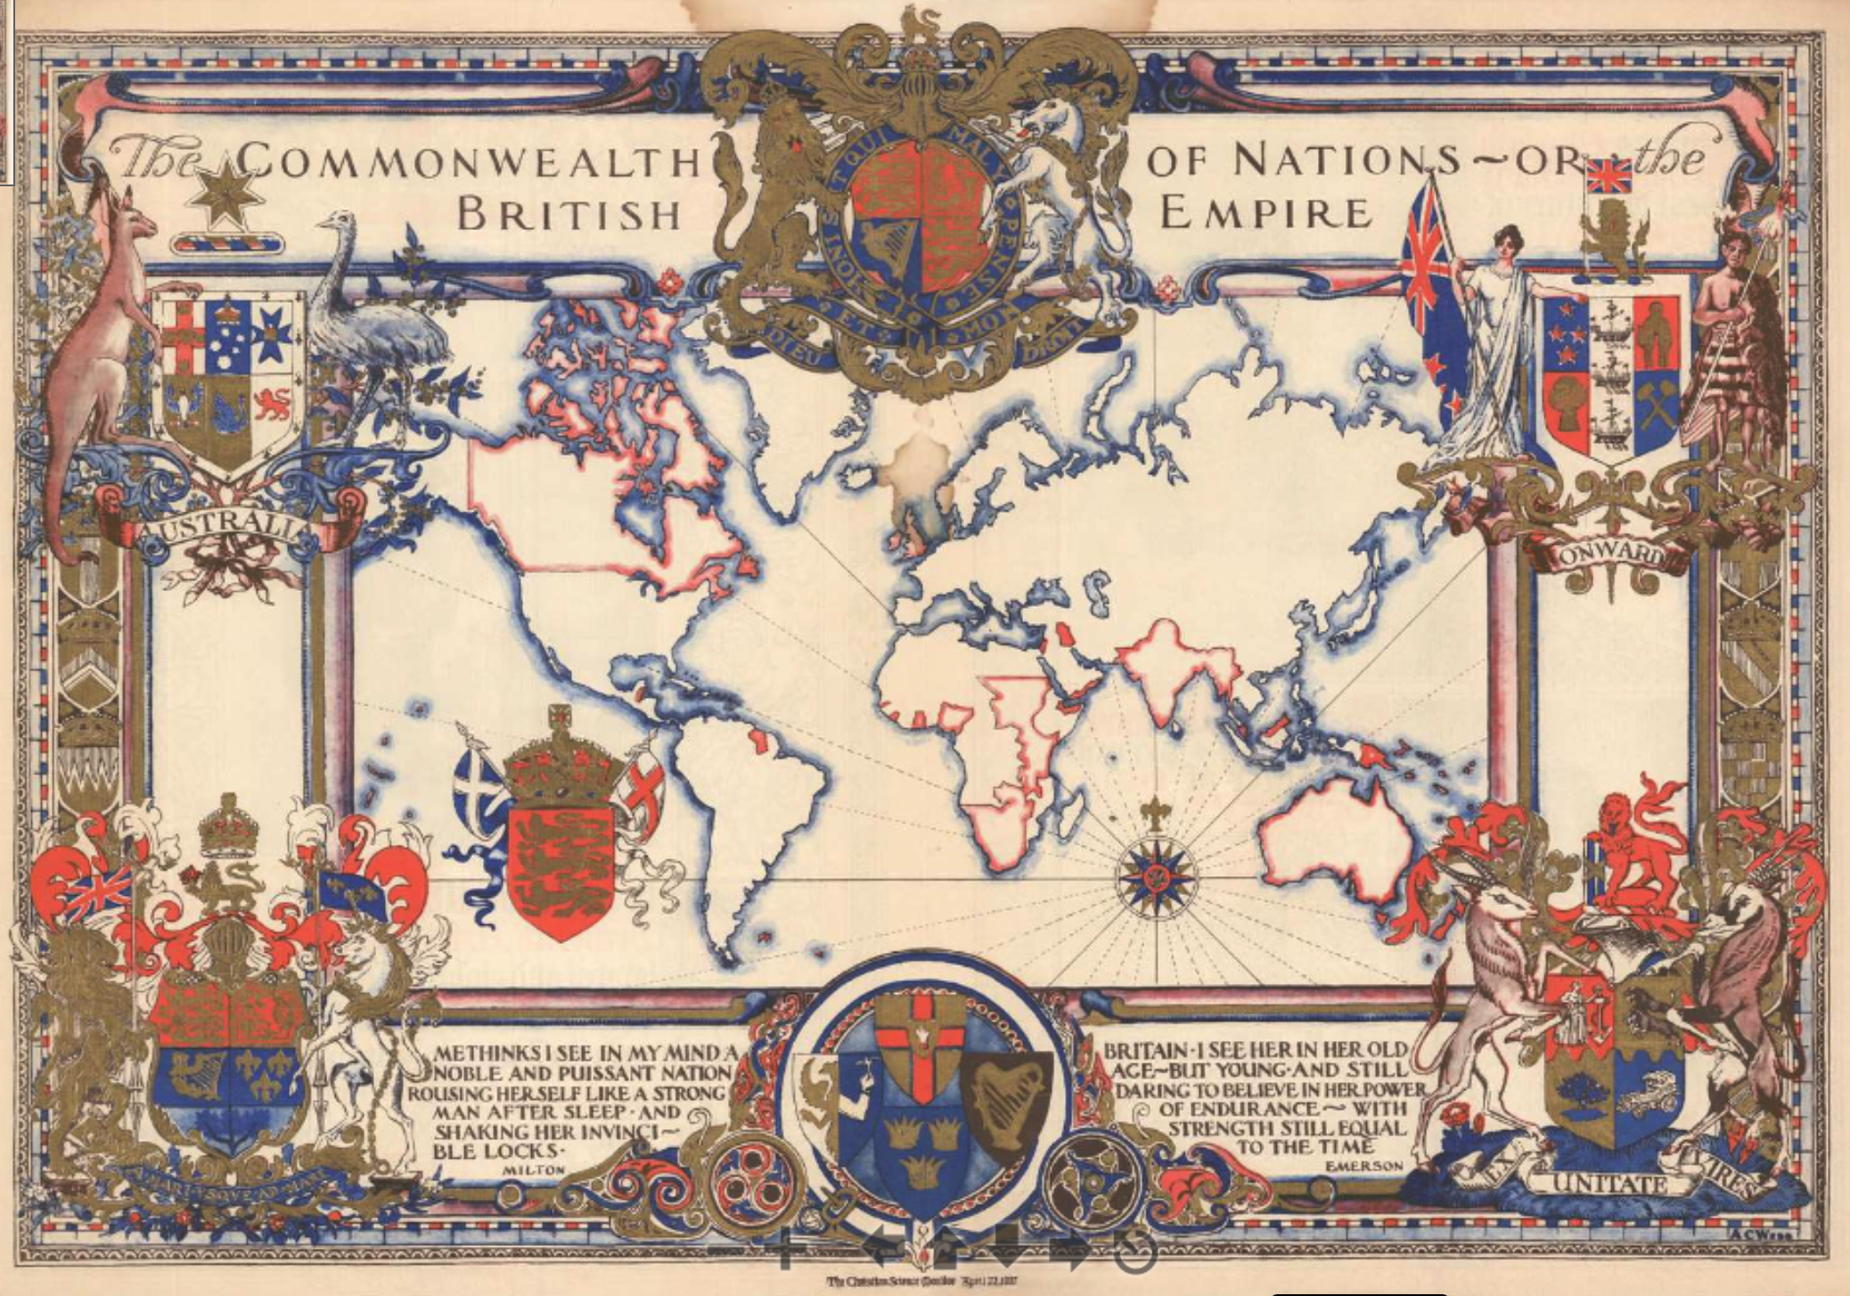
Do borders make belonging in a bordered/colonised world?
Does the phrase ‘imagined communities’ ring any bells? Hop on the Library Search bar (not Google, please) and learn a little about it. Hint: it all starts with the historian Benedict Anderson. How does his concept of ‘imagined communities’ relate to migration?
The Commonwealth of Nations - or the British Empire. 1937 (dated) Christian Science Monitor
Notes:
Description
This is a stunning 1937 pictorial map of the world highlighting the British Empire. The map was drawn by Alonzo C. Webb to celebrate King George VI's May 1937 coronation and published in a special color section of the Christian Science Monitor. It depicts the whole world on a Mercator Projection, with British territories, or the Commonwealth, highlighted in red. The whole is surrounded by elaborately gilded heraldic designs. Quotes from Milton and Emerson lionizing British achievement appear along the bottom border. The magnificent blue and red ink and the gilt work truly makes this an eye-catching piece.
Coronation of George VI
The coronation of George VI and his wife Elizabeth as King and Queen of the United Kingdom and the Dominions of the British Commonwealth took place at Westminster Abbey, London, on 12 May 1937. George VI ascended the throne upon the abdication of his brother, Edward VIII, on December 11, 1936, three days before his 41st birthday. The event was designed not only as a formal crowning, but also as a public display the breadth and power of the British Empire.
Publication History and Census
This map was designed by Alonzo C. Webb map and published by the Christian Science Monitor, on April 22, 1937. We are aware of only one edition.
Cartographer
Alonzo C. Webb (April 1, 1888 - 1974) was an American engraver, architect, painter and illustrator. Web was born in Nashville Tennessee. He attended the Art Institute of Chicago from 1907 to 1909, then enrolled in the Stout Institute of Wisconsin in 1911 to study building and construction for one year, before attaining an architecture degree at the University of Illinois (1912 - 1913). During World War I he served with American Engineering Forces in France, falling in love with that country. After the war he studied art at the A.E.F. Art Training Center in Bellevue, France, a school set up for American soldiers. Determined to stay in Paris, he give up his architectural career, which he could not practice in France, to make ends meet doing various odd illustration jobs and making sings in English for millinery shops on Rue de Rivoli. His work gradually became more popular and frequently appeared in the French weekly periodical, L'Illustration. In the 1920s and 30s he worked multinationally, producing art and architectural illustrations for American, French, and Italian interests. Webb moved to London in the 1930, remaining there until his death in 1974. More by this mapmaker...

Slide 7
National Myths: what (and who) are they FOR?
With your group:
How many ‘national myths’ have you come across in your modules, the media, and/or your daily lives?
What are the myths Spickard focuses on, and why? How do they work in political and cultural terms?
How do migrants respond to and use national myths, and how are they used against newcomers?

Slide 8
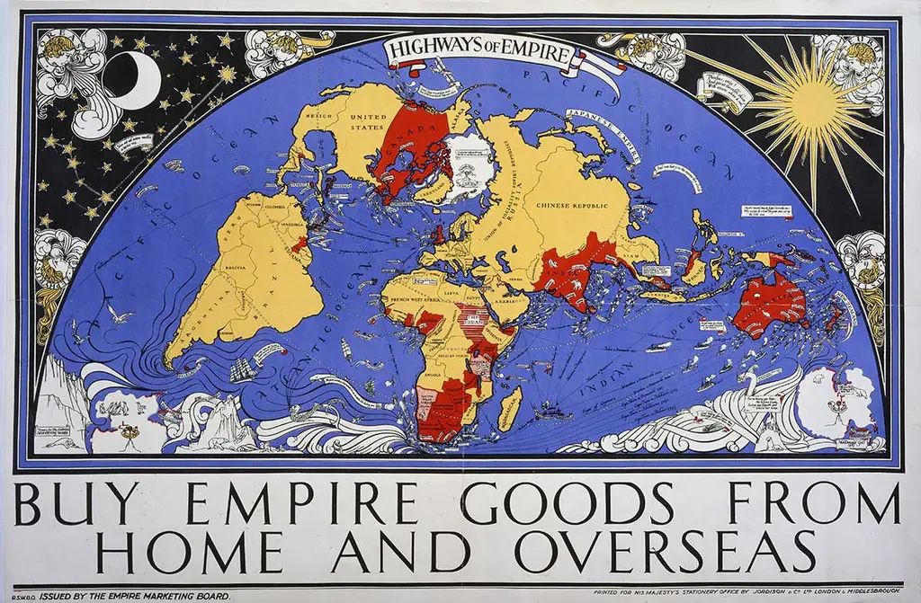
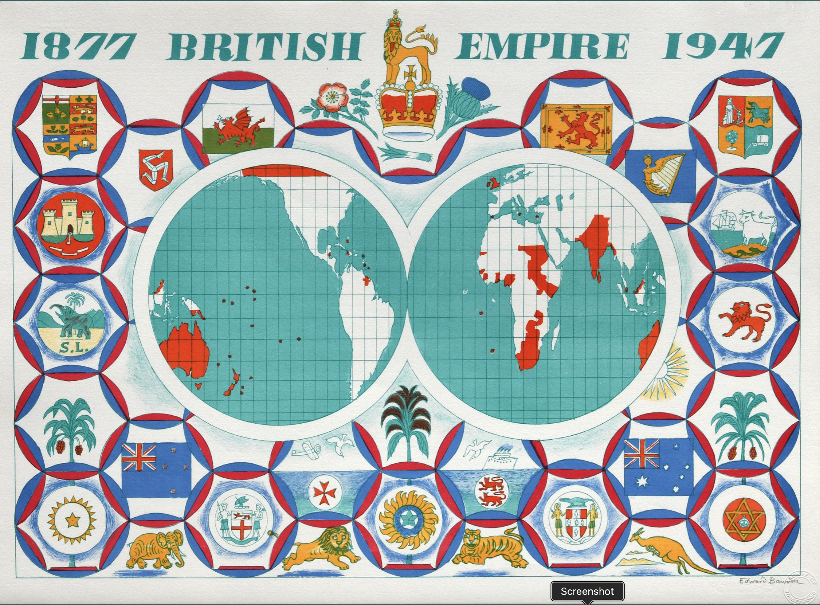
What are the imagined communities projected by these two maps? (for more, see TNA, here!
As seen in 1927, on a billboard 20 Ft long, 10 High, above Charing Cross in London
As seen, retrospectively, in 1985 at a banquet for an exhibition on ‘The Style of Empire’ in Florida
Notes:
This poster, produced in 1927 by the Empire Marketing Board, was intended to depict the United Kingdom as at the centre of a vast international empire. It was designed by well-known graphic designer Macdonald Gill, who had become famous for his ‘Wonderground Map of London Town’ which was first displayed in 1914.
‘Highways of Empire’ was originally displayed on an advertising hoarding 20 feet long and ten feet high in Charing Cross in London. It was hugely popular when first unveiled, so much so that smaller reprints were produced and sold to the general public.
Born in 1903, Bawden was a precocious artist even as a teenager, attending classes at the School of Art in Cambridge aged 15 and receiving a coveted Royal Exhibition Scholarship to the RCA. After his first success in collaboration with Eric Ravilious designing the mural for the Morley Working Men’s College refectory in Lambeth in 1928, Bawden’s success continued until the late ‘30s.
Producing work for London Transport, he was made an Official War Artist in 1940. After the war, he consolidated his artistic reputation with a large body of prints, illustrations, posters, catalogues and murals and attained full RA status in 1957. After a decline in popularity, in 1989 Bawden was accorded a major retrospective at the V. and A. Museum. Though too ill to attend, he died a happy man later that same year.
Signed original colour lithograph.
Printed at the Curwen Studio in an edition of 100.
The Wolfsonian Collection is at Florida International University, Miami Beach.
It contains a variety of artifacts primarily of North American and European origin.
During 1984 it was decided to hold an exhibition the following year to be called 'Style of Empire - 1877 - 1947' and Bawden was commissioned to provide a mural which was painted on panels in Saffron Walden with the assistance of his grandson, Tommy. It took the form of a map showing the British Empire as it was in the 1930s.
When it was seen by the organisers, they asked Bawden to provide a print of the same subject for each of the guests at a banquet for the opening of the exhibition in February 1985.
Bawden drew the map on half-matt plastic and oversaw its printing lithographically at the Curwen Studio.
Bears the blindstamp from the Archive of Stanley Jones. All from https://www.goldmarkart.com/products/edward-bawden-british-empire-map-eb-mg175-s?srsltid=AfmBOorAQN5X2ppF5IcSDQJn_Y3MQreMSkIKVH6J2USWQjcMb1_aJuBy

Slide 9
National myths
Paul Spickard:
What does it mean to be ‘a nation of immigrants’? To whom?
How does Ellis Island fit into this narrative?
WHEN did USA begin to celebrate being ‘a nation of immigrants’ and why?
‘Anglo-normativity’ and who is left out of the ‘immigrant nation’ party?
Sub theme: are slaves ‘immigrants’?
Gualtieri:
How do the ‘national myths’ (e.g. ‘Phoenicianism’, Lebanon as a ‘natural bridge’) and ‘imagined communities’ of migrating communities aid or inhibit migrants on arrival and in settlement?
Compare the impacts of such ‘national myths’ to the impacts of more material factors, e.g. war and resettlement; existing co-ethnic communities; established and familiar sea routes, etc.
Does Syrian example serve as a counter narrative to US ‘national myth’, or to ‘Phoenicianism’, or both?
Fun blogs: MidAfternoon Maps; Turkey 1893 Expo
And in the UK? What does Taylor say, and what do you think?

Slide 10
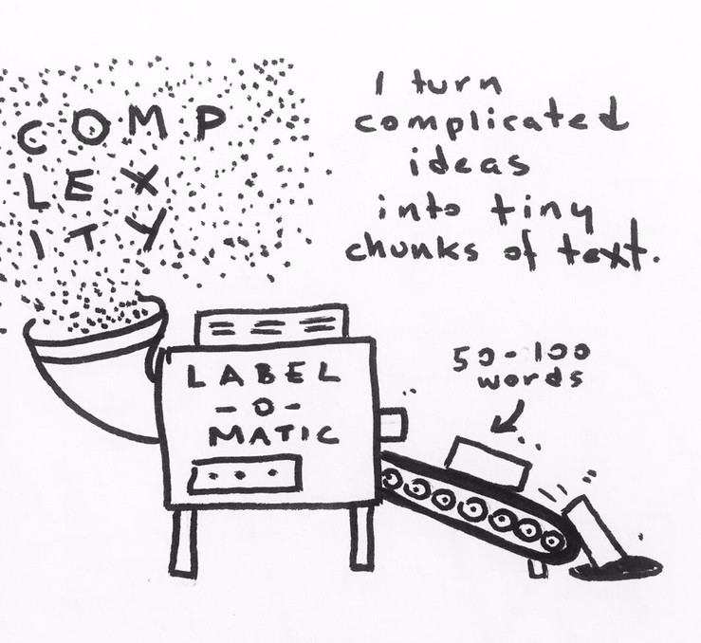
Questions on the short essay?
Here’s a helpful blog from a teacher’s perspective: ‘Public History in the Wild’ and one from a student- turned-teacher: ‘Crowdsourcing a history of the people’.
And for more ‘how-to’ sources and guidelines on ‘public history’, see the readings for week 8, when we will also have a workshop in the MRC!
© B. Erin Cole. If you learn best through images and humour, check out her website

Slide 11
If you are still looking for your example:
A few promising online or in person options:
Ugandan Asians a living history LIVE in Lewisham 23 Oct.
Mixed Museum
Colour is Mine (If you are fond of fashion or the visual arts, and want to see the influence of migration, you’ll love this one!) And this one, expanding the first.
Migration Museum (Note: not the greatest landing page, but just scroll down for exhibitions)
National Archives I’m sending you to their guide, mostly aimed at family history buffs, but you can also see lots of digitised content at the TNA, including images and the landing register of the Windrush. See also the amazing ‘Our Migration Story’ See also this great collection of their migration-focused projects!
Herbert Gallery Coventry Live (Free) exhibition of the city includes great displays on migration
Museum of Birmingham Live (free) exhibition of the city includes great displays on migration
Back-to-Backs Birmingham Live (NT discount for student ID) A fantastic look into the lives of the working poor, including migrants to the city who once lived in these spaces.
Polish pages at TNA ‘Our Migration Story’, or other Polish community history pages.
Museum of American History, Smithsonian, ‘Becoming US’ resources

