Slide 1
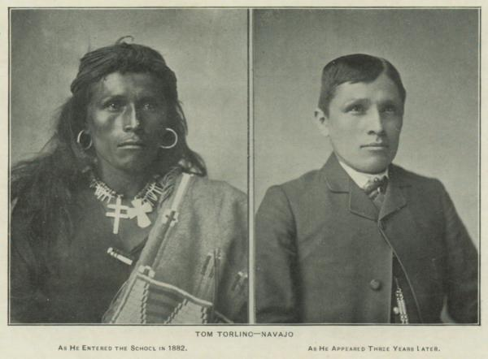
Choate, John. Souvenir of the Carlisle Indian School. 1902. 1902, carlisleindian.dickinson.edu/publications/souvenir-carlisle-indian-school. Accessed 6 Nov. 2025.

