Slide 1
Foreign Bodies: Settlement
Professor Roberta Bivins
Centre for the History of Medicine
University of Warwick
peopleshistorynhs.org

Slide 2
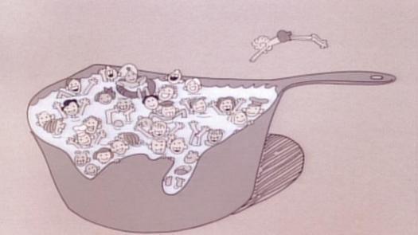
Life in the ‘Melting Pot’?
Schoolhouse Rock ‘Great American Melting Pot’ 1976

Slide 3
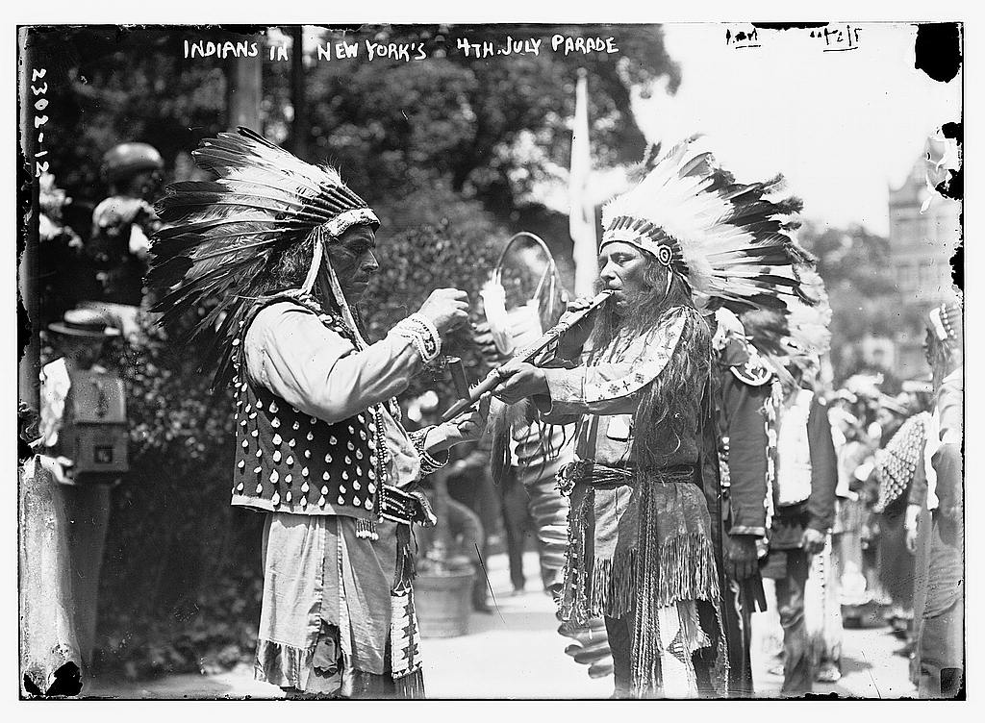
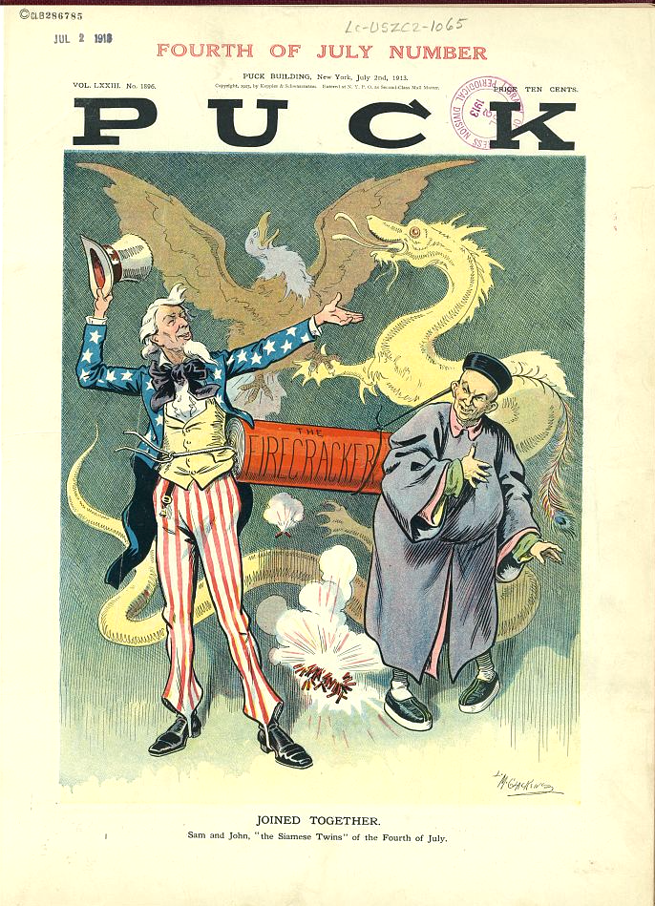
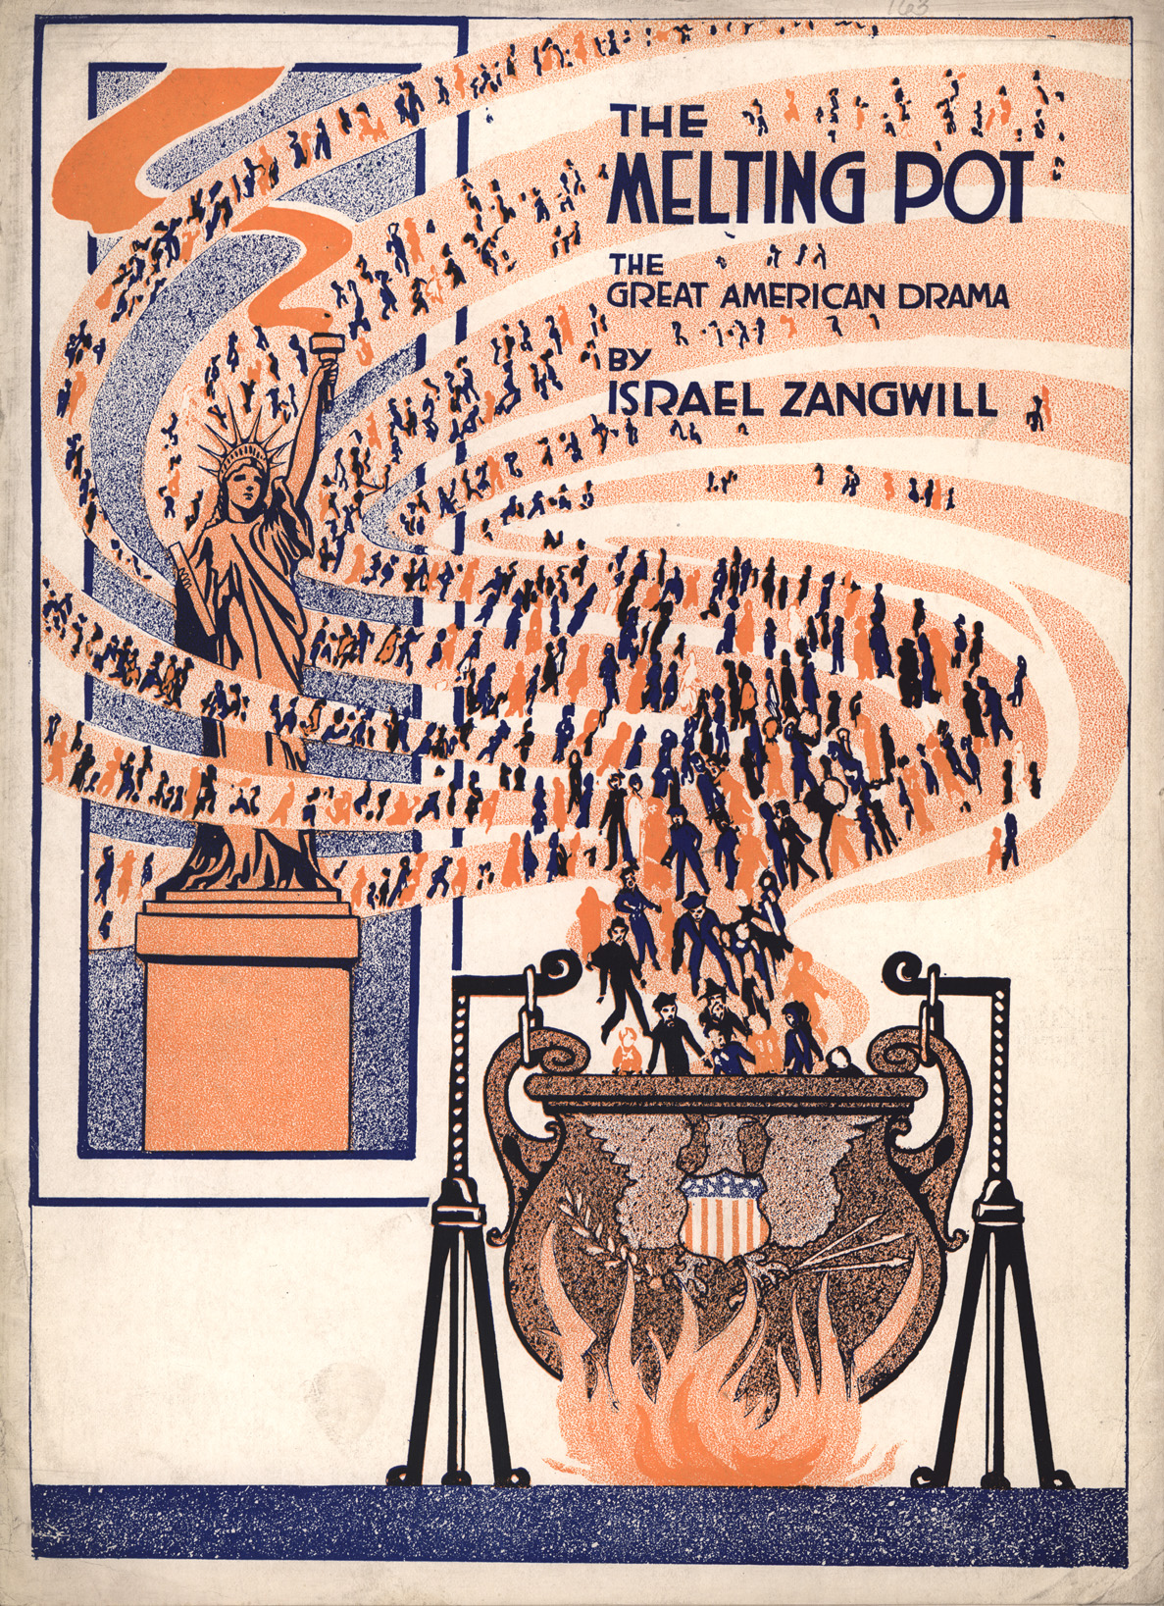
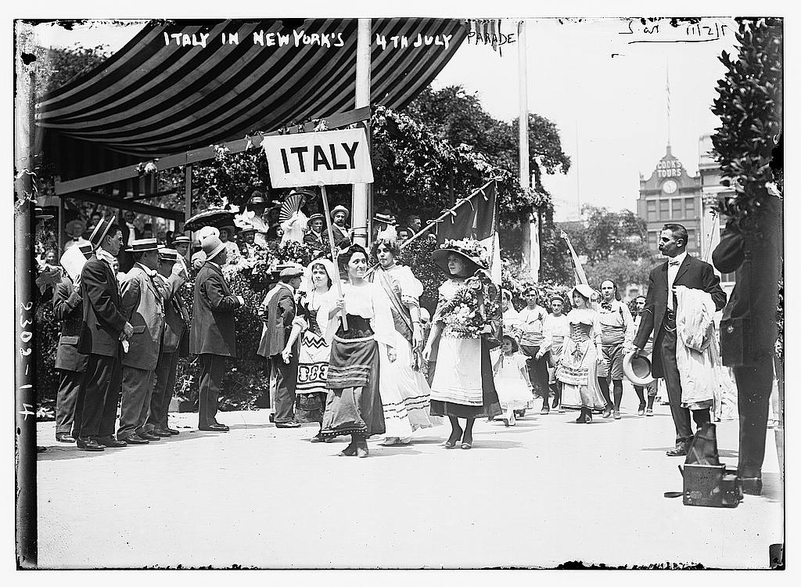

Slide 4
Distinctive and (therefore?) Dangerous: Settling down as an Ethnic American
Overarching question:
What does the history of ethnic settlement in North America tell us about models of ‘racial’ vs. cultural difference?
Specific Questions:
What went wrong (in practical terms) with ‘racial’ bars to entry in the US and Canada?
How should we understand the relationship between racialisation, medicalisation and assimilation?
What do US and Canadian models of naturalisation tell us about the ‘imagined community’ of these nation states?
Does this history speak to the present day?

Slide 5
By J. S. Pughe (d. 1909) - Cartoon by J. S. Pughe published in Puck magazine, 9 August 1899,
Public Domain, https://commons.wikimedia.org/w/index.php?curid=72696510

Slide 6
‘Doing as Americans Do’
Assimilation
Integration
NARA 27671/44, Americanization files, Records of the Immigration and Naturalization Service, RG 85. https://www.originalsources.com/Document.aspx?DocID=FW85CLU3CQ38WKZ#
https://www.eurasiareview.com/24102018-measuring-immigrant-integration/
Notes:
Around 1903, Granite City expelled its African American residents. Loewen, James W. (2005). Sundown Towns: A Hidden Dimension of American Racism.
Schools for Americanization (see original website at link above)
Historical Background
At the close of World War I, public pressure mounted to assimilate immigrants more rapidly into American culture. The postwar influx of Southern Europeans into America—immigrants who differed in religion and culture from many of those who had come before—fueled that pressure.
In the 1920s, local and state governments actively encouraged a policy of Americanization, to which English-language instruction was basic. Previously, churches and social clubs founded by immigrants had offered such language instruction without support from public funds. With the Americanization program, the Federal Government prepared appropriate textbooks that local communities could use to teach English and citizenship to immigrants, both young and old. Localities opened classroom space in public schools to the newest Americans and recruited volunteer teachers from service clubs, immigrant social organizations, and even labor unions. The remarks of a young Armenian high school graduate in Watertown, Massachusetts, capture the spirit of the Americanization movement:
I was only seventeen years old when I first came to America, the land of heroes and great men. My dream was always to come into this great and free country, to live as a free man, without fear that my life was in danger…. I was not able to speak English at all, but today, with the aid of the night school, I can speak and read and write very well the English language. I love and admire America because she helped me many times and because she is the only unselfish nation in the world.During the period 1919-20, according to the Department of Commerce and Labor fiscal year 1920 report, more than half a million immigrants took their seats in classrooms to learn English; of these, 26,000 were adults. The concentration of new Americans within each state determined the number and type of programs offered. By the end of World War I, twenty towns in Illinois, for example, offered English instruction; and the ranks of students numbered over 4,000. Granite City, Illinois, a steel-producing town north of East Saint Louis, where the program announced in this document was located, offered English instruction through the Americanization program to its immigrant population of mostly Hungarians. The poster reproduced here appeals to immigrants in Granite City to attend classes at one of four Americanization schools.
Today, an Americanization school concept persists, retaining the character of its early years. The Immigration and Naturalization Service continues to provide adult immigrants who are not regularly enrolled in public schools with textbooks and home study materials. However, the initiative for Americanization, while affected by waves of political refugees like the South Vietnamese and Haitian boat people, remains a local and state responsibility. Across the country today, communities provide space for classes in public schools and recreation centers, and voluntary organizations recruit instructors for citizenship and English classes.

Slide 7
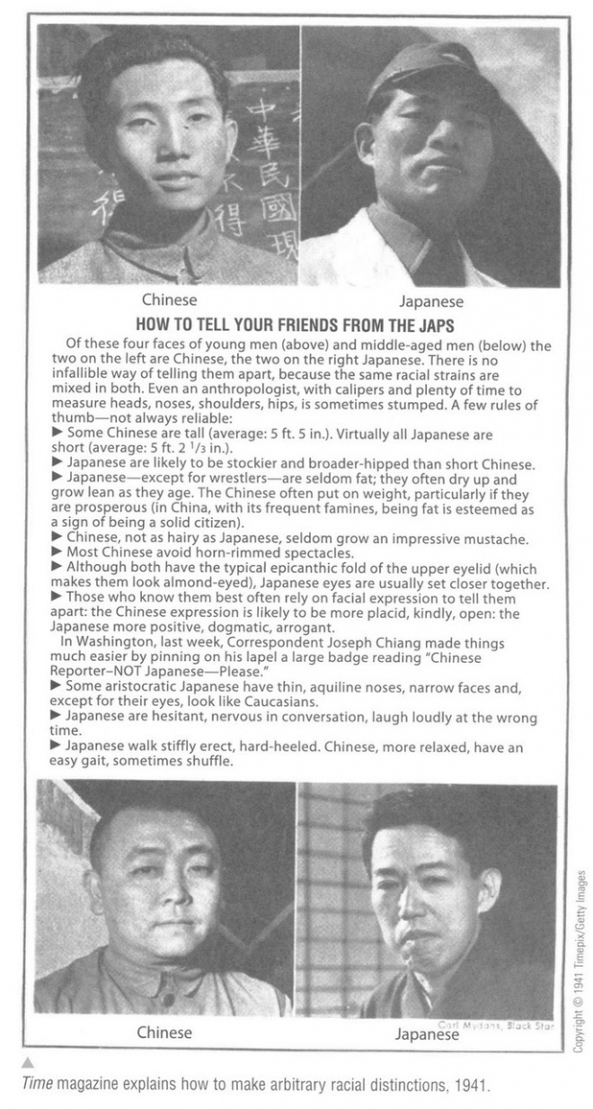
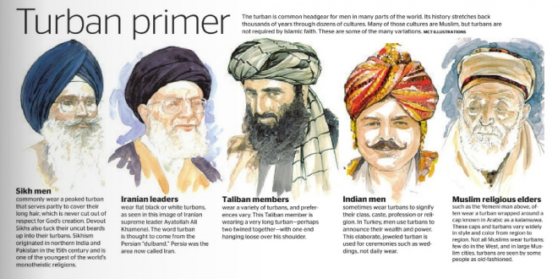
How to Recognise Orientalism, Essentialism, and Stereotyping in Historical Sources…
Sami Kiswahi, ‘How to tell your friends from the Japs’ in TIME, 1941 vs. ‘Turban Primer’ in RedEye, 2012

Slide 8
Discussion
In your own archive groups, distil the main ideas you want to share about the readings you covered for this week.
Search the digital archives to explore attitudes towards the settled US migrant community of your choice. Discuss between yourselves what they tell us about settlement and assimilation.

Slide 9
Archives:
National Museum of American History Collections
Library of Congress
Our module Archive
Harper’s Weekly and more comprehensively here (but harder to search)

Slide 10
Reading Week Notes:
My office hours will be on Teams during reading week.
If you need to see me, please do book in, so that I know to get a Teams invite across to you and fire up the computer!

