Slide 1

HI3H7 – Week 5 Settlement, The Limits of Migration & Assimilation

Slide 2
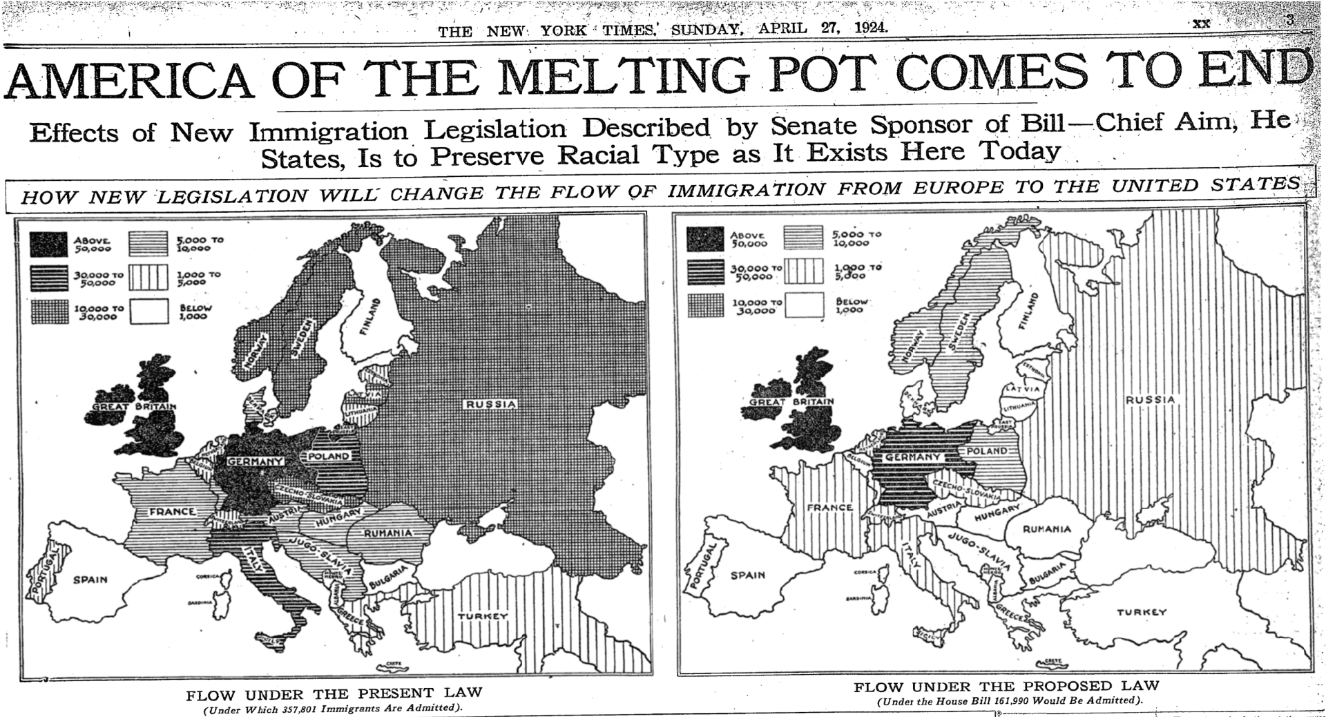


‘The Myth of the Melting Pot’ – New York Times – Apr. 27, 1924

Slide 3

What the source is doing:
The source shows America’s role in the tailoring of which immigrants can come in and out of the country, cutting against the ‘open door’ policy to which the ’nation of immigrants’ epiphet is ascribed.
This builds on the sense of hierarchy we discussed in last weeks class where there were stipulations around certain ethnicities that were seen as more/less desirable from an immigration perspective.
Nations in Eastern Europe have been dramatically excised from immigration planning under the proposed plan in the diagram, that shows less 1,000 people from Romania, Hungary and Yugo-Slavia.
At the same time there is an acute emphasis on countries with a high WASP population with better relative GDP (a greater middle-class of earners) , including Germany but especially Great Britain.

Slide 4
As well as this, the numbers of people migrating to the US under the proposed plan has been halved, from 357, 801-annum to 161,990-annum.
This shows a call for an immediate taper for migration and signals and anti-immigration sentiment that was established in government as early as the 1920s.
In the US context, this also indicates a politicization of immigration, using it as a tool for increased political leverage over opponents at the expense of immigrant groups themselves.

