Slide 1
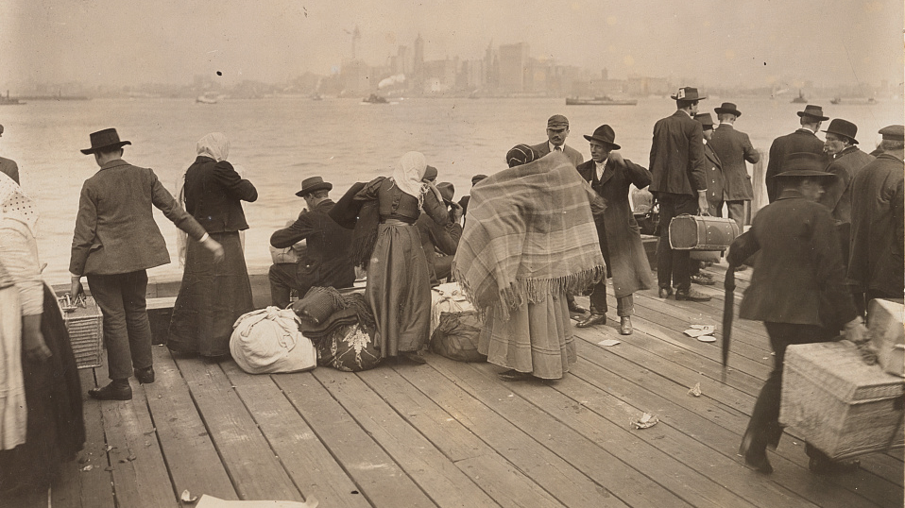
Archive Source on Settlement: The Limits of Assimilation and Integration
Group 3: Komal Mistry

Slide 2
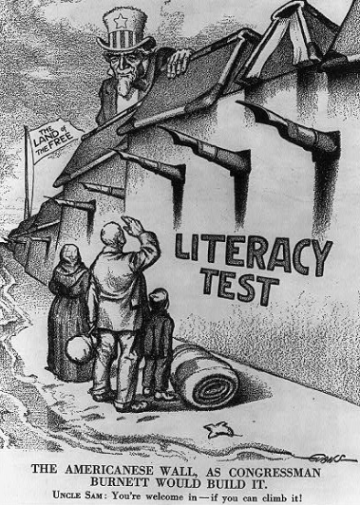
1917 Immigration (Barred Zone) Act:
‘That after three months from the passage of this Act, in addition to the aliens who are by law now excluded from admission into the United States, the following persons shall also be excluded from admission thereto, to wit: All aliens over sixteen years of age, physically capable of reading, who can not read the English language, or some other language or dialect, including Hebrew or Yiddish.’
Title:
The Americanese wall - as Congressman Burnett would build it / Evans. "Watchful waiting" ; A case where it is one of "My policies" / J. Held.
Summary:
Prints of cartoon drawings show: 1. high wall labeled "Literacy Test" and spiked with pen nibs to keep out immigrants, built as Congressman John Lawson Burnett would like it, with Uncle Sam saying to immigrant family below: "You're welcome, if you can climb it";
Artist: Evans, Raymond Oscar
Created/Published: 1916
Location: Library of Congress
Percentage of people aged 14 or over who were illiterate (unable to read and write in any language), by race and nativity 1910:
Total: 7.7% White Total: 5% White Native: 3% White Foreign-born: 12.7% Black and Other: 30.5%
Congressman Burnett (1854-1919):
In 1907, he called Syrians ‘the most undesirable of the undesirable peoples of Asia Minor.’

