Slide 1
Foreign Bodies: British Migrants in the 20th Century
Professor Roberta Bivins
Centre for the History of Medicine
University of Warwick
peopleshistorynhs.org

Slide 2
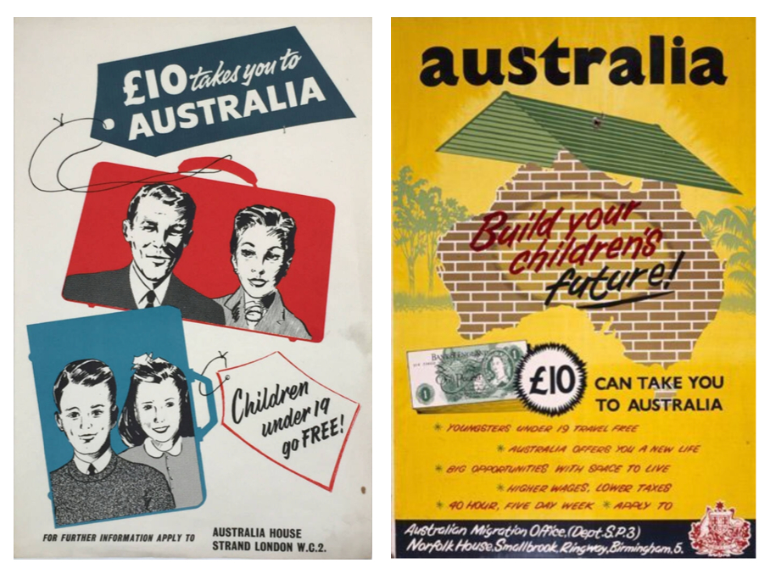
Britain: An ‘Emigration State’?
Empire and Emigration:
Is subsidised emigration also imperialism?
How does this model fit with ‘transnationalism’
What is the relationship between ‘£10 Poms’ and ‘White Australia’?
Compare ‘Elizabeth: The Originals II’ with ‘Battlers’ Tales’…
‘Time Will Tell’ Exhibition

Slide 3
Again: What defines the ‘ideal’ Australian (or Canadian) migrant?
Overarching question:
What does the history of post-colonial settlement in the Commonwealth tell us about models of the ‘ideal migrant’ and their intersections with national myths at home and abroad?
Specific Questions:
What were children ‘good’ for? Could they be the ‘germs of nations’?
What were the ‘ethical dilemmas of empire’ in relation to supported emigration?
How did the models of child, female and family migration fit with and/or deviate from ideals about the Commonwealth, free movement, and relations between ‘post-empire’ and ‘post-colonies’?
When and why was Britain an ‘emigration state’?

Slide 4
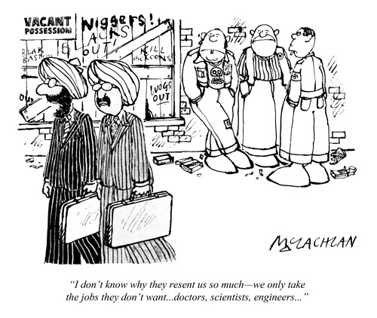
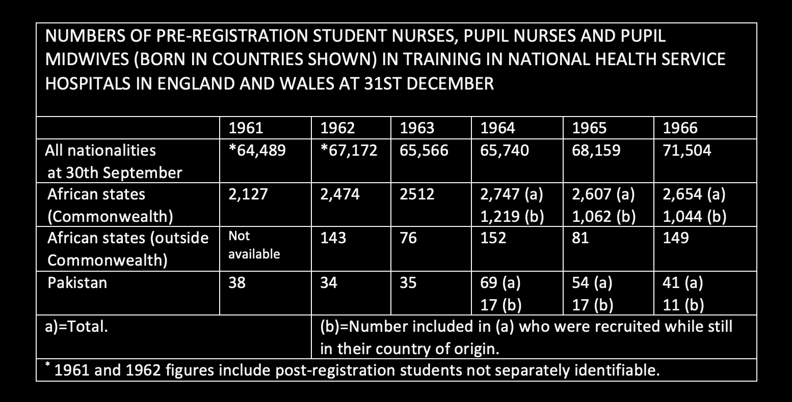
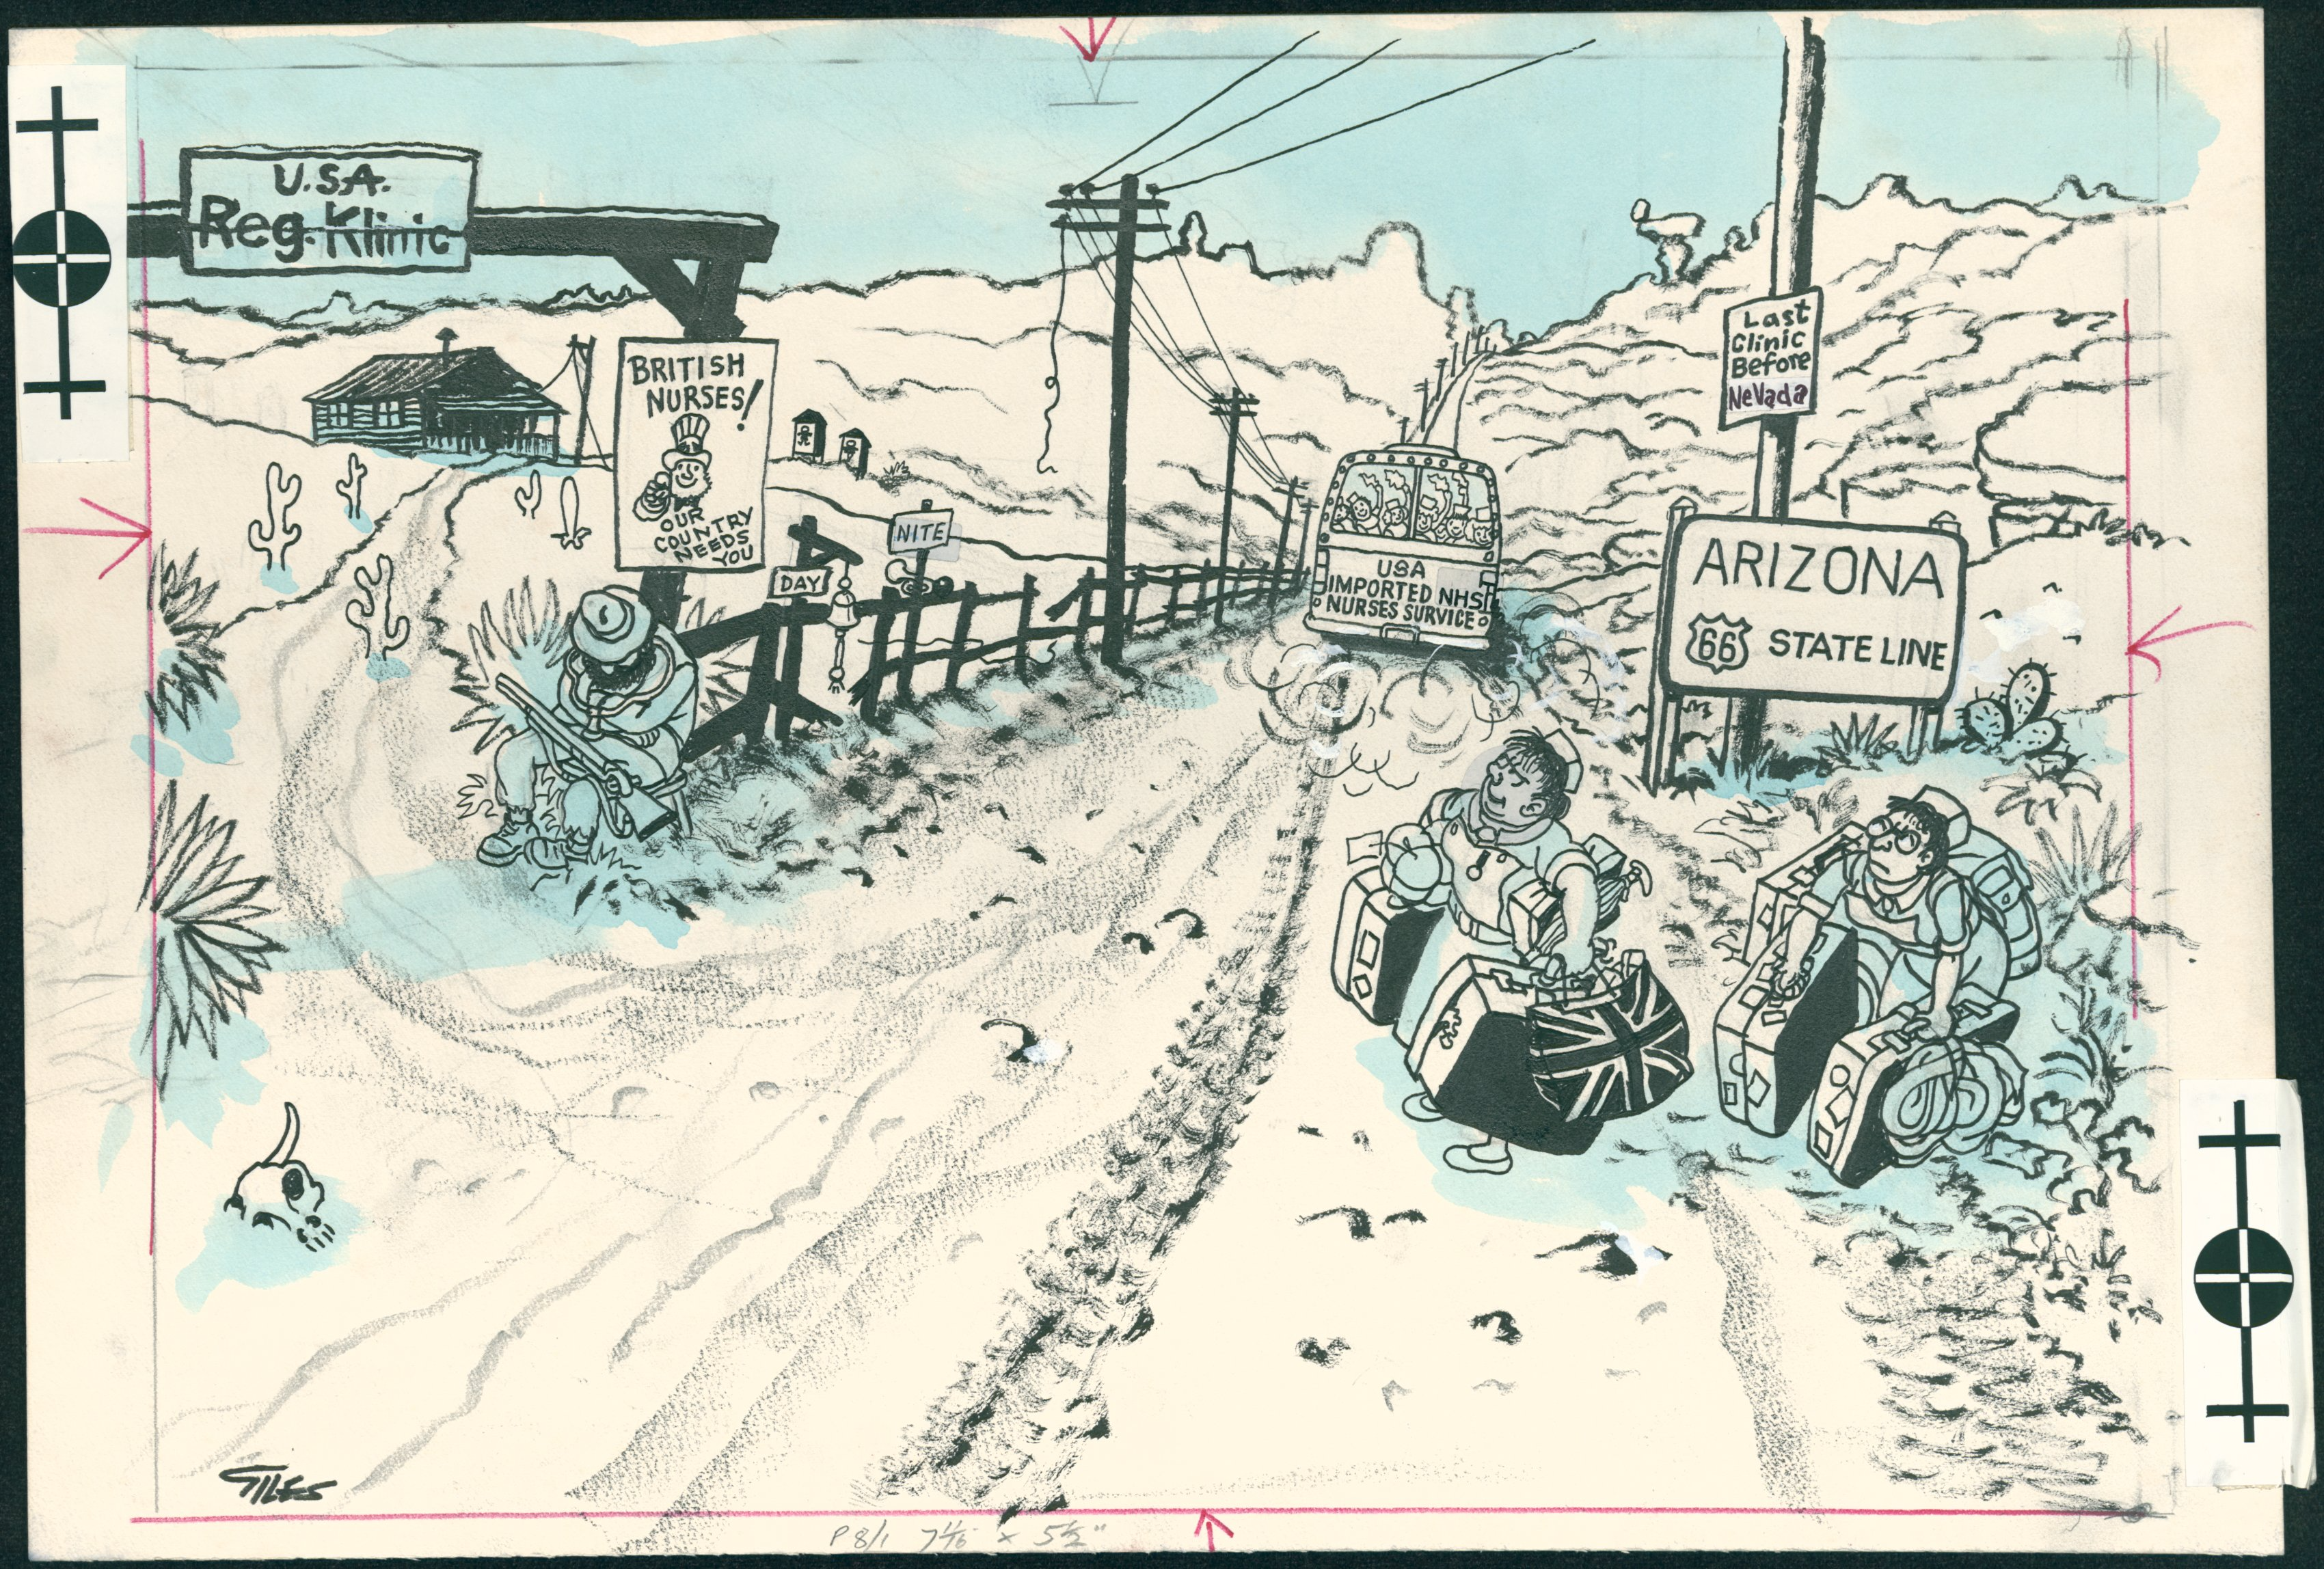
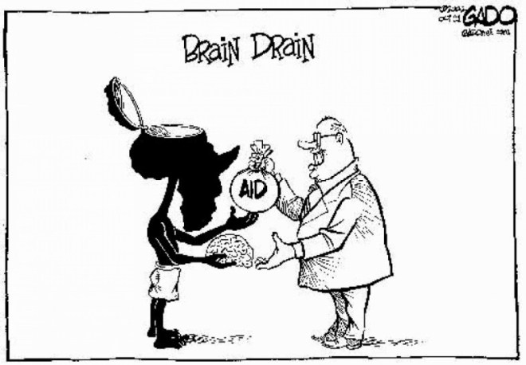
Medical Migration
Are doctors and nurses ‘ideal migrants’? ‘Ideal emigrants’?
What do the contrasting images of medical migration tell us about elite migration, and about migrant agency more generally?

Slide 5
Discussion: The Applied Project
Questions?
Support you would like?
Models and Ideas: how is it going?

Slide 6
Discussion: The Archive and the Readings, Term 2
Your Interim Feedback
Response and plan going forward
Choosing ‘your’ week
Assessment

