Slide 1
Week 11 British Migrants in the 20th Century: ‘£10 poms’, ‘Home Children’ and doctors
Group 2: Adelina, Abi, Felicity and Bella

Slide 2
British propaganda on Emigration to South Africa

Slide 3
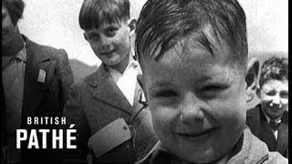

Slide 4
‘South Africa Welcomes Children from Britain’ (1940)
British Pathe
British Pathe was one of the first journalism companies to create video articles such as this which were shown in cinemas.
People would go to the cinema to watch this as a type of news
1940- during WWII

Slide 5
Draws similarities to the Windrush Narrative
Evidence of mass child emigration presumably forced however from the video it is unclear
The British public were being shown positives of emigration and that South Africa was a ‘home from home’
Boosting British morale around child emigration and encouraging more parents to send their children to South Africa
Majority white children showing evidence of this emigration being a ‘civilising mission’ to the Commonwealth despite decolonisation

Slide 6
British migrants in South Africa

Slide 7
British advertisement for Australian emigration

Slide 8
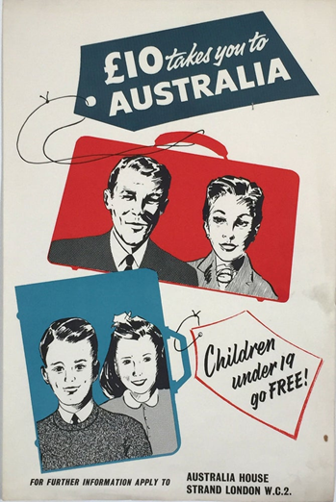
Poster advertising ‘£10 poms’ scheme
C.1960 - 15 years after launch of the scheme
Created by the Australian Embassy in London
Minimalist and eye-catching design
Source found on New York antique website, recently sold (https://www.antipodean.com/pages/books/24928/10-takes-you-to-australia-children-under-19-go-free-poster?soldItem=true_)

Slide 9
Stereotypical nuclear family
Demonstrates selectivity in emigration
Labels on suitcases:
Product for sale?
Reminiscent of holidays?
Minimalist poster - further information only granted on application
Little information about where and how the poster was seen

Slide 10
Life in Australia for British migrants

Slide 11
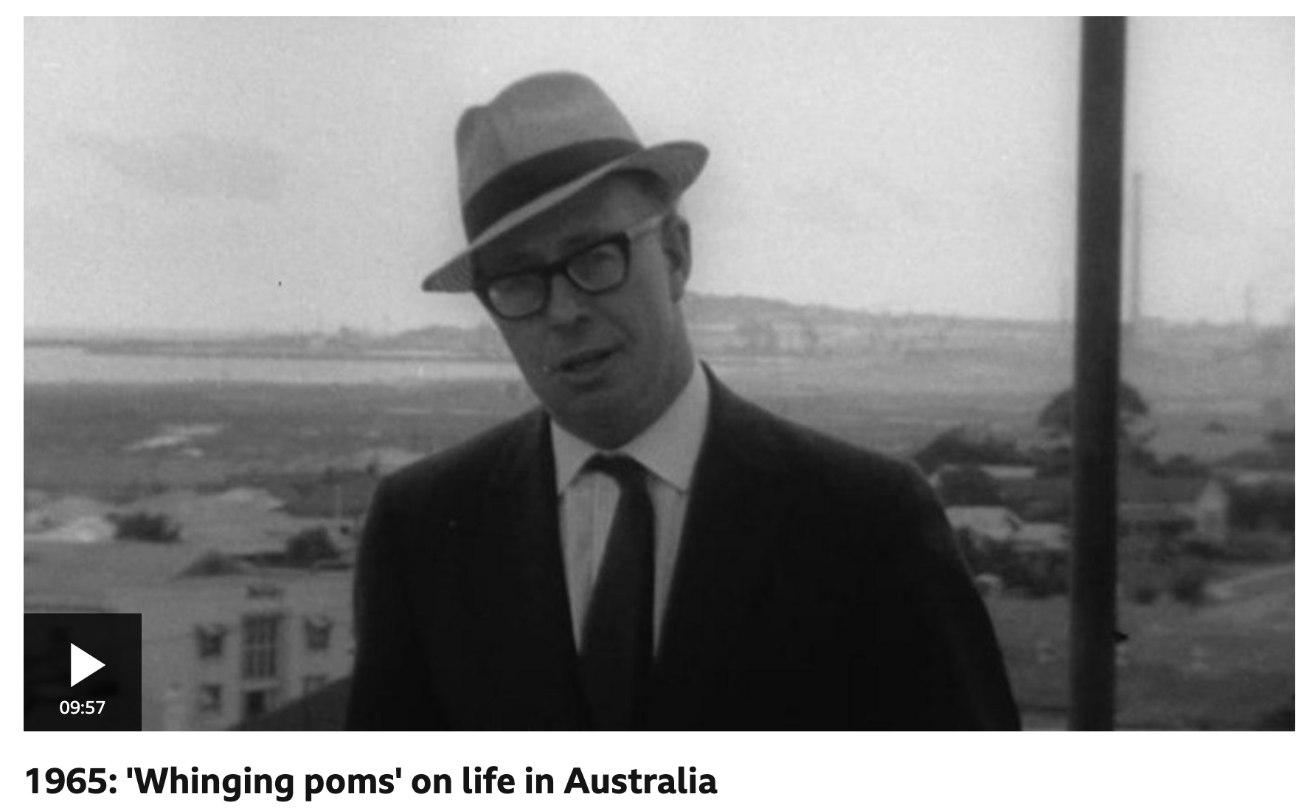
BBC Archives 1965 - ‘The Whinging Poms’
https://www.bbc.co.uk/videos/c977jdv297eo
Notes:
bbc 1965:
‘tonight’ show about world affairs
it was filmed in 1965
Hostels were not luxurious but it was better than coming to nothing, but expectations were raised in advertising
Hotels were meant to be temporary, a 2 year lease, where migrants expected to save enough to buy a home, but many did not manage and moved back to england after the 2 year contract,

Slide 12
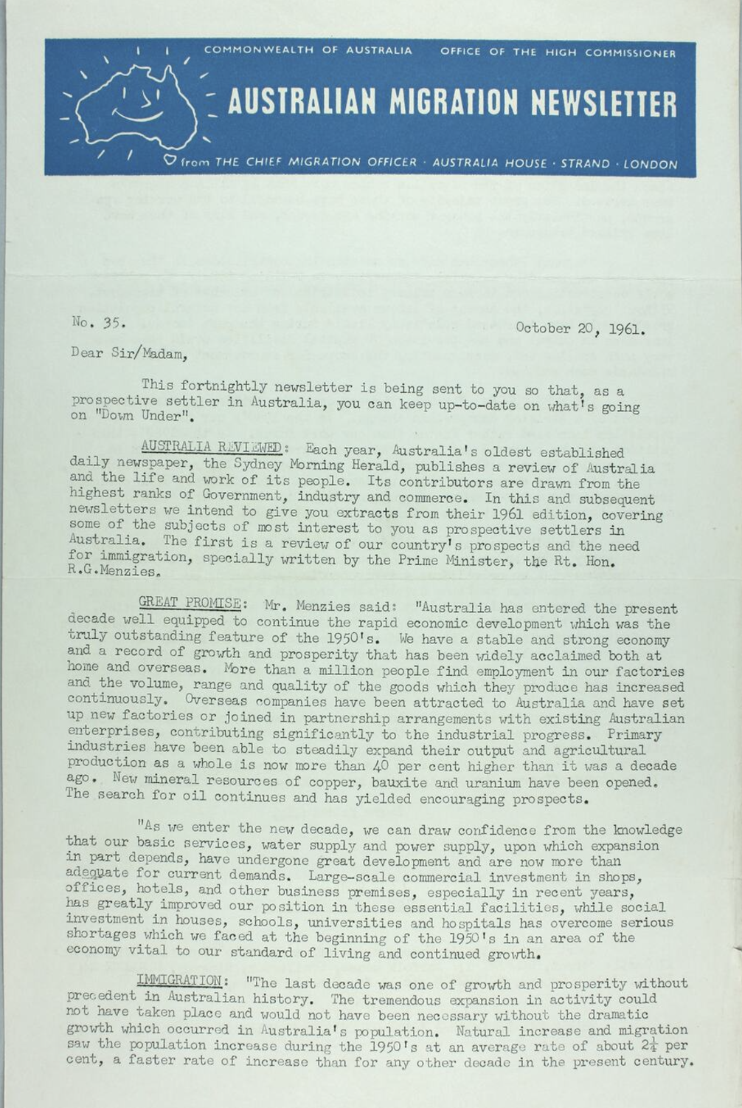
Museums Victoria Collections
Newsletter from 1961
Rapid economic development of Australia post-war and the large surge of british migrants.
A lot of job seekers but job market not keeping up (espacially skilled jobs).
https://collections.museumsvictoria.com.au/items/1921263
Notes:
Bbc filmed was filmed in 1965, this newsletter - 1961, a surge of brits seeking better economic opportunities and warmer climates, especially after the long cold snowy winter in 1962-63.

Slide 13
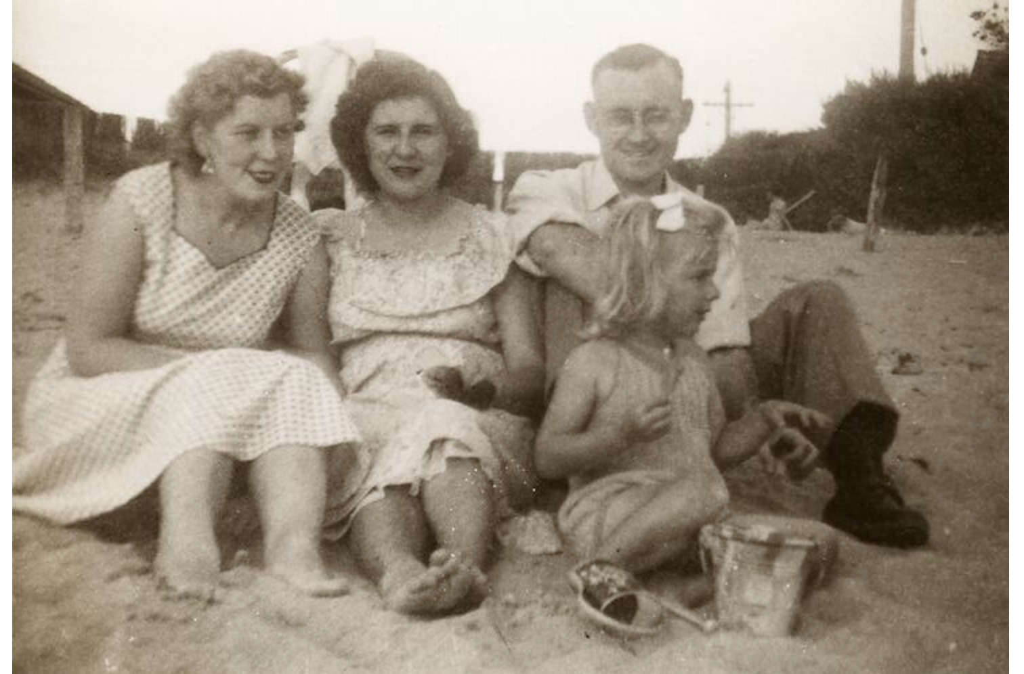
Museums Victoria Collections
Leech Family
Homesickness and return to England
Easy to go to Australia but harder to come back
https://collections.museumsvictoria.com.au/items/2102133
Notes:
25% of british moved back to england due to homesickness and unsatisfied expectations
⅓ of them returned to australia again, ‘boomerang pom’

Slide 14
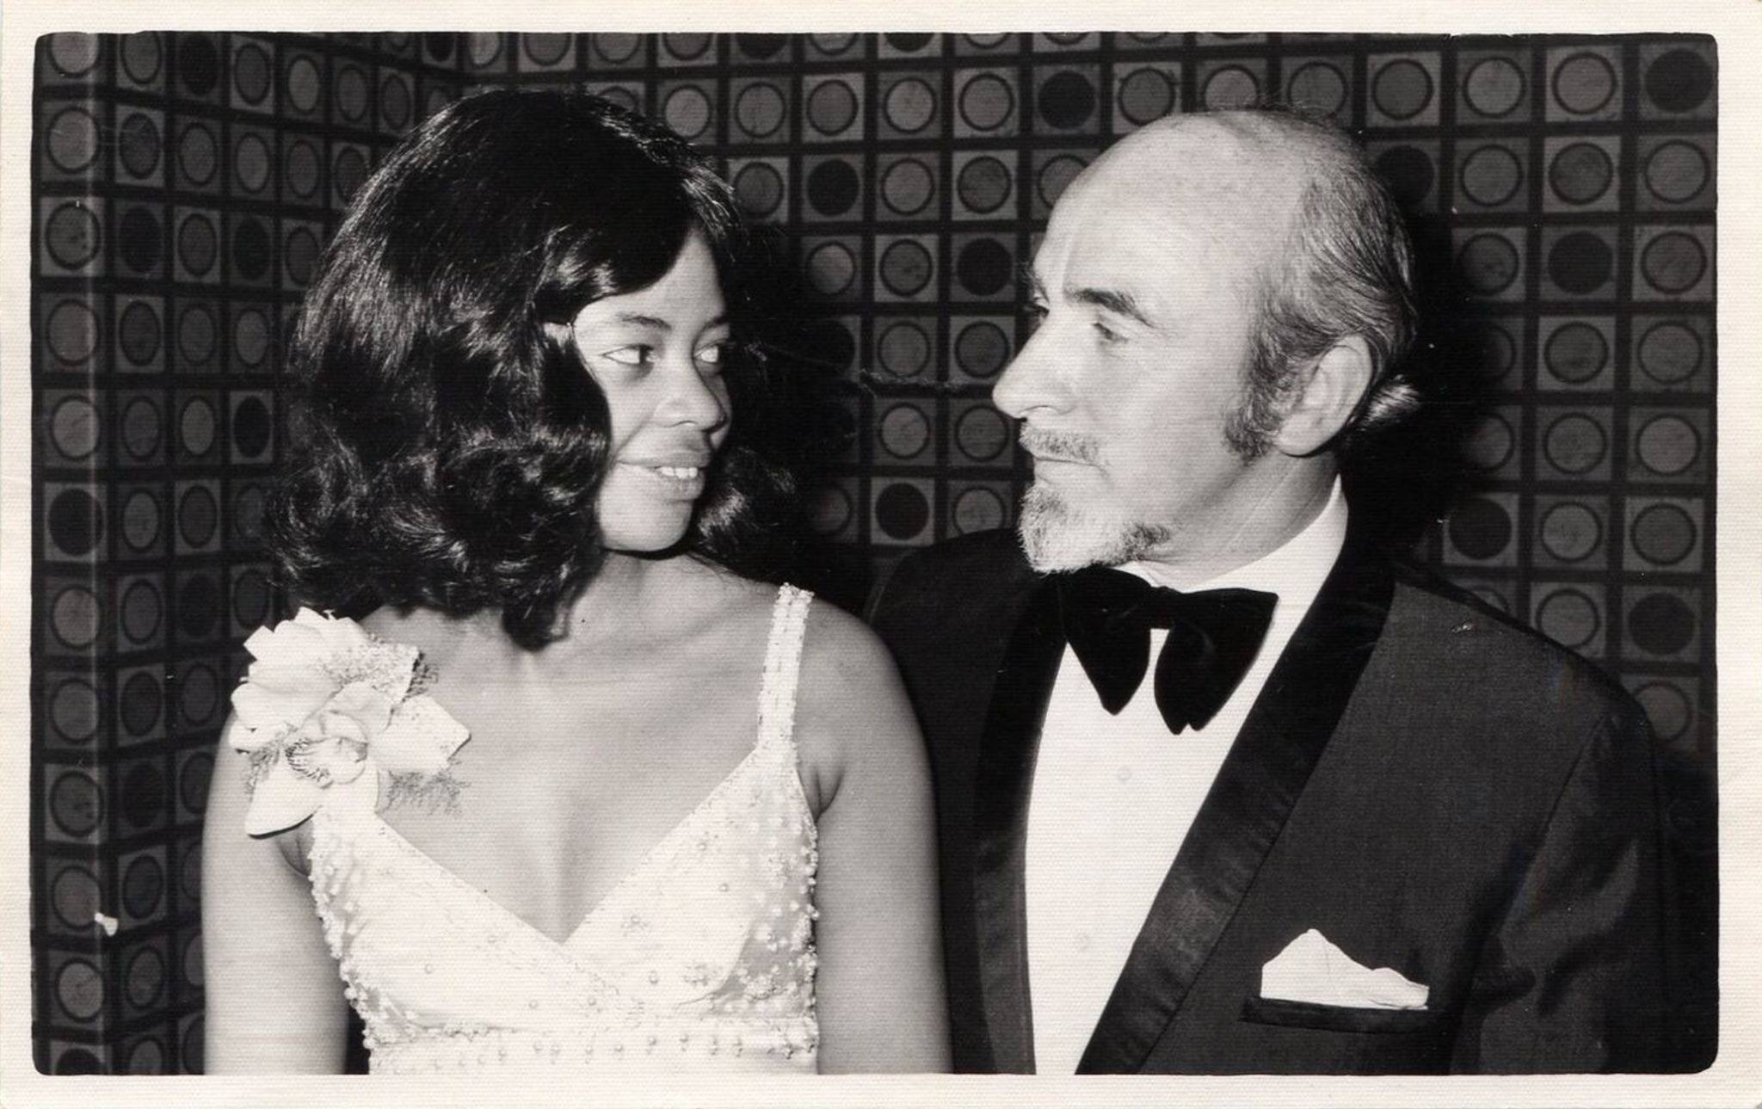
Museums Victoria Collections
Sylvia & Lindsay Motherwell
Personal and political freedom as reasons for move to Australia
https://collections.museumsvictoria.com.au/items/2407743

Slide 15
Who moved to Australia?
Lots of people moved to Australia by choice, they benefited from the ‘£10 pom’ scheme and would be found housing and work by the government, often in the form of hostels initially
After that, many of them managed to form lives in Australia, with support from the government, since they were viewed as “the right kind of migrants”, as we have seen elsewhere in this module
However, the other large group of British migrants to Australia were treated less well- children

Slide 16
British Child Migrant Program
“Home children” was a scheme established in 1869 and transported around 100,000 around the world by the 1970’s
The idea was to make a “stock” of brits in Australia, especially post war when around 3300 were sent to Australia
Children (and orphanages) were promised sunshine and happiness but were instead usually kept in overcrowded orphanages or given to foster families who wanted the children for various forms of labour
Some families also willingly sent their children, assuming their lives would be better, regardless, almost every child migrant was from a disadvantaged background

Slide 17
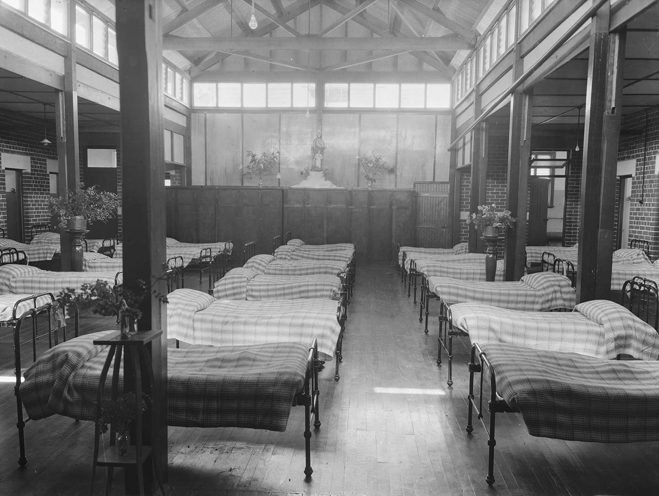
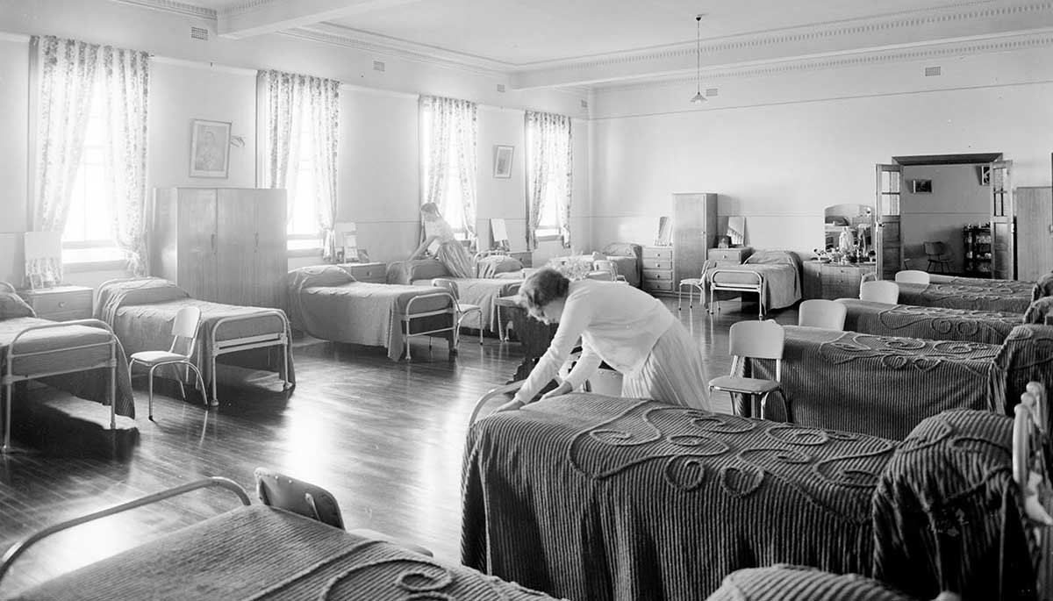
As this image of a 1950-60s western Australian dormitory shows, there were lots of children packed into a very small space with no privacy or place to store any personal belongings.
Institutionalised “care” in Australia often resulted in abuse, neglect and trauma, with the government disregarding any responsibility to protect or safeguard the children it was willingly bringing in.
Many children recall exploitative and dangerous hard labour, criminal physical, psychological and sexual abuse, neglect and deprivations.
While not all children were abused or suffered neglect, no child was safe from such fates because the system was poorly resourced
Dormitory facilities at Castledare, Western Australia
Home of the Good Shepherd, Ashfield, Sydney, 1963

Slide 18
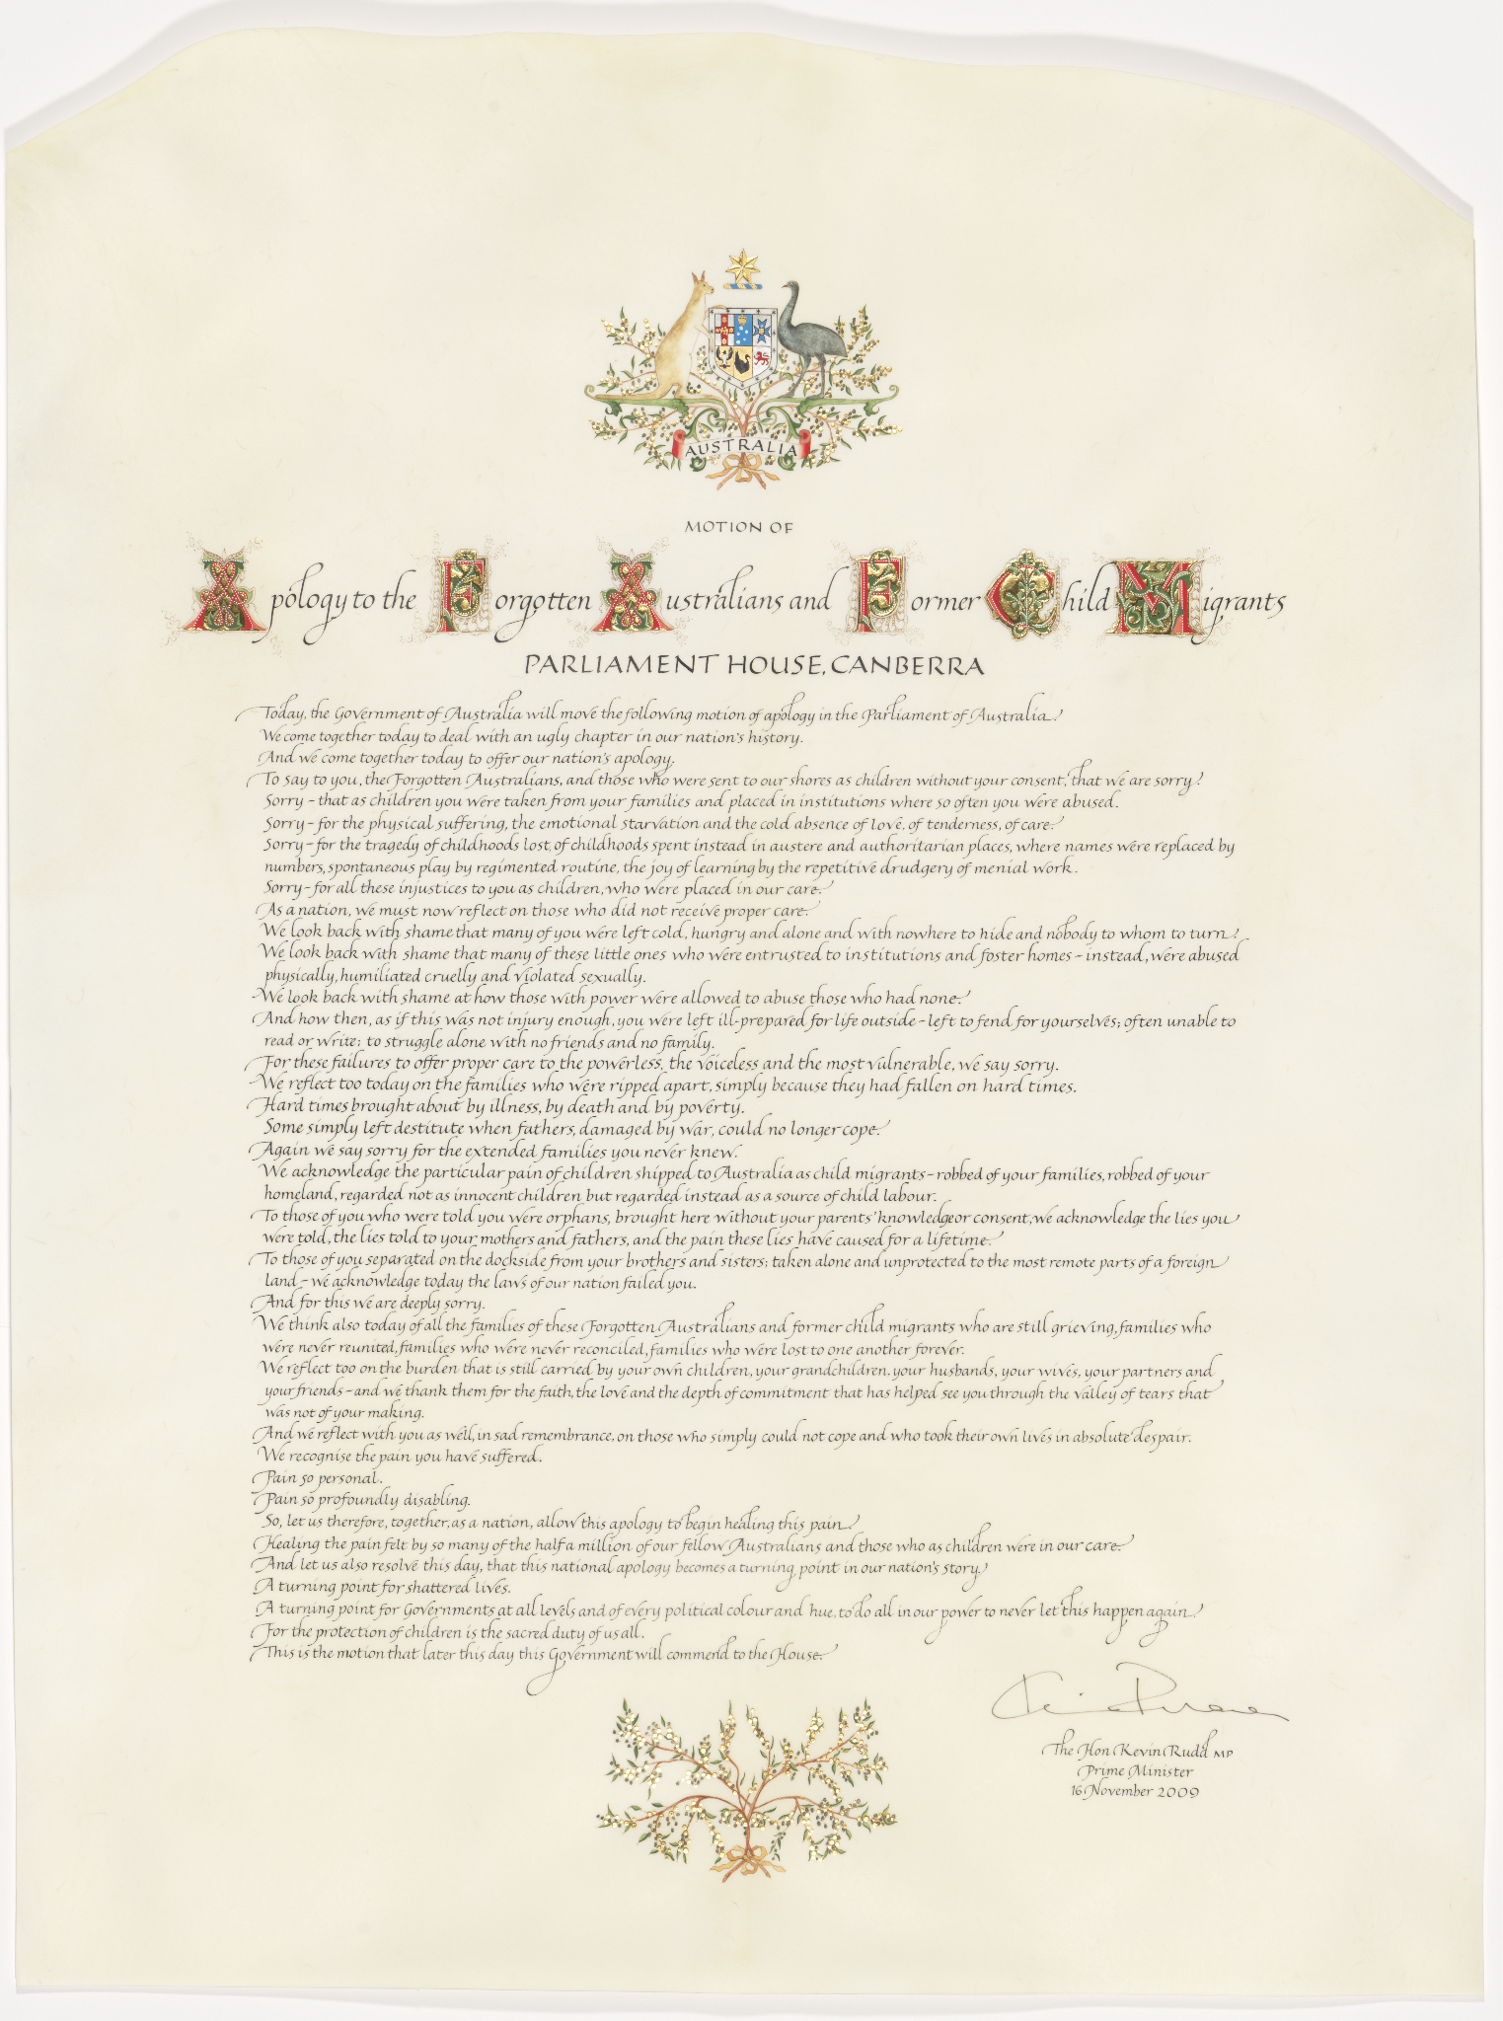
Apology
In a ceremony in the Great Hall of Parliament House on 16 November 2009, Prime Minister Kevin Rudd apologised to the ‘Forgotten Australians’ and former child migrants on behalf of the nation
Practical compensation was also given, as money and emotional support was given to victims and the government promised to support archives in work surrounding the legacy of the scheme

Slide 19
