Slide 1
'We are here because you were there': Migration in the Metropole

Slide 2
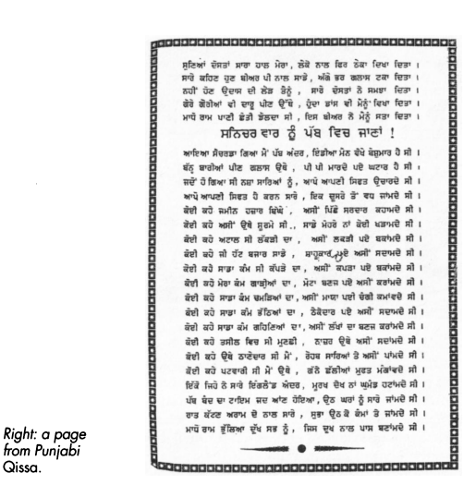
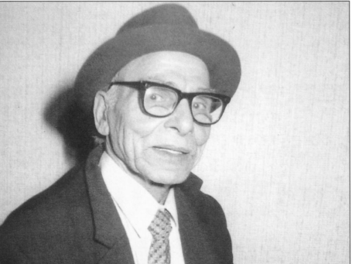
Mera England da Safar ("My Passage to England")
Poem by: Madho Ram Mahimi
"rigid regime, twelve-hour shifts, masochistic work"
''Why do you take my joys away? How will the lonely days pass without you? the husband gets no respect or salvation, doesn't the whole world know?"''
Madha Ram
Punjabi foundry worker who settled in Wolverhampton, UK, in 1958.
''huddle in pub, share drinks, sing songs''
Madho Rams poem is in the Punjabi language and consists of 50 pages of A4 sheets
-Oral History Society

Slide 3
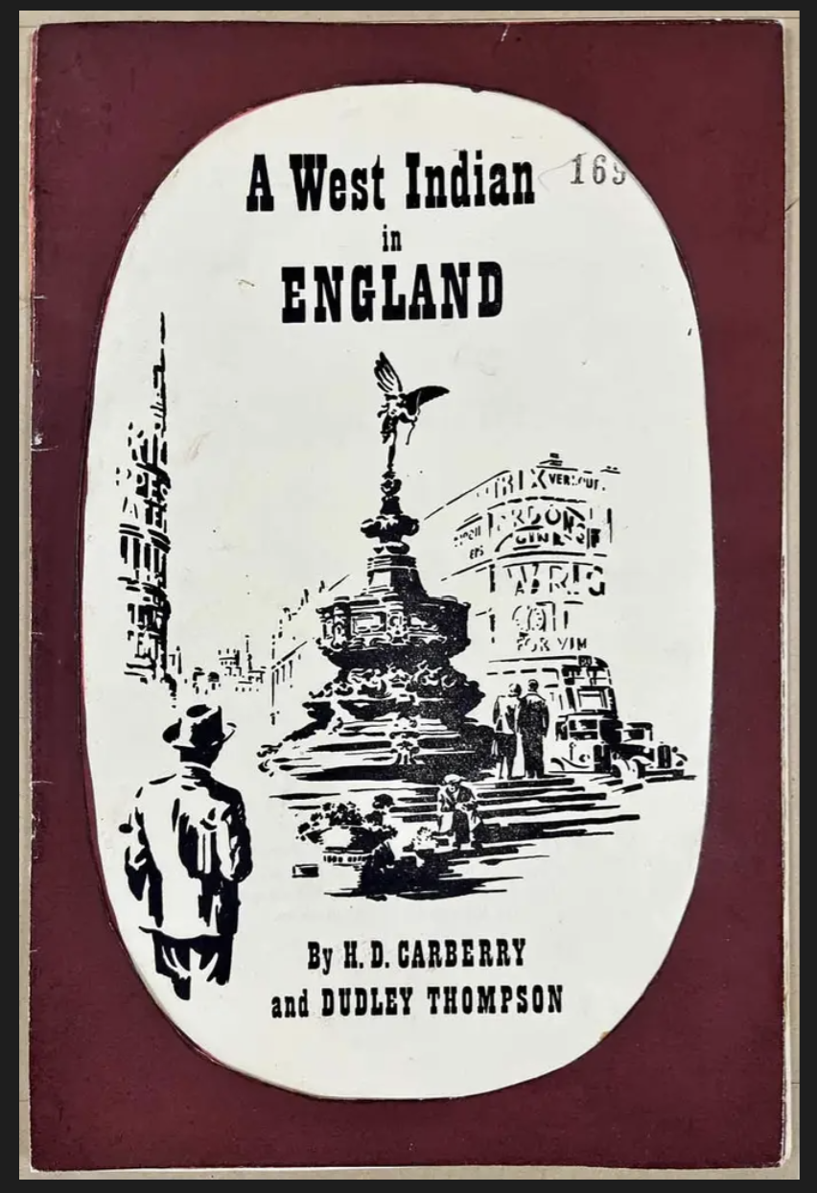
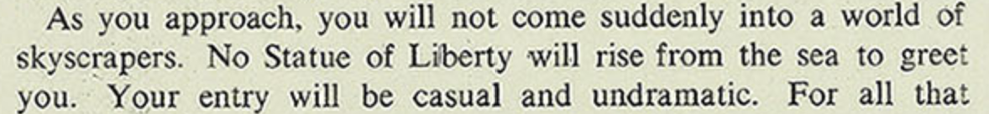
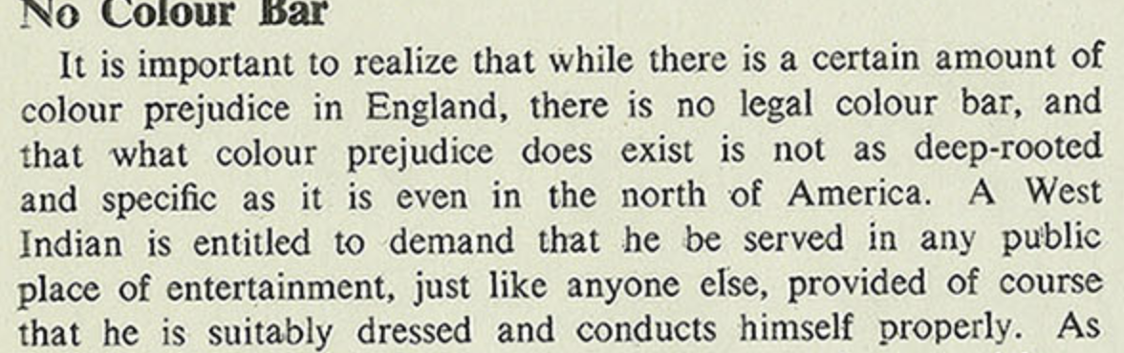
‘A West Indian in England' leaflet by HD Carberry and Dudley Thompson
The leaflet was approved by the government and was designed to give early immigrants some idea of life in Britain
Main Themes:
Racism
Assimilation
Comparisons to America
Link: https://www.nationalarchives.gov.uk/education/resources/commonwealth-migration-since-1945/booklet-west-indian-on-england/

Slide 4
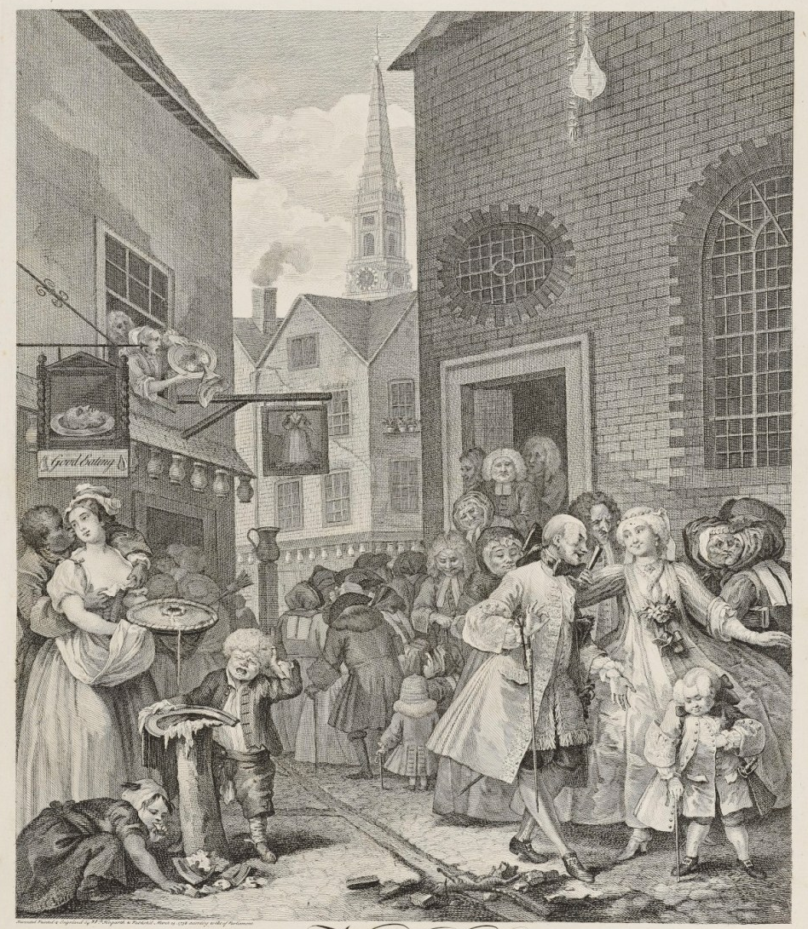
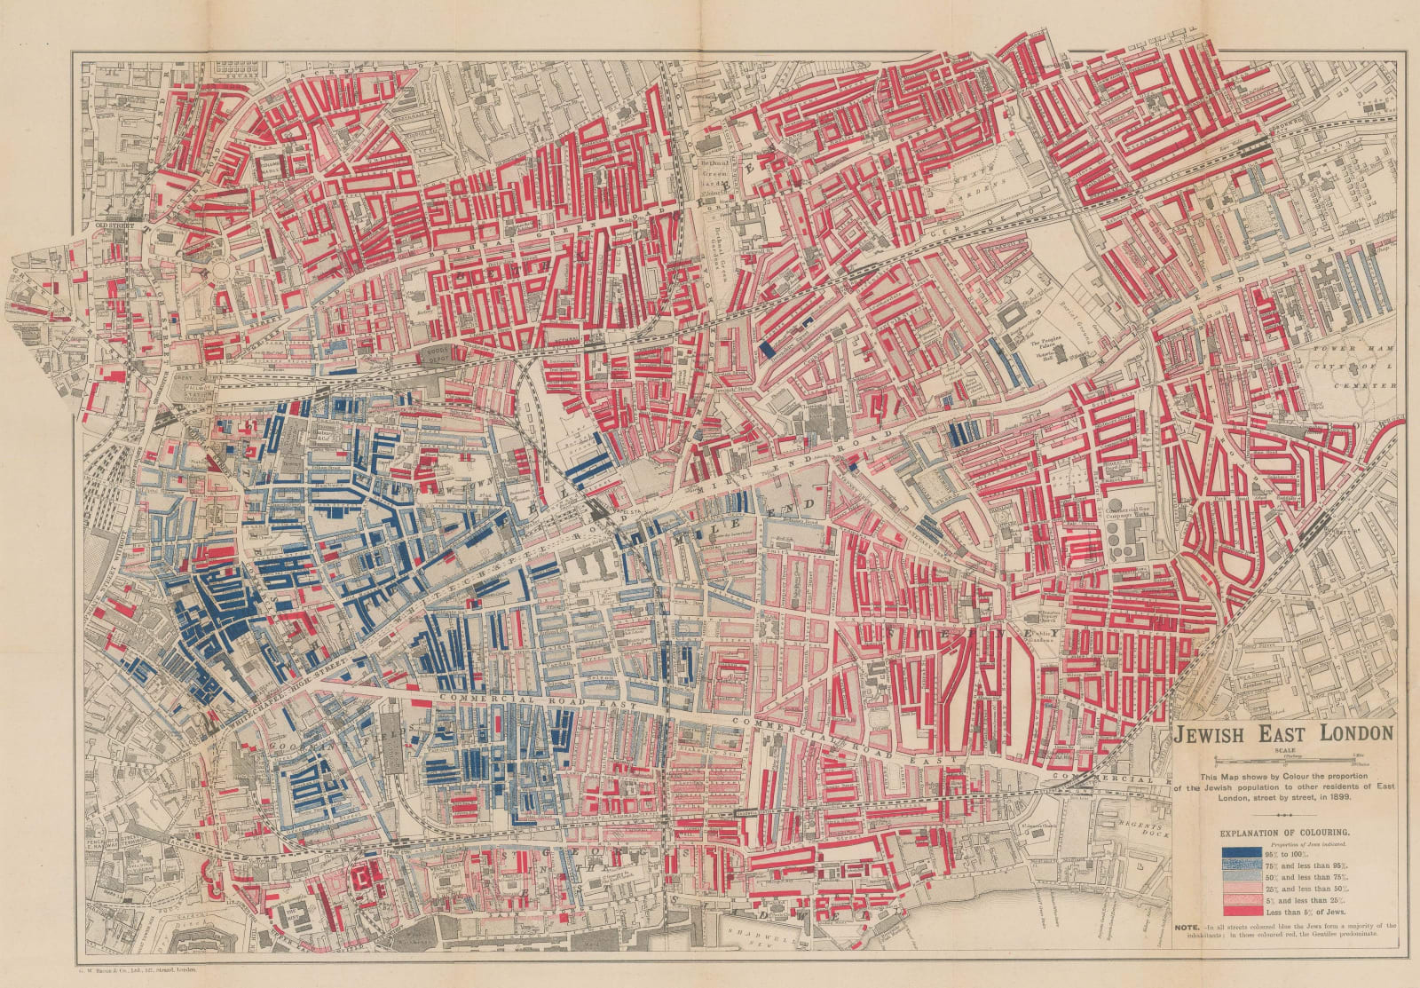
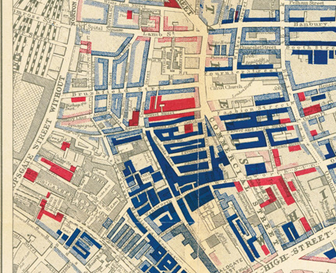
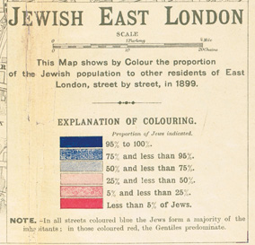
Does the arrival of the Empire Windrush mark a moment of discontinuity in Britain's migration story, or of continuity?
'Jewish East London 1899' George Arkell (1901)
'Noon' William Hogarth (1738)

Slide 5
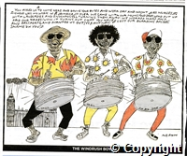
The Windrush Boys
The Windrush Boys
"You asked us to come here and drive your buses and work day and night as nurses there was no work in Jamica so over we cam with our mums and dads who put up with landladies and Enoch Powell turning them away. We worked hard and paid our taxes! Now it turns out that you have lost our boarding passes! And passports and wanted us out! Anyway! Shame on you!"

