Slide 1
Windrush, Whiteness, and the end of ‘Open Door’ Britain:
‘We are here because you were there…’

Slide 2
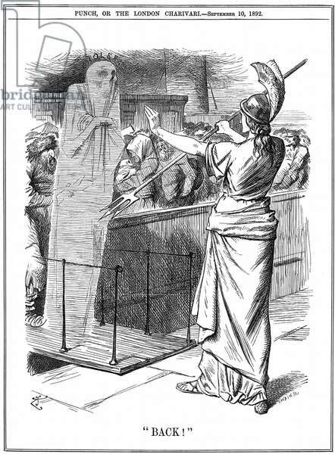
Britain: ‘Emigration State’ to (Im?) migration Destination
If the UK was forged as an ‘emigration state’, what might we expect to see when it (repeatedly) became a migration destination?
A few migration ‘crises’:
  Loss of the ‘First Empire’
  French Revolution
  Irish Potato Famine
  Pogroms and Russian Revolution
‘Britannia holding back Cholera at British ports’. In the outbreak of 1892 about 260,000 died in Russia and 7,600 in Hamburg. The epidemic was prevented in Britain.’ John Tenniel cartoon from Punch London 10 September 1892.
Chester Cathedral, 1785

Slide 3
‘Reverse colonisation’?
Does it matter that post-war migration reversed the trajectory of imperial movement?
Osbert Lancaster, Daily Express, 21 April 1971
Margaret Belsky, The Sun, 18 October 1966
Jon, Daily Mail, 29 April 1968
Michael Cummings, Sunday Express, 8 March 1970

Slide 4
Primary Source Work
Question:
Compare responses to migrants from Europe and Ireland with those from Britain's former colonies and Dominions. What rationales for inclusion and exclusion were applied to these different groups, and by whom?
Sources:
Either 100 Voices: people nation empire
OR
British Cartoon Archive
OR
News and Newspapers

Slide 5
Historic Hansard and the Immigration Debates
‘ there are questions of policy behind this Bill on which honest people take differing views. …It imposes additional restraints by inserting a section into the Commonwealth Immigration Act 1962. So perhaps I should start by reminding the House what that Act does. It is the 1962 Act... Under that Act, the immigration officer can admit or refuse, and can impose conditions as to length of stay or as to employment. …
Entry cannot be refused to a person who is, or has been within two years, ordinarily resident here, or a person with an entry voucher, or a bona fide student coming here to undergo an educational course, or a person who can financially support himself, or a wife or child under 16 of a resident, or who accompanies one who is allowed to come in, except that entry is not permitted, first, to a person convicted of a crime which is an extradition crime; secondly, to a person undesirable on medical grounds; and thirdly, to a person who is undesirable on grounds of national security…A child under that Act includes stepchild, adopted child and illegitimate child. Lastly, … the immigrant—not his wife or children—may be medically examined.
These controls have been found in practice since 1962 to be inadequate in the following respects. First of all, clandestine entry is not an offence. Most people are very surprised to hear that. It is for aliens, but it has not been for Commonwealth citizens. Under this Bill it will be an offence to enter without examination by an immigration officer. Next there is to be a change in relation to children. At the moment about 8,500 vouchers a year are issued. They Are not all taken up. What has risen very much has been the number of children coming in—and this will interest the noble Lord, Lord Elton, who has always maintained that it is a fatal mistake to allow those who settle here to bring all their dependants at any future time. In 1965 there were 24,000 children, in 1966, 26,000, and in 1967, 35,000. Altogether, in 1967, 58,000 immigrants in all came in, and as a matter of interest 19,000 were from India, 18,000 from Pakistan, 12,000 from the West Indies, and there were 7,000 others.
The Government have always thought—and, if I may say so, I entirely agree—that we have been right to say that anyone who is allowed in may either bring with him or have subsequently reside here his family. I can understand the attitude: "It is all very well to have a man who is going to do some work, but to have his wife and children here, too, only adds to our problems without our getting any benefit from it." I do not think that is right or humane. The unit on which most civilisations are planned is the family, and we have always thought that this is right.
I suppose we are all affected by our own experience. I remember being shown round some native townships outside Johannesburg by a very kind South 919African official—being white I could not have got there if he had not done so—and I remember a large building for contract men who come in from the country. They are bound to leave their wives and children for a year or two years. There was a little room with a wooden table, a wooden bed and a wooden chair; and the whole place was completely surrounded by barbed wire. I said: "These men go out to work. Why do they have to be shut in with barbed wire?". He said to me: "That is not to keep the men in; that is to keep small boys out." I think that, even from the point of view of our own population, it is not a good thing to have large numbers of men who are in fact married but are separated from their wives and children.
HL Deb 29 February 1968
LORD STONHAM ‘The clause is very clear here. It refers to a person who proposes to attend a course of study at any university, college or school, being a course which will occupy the whole or a substantial part of his time. I imagine that in the main the Government are thinking of university students or those who are going to attend a full-time course at a technical 465college. They will be a particular class of person, either supported by scholarships or whose families are able to afford to send them over and support them while they are here. [However] A very substantial number of immigrants from the Commonwealth are attending as evening students at the many polytechnics and schools throughout the country.
Last night at nine o'clock I was at the Northern Polytechnic, which is at Holloway in North London. …I should say that approximately half of all the students I saw were coloured—varying degrees of colour it is true, but obviously about half of them were Commonwealth students. Some of them no doubt were studying comparatively simple subjects, like improving their English; but many of them I saw coming from classrooms dealing with technical subjects—some of them quite advanced technical subjects. It is quite obvious that they are working during the day-time and attending these courses during the evening, and taking advantage of facilities for improving their education which are not available in their own country. I should have thought that that was not only extremely valuable to them, but also extremely valuable to the Mother Country. Therefore I hope that the noble and learned Viscount will give us some idea of what is meant by a "substantial part of their time". They would be attending for perhaps three hours during an evening, several times a week, which would add up to a quite substantial amount of study. They have to enrol in advance for these courses, and they are properly scheduled educational courses with a syllabus. I should hope that students who enrol for such courses would not be debarred but will be included in the provisions of Clause 2 (3) (b). Find it here. HL Deb 20 March 1962

