Slide 1
Foreign Bodies: ‘This crowded isle’ and the end of ‘Open Door’ Britain
Professor Roberta Bivins
Centre for the History of Medicine
University of Warwick
peopleshistorynhs.org

Slide 2
What happens in UK immigration discourse after 1948?
In your archive groups, think about how immigrants and immigration have been discussed in the UK since WWII. What metaphors, analogies, come up repeatedly? What is the tone of discourse?
If this is your archive week, prepare to discuss your find in this light. What does it tell us?
Michael Cummings, Daily Express, 17 Jan 1962

Slide 3
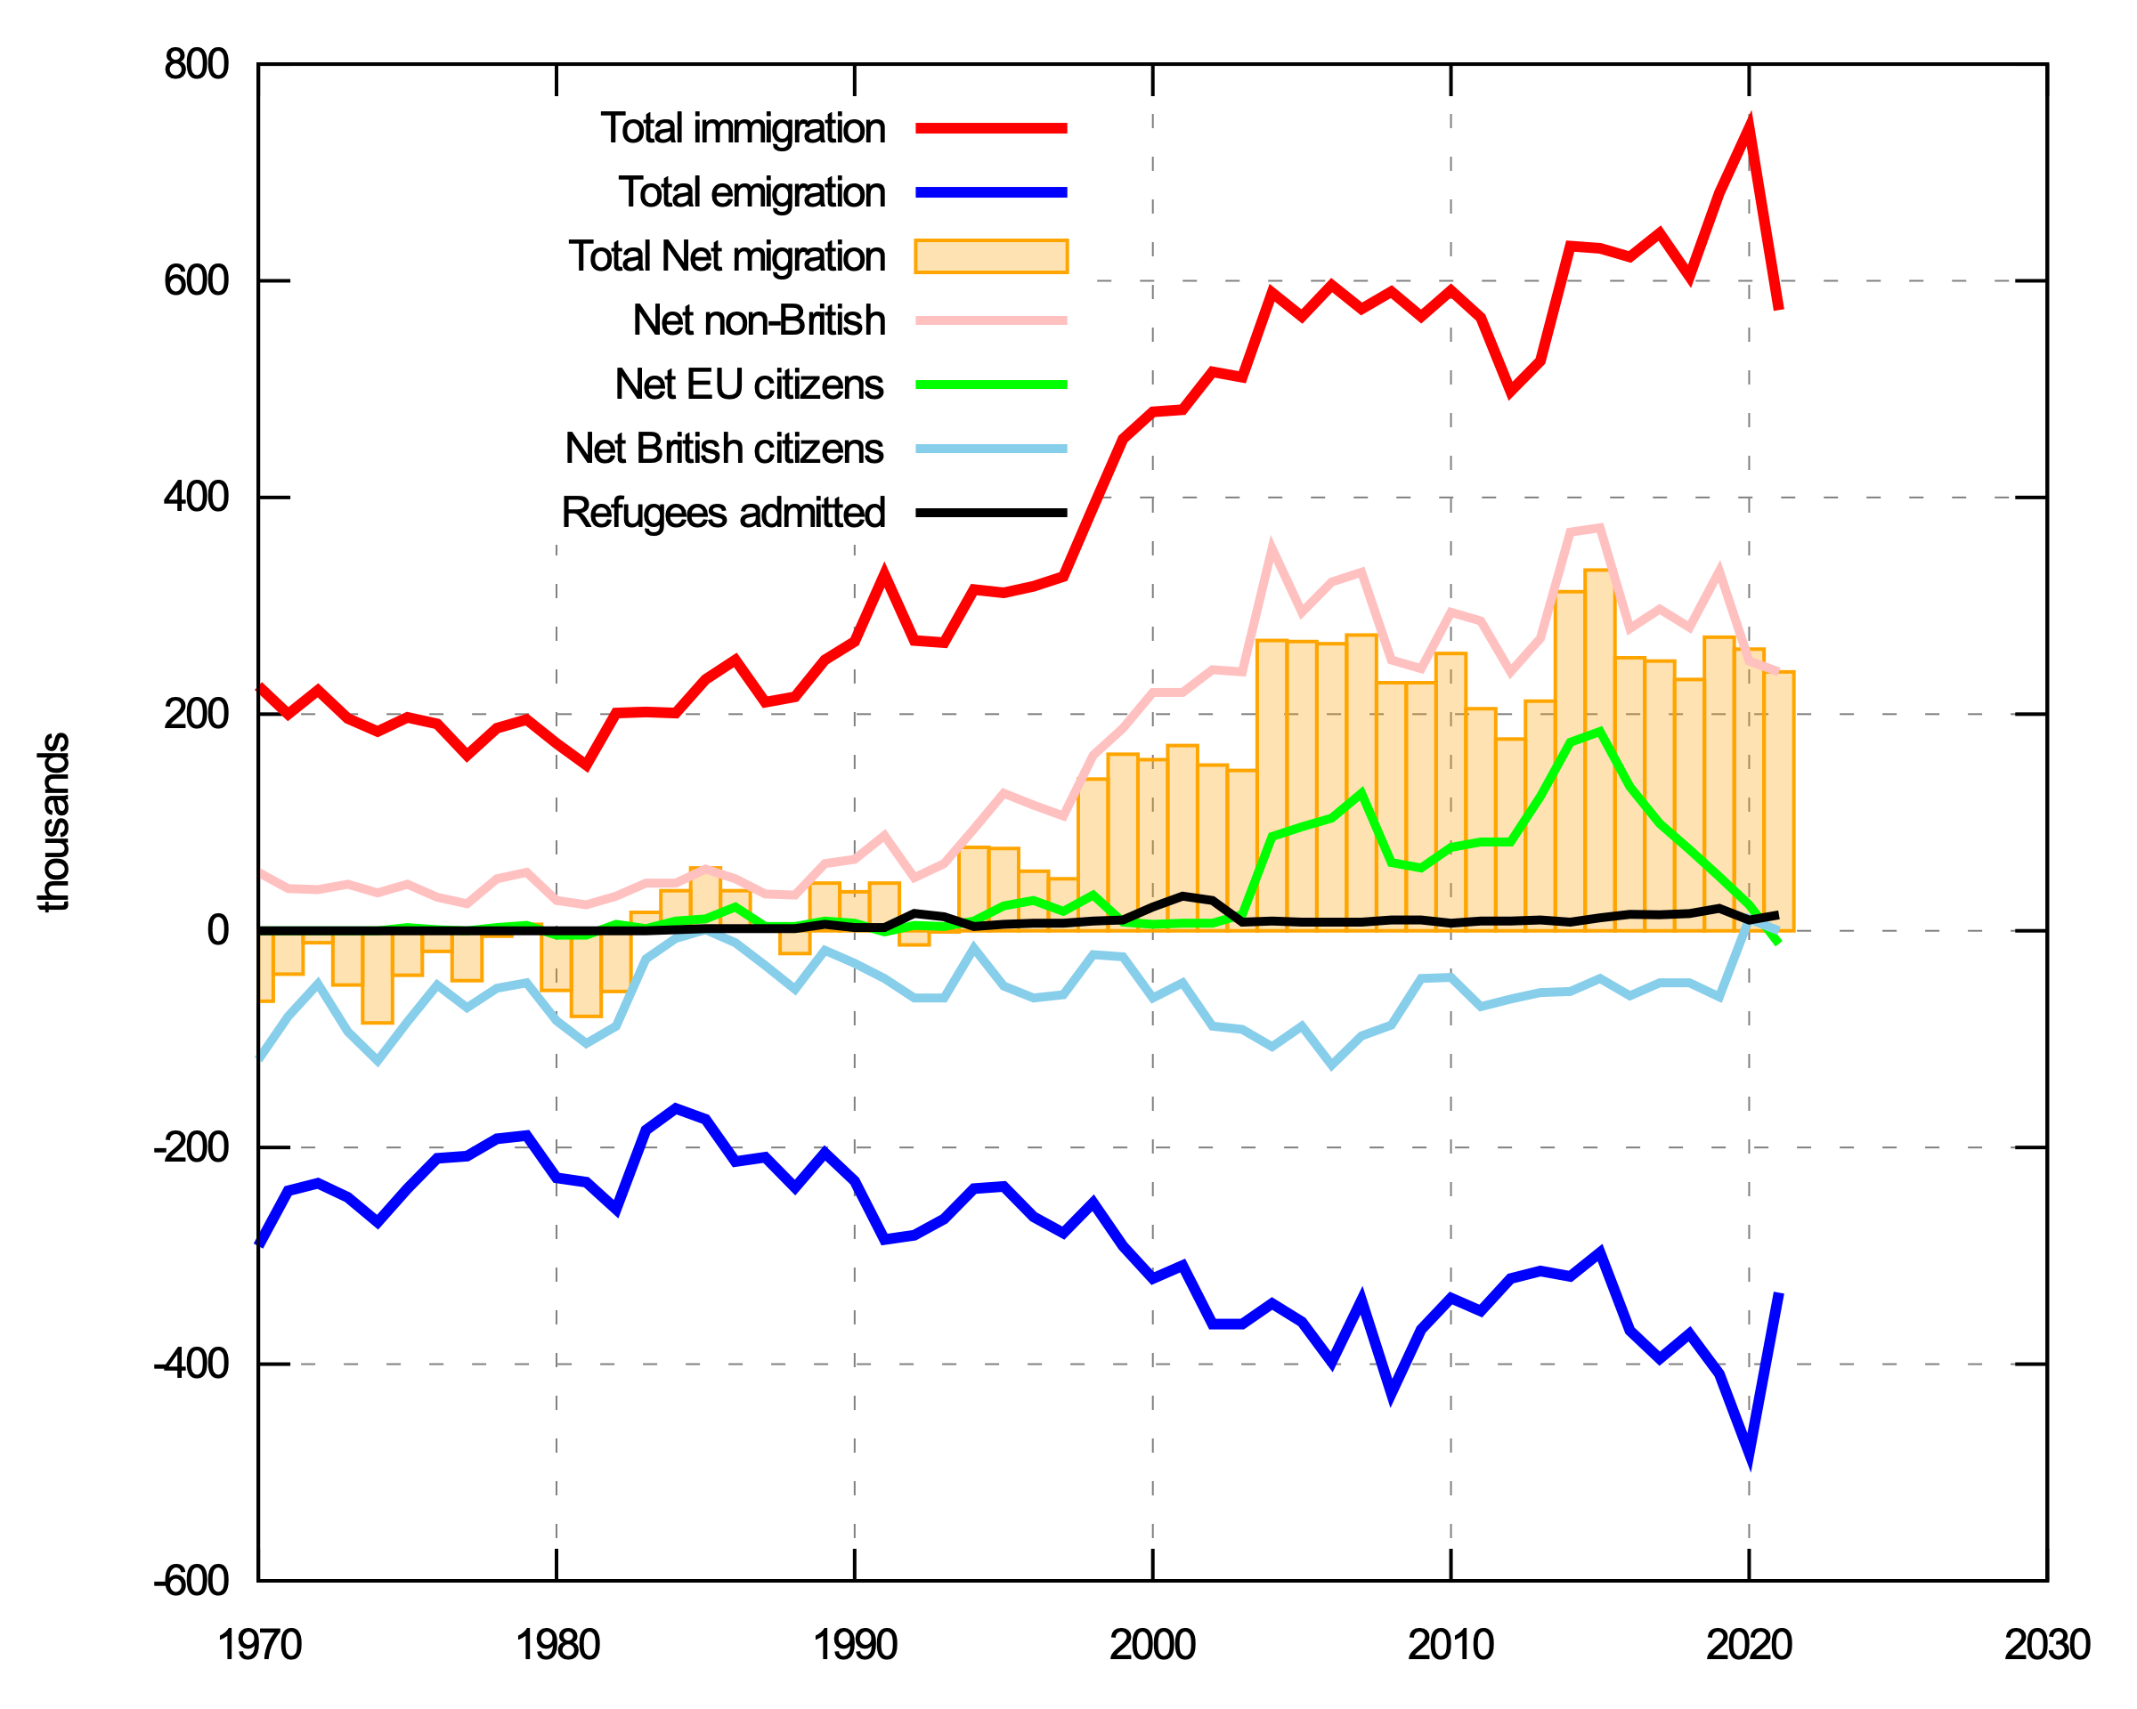
(Never)Ending ‘Open Door Britain’ … or ‘Why Immigration control doesn’t work’
Migration is inherently transnational: one nation cannot determine its immigration policy without considering global conditions;
Legal and physical borders must be permeable: no island is an island
Past commitments affect responses to new circumstances
So: WWII economic impacts; Cold War geopolitical impacts; imperial commitments; local populations; national myths all shape migration policy… And let’s not forget the Ireland Act of 1949, which states, ‘notwithstanding that the Republic of Ireland is not part of His Majesty’s dominions, the Republic of Ireland is not a foreign country for the purposes of any law in force in any part of the United Kingdom or in any colony, protectorate or United Kingdom trust territory,’

Slide 4
Organic, Free-Range Essay Planning
Step 5: How should I structure? Themes vs Chronology
Step 6: Sketch it out: avoid repetition, concentrate description
Step 1: What are my questions?
Step 2:
What is the context?
Step 3: What evidence can I use?
Step 4: What is my argument?
THINK
READ
RESEARCH
THINK
HOW DO I WRITE?
OUTLINE
I. Context: outbreaks and CIA Bill
II. Media Reponses UK: Immigration Debates pre
III. Media Reponses Pakistan: health or hatred
IV. Media Reponses UK: Migrant=threat
V. Long-term Effects: immigration control; mis-perceptions of migrants
Why does the 1962 CIA introduce health checks? Why was this ‘neutral’ in UK, but outrageous in Pakistan?
Post-war, post-colonial UK and Pakistan, post NHS, post “race riots” of 1958, PRE first restriction of Imperial citizenship
2’ reading → to Hansards, TNA file series, historical newspapers. These → to diplomatic papers and medical journals
Smallpox outbreak legitimates restriction, ‘health checks’. ‘Objectivity’ of science’ appears to legitimate intervention
I like storytelling and evidence more than theory; my story is one of cause and effect; themes follow chronological shifts

Slide 5
Archive Exploration
Group

