Slide 1
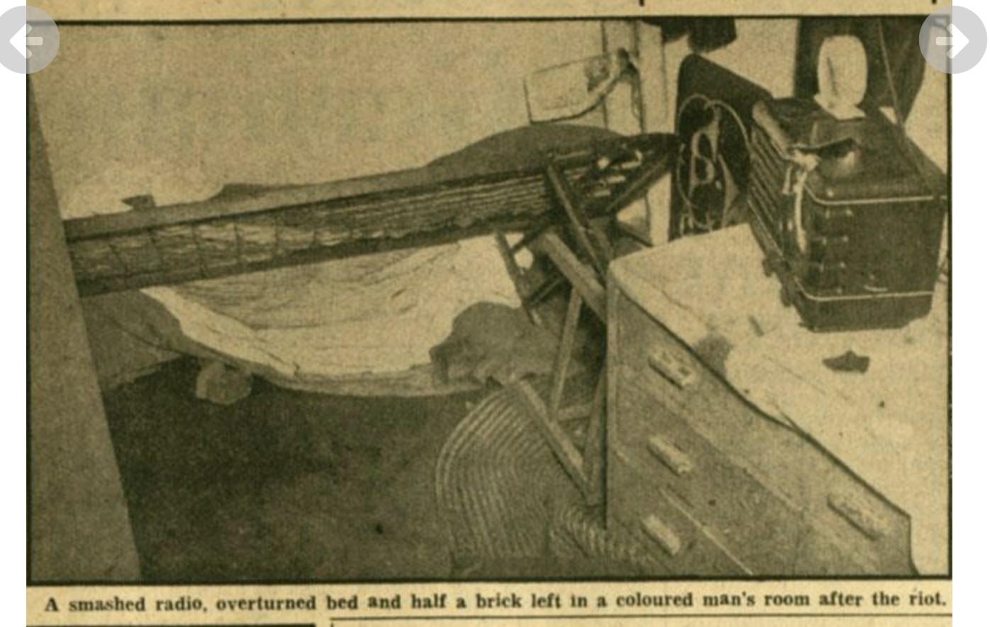
‘Race rioting’: racial clashes in British migrant hostels, 1946-1951
Notes:
8th August 1949, Causeway Green hostel, West Midlands – violent fighting breaks out. initiated by Poles upset over the attentions of a woman favouring the Jamaicans at a dance. Frequent occurrence, not out of ordinary

Slide 2
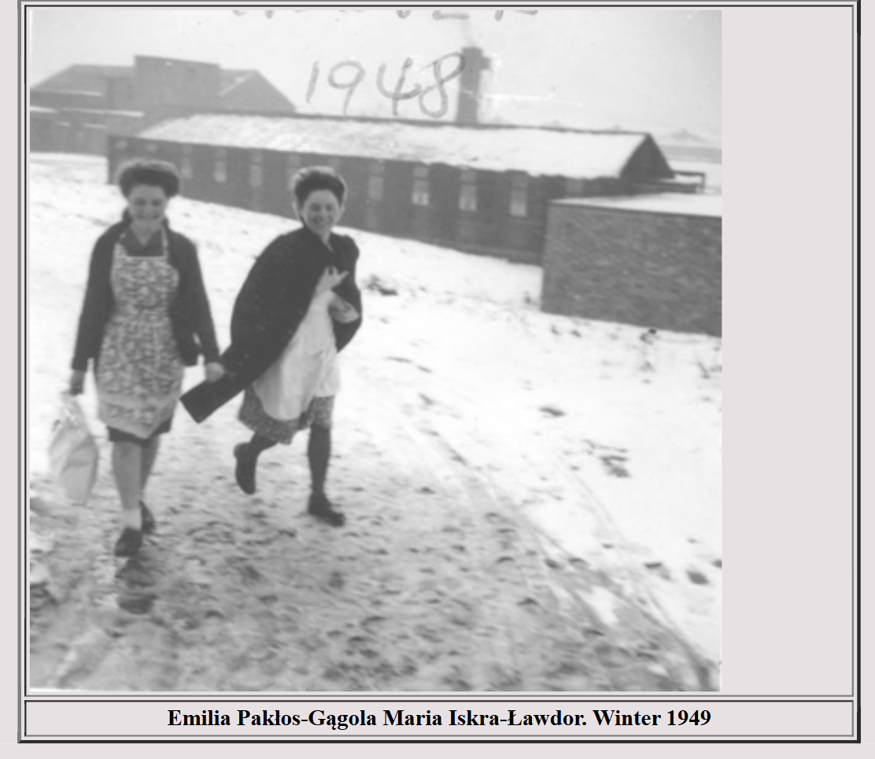
Context
1948 – British Nationality Act
People from the Commonwealth/ Colonies to have right to live and work in Britain
Approx. 300,000-500,000 from the Caribbean (1948-1971)
1946-1951 - European Voluntary Workers schemes
Around 80,000 unskilled workers from primarily Eastern Europe
Alien status/ displaced – unstable, fired first, undesirable jobs
Upon arrival to Britain, workers found a shortage of accommodation
Migrant hostels set up near unskilled labour hotspots – Midlands and North especially
Causeway Green Hostel (Aug 1949):
235 Poles, 18 EVWs,
235 Southern Irish
50 Northern Irish
65 Jamaicans
100 English, Scottish and Welsh.
Notes:
Nissen huts

Slide 3
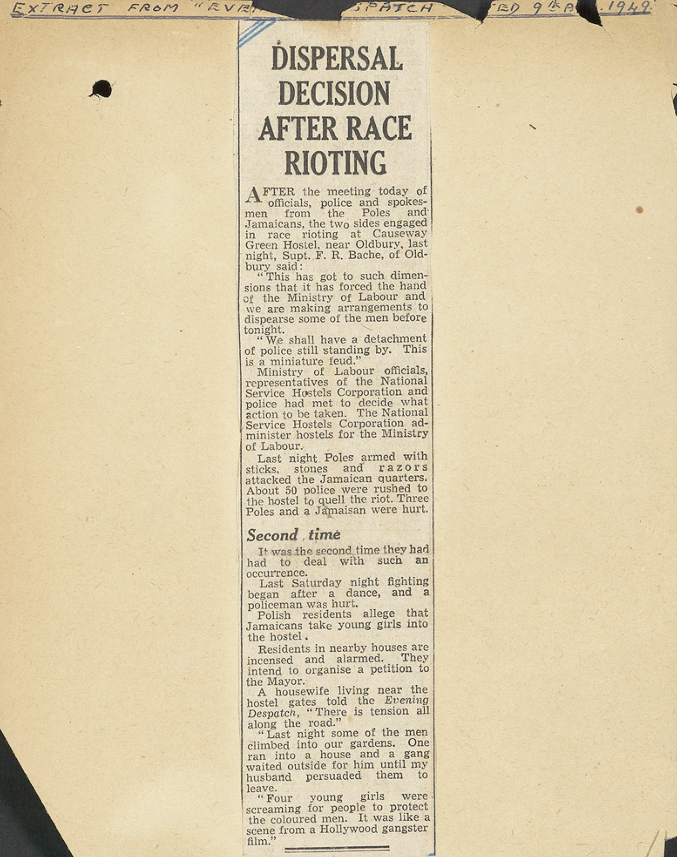






















15th April 1949 – Birmingham's Evening Dispatch
Pre-dating 1958 Notting Hill riots
Stereotypes of morals and sexuality in terms of race and class
No community integration
Led to limits (30)
‘invasive’ - language
Violence instigated by Poles
jealousy
Notes:
8th August 1949, Causeway Green hostel, West Midlands – violent fighting breaks out. initiated by Poles upset over the attentions of a woman favouring the Jamaicans at a dance. Frequent occurrence, not out of ordinary
BED 1902-1963, working/middle class paper, regionally but not nationally significant
Paper published 1 week after the dance
hostel Management intended to evict Jamaican workers, reacted with resistance in staying put
Other points to remember:
Illegitimate mixed-race babies
Letchworth, West Bromwich, Leeds, Nottingham, Coventry and Birmingham; instances from 1946, 2 years before Windrush
Poles and Southern Irish instigated violent clashes with migrant workers from West Indies

Slide 4
Conclusions
Reflects that Eastern European migration was encouraged, on grounds of ‘ideal immigrants’, falling-birth rate “vigorous new blood from overseas”, “of great benefit to our stock”
On other hand, West Indies labourers desired for their labour, not for their presence
Prevalent theme of inter-racial relationship themes, esp. by locals
‘race riots’ implies a matched clash, but Poles 4:1
Haliburton explicitly pointed out problems started with managements sudden decision to ‘segregate the coloured inhabitants from the Polish and British’ -> two groups were not encouraged to integrate -> hostility

