Slide 1
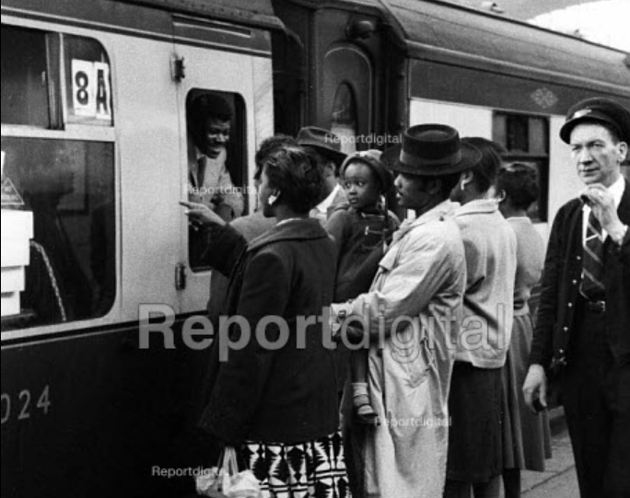
'HOME FROM NO HOME: DISILLUSIONED MIGRANTS GO' The Manchester Guardian, September 25th 1958 By Normal Shrapnel

Slide 2
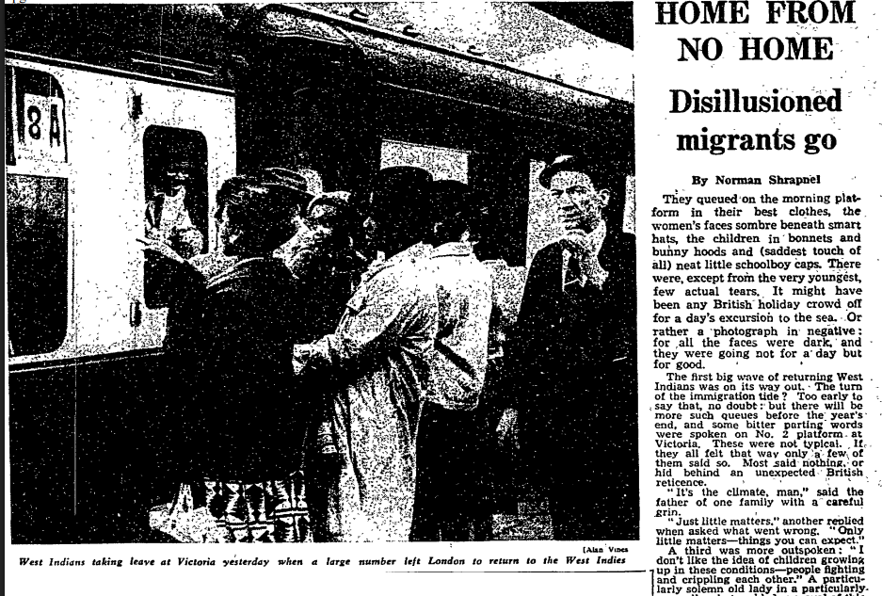
KEY SUMMARY/ CONTEXT
ST ANNE'S/ NOTTING HILL 1958 – Racially motivated riots that took place in August/ September 1958 in working class areas with high proportions of Caribbean migrants, whereby mostly white working class (especially youths) attacked Caribbeans and their properties in an eruption of racist violence
Reporting of the scenes at Victoria station describing crowded platforms of West Indians leaving Britain to return back to countries such as Jamaica and St Kitts in the wake of the Nottingham and Notting Hill Riots of September 1958.
2/3 of the article is concerned with documenting the attitudes of those that have decided to leave Britain, ranging from more limited comments to more outspoken responses regarding discrimination and the general conditions encountered since arriving in Britain.
Notes:
Reason for choosing this source as it provides an opportunity to understand the perspectives of West Indians on the rising tensions in Britain
With a pinch of salt

Slide 3
ANALYSIS
Quotes from Shrapnel (author)
'..some bitter parting words were spoken'
' ...few actual tears. It might have been any British holiday crowd off for a days excursion to the sea'
'Most said nothing or hid behind an unexpected British reticence'
More witty than politically charged
Comments from West Indians
General
'It's the climate man'
'Just little matters'
'Tell them about Christ here, they do not believe you'
Violence
'I don't like the idea of children growing up in these conditions – people fighting and crippling each other'
Colour Bar
States multiple gave the response of discrimination in housing and jobs
'One time I went for a job and they said they hadn't got their jobs for their own people'
Centrist/ Liberal approach – Relatively neutral stance representative of educated, middle class audience
Comments themselves, Shrapnel acknowledges as not applicable to all but does provide insight into the variety of areas of tension – giving a platform for grievances of those discriminated against
Surprising lack of mentions of Notting Hill – which could be down to Shrapnel keeping with the light-hearted tone of the article (as he does not even mention it in the intro), or people not wanting to discuss the matter
Overcrowded platform – desperation to leave – and visibly excited – despite fare cost (£1k plus today)

