Slide 1
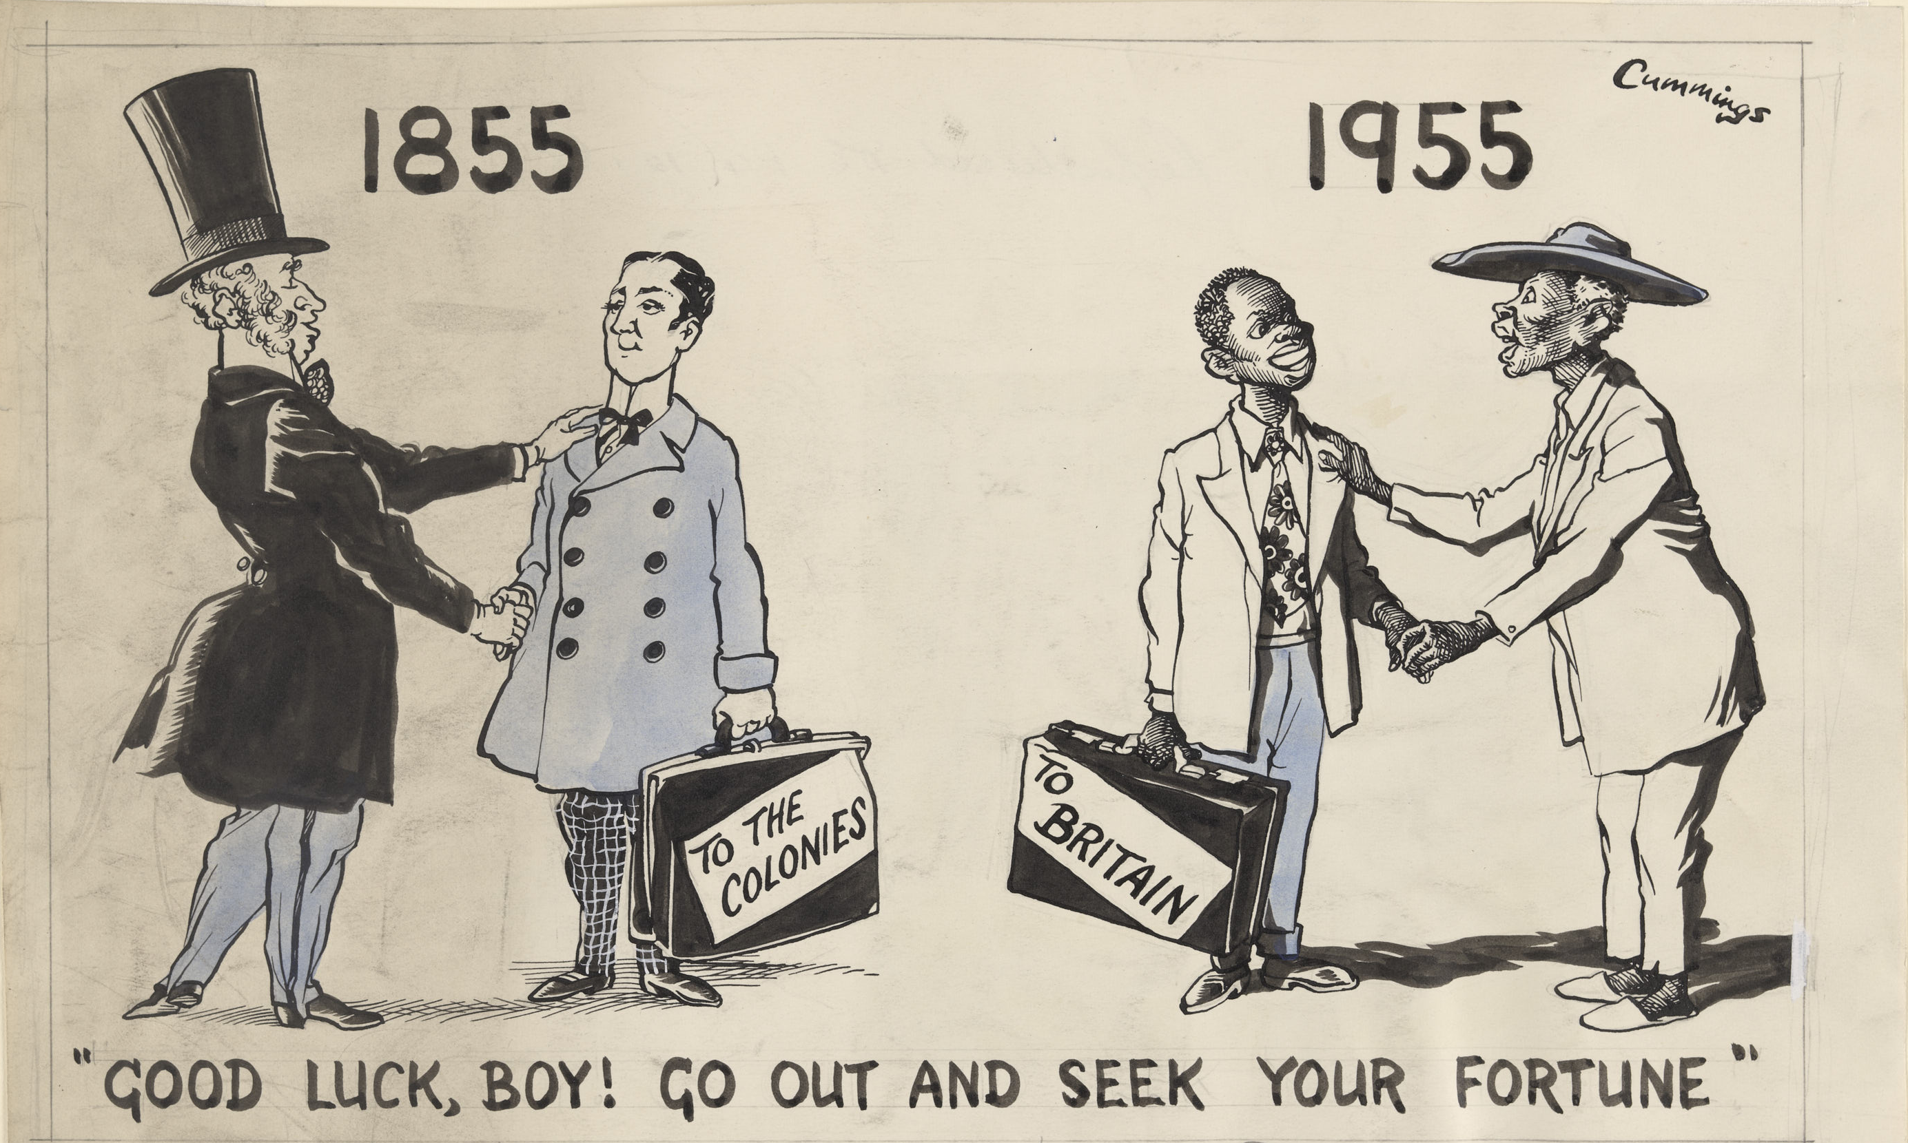
Michael Cummings
‘“Good luck, boy! Go out and seek your fortune!”’
Daily Express
25.5cm x 37cm
12th January 1955

Slide 2
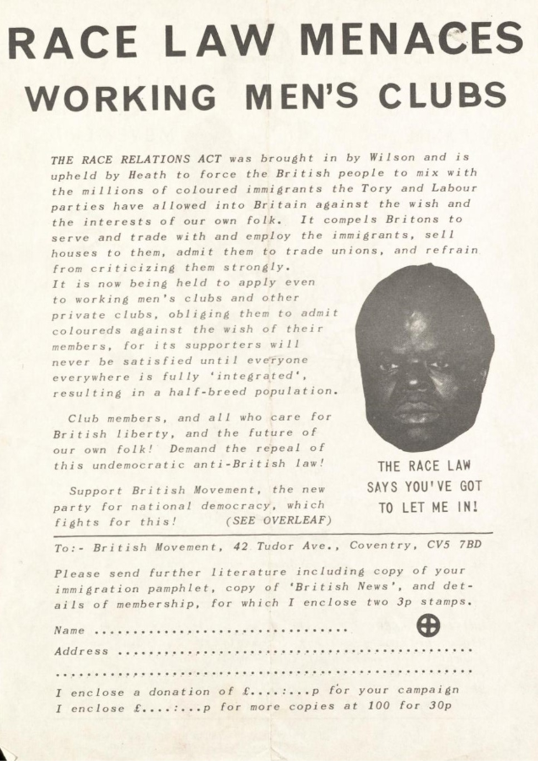
‘Race Law Menaces Working Men’s Club’, Greater Britain Movement, 1965

Slide 3
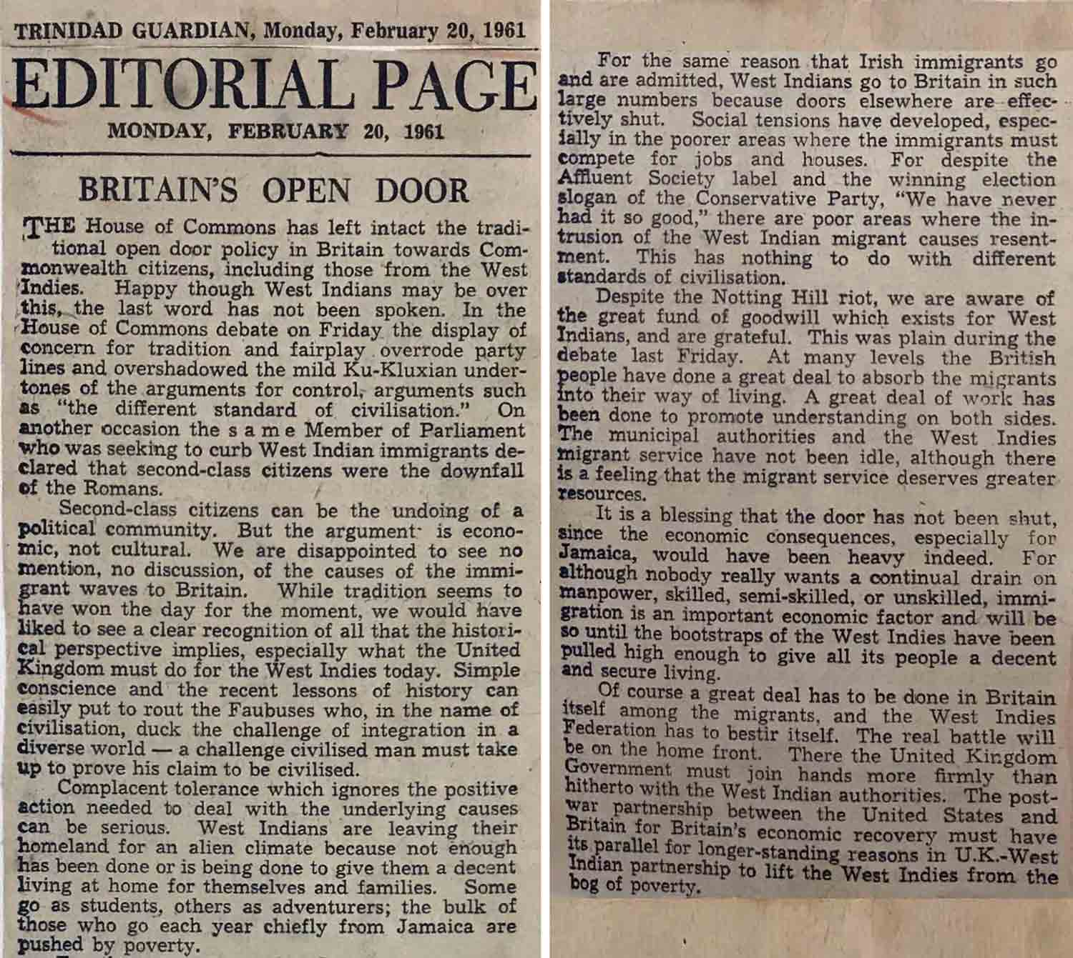
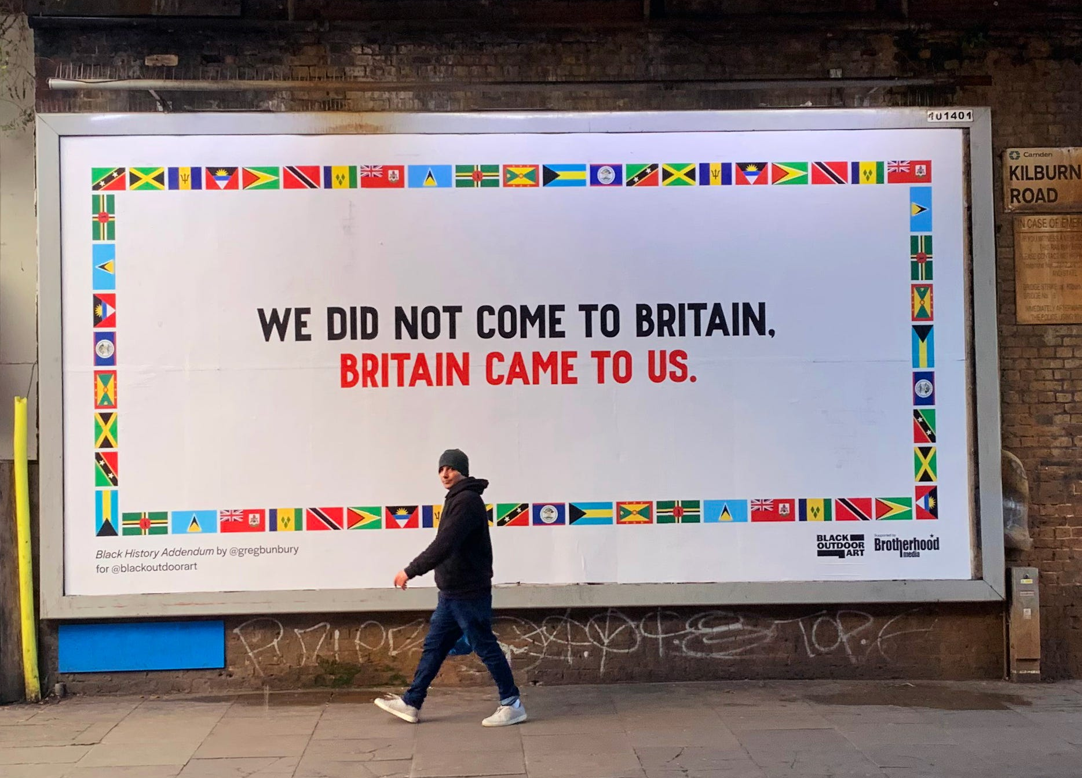
Kilburn, London, October 2022 - a billboard of the artwork ‘Black History Addendum’, created by Greg Bunbury
Trinidad Guardian 1961 cutting (WIFAC Collection)

