Slide 1
“Should We Let Them Keep Pouring In?”
Rory Wilkes

Slide 2
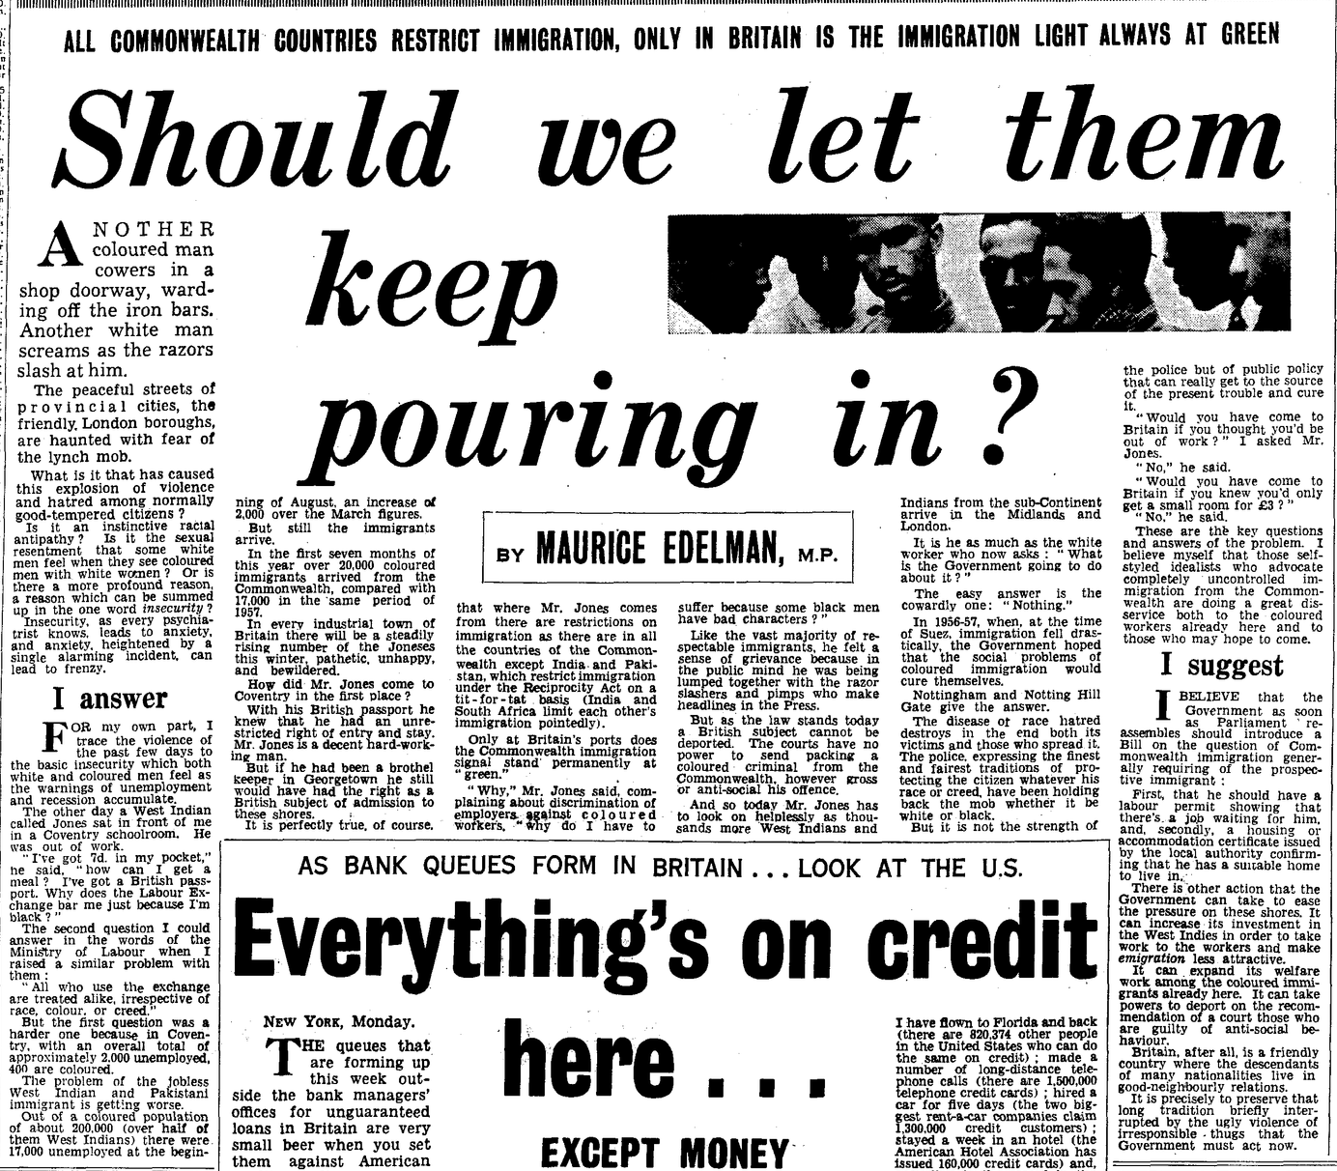
Daily Mail – Tuesday 2nd September 1958- Maurice Edelman.

Slide 3
The Daily Mail/Maurice Edelman in 1958
Daily Mail, tabloid newspaper set up in 1896.
At the time- headed by Esmond Harmsworth, quite hostile toward immigration- heavily right leaning paper.
Significant readership in Britain- Fact that it is mentioned in the Hansard Documents highlights the political significance of the paper.
Maurice Edelman (Labour MP)- Wrote a Weekly comment in another paper, the New Statesman

Slide 4
Context- Britain
1946 and 1947- Free and Assisted Passages Schemes- Into and Out of the UK.
1948- British Nationality Act
Debates about the usefulness of the 1948 Act- part of the desire to maintain have a Britishness separate from empire.
Racialized opinions common within parliament
Needed empire to fulfill a labour shortage in 1950s but would be diluted by ‘British Stock’
In the late 1950s and Early 60s labour market shrinking.

Slide 5






Key aspects/debates
Major Quotes and phrasing –
Use of the Anecdotal “Mr Jones” as an example for the symbolism of the migrant.
“the problem of the West Indian and Pakistani Immigrant is getting worse.”
“Only at Britain’s Ports does the Commonwealth immigration stand permanently at green”
Pressures on the immigrants to have jobs set up before they arrive
Does note- “Britain, after all is a friendly country where the descendants of many nationalities live in good relations”
Overall- links to previous tropes about the ‘right’ person and what they can provide to Britain.

Slide 6
References
https://hansard.parliament.uk/commons/1961-02-17/debates/34eb2488-fd18-43d5-9df3-42bdb7ca4555/ControlOfImmigration - Hansard Debates.
https://go.gale.com/ps/retrieve.do?tabID=Newspapers&resultListType=RESULT_LIST&searchResultsType=SingleTab&retrievalId=e029ea13-26dc-474e-b614-f8af566eaefb&hitCount=630&gtmSearchId=9b5554ee-2c73-4a43-b557-93b3e62c570c&searchType=AdvancedSearchForm&currentPosition=88&docId=GALE%7CEE1864925174&docType=Article&sort=Pub+Date+Forward+Chron&contentSegment=ZDMH-MOD1&prodId=DMHA&pageNum=5&contentSet=GALE%7CEE1864925174&searchId=R23&userGroupName=warwick&inPS=true- Royal Mail Archives
https://www.historic-newspapers.com/en-gb/blogs/article/daily-mail-history?srsltid=AfmBOoq_POtAyMpw0XRq31EY35Ozw-rm-B5LJLAK35Lnmc_NTDD5q0zC
Sandelson, N., & Pottle, M. (2011, January 06). Edelman, (Israel) Maurice (1911–1975), politician and novelist. Oxford Dictionary of National Biography.
Paul, Kathleen. “‘British Subjects’ and ‘British Stock’: Labour’s Postwar Imperialism.” Journal of British Studies, vol. 34, no. 2, 1995, pp. 233–76.
Roberta Bivins, ‘"The people have no more love left for the Commonwealth”: Media, Migration and Identity in the 1961-2 British Smallpox Outbreak’, Immigrants and Minorities, 25 (November 2008) 3: 263-289.

