Slide 1
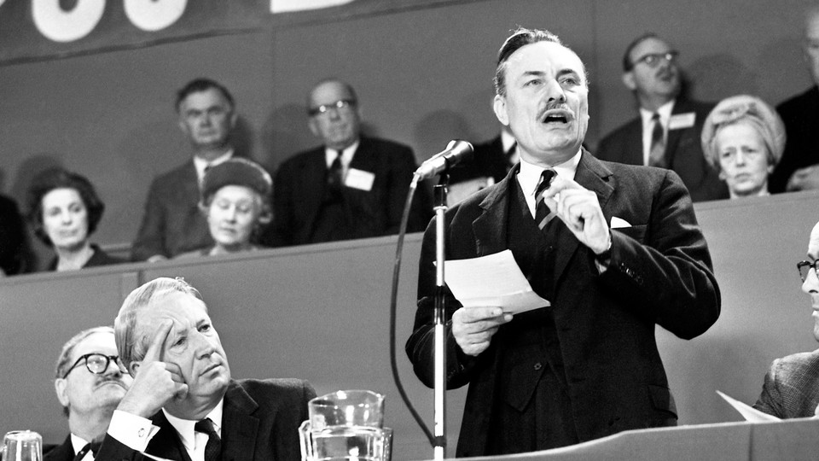
Enoch Powell’s ‘Rivers of Blood’ Speech
Reactions and Consequences
Image via The Atlantic

Slide 2
‘Rivers of Blood’
Speech given by Enoch Powell MP on April 20th 1968, Conservative Political Centre, Birmingham
“In this country in 15 or 10 years’ time, the Black man will have the whip hand over the white man.”
“Difficulties lie in the present but the evils to be prevented or minimised lie several parliaments ahead.”
“Alien element introduced into a country of population.”
“Entry to this country was admission to privileges and opportunities eagerly sought…the existing population found themselves made strangers in their own country.”
“The sense of being a persecuted minority which is growing among ordinary English people…is something that those without direct experience can hardly imagine.”
As I look ahead, I am filled with foreboding; like the Roman, I seem to see "the River Tiber foaming with much blood."

Slide 3
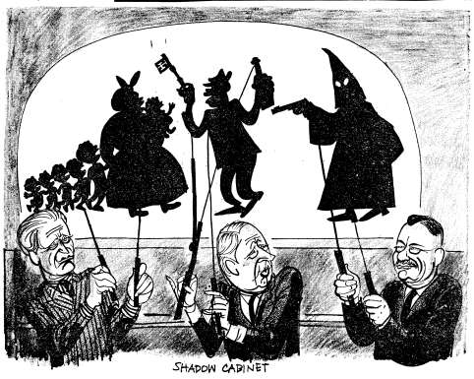
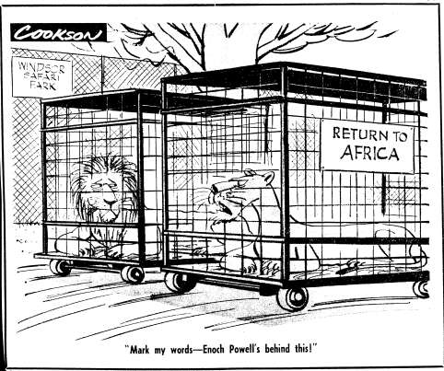
Arthur Horner, New Statesman, April 26th 1968
Bernard Cookson, Evening News, Feb. 22nd 1973

Slide 4
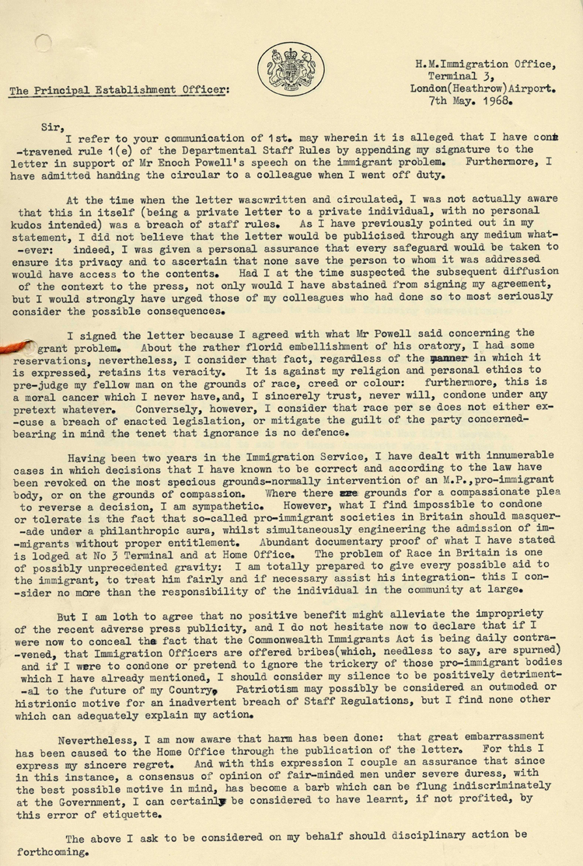
Letter from an immigration official at Heathrow Airport voicing support for Enoch Powell following his speech, May 7th 1968, via National Archives
Powell’s views on immigration were a decisive factor in the Conservative Party’s unexpected victory in the 1970 general election
Over 10,000 letters sent in support, the most a politician has ever received in such a small space of time
Sparked a string of racial attacks in Wolverhampton and across the country
75% of the British population agreed with Powell’s demand for non-white immigration to be halted completely
60% agreed with the call for the repatriation of non-whites already resident in Britain

