Slide 1
Foreign Bodies: African Mobility Unit
Professor Roberta Bivins
Centre for the History of Medicine
University of Warwick
peopleshistorynhs.org

Slide 2
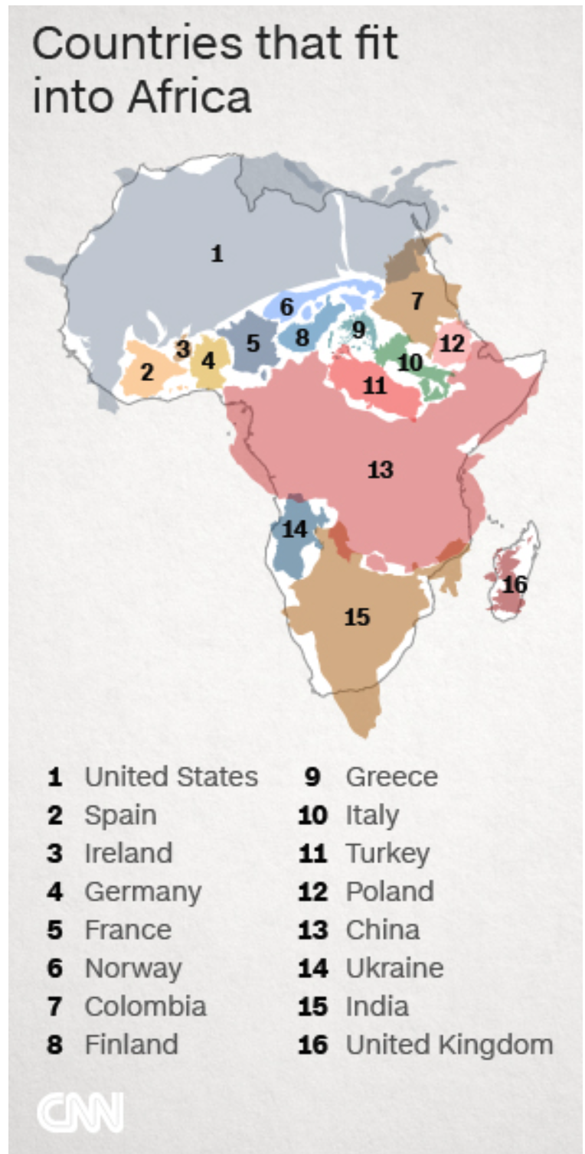
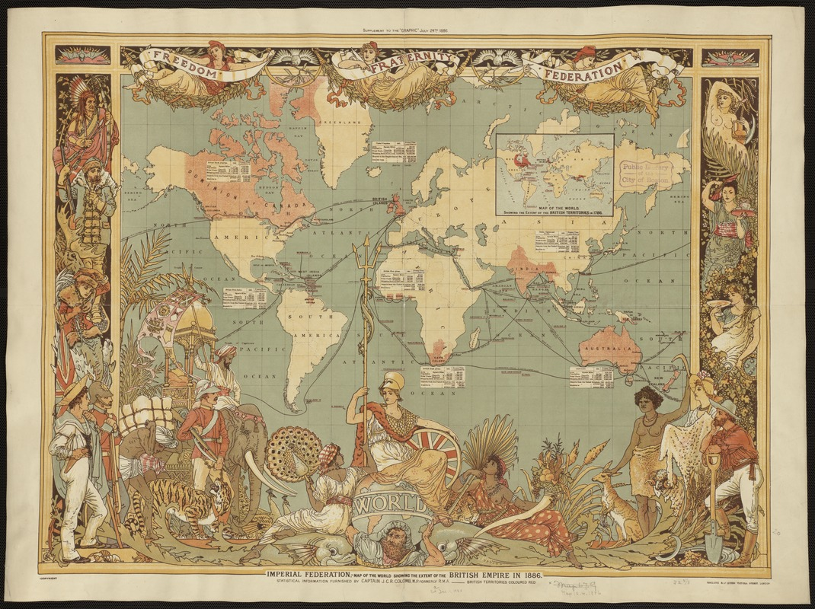
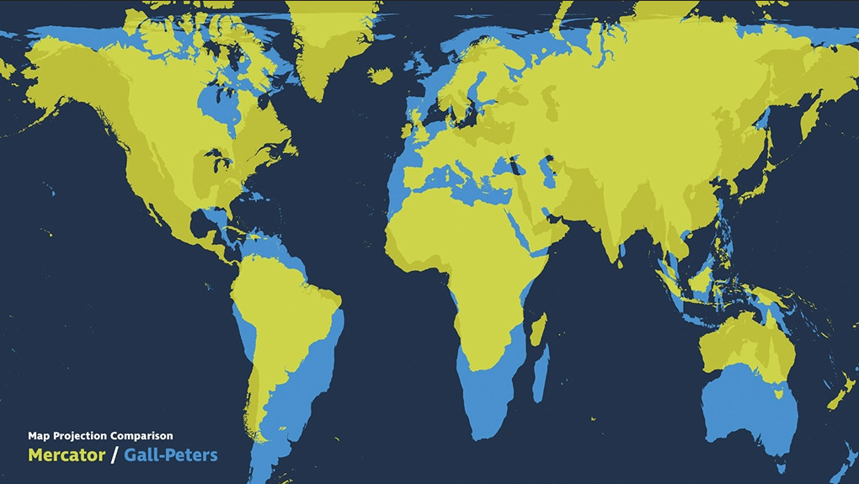
Mapping Africa in the World
Mercator Projection Map of the World Imperial Federation ‘British Empire in 1886’.
Mercator Projection vs Gall-Peters

Slide 3
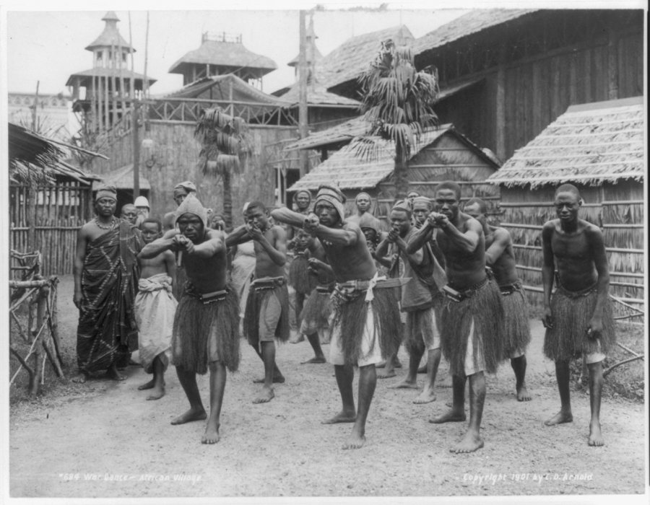
What do you see when you think about African mobility?
With your archive group, choose an image or headline that represents your view of African mobility in the past, and another that represents African mobility today. Use the historical newspaper archives, image collections like Google Arts and Culture or the Empire Through the Lens exhibition or full collection; the resource of the FCO collections at KCL or any other archive or collection you prefer.
Relate these images to the ‘Middle Passage epistemology’ and ‘post-war epistemology’.
“War Dance — African Village.” Buffalo Worlds Fair, 1901 The representation of Africans and African Americans at the world’s fair drew protests. (C.D. Arnold/Library of Congress Prints and Photographs Division)

Slide 4
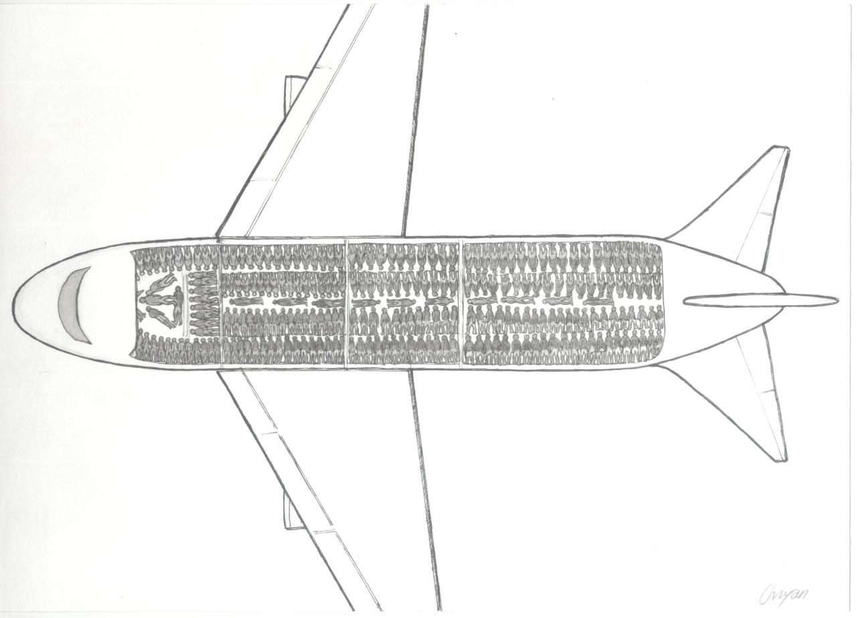
Oviyan Arts ‘Charter Flight’, 2013

Slide 5
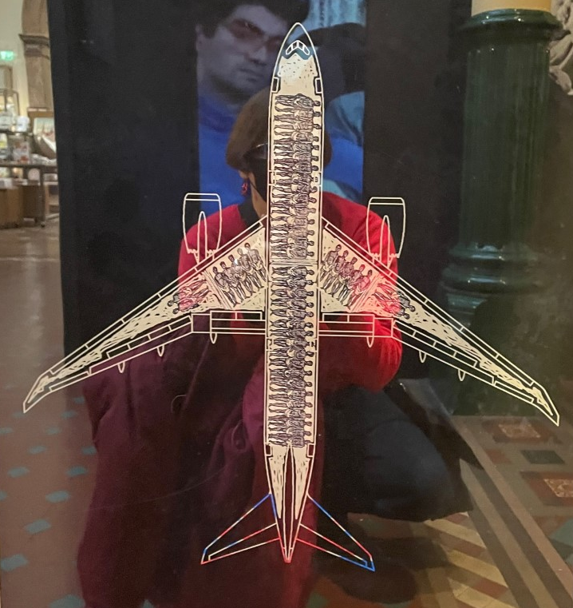
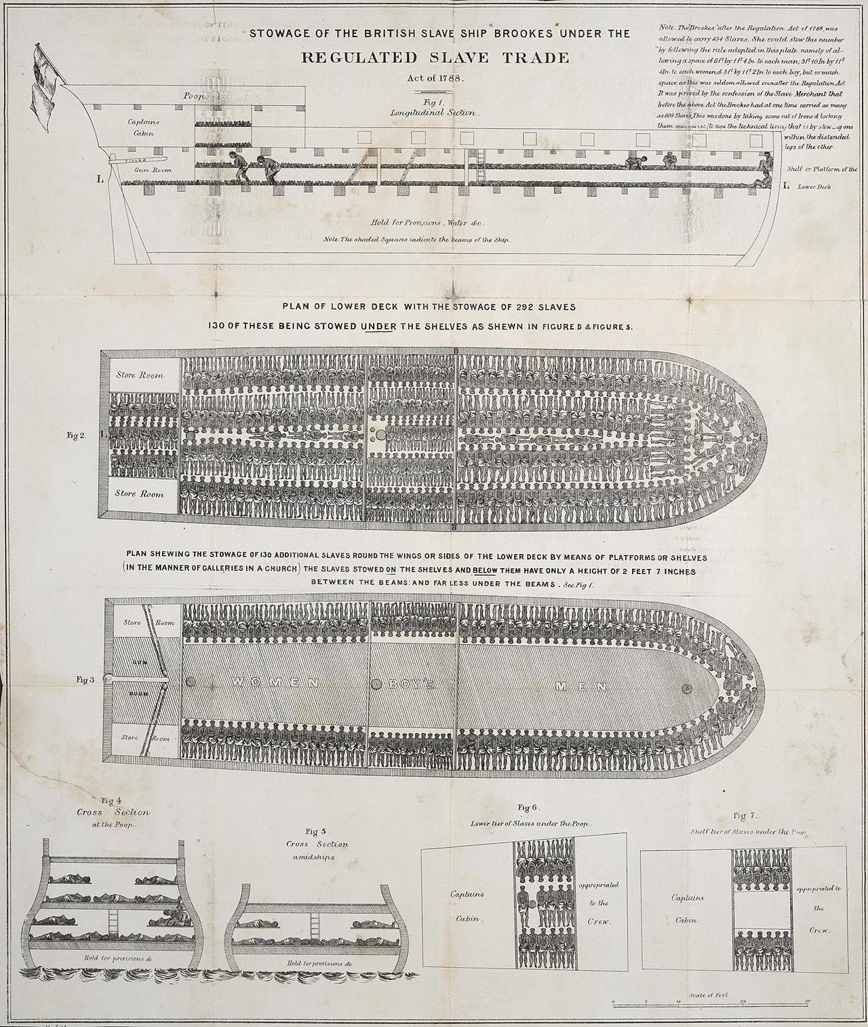
Seeing African Mobility
By Plymouth Chapter of the Society for Effecting the Abolition of the Slave Trade - This image is available from the United States Library of Congress’s Prints and Photographs Division under the digital ID cph.3a34658.
‘Black Lash’ Birmingham Museum and Art Gallery, 2022

Slide 6
From the Readings
What do you think about Donald Martin Carter’s turn to fictions and cultural representations to understand ‘Afro-Europe’? What are the strengths and weaknesses of these sources?
How can we handle the tension between ‘the romance of the local’ (in Zeleza) and ideas of ‘global forces’ at work in mobilizing Africans and in reactions to them?
Compare Zeleza’s response to the ‘African-Americanization of Afro-Europe and Afro-Asia’ with Michelle Wright’s critique of the ‘Middle Passage epistemology’. Which one will handle African mobility better? Do the leave out the same phenomena, groups, individuals?

