Slide 1
Foreign Bodies: Imperial Pasts, Migrant Presences
Professor Roberta Bivins
Centre for the History of Medicine
University of Warwick
peopleshistorynhs.org

Slide 2
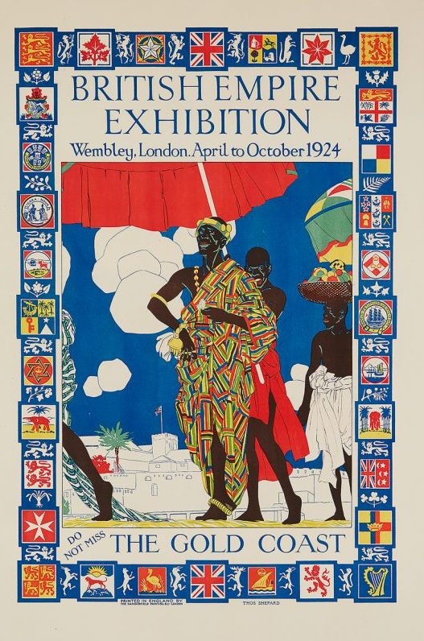
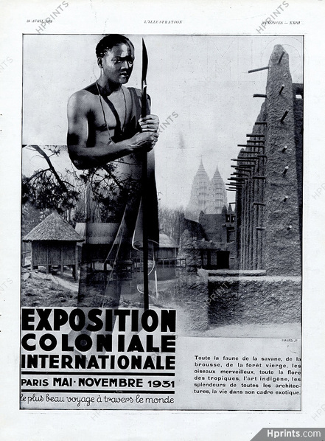
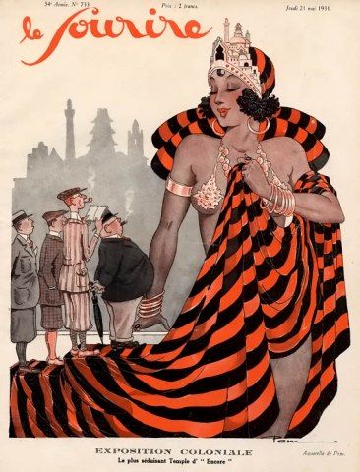
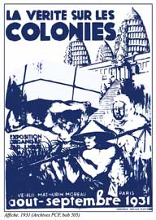
‘Africa’ in Imperial Europe and ‘Empire-curious’ America
Advertisements and coverage of the Exposition Coloniale Internationale, Paris 1931, and anti-imperialist counter-exhibition
Thomas Shepherd, ‘British Empire Exhibition: The Gold Coast’, 1924 See more here

Slide 3
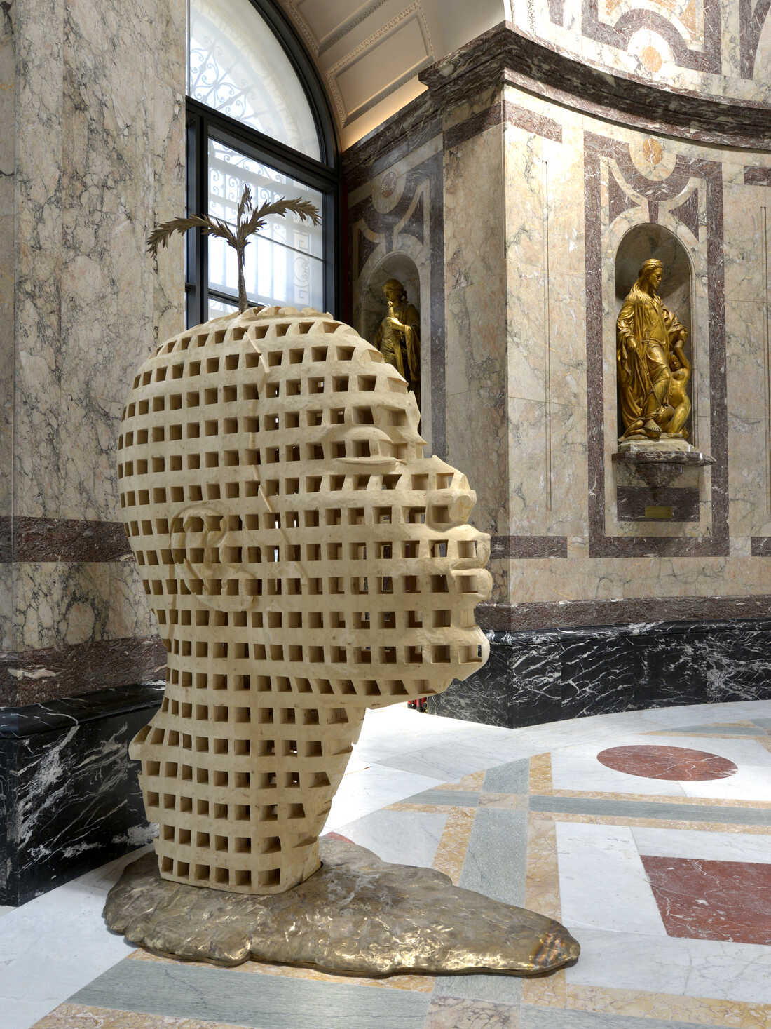
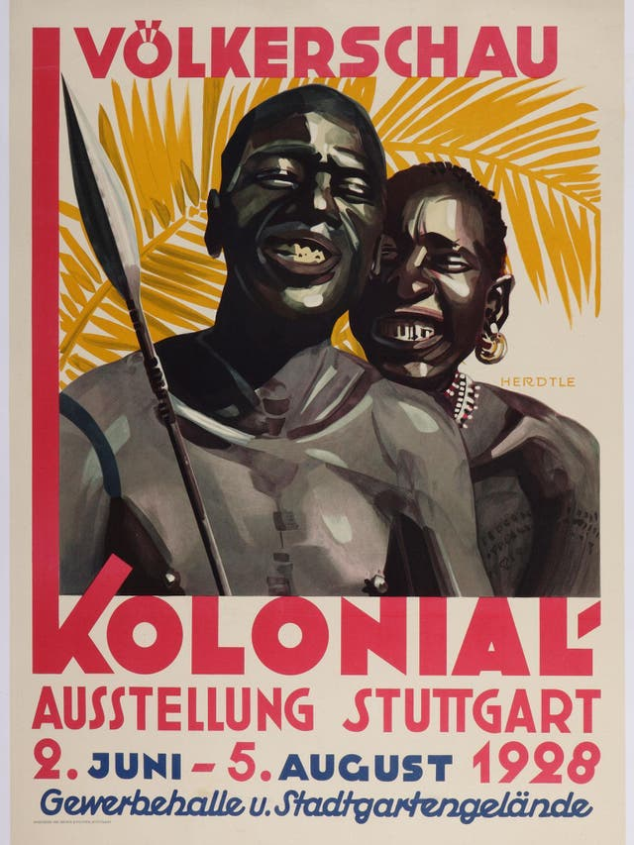
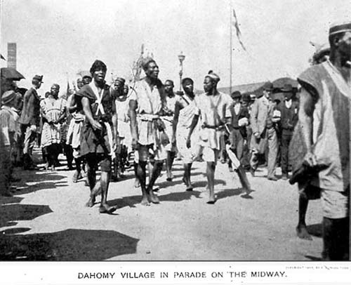
State representation vs Self-Representation
"Dahomey Village in Parade on the Midway," 1893 World's Columbian Exposition in Chicago. Courtesy Special Collections and Preservation Division, Chicago Public Library.
Stuttgart Colonial Exposition Advertising Poster, 1928
The Aimé Mpane sculpture "Congo, New Breath" greets visitors to the remodeled Royal Museum for Central Africa. Jo Van de Vijver/RMCA, Tervuren
Read/listen for more: NPR ‘Human Zoos’; BBC ‘Human Zoos’

Slide 4


Slide 5
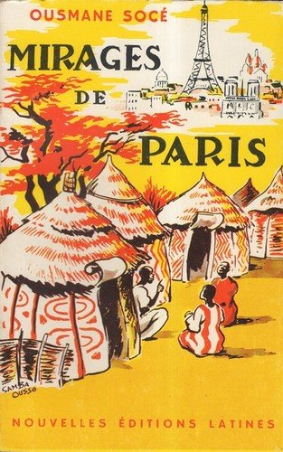
Working with the Readings
Thinking critically, do these studies escape the ‘romance of the local’? What about the ‘African-Americanization of Afro-Europe and Afro-Asia’?
What differences and what similarities do you find between the scholarly accounts and the first person ones? Compare the account of Coulibaly and Slava Tines’ articles, or Emechta and Whittall’s chapter.
What do you think about the Boittin piece about terminology and self-fashioning amongst African and Afrio-Caribbean migrants to France?
How does it challenge existing narratives and theories of Afro-Europe?
What does it tell us about intra-community tensions?
And how SHOULD historians address the divisions and divisive issues recognised and utilised by communities – but nonetheless very sensitive…
Read more

Slide 6
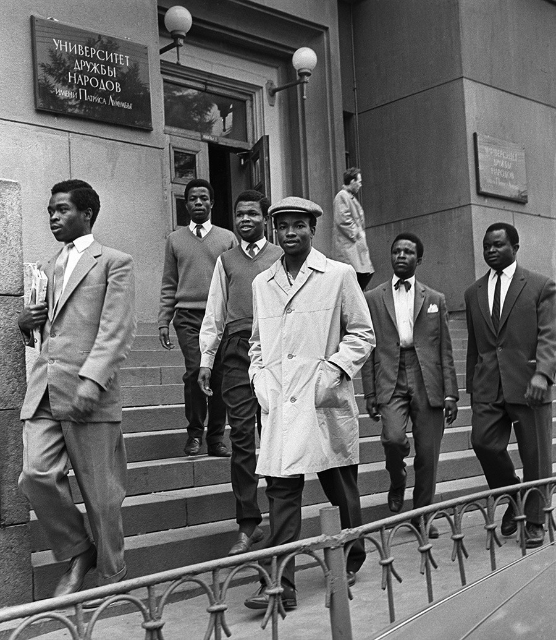
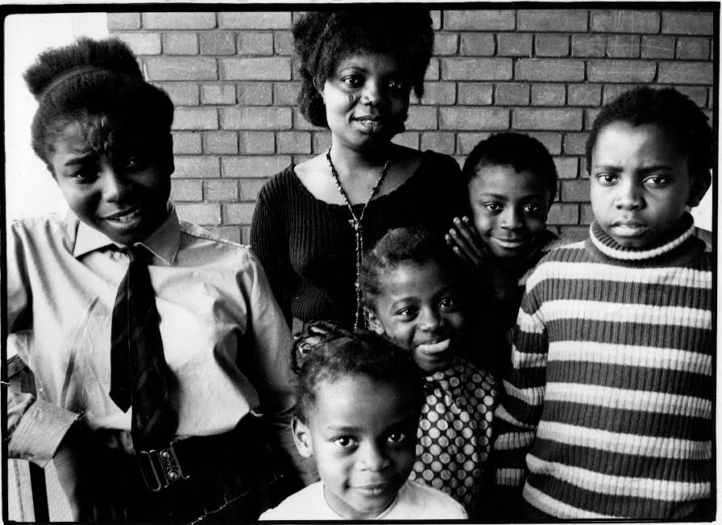
What do the autobiographical accounts add to the scholarly picture?
Buchi Emecheta, 1944-2017, with her five children. Photo courtesy of Sylvester Onwordi.
Students at the Patrice Lumumba University in Moscow.
Vladimir Minkevich/Sputnik

