Slide 1
Homelands and Hostlands: hybrid homes or multiple identities
Professor Roberta Bivins
Centre for the History of Medicine
University of Warwick
peopleshistorynhs.org

Slide 2
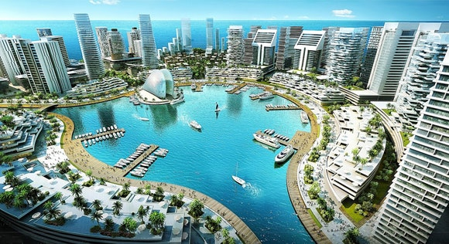
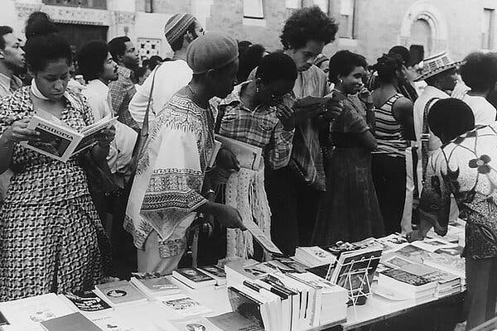
African Mobility, African Capitalism?
When we ‘provincialize Europe’, does that change what the ‘isms’ look like too?
Similarly, if we de-center anglo-normativity and national myths, do we also change feminism, ‘ability’, or even ‘Afrocentrism’?
People browsed at an early iteration of the African Street Festival, now called the International African Arts Festival, which grew out of The East and celebrated its 50th anniversary last summer. Credit...Ron Warwell and Osei Chandler, NYT 2022
Notes:
https://www.nytimes.com/2022/02/11/nyregion/the-east-brooklyn-documentary.html

Slide 3
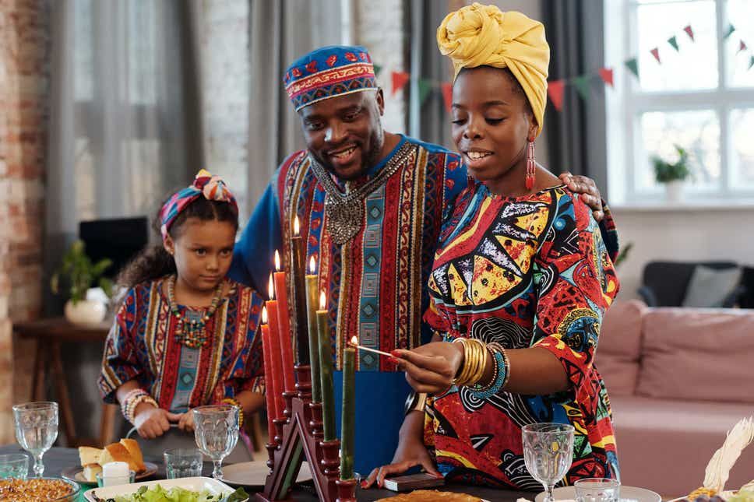
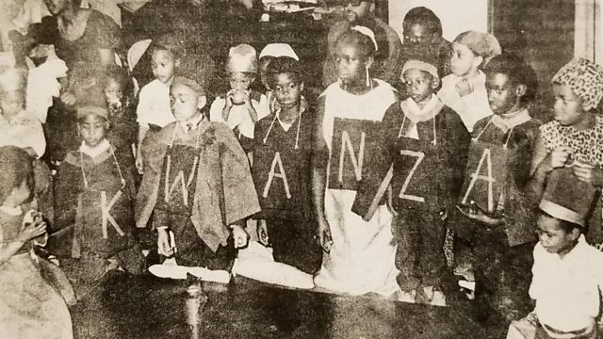
Kwanza: Buying (into) ‘Africa’?
The first Kwanza, Los Angeles, 1966
Kwanza as depicted in the Evening Standard, 2022
(NB: Compare to the re-invention of modern Christmas in the US or UK: from a festival of misrule to a consumerist family celebration)

Slide 4
Discussion
Ask your neighbours:
Is Afrocentrism a culture of resistance, or of reconstruction?
Does marketisation change the meaning or dynamics of Afrocentric interventions (e.g. Kwanza)?
What does ‘Afrocentrism’ mean for African migrants?

Slide 5
The Big Question
In this unit we have looked at African migrants in France, Britain, USSR, and USA.Looking across these examples,
How do and how should migrants manage their intersectional identities? Do plural identities dilute or multiply belonging?

Slide 6
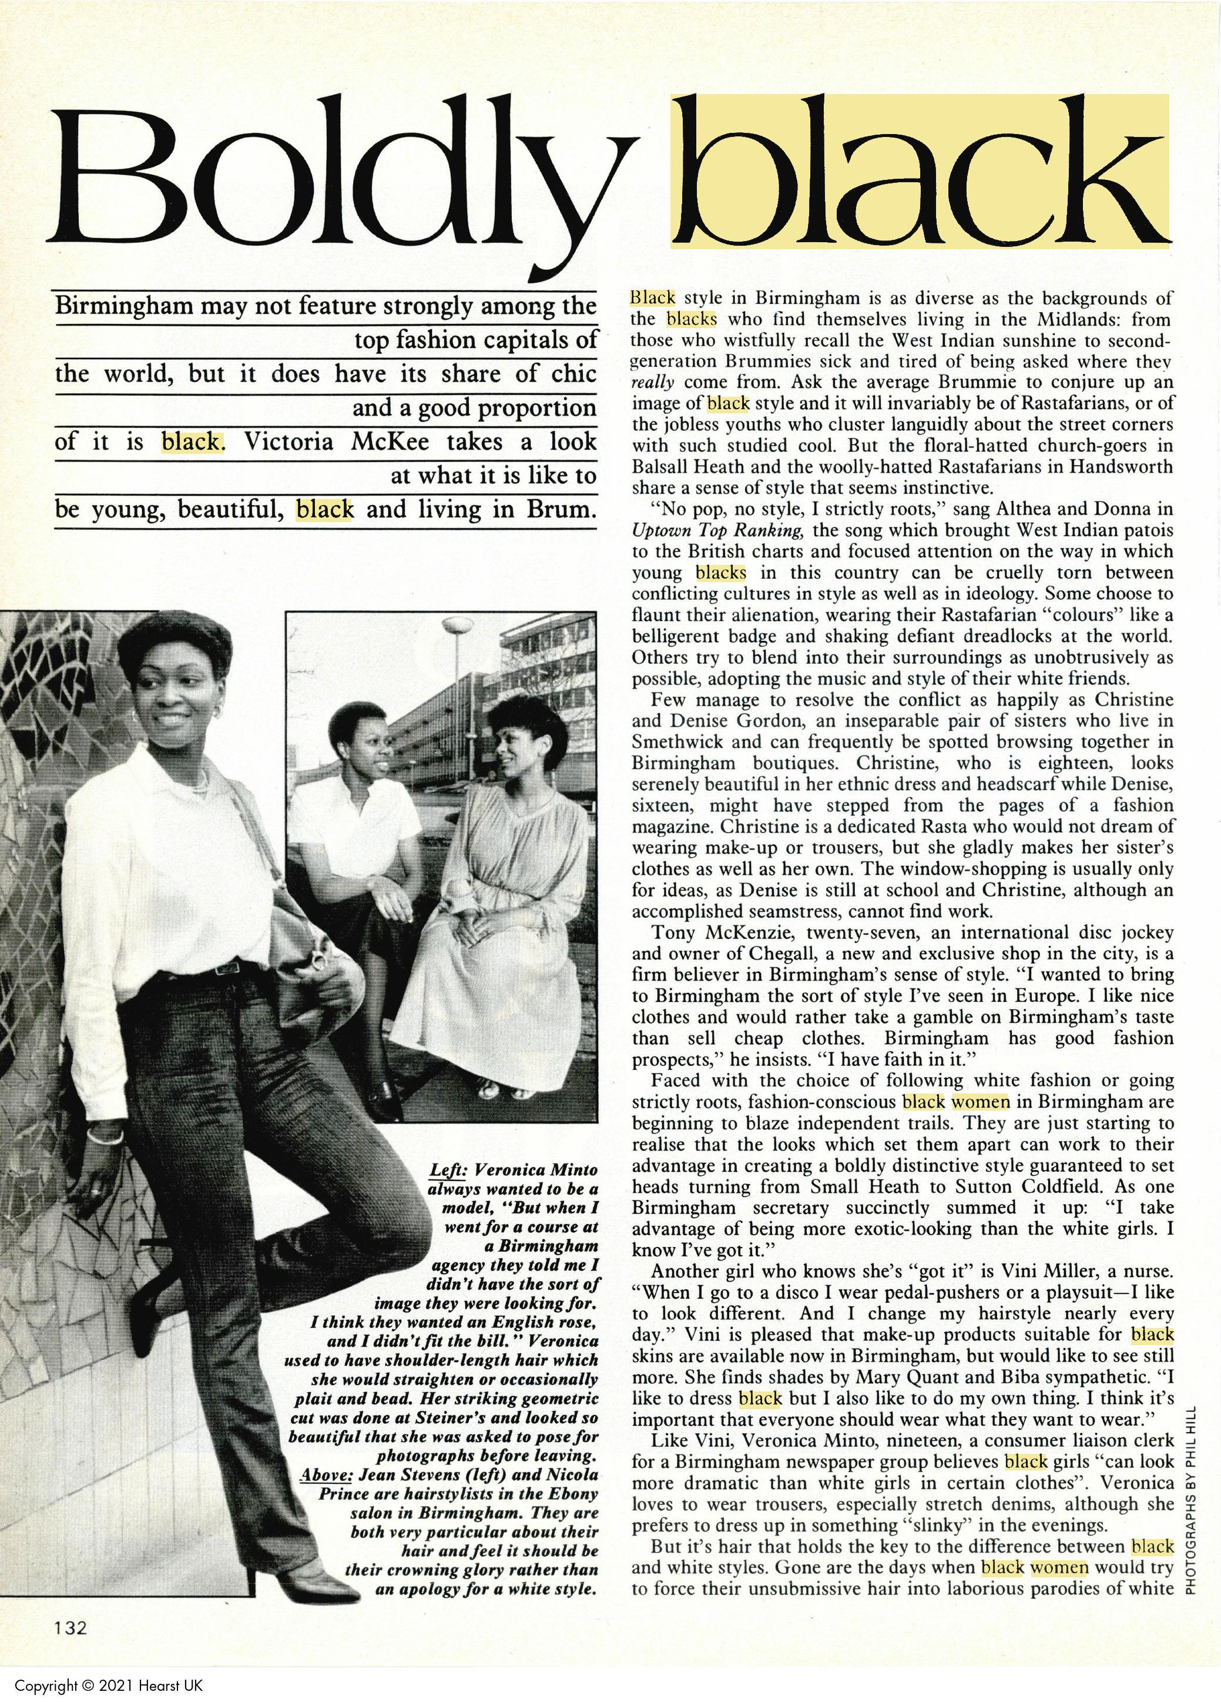
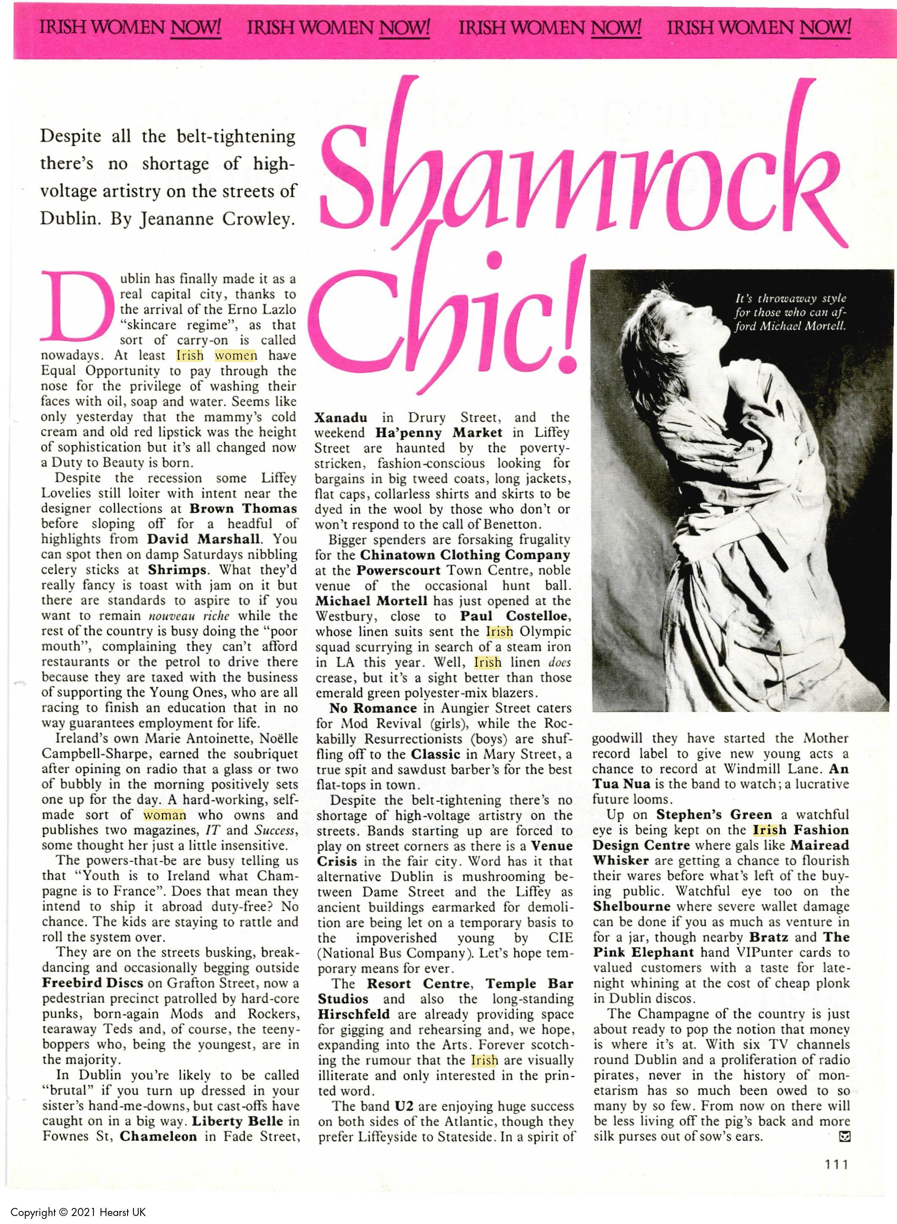
Black Women in the Media
With your group:
Explore representations of Black Women in the British Media via:
Race Today (a magazine produced by the Institute of Race Relations and then the Brixton-based Race Today Collective)
AND in one of the following:
Spare Rib (a radical feminist magazine led by largely White feminists with varying levels of Black and Asian representation)
OR British Cosmopolitan (a mainstream British fashion and lifestyle magazine via the Women’s Magazine Archive database in the Library)
COMPARE with representations of women from any other minoritized ethnic group.

