Slide 1
Module Archive Group 5: Naming to Control

Slide 2
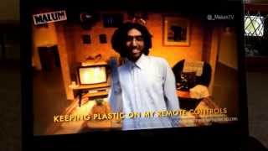
Source 1
Being a Freshie’s Cool (Mawaan Rizwan), 2012

Slide 3
Being a freshie's cool (Mawaan Rizwan 2012)
CHORUS: All my life I've been a Freshie
My Mum and Dad are Freshie too
Join my gang of Freshies
It's time to know – being a Freshie is cool
Fresh off the boat with a student visa
Work in a chicken shop on Green Lane
Came to the country in a silk kurta
Exchanged that in for a chav's gold chain
In my car, a gold and red tissue box
Perving on young girls on the bus
They all run away
Why they run away?
Import, export, socks with flip flops
Hairy arms, hairy brow, curry house, sweet shop
Yes I am a bad man, rasta man, blood clot
Rollin’ in my Honda blasting Indian hip hop – yaar
Giving wrong change in my corner shop
Charming the white girls with my swagger on lock
Side parting with the greasy top
Olive oil in my hair and popping them spots
Playing Jay Sean on my speaker phone
Keeping plastic on my remote control
Walking round town taking tourist photos
To show my village children London life back at home.
Cleaning my ears with my set of car keys
Picking my nose while I'm walking down the street
Wearing fake Armani
And yes I voted BNP – No way!
CHORUS

Slide 4
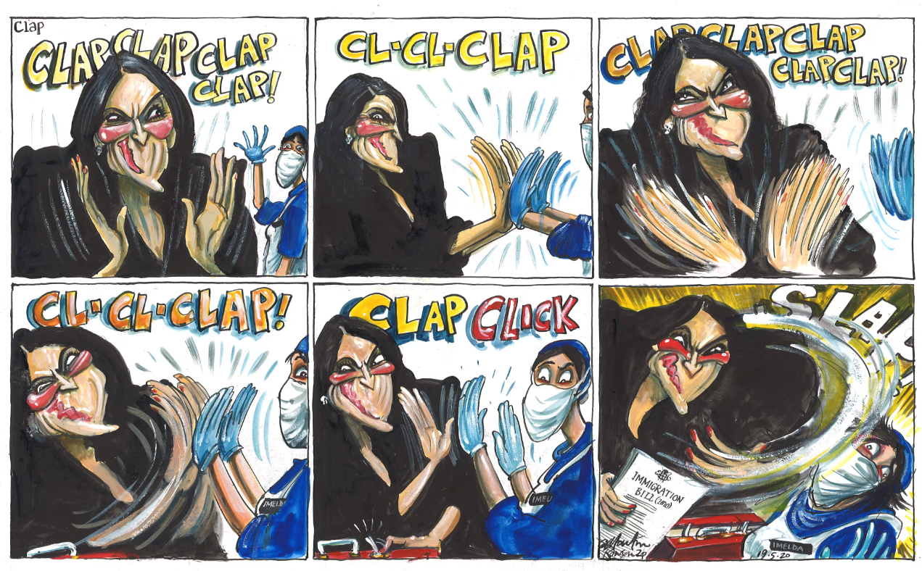
Source 2
Priti Patel, the NHS and Immigration, Martin Rowland for the Guardian (2020)

Slide 5
Source 2- Context
This cartoon refers to the The Immigration and Social Security Co-ordination (EU Withdrawal) Bill. The bill essentially marked the end of “the freedom of movement” for migrants from the EU. The NHS relies very widely on migrants to fill essential positions such as nurses.
I picked this source as it represents the extension of animosity to not just migrants of colour, but migrants in general, despite the fact the UK is heavily reliant on migrants. It shows a very important and current political priority, of ‘ending’ multiculturalism over maintaining essential institutions like the NHS.It is a brilliant call-back to arguments about what is ‘truly’ British.

Slide 6
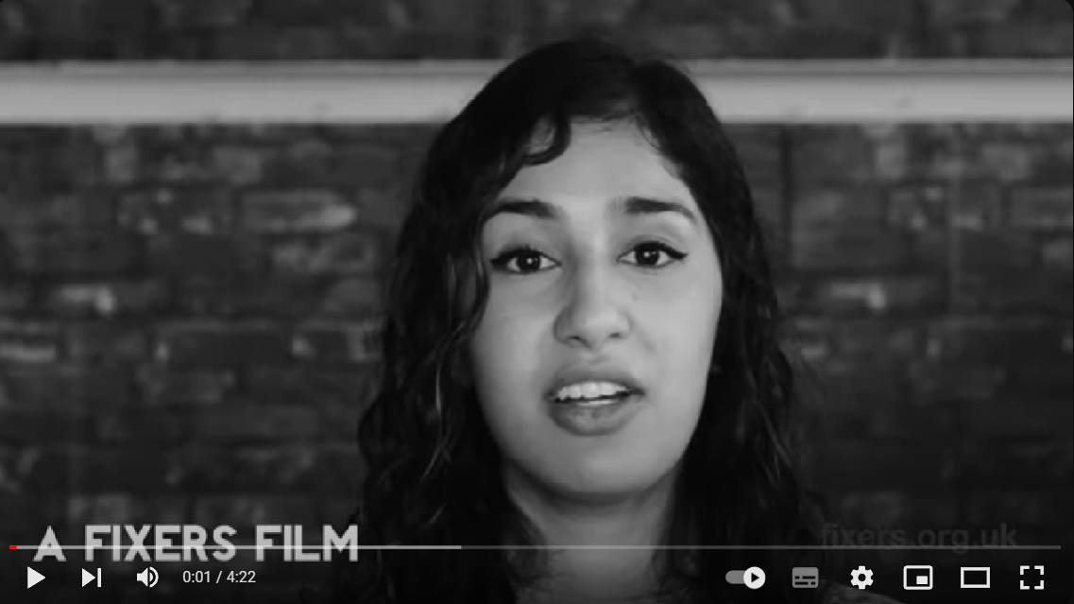
Source 3
Multicultural Britain- experiences of second generation migrants.

Slide 7
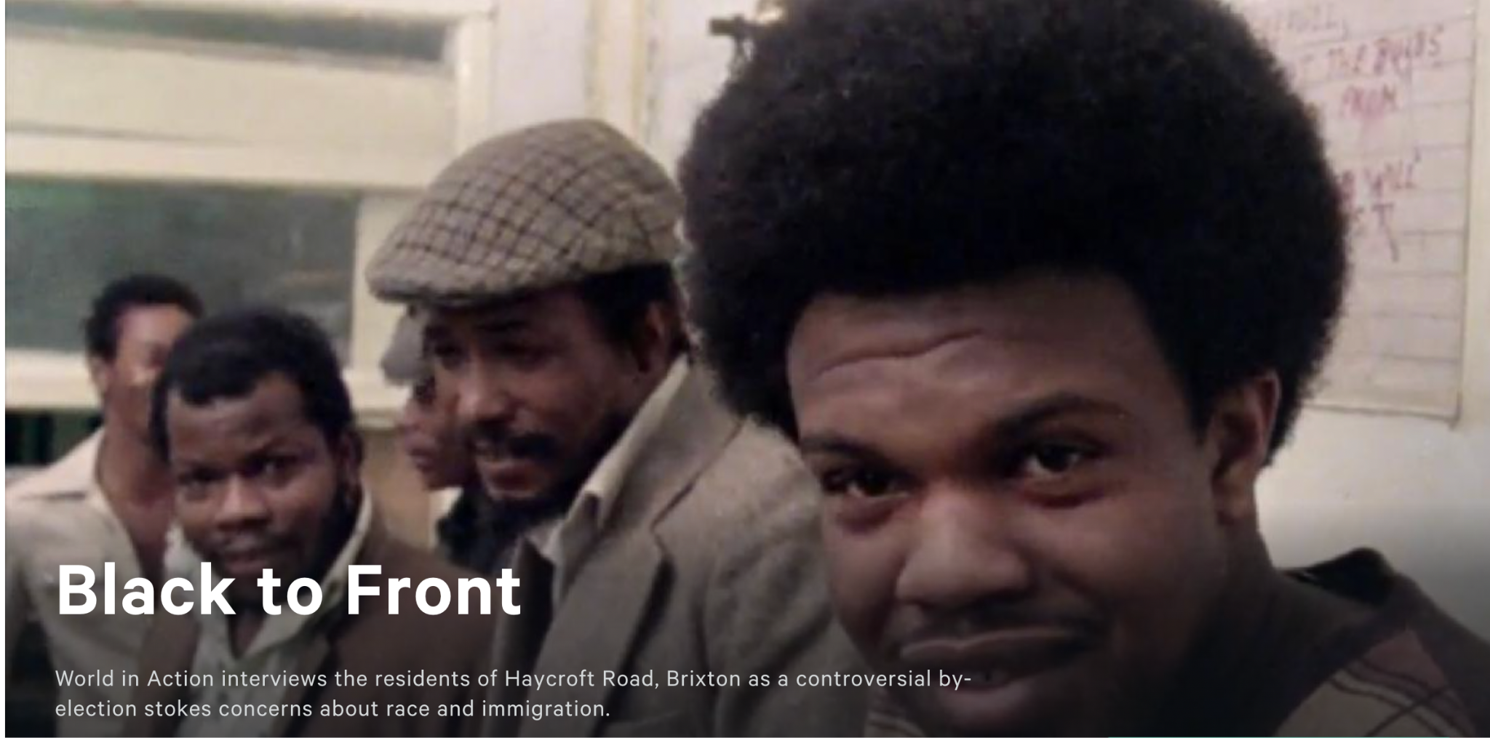
Source 4:

Slide 8

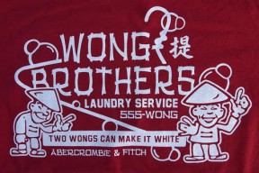
Source 5

Slide 9
