Slide 1
Naming to Control
Professor Roberta Bivins
Centre for the History of Medicine
University of Warwick
peopleshistorynhs.org

Slide 2
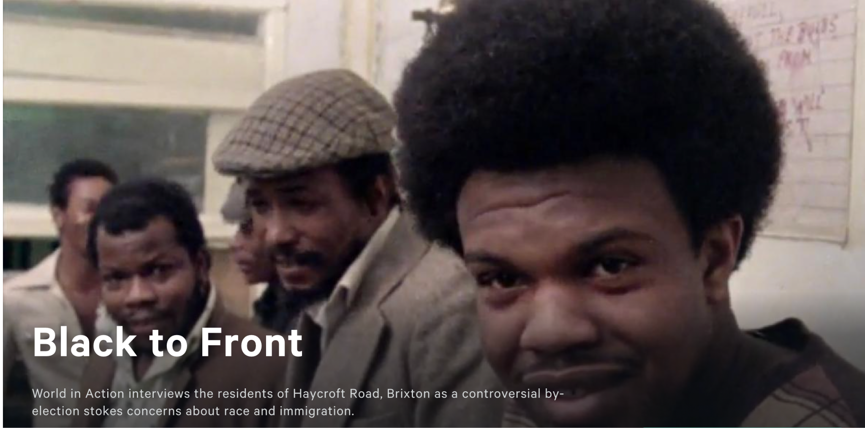
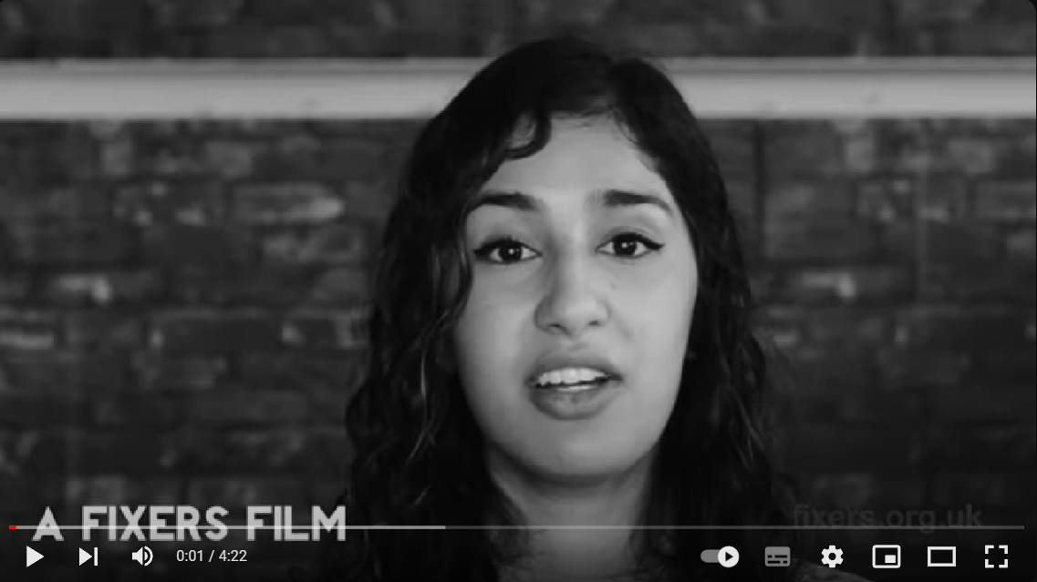
The power of naming: Two perspectives
Black To Front, 1978
Multicultural Britain, 2017

Slide 3
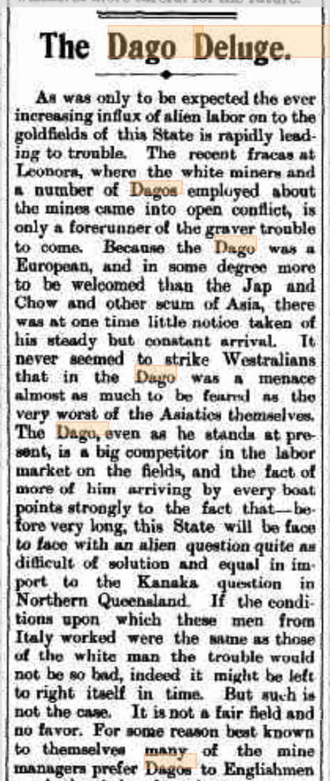
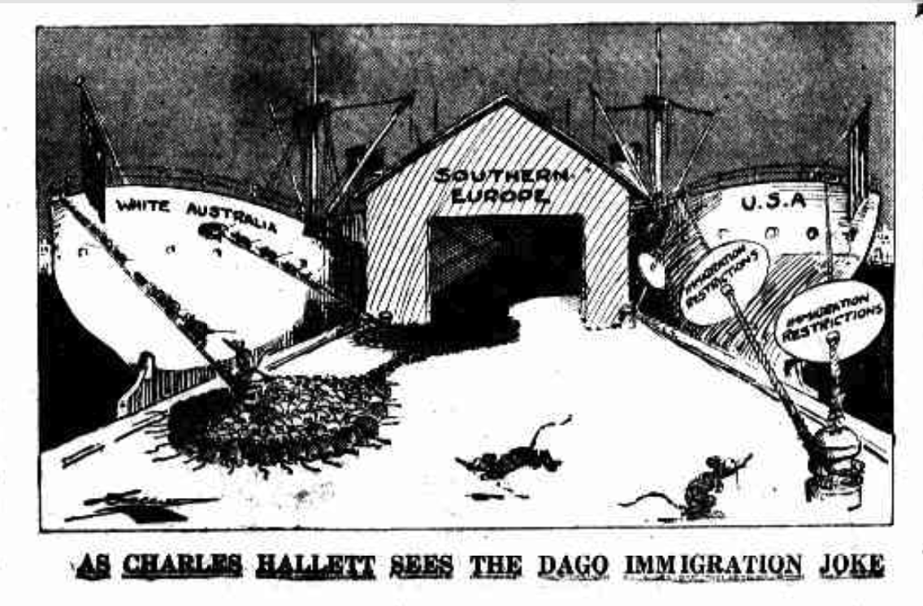
Why do we name (-call) immigrants?
As was only to be expected the ever increasing influx of alien labor on to the goldfields of this State is rapidly leading to trouble….. Because the Dago was a European, and in some degree more to be welcomed than the Jap and Chow and other scum of Asia, there was at one time little notice taken of his steady but constant arrival, never seemed to strike Westralians that in the Dago was a menace almost as much to be feared as the very worst of the Asiatics themselves. The Dago, even as he stands at present, is a big competitor in the labor market on the fields… If the conditions upon which these men from Italy worked were the same as those of the white man the trouble would not be so bad, indeed it might be left to right itself in time. But such is not the case… White miners are getting tired of seeing their places filled by unskilled, cheap labor from the shores of the Mediterranean. …These men do not bring their womankind here, and being of a low moral caste they cannot intermarry with our people any more than the Chows and Japs can. They cannot, therefore, be looked upon as desirable immigrants—they are most undesirable. They do not settle upon the land, neither do they develop any of our resources. They simply undercut the workman in wages, and save and hoard their scanty earnings with the one set purpose of returning to their native land as comparatively rich men. Some stricter testing of these men will have to be made upon their landing, and if they cannot come up to the mark they should be bundled back bag and baggage. Westralia wants population badly enough, but we can well afford to wait—for years if need be, and get people of our own race—in preference to harboring this scum of Europe
‘As Chales Hallett Sees The Dago Immigration Joke’, Smith’s Weekly, 9 July 1927, 14
https://freilich.anu.edu.au/news-events/blog/dago-wog-remembering-stinging-slurs#_ftn2
‘The Dago Deluge’, Truth, 20 February 1904, 2

Slide 4

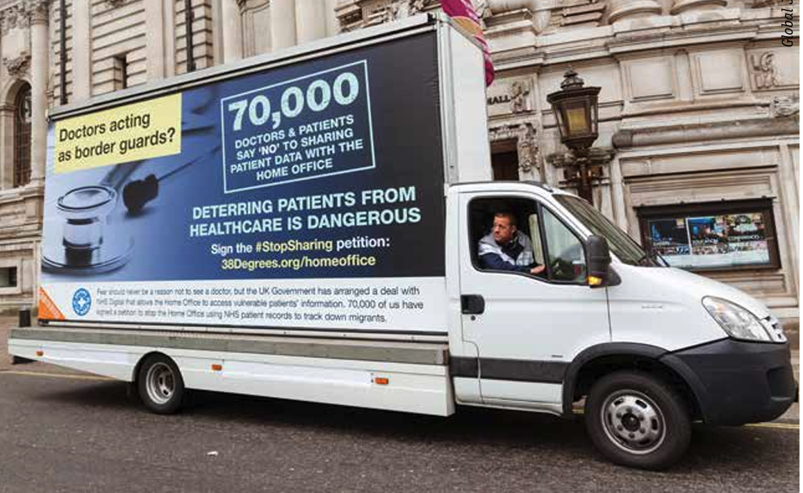
Discussion
In your groups:
Why do receiving communities name-call migrants and their communities? Have the names, or the rationales change over time in the UK? What about ‘naming’ in medicine and public health?
What, historically, have been the common themes, metaphors and memes used to denigrate migrants and their descendants? What does this tell us about receiving societies?
What happens to slurs as migrants and communities settle and become citizens? To what degree are migrants and communities about to resist the controlling power of ‘naming’?

Slide 5
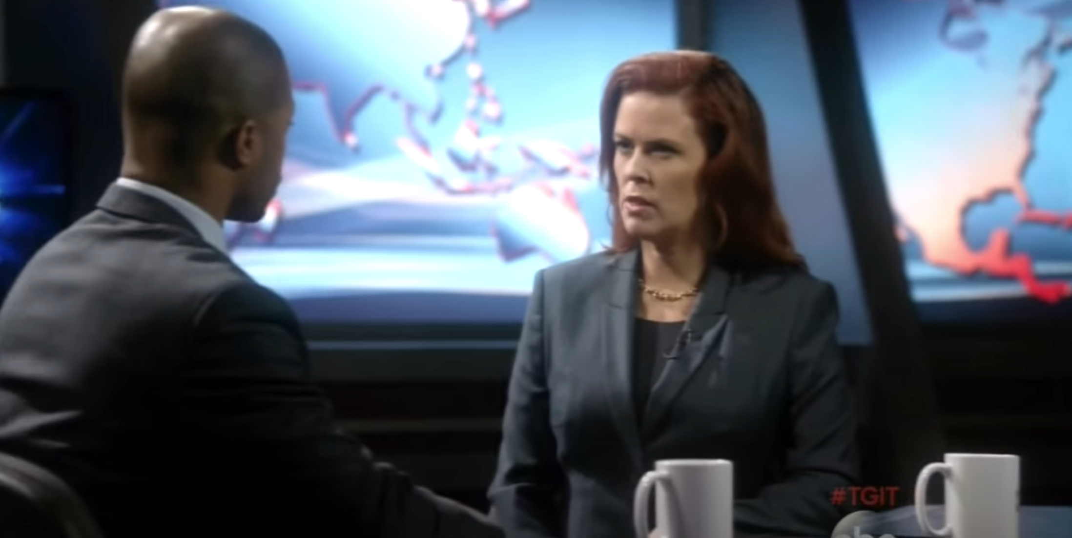
‘Dog Whistle Politics’

Slide 6
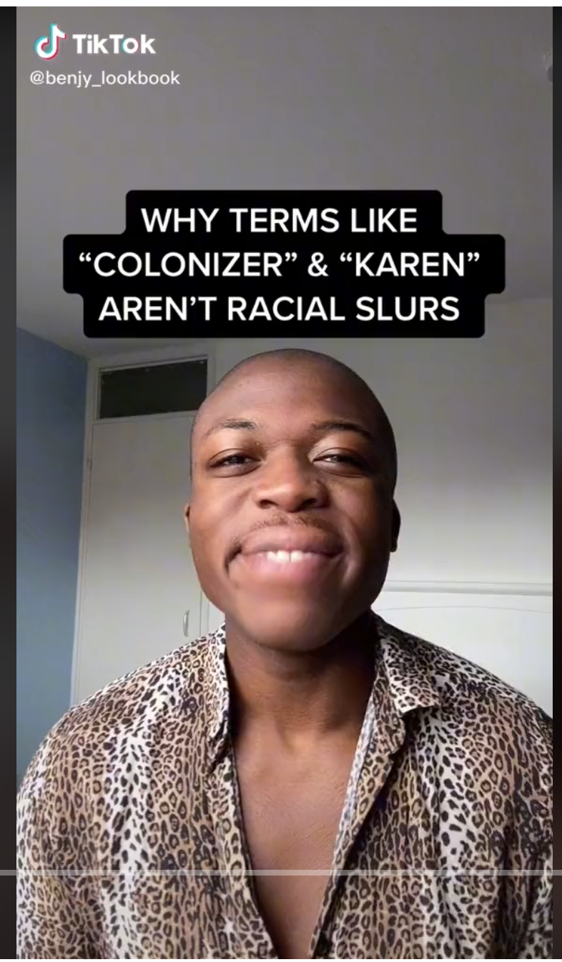
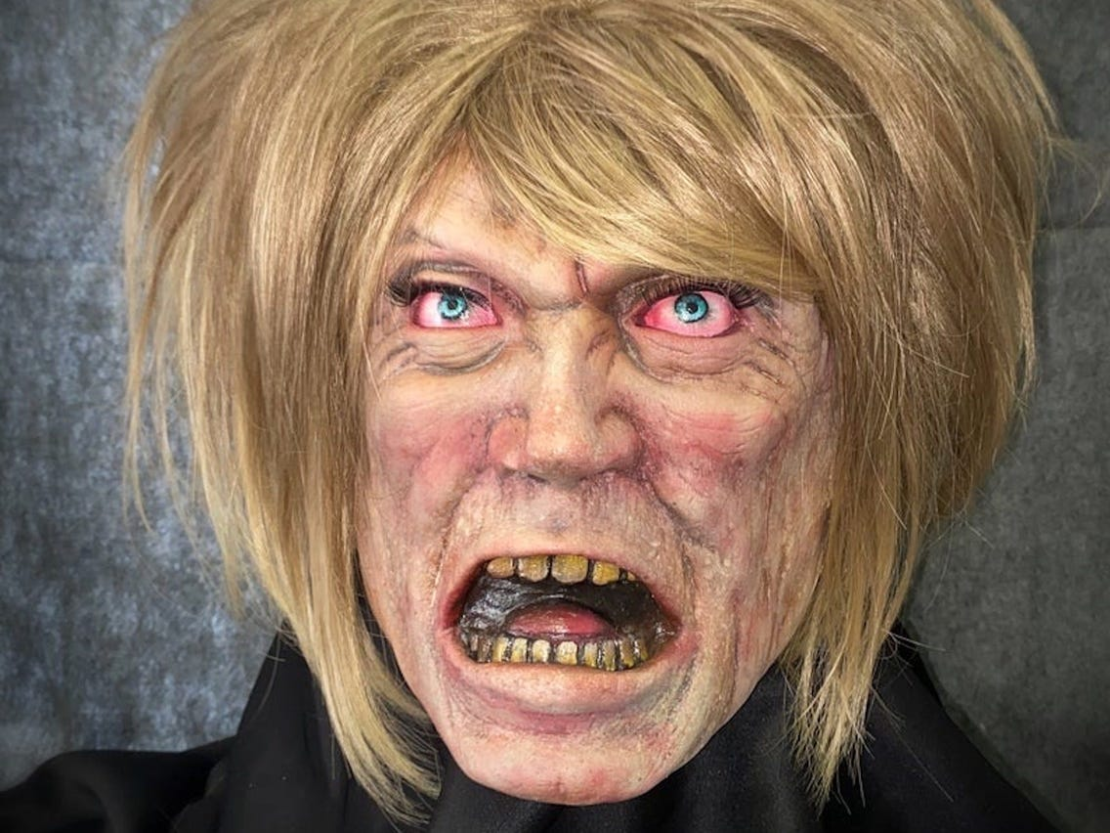
Are all slurs evident? Equal?
The ‘Karen’ Halloween Mask of 2020
What isn’t a racial slur?

Slide 7
Discussion
In your groups:
Start with a quick round of Foreign Bodies ‘Taboo’. As you play, think about the challenges posed by the human instinct to name, categorise and simplify in an area as complex as human mobility and belonging. How easy or hard is it to convey your term without falling into easy habits of speech and language?
Next, discuss the Pilkington reading. Were you shocked? Surprised? Did you recognise the tropes and fears being expressed? Did you find the testimony credible?

Slide 8
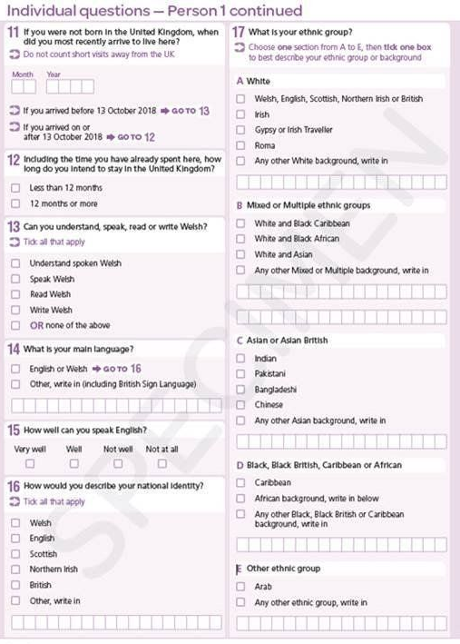
Naming to control, part 2
Thinking about the BMJ article and the 2021 census, what does it teach us about the power – positive and/or negative – of categorization and ‘naming’ in the real world?

Slide 9
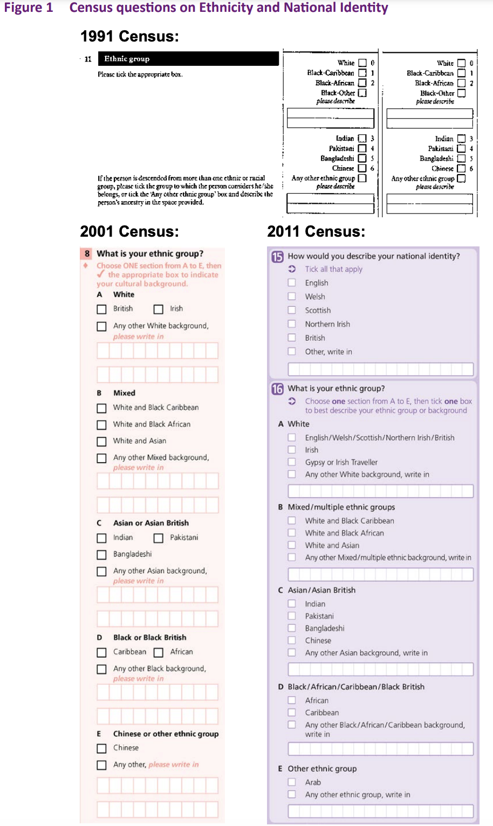
What might the changes in the census categories tell us?
Ethnicity data was collected for the first time on the 1991 census. It has since been collected on every census, inc. 2021 →

Slide 10
Module Feedback Day
Yes, here we are again! Please do share with me all the thoughts you may have about this module, using the form here:
https://warwick.ac.uk/fac/arts/history/students/currentug/modulefeedbackform/
You are group number 1 if we meet between 11 and 1 pm.
You are group number 2 if we meet from 2-4 pm.
THANK YOU! It is students like you who have helped me teach this module as creatively and inclusively as possible by always telling me what I’ve done right and what I could do better!
And don’t forget – we do meet next week and in T3, for our final essay workshop.

