Slide 1
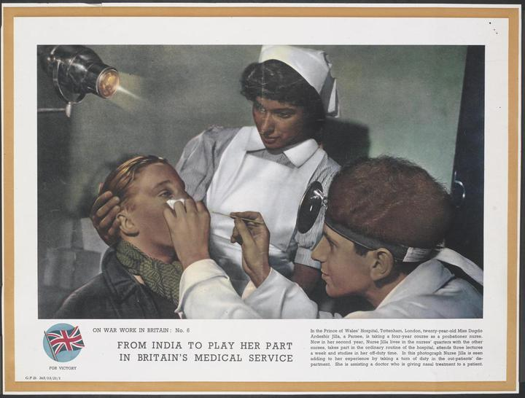
From Civis Britannicus Sum …
‘In a world in which restrictions on personal movement and immigration have increased we still take pride in the fact that a man can say Civis Britannicus sum whatever his colour may be, and we take pride in the fact that he wants and can come to the Mother country.’
Henry Hopkins, Minister of State, Colonial Affairs, 1954
© Crown Copyright. IWM http://www.iwm.org.uk/collections/item/object/33289
Notes:
ON WAR WORK IN BRITAIN: No. 6 FROM INDIA TO PLAY HER PART IN BRITAIN'S MEDICAL SERVICE In the Prince of Wales' Hospital, Tottenham, London, twenty-year-old Miss Dogdo Ardeshir Jilla, a Parsee, is taking a four-year course as a probationer nurse. Now in her second year, Nurse Jilla lives in the nurses' quarters with the other nurses, takes part in the ordinary routine of the hospital, attends three lectures a week and studies in her off-duty time. In this photograph Nurse Jilla is seen adding to her experience by taking a turn of duty in the out-patients' department. She is assisting a doctor who is giving nasal treatment to a patient.
COLONIAL IMMIGRANTS
HC Deb 05 November 1954 vol 532 cc821-32

Slide 2
…To ‘country of origin’ screening (for some), NHS surveillance (for others)
2016
2005

Slide 3
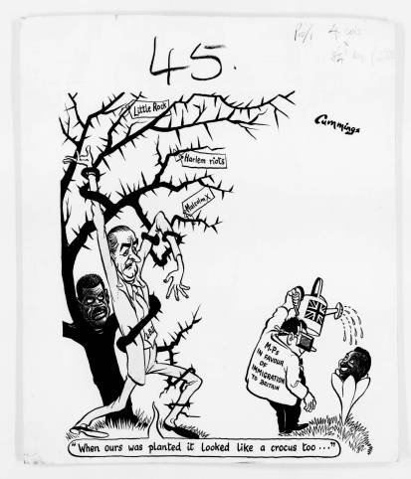
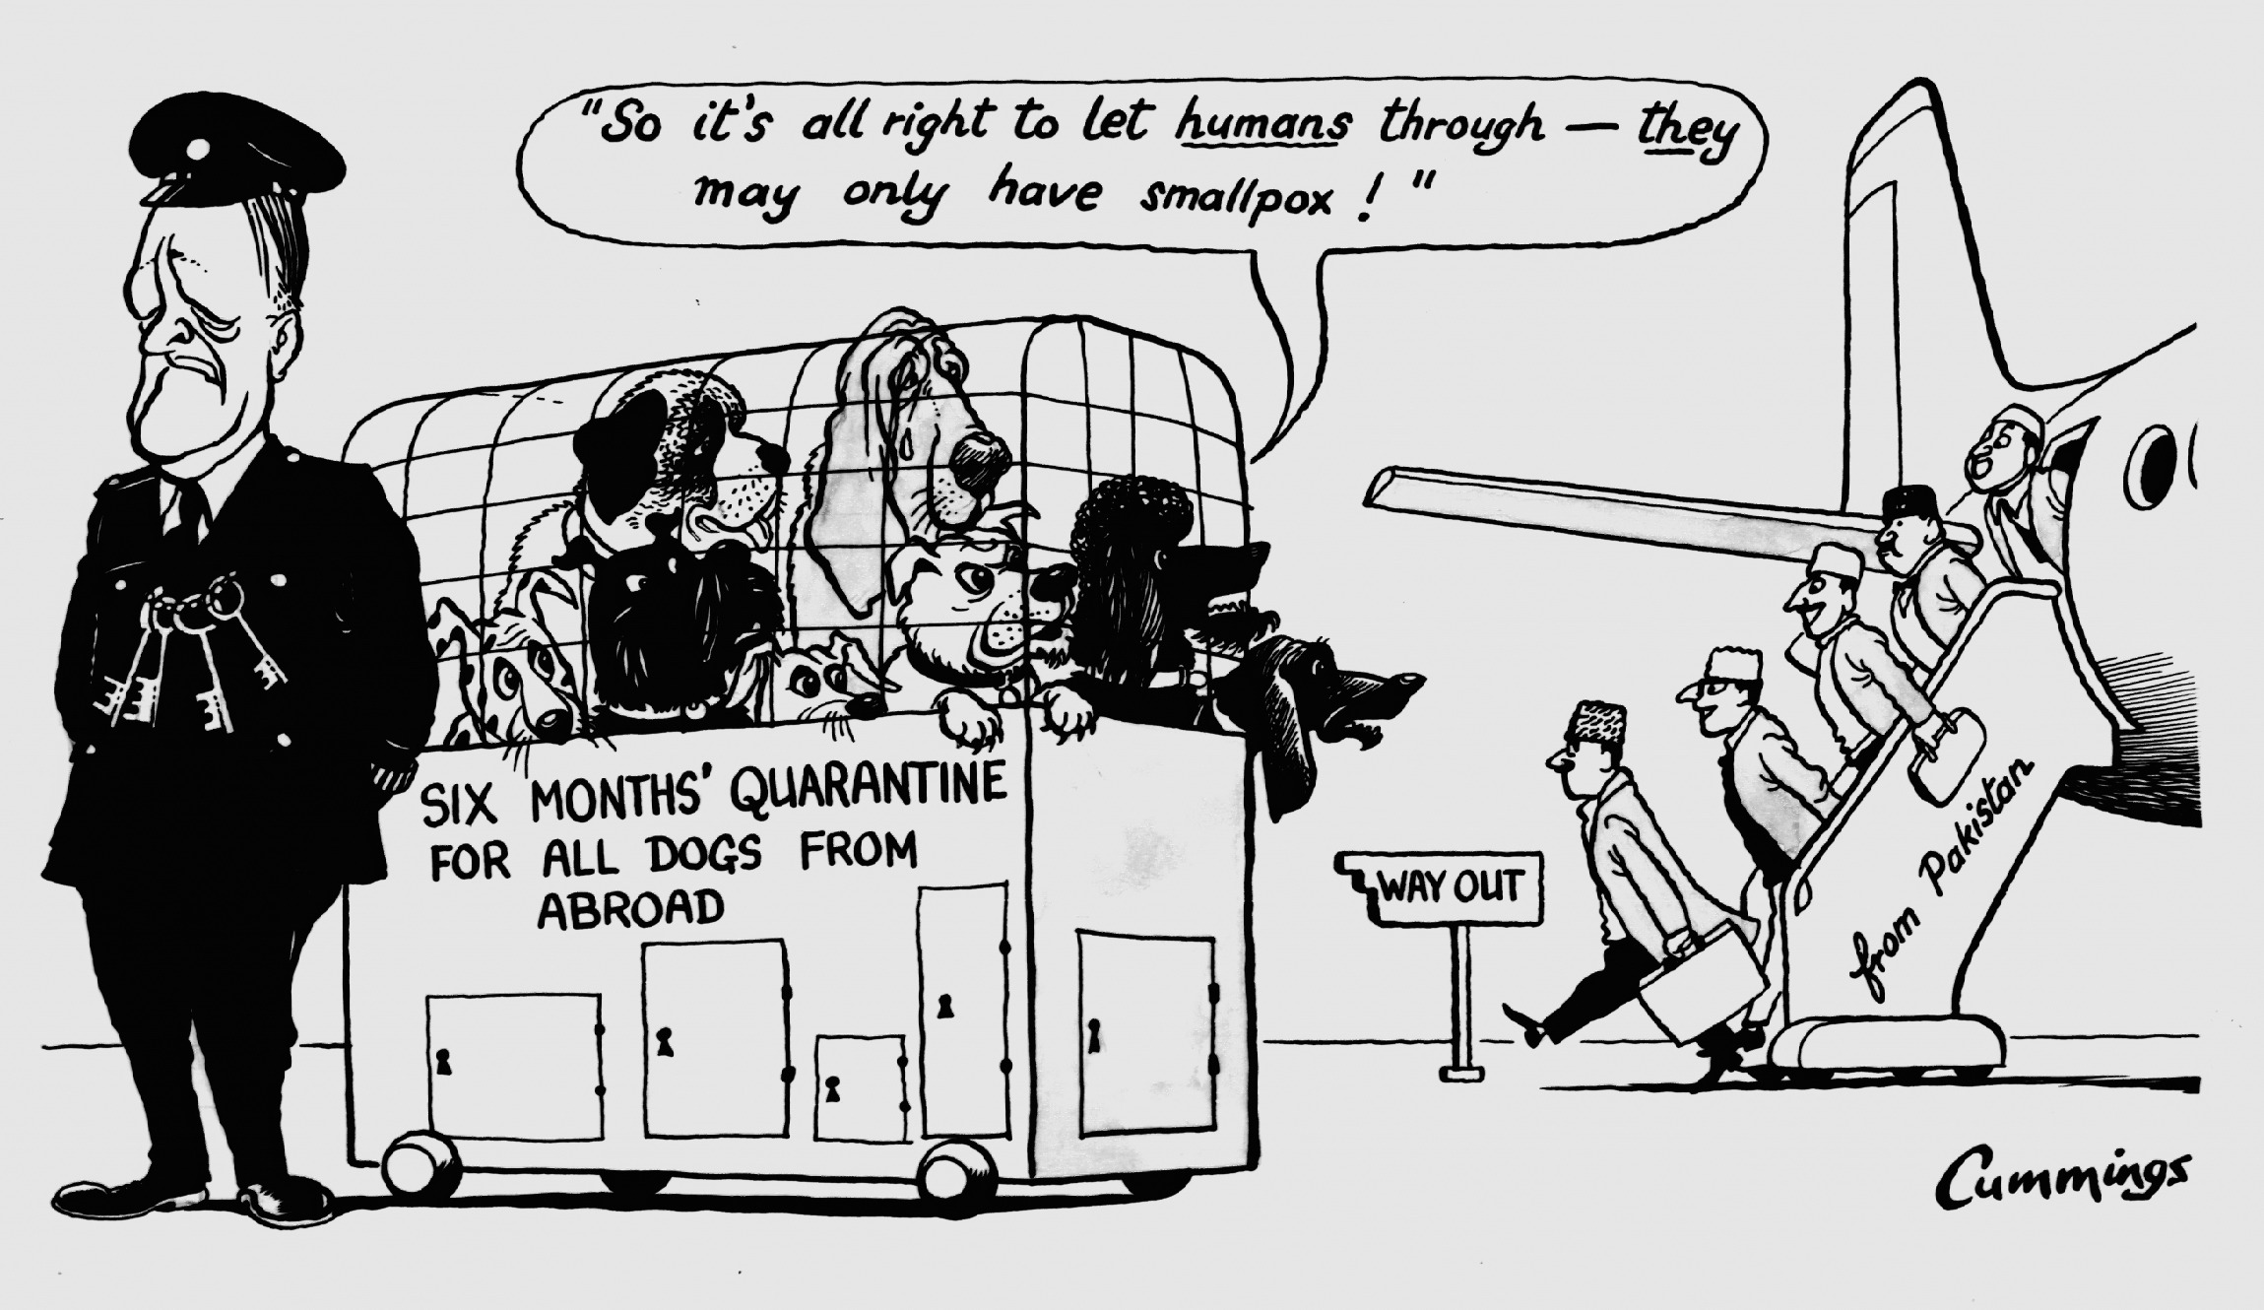
Closing the Open Door
© Express Syndication Ltd., British Cartoon Archive, University of Kent, Michael Cummings, Daily Express, 17 Jan 1962
*But in fact, success of NHS chemoprophylaxis/MMR campaigns made it cheaper to treat TB than to exclude it at the border by 1960s…
(c) Michael Cummings, Daily Express, 3 Mar 1965, courtesy of British Cartoon Archive, University of Kent.
Notes:
Ironically, while popular opinion frothed against a hypothetical immigrant ‘burden’ on the NHS, it was the Health Service’s success that most powerfully rationalized inaction at the border. With the advent of chemotherapies, it was increasingly cheap to treat TB via the NHS; prohibitively expensive to exclude it.

Slide 4
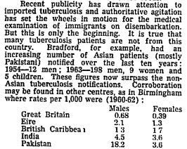
‘‘The climate of opinion on medical inspection has undergone a significant change since 1962. The emphasis for more adequate medical examination has built up over recent months.’ Atter to Roffey, Ministry of Health, June 1965
2004
1965
2001
Notes:
Guardian Newspapers Limited Mar 9, 1965; Copyright © 2013 ProQuest LLC. All rights reserved.

Slide 5
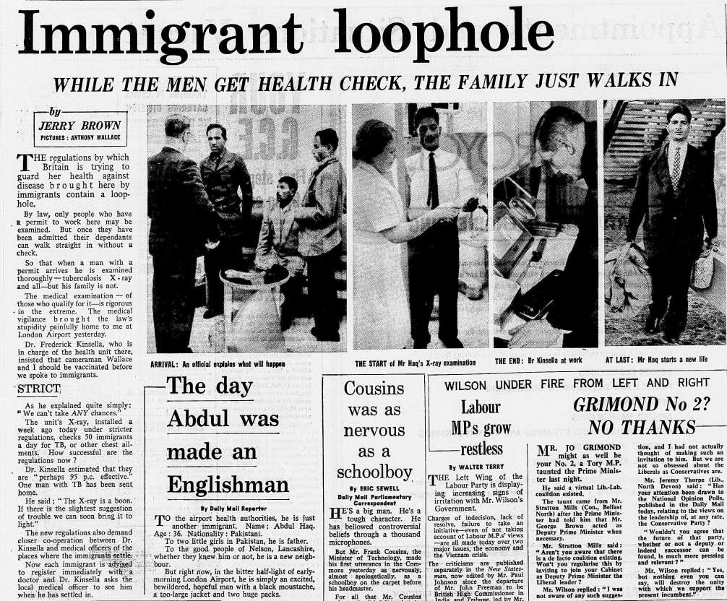
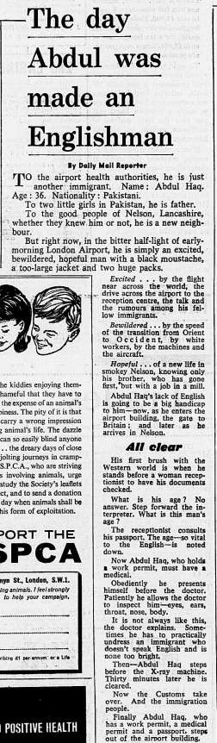
1965: The exam that makes the (English) man?

Slide 6
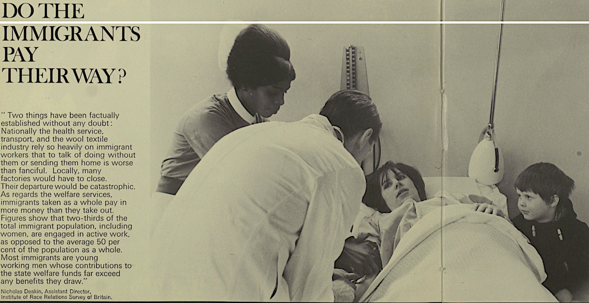
Illustrated London News, 1968
Immigrants: ‘burdening’ or benefiting the NHS?
Daily Mail, 17 July 1968

Slide 7
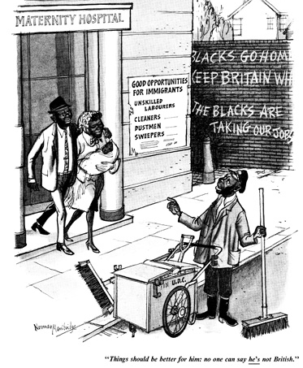
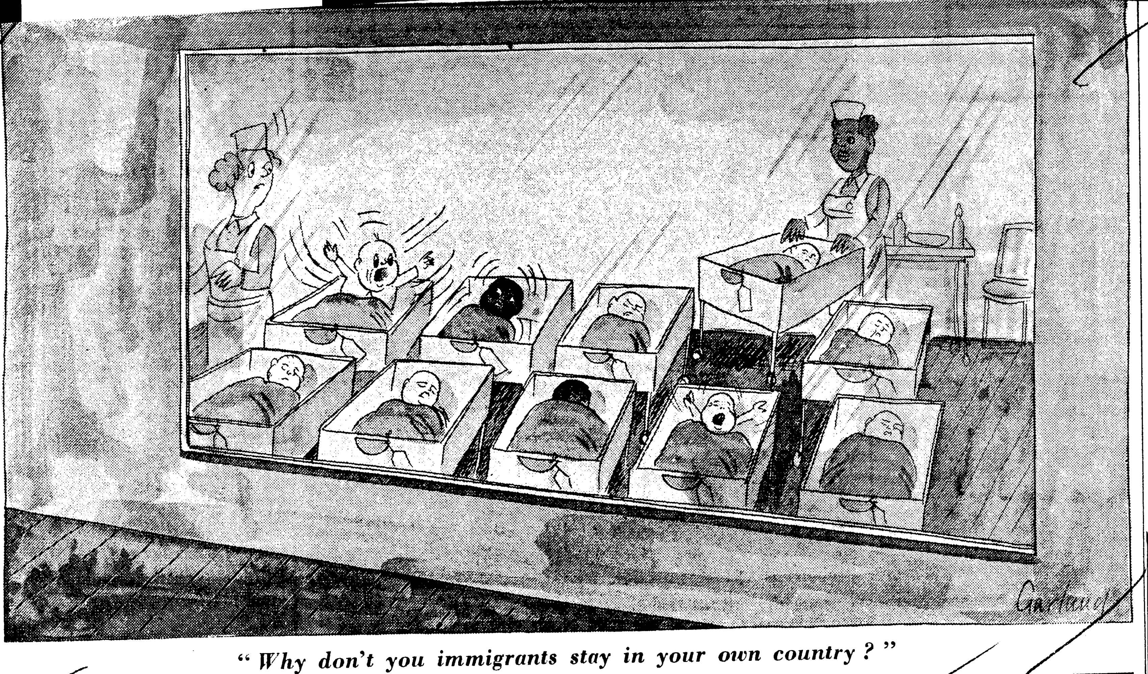
Saviours of the Service or ‘born immigrants’?
© Punch Archive, Norman Mansbridge, Punch 1954
© Telegraph Media Group, Nicholas Garland, Daily Telegraph, 25 April 1968 British Cartoon Archive, University of Kent

Slide 8
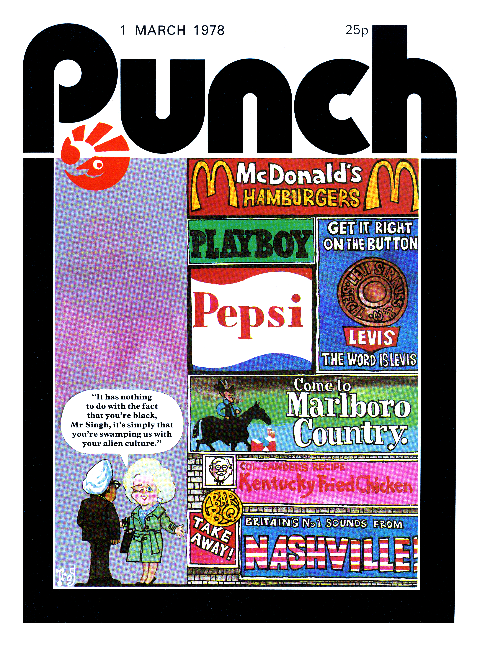
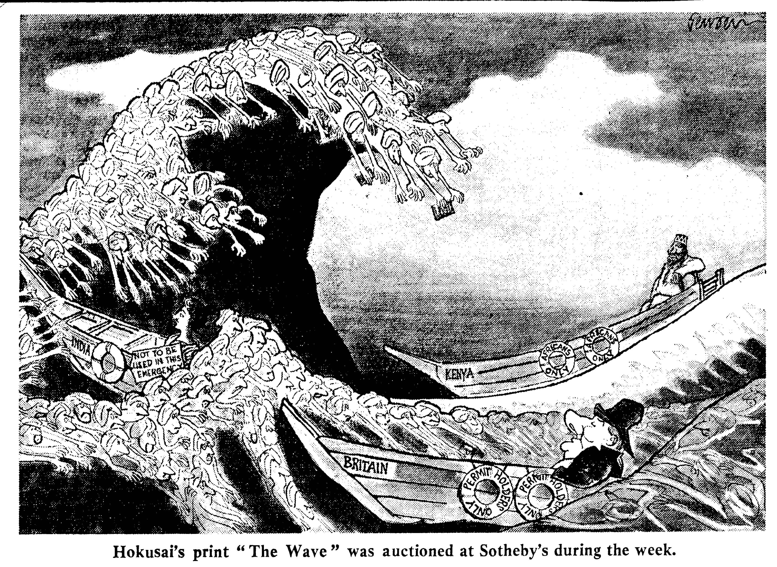
Hydraulic hysterics
© John Jensen, British Cartoon Archive, University of Kent, John Jensen, Sunday Telegraph, 4 March 1968
© Punch Cartoon Archive, 1978

Slide 11
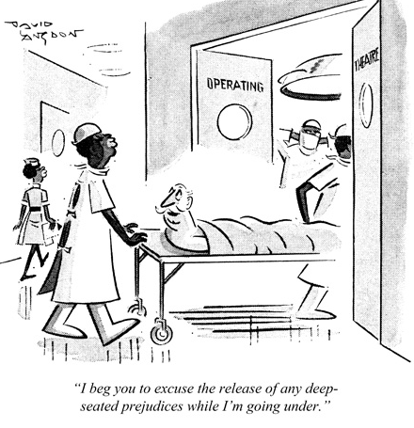
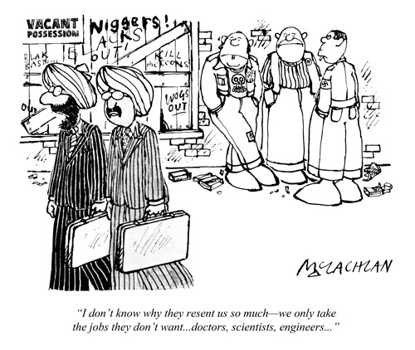
Another perspective: Immigrants as experts…
©David Langdon, Punch, 1939
©David Langdon, Punch 1969
©Ed McLachlan, Punch, 1979

Slide 12
The UK public health services must be assumed to be one of those with the highest standards in the world. The health services in the countries from which our immigrants come are of a very much lower standard … To give greater weight to medical considerations as a grounds for refusal means consigning to greater disadvantage those who are disadvantaged already. In contrast, the UK has never hesitated to absorb qualified doctors and other medical professionals from developing Commonwealth countries, thereby weakening further the[ir] health services.
G.I. de Denny, ‘Medical Examinations’ 16 May 1980.
©Illingworth, Punch, 1967

