Slide 1
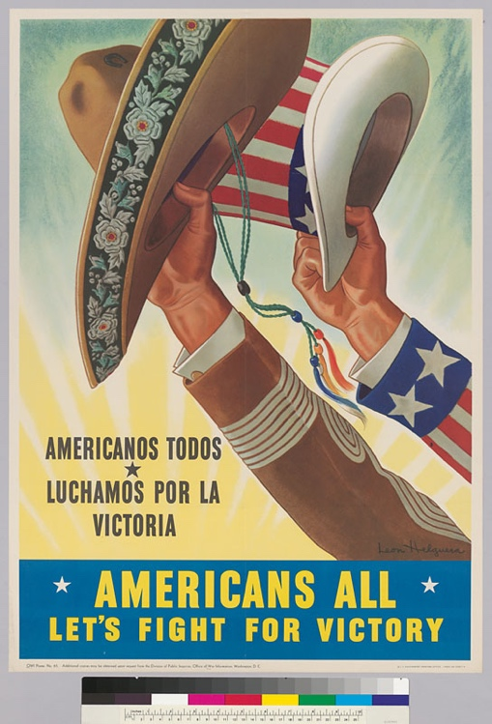
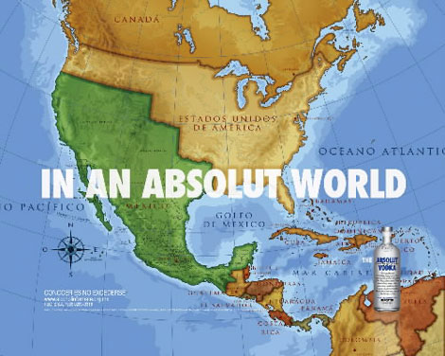
Braceros and the Borderlands in Context

Slide 2

But first:
Remember that next week, we meet in the MRC!
And…

Slide 3
Historical Background of the Southwestern Borderlands
  1848: US/Mexico border demarcated, but viewed by both states and residents as ‘traversable’ and largely unregulated.
  1916: transformation of El Paso’s Santa Fe Street Bridge between Ciudad Juarez and El Paso, a key point of entry for US-bound Mexicans, into an ‘iron-clad quarantine’ overseen by Claude C. Pierce, senior surgeon of the USPHS (United States Public Health Service)
  1920s: Western Hemisphere migrants remain exempt from national origins quotas introduced by 1921 Emergency Quota Act and subsequent Immigration Act of 1924, with its tighter quotas and 350,000 total immigrant visa limit.
HOWEVER: Attitudes towards Mexican migrants in this period also shaped by combination of reports of Mexican epidemics; friction between Mexican Revolutionaries and the US military; climate of heightened fear of disease and contamination in the US. This generates pressure to regulate US Southern land Border and an expansion and modernisation of inspection facilities at, e.g. El Paso (see Alexandra Minna Stern reading)
TL;DR: Both politico-cultural and medico-scientific factors contributed to US government demands for the surveillance, sterilization and quarantine of ‘aliens’ at the Mexican border

Slide 4
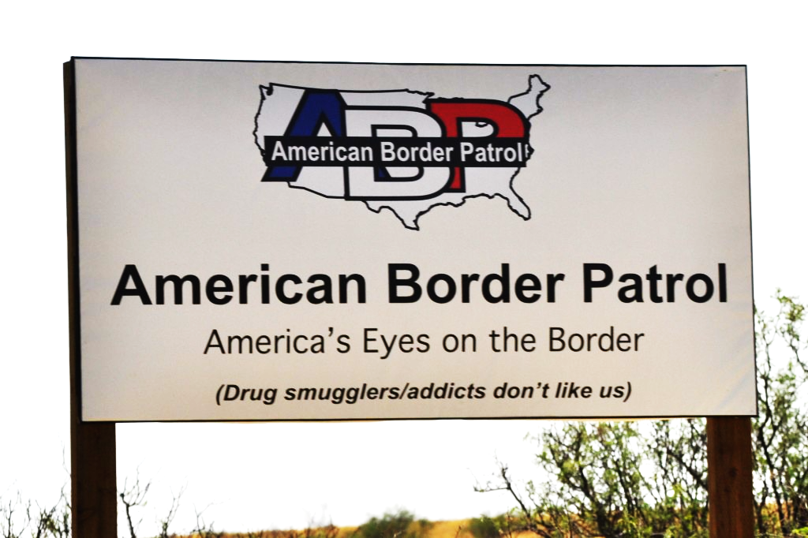
Comparing Inspection Regimes: El Paso Station vs Angel, Ellis Islands
Originally designed for the purposes of inspecting Chinese (c. 17,300 enter here or via Canada from 1883-1920), Jewish, Italian and Slavic immigrants seeking ‘back-door’ entry into the US at the turn of the 20th century; These migrants were presumed ‘suspect’ because entering at this less guarded border: 1860-1910, Mexican border was the biggest unpatrolled border in the US
Extreme and dehumanising medical inspection; included stations for sterilization of clothes and delousing (men found with lice had heads shaved and women forced to douse hair with kerosene); stripping and showers compulsory and integrated directly into the general immigration examinations: ‘Forced nudity and totalizing disinfections continued into the late 1920s, long after the typhus panic had subsided’ (Stern)
Very high numbers processed: at the Texas border, 871,639 inspected (2,830 per day at Santa Fe Bridge); 69,674 disinfected; 30,970 vaccinated for smallpox; 420 excluded for illness; 7 denied entry for refusing disinfection; 8 retained for observation – numbers surpass those for Ellis Island during this period, while proportions of exclusions more closely resemble Angel.

Slide 5
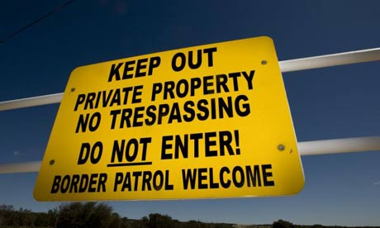
So: Techniques of inspection and medico-psychological examination were not imported from Ellis Island to the southern border: rather (as Stern emphasises) medicalization developed as a key feature of race relations and treatment of immigrants at the Southern 9as at the Pacific) border, particularly in the context of US imperialism and nation-building in the early 20th century
Note too the professional pasts and ideological/political/scientific leanings of influential individuals defining this Border: e.g. Pershing (fought in Civil War, involved in projects in the Caribbean and Pacific); Jordan (a ‘stalwart antiexpansionist and anti-imperialist’ for fears of racial miscegenation, and a key figure in the American eugenicist movement); and Pierce (a senior surgeon in the USPHS, header of the ‘iron-clad quarantine’ project, whose pro-eugenics stance was enforced through practices of social containment and ‘bodily pursuit’) – crucial to the construction of the Mexican border
TL; DR: Crucial convergence of militarisation and medicalisation during the 1910s forms Southern Border regimes; these are highly
resonant of US imperialist crusades in the tropics more generally (e.g. ‘imperial hygiene’ for Philippine colony)

Slide 6
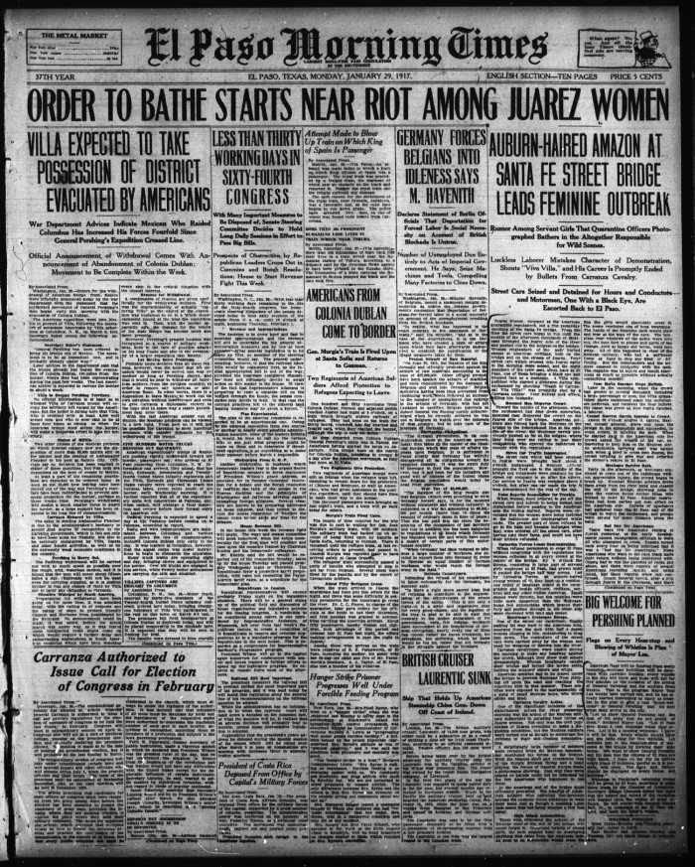
El Paso Morning Times
Monday, January 29, 1917.
Carmelita Torres, 47 years old, likely to have been a domestic worker
“The greater part of them refused to go to the bath and became indignant when they were ordered off the street cars, after having paid their fares, and could not have their nickel refunded.”
“They came out with clothes wrinkled from the steam sterilizer, hair wet and faces shining, generally laughing and in good humor. The immigration men predict that as soon as the Mexicans become familiar with the bathing process they will not only submit to it, but welcome it.”
Notes:
http://elpasotimes.typepad.com/morgue/2008/10/order-to-bathe.html

Slide 7
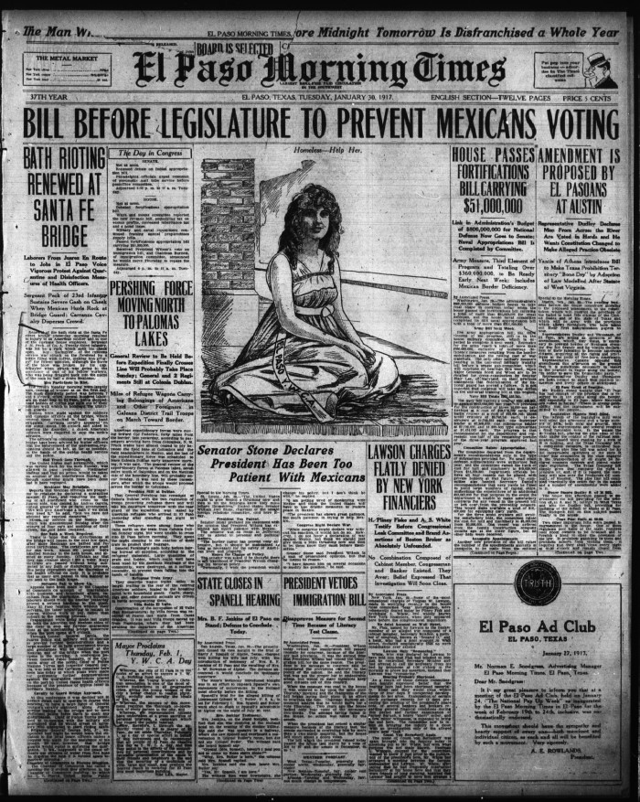
El Paso Morning Times
Tuesday, January 30, 1917.
“Laborers from Juarez en route to jobs in El Paso voice vigorous protest against quarantine and disinfection measures of Health Officers.”
“One Bath a Week Required. The certificates are good for one week. Officials say that they can cleanse about 1800 a week. ”
“Servants Fail to Show up. Appeals have been made to the Chamber of Commerce on account of interference with business and household affairs, resultant from the quarantine.”
Notes:
http://texashistory.unt.edu/ark:/67531/metapth198631/m1/1/

Slide 8
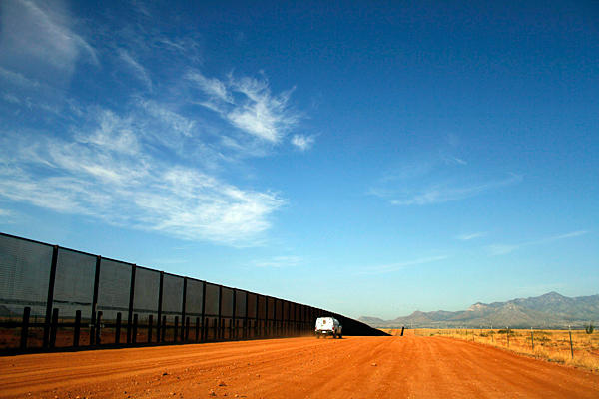
Significance of the Borderlands Quarantine
Helped to construct and solidify a boundary which had previously been characterised as fluid, thus demarcating and separating Mexicans from Americans on a landscape largely contiguous and undivided by climate or topography. ‘Medicalization was crucial to the crystallization of boundaries that traversed the urban geography of El Paso, the behaviors of the city's elite, and the demarcation of the edges of the state.’ Stern, 72
‘In the context of Mendelian eugenics [Mexicans’] liminal position as mestizos made them ineligible for whiteness and yet unclassifiable according to earlier racial distinctions. Discourses of blood thus produced a new racialized group at once non-white and non-black, while helping to delimit Mexico as a totally foreign land…’ Stern, 81

Slide 9
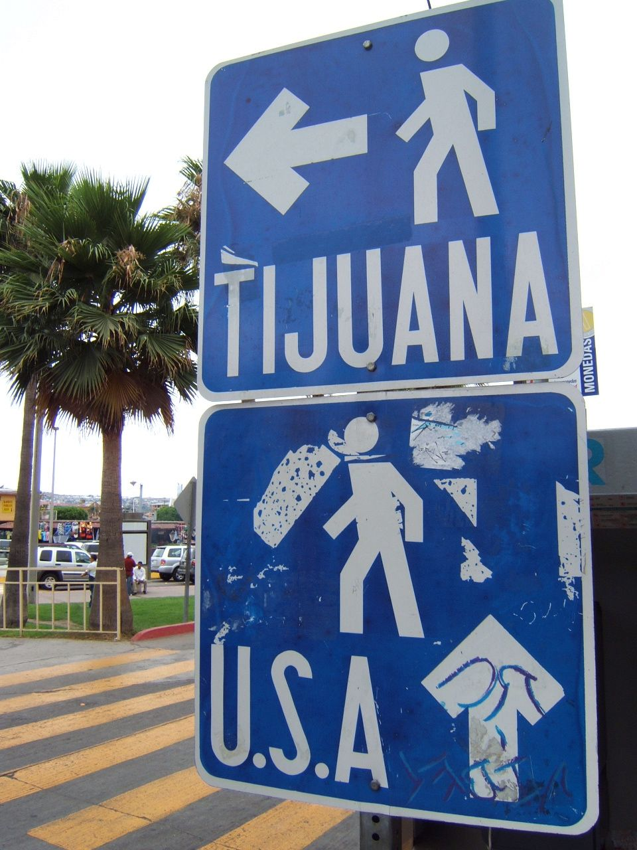
Medical Discourse and Racial Ideology at the Border
‘Mexicans imperil in some measure the health of the race in its onward march…’ (Edgar L. Hewett, ‘A Conspicuous Failure in Race Betterment’, 1915)
Languages of medicine and science used to sanction ideas of racial difference, ‘bolstered by a cluster of discourses - sanitarianism, evolutionism, manifest destiny’
2 discourses of blood – medical (concerned with targeting and eliminating specific microorganisms) and eugenic (preoccupied with the hereditary factors which determined human attributes) - framed discussions of citizenship, naturalisation and inclusion in the US
Concern with policing and disciplining private realms of gender and sexuality also prevalent - Anglo elite of El Paso were extremely troubled with the red light district of the area, and relegated prostitutes to confined areas and force them to pay monthly registration fees (further boundaries of identity scrutinised, racialised and medicalised)
So how does all this relate to Braceros?

Slide 10
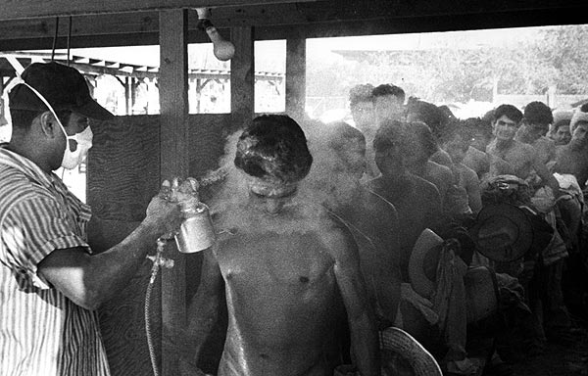
Los Braceros https://en.labournet.tv/video/6161/harvest-loneliness-bracero-program
Bracero Program (1942-1964) Strong Arms to aid the USA.
Men are sprayed with a mixture usually including: DDT, Kerosene, Vinegar, Soap and water
US Photographer: Leonard Nadel
Photographs were taken in 1956.
Notes:
http://www.latimes.com/news/local/la-me-tobar-bracero-pictures,0,4963915.photogallery

Slide 11
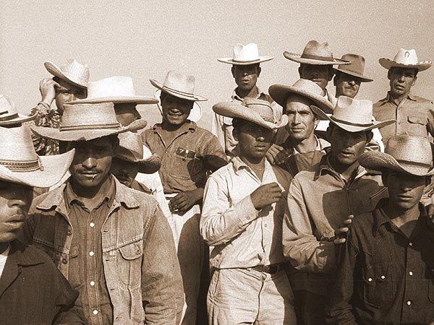
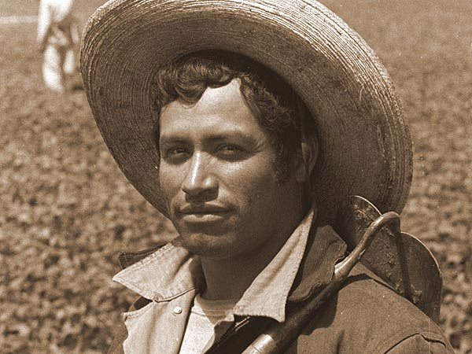
Clean enough to enter the U.S.
Notes:
http://www.latimes.com/news/local/la-me-tobar-bracero-pictures,0,4963915.photogallery

Slide 12
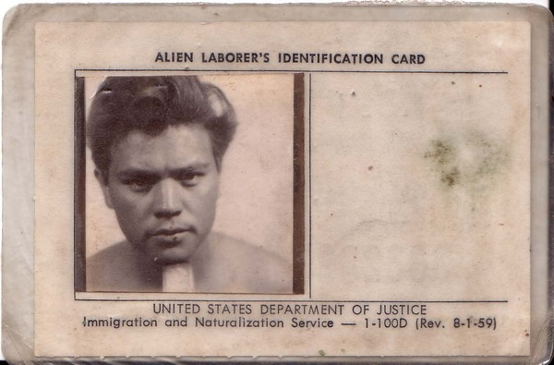
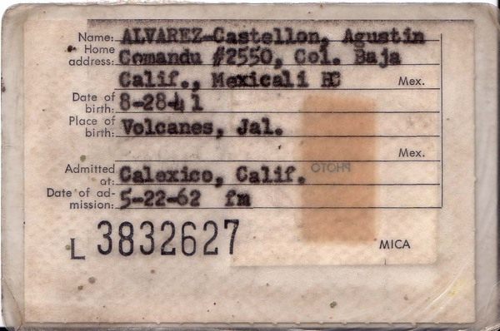
Alien Identification Cards
Certificates Required of Travelers
“The certificates read “United Stated Public Health Service, Mexican Border Quarantine. The bearer, …………, has been this day deloused, bathed, vaccinated, clothing and baggage disinfected.”

