Slide 1
“Opium dens in London”
Week 9: “Civic Britannicus sum” forging imperial citizenship

Slide 2
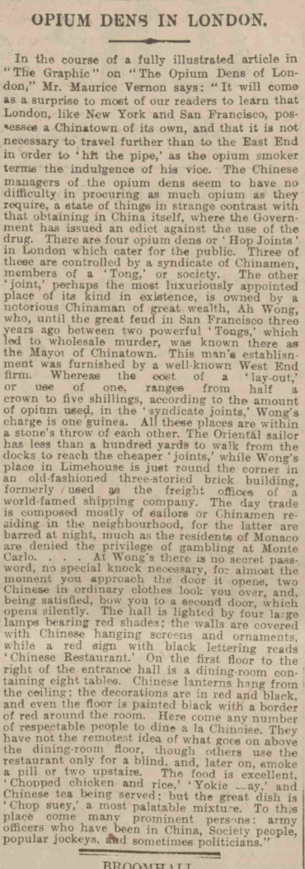

Slide 3
Background of the source
Published in December, 1907 by Manchester Courier
Advocate of commerce and agriculture, Pro Church of England, more of a conservative stance
established as a counterpoint to the Manchester Guardian

Slide 4
1907 in history:
- Britain: imperialist, expanisionist, diplomatically strong power
China/ Chinese people:
→ governed by Qing, anti-foreign, backwardness, isolationst, corrupt

Slide 5
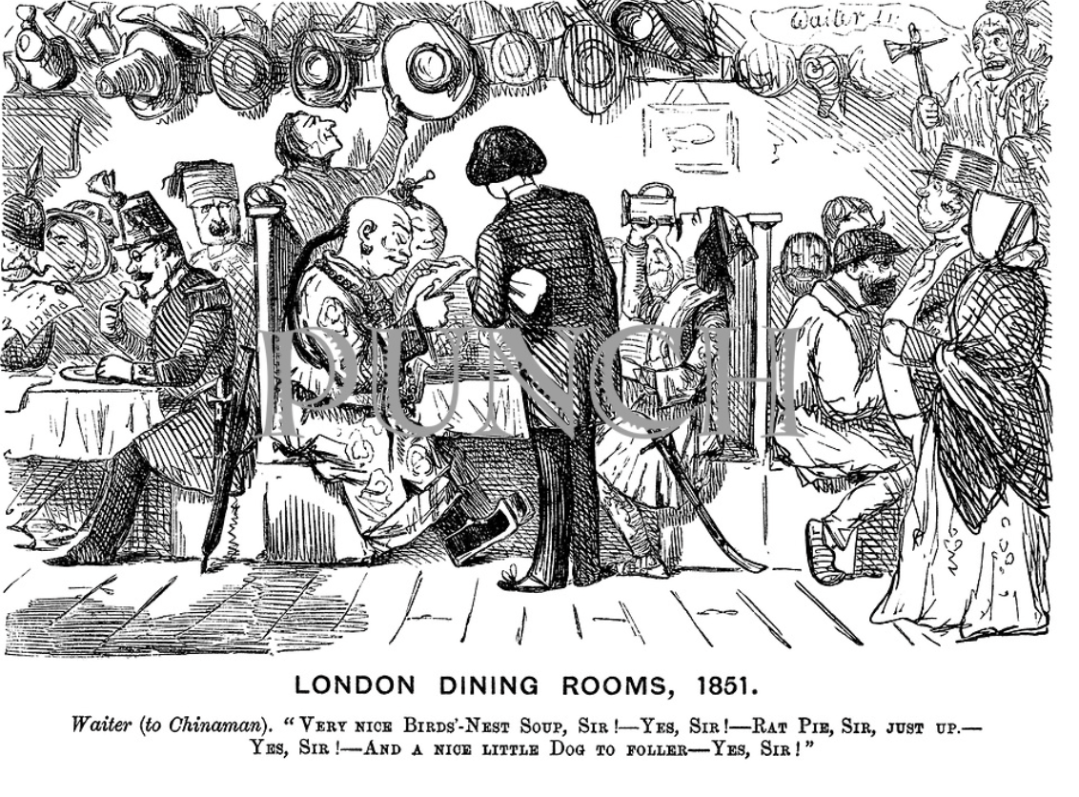
Notable features: descriptions of Chinatown
Chinatown = opium-filled secret lairs hidden behind Chinese restaurants
Depicts the 1900s stereotypes of Brits on Chinese
Descriptions: exotic, mysterious, fear
Food: they praised the “normal” kind of Chinese food to Brits,
Eg, “Chicken with rice”

Slide 6
Chinese migration in Britain during the 1900s
Overlooked aspects in British history/ society in the 20th century:
Reasons of Chinese migrants to Britain differs to other commonwealth countries
Britain’s extensive trading routes around the Far East → employing Chinese sailors
Singapore, Shanghai, Hong Kong
Political instability in China and high unemployment for young labourers

Slide 7
“universal citizenship”: Britain’s approach on Chinese migrants
“It is also true that not all empire migrants (or migrants with other origins) who moved around the British Empire were welcome in all its constituent parts. The myth of empire widely held in Britain through most of this period was that all those born within the empire at home or overseas were equally subjects of the crown. This doctrine was enshrined, for example, in the British Nationality and Status of Aliens Act in 1914 which defined British subjects as ‘Any person born within His Majesty's dominions and allegiance. By implication at least, any such person had a right of entry into the UK and into any other part of the overseas empire”

Slide 8
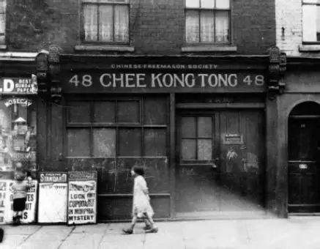
“universal citizenship”: Britain’s approach on Chinese migrants
Most work as cooks, establishing Chinese restaurants
Food businesses as a way to assert cultural identity while navigating racialised realities

Slide 9
reflection
'Subject' or 'citizen', 'native' or 'national': were all imperial migrants also (equal) imperial citizens? Why or why not?

