Slide 1
Empire on the Move: ‘Civis Britannicus sum’?
Roberta Bivins
Department of History
University of Warwick
r.bivins@warwick.ac.uk

Slide 2
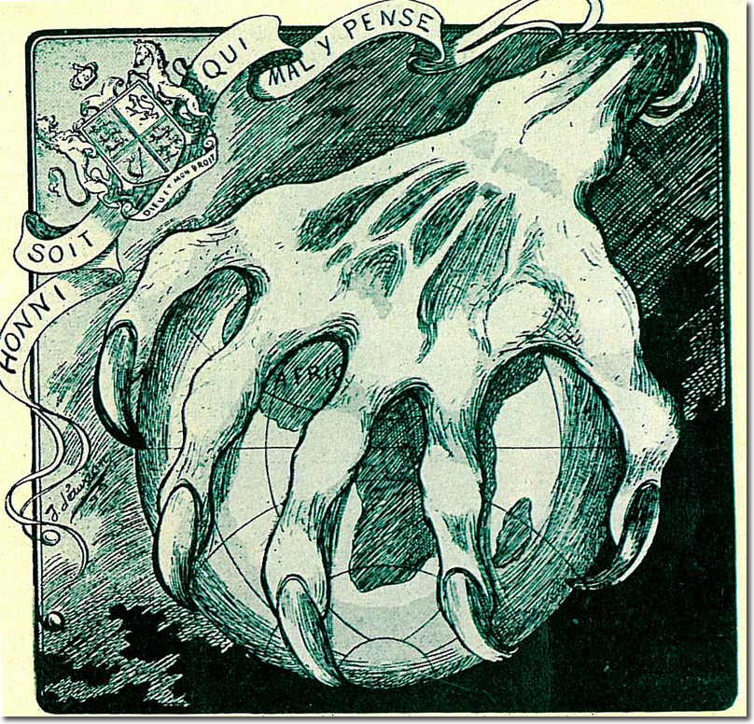
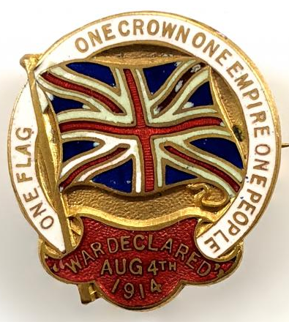
But first:
Reminder:
Archive groups and weeks
Interim module feedback
Applied project Q & A

Slide 3
Subject, national, citizen?
1948 British Nationality Bill Debates
‘[A]s the United Kingdom has not defined by law its nationals or citizens, and that the only status possessed by the people of the United Kingdom is that of British subjects, there has grown up a tendency to regard the term "British subject" as meaning a person belonging to Great Britain, and to obscure its true meaning of a person belonging to any country of the Commonwealth who is a subject of the King.
A minor inconvenience resulting from the absence of any specific definition of United Kingdom nationals or citizens has been that, in treaties or in legislation, when it has been necessary to refer to such persons, this country has been obliged to use some such phrase as "belonging to the United Kingdom.”’
James Chuter Ede, Secretary of State for the Home Department, 1948 (House of Lords)
1954 Colonial Immigrants Adjournment Debate
‘As the law stands, any British subject from the Colonies is free to enter this country at any time as long as he can produce satisfactory evidence of his British status. That is not something we want to tamper with lightly. In a world in which restrictions on personal movement and immigration have increased we still take pride in the fact that a man can say Civis Britannicus sum whatever his colour may be, and we take pride in the fact that he wants and can come to the Mother country.’
Henry Hopkinson, Minister of State, Colonial Affairs
Notes:
See https://hansard.parliament.uk/Commons/1948-07-07/debates/23bb588e-7a27-4f12-ba7c-e89afabf501e/BritishNationalityBillLords for quotation
https://hansard.parliament.uk/Commons/1948-07-13/debates/0ea6f806-f0b1-4247-9211-c343910b1e28/Clause1%E2%80%94(BritishNationality)

Slide 4
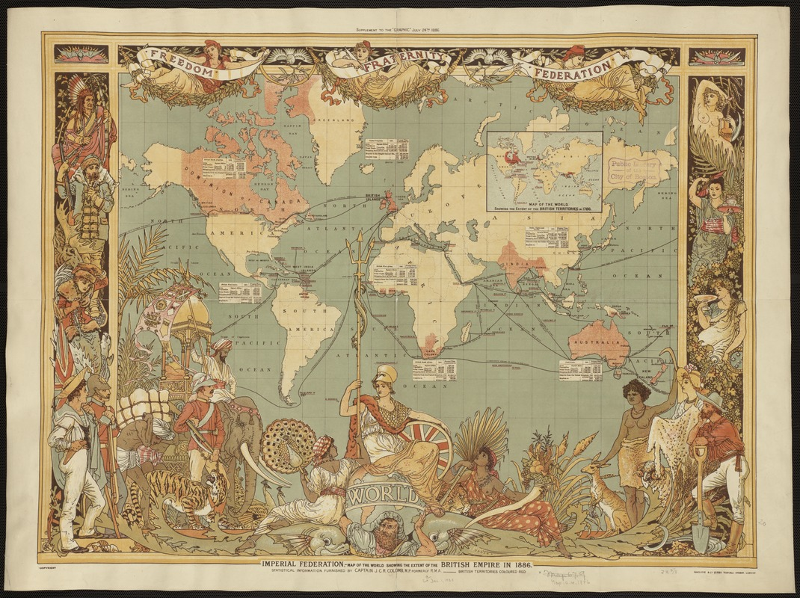
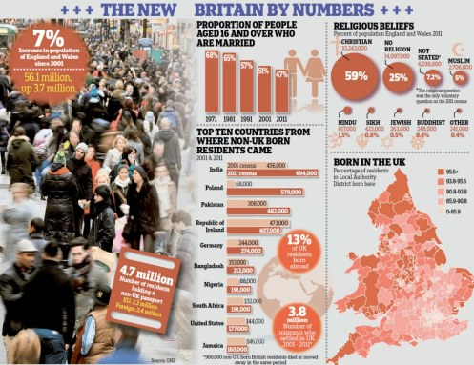
Migration-nation Britain?
Imperial Federation, map of the world showing the extent of the British Empire in 1886, published in The Graphic, a popular newspaper.
Daily Mail, 12 December 2012

Slide 5
How do historians write the history of migration in Britain?
Traditionally:
Parliamentary debates
Border and Census Data
Newspaper coverage
Legislation
Policy documents
Inclusively:
Visual representations – photos, film, television, cartoons
Oral history
Diaries/Memoirs/Letters
Community documents

Slide 6
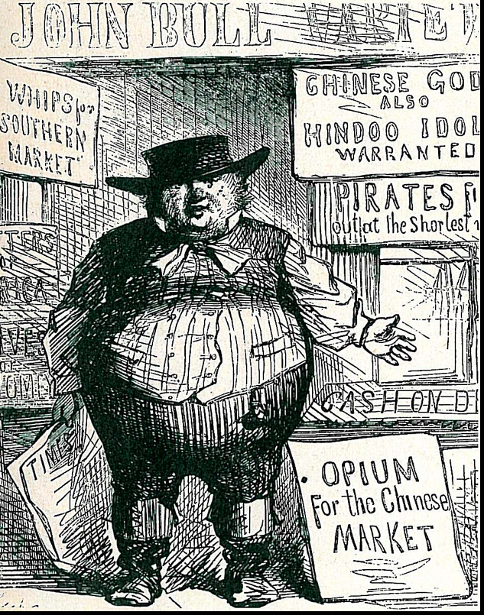
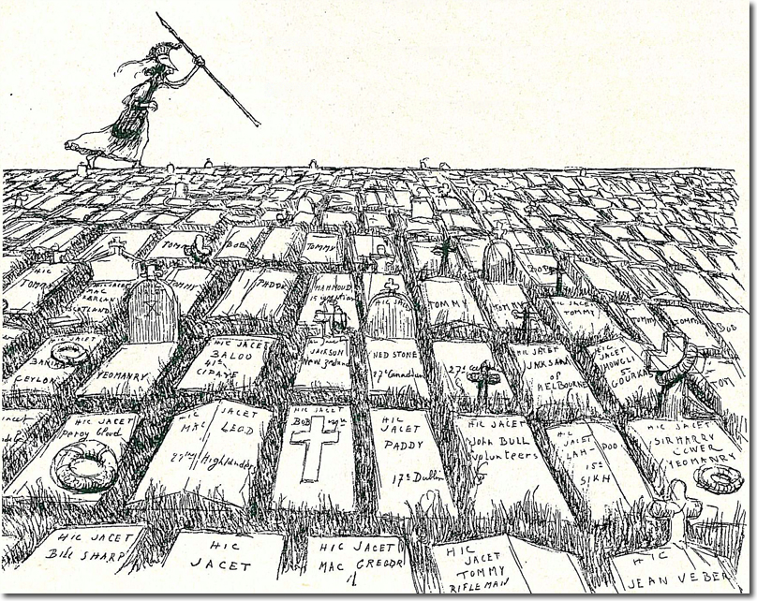
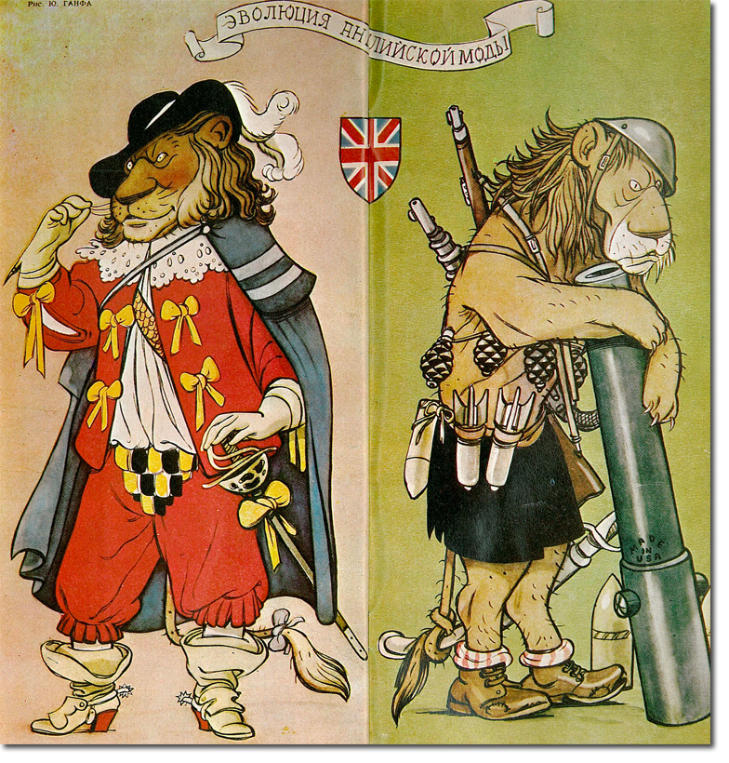
And what does British Empire look like from abroad?
View from USA, Mid-19th c.: Shopkeeper to the World, Moral Authority to None
View from France, Boer War: Death-Dealing Mother Britannia
View from USSR, 1956 Suez Crisis: Weary and Dependent
Notes:
All from https://www.britishempire.co.uk/media/foreigncartoons/foreigncartoons.htm
Soviet image from Krokodil Satirical Magazine, founded 1922: Foremost among journals that attacked the British Empire was the Soviet satirical magazine, Krokodil. Founded in 1922, as a sister magazine to the Party newspaper, Pravda, it had a tradition from the start of employing some of the best artists and writers in the Soviet Union. This cartoon appeared at the time of the Suez Crisis of 1956.It shows that the old swashbuckling British Lion had become a very forlorn and tired warrior by the time of 1956. Interestingly, the weapons are shown to be provided by the USA hinting that Britain was nothing but an American stooge - despite the fact that the US was deeply critical of the British action at Suez.’

Slide 7
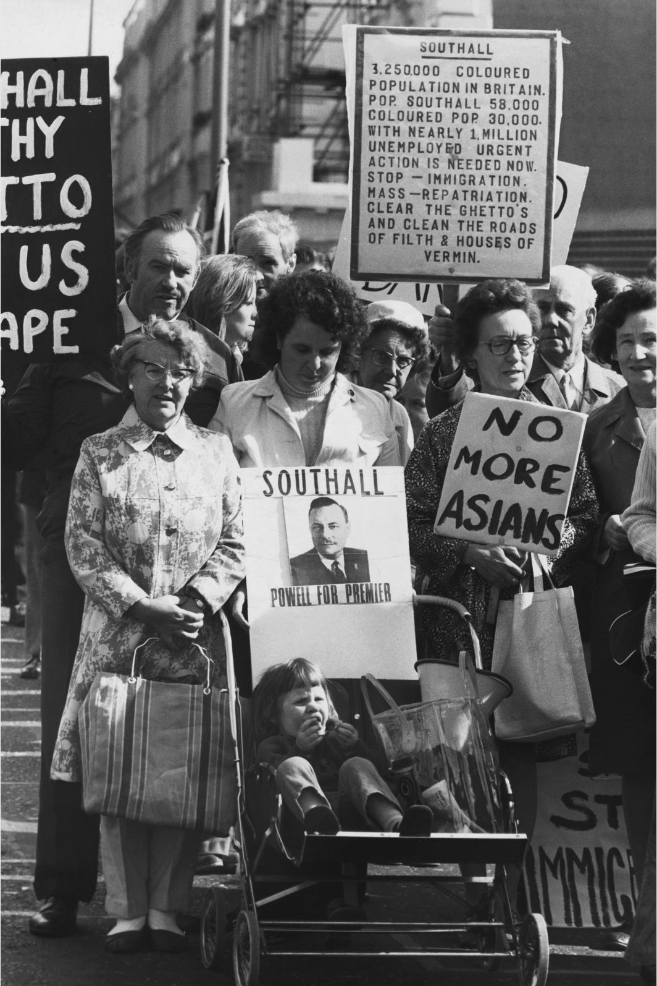
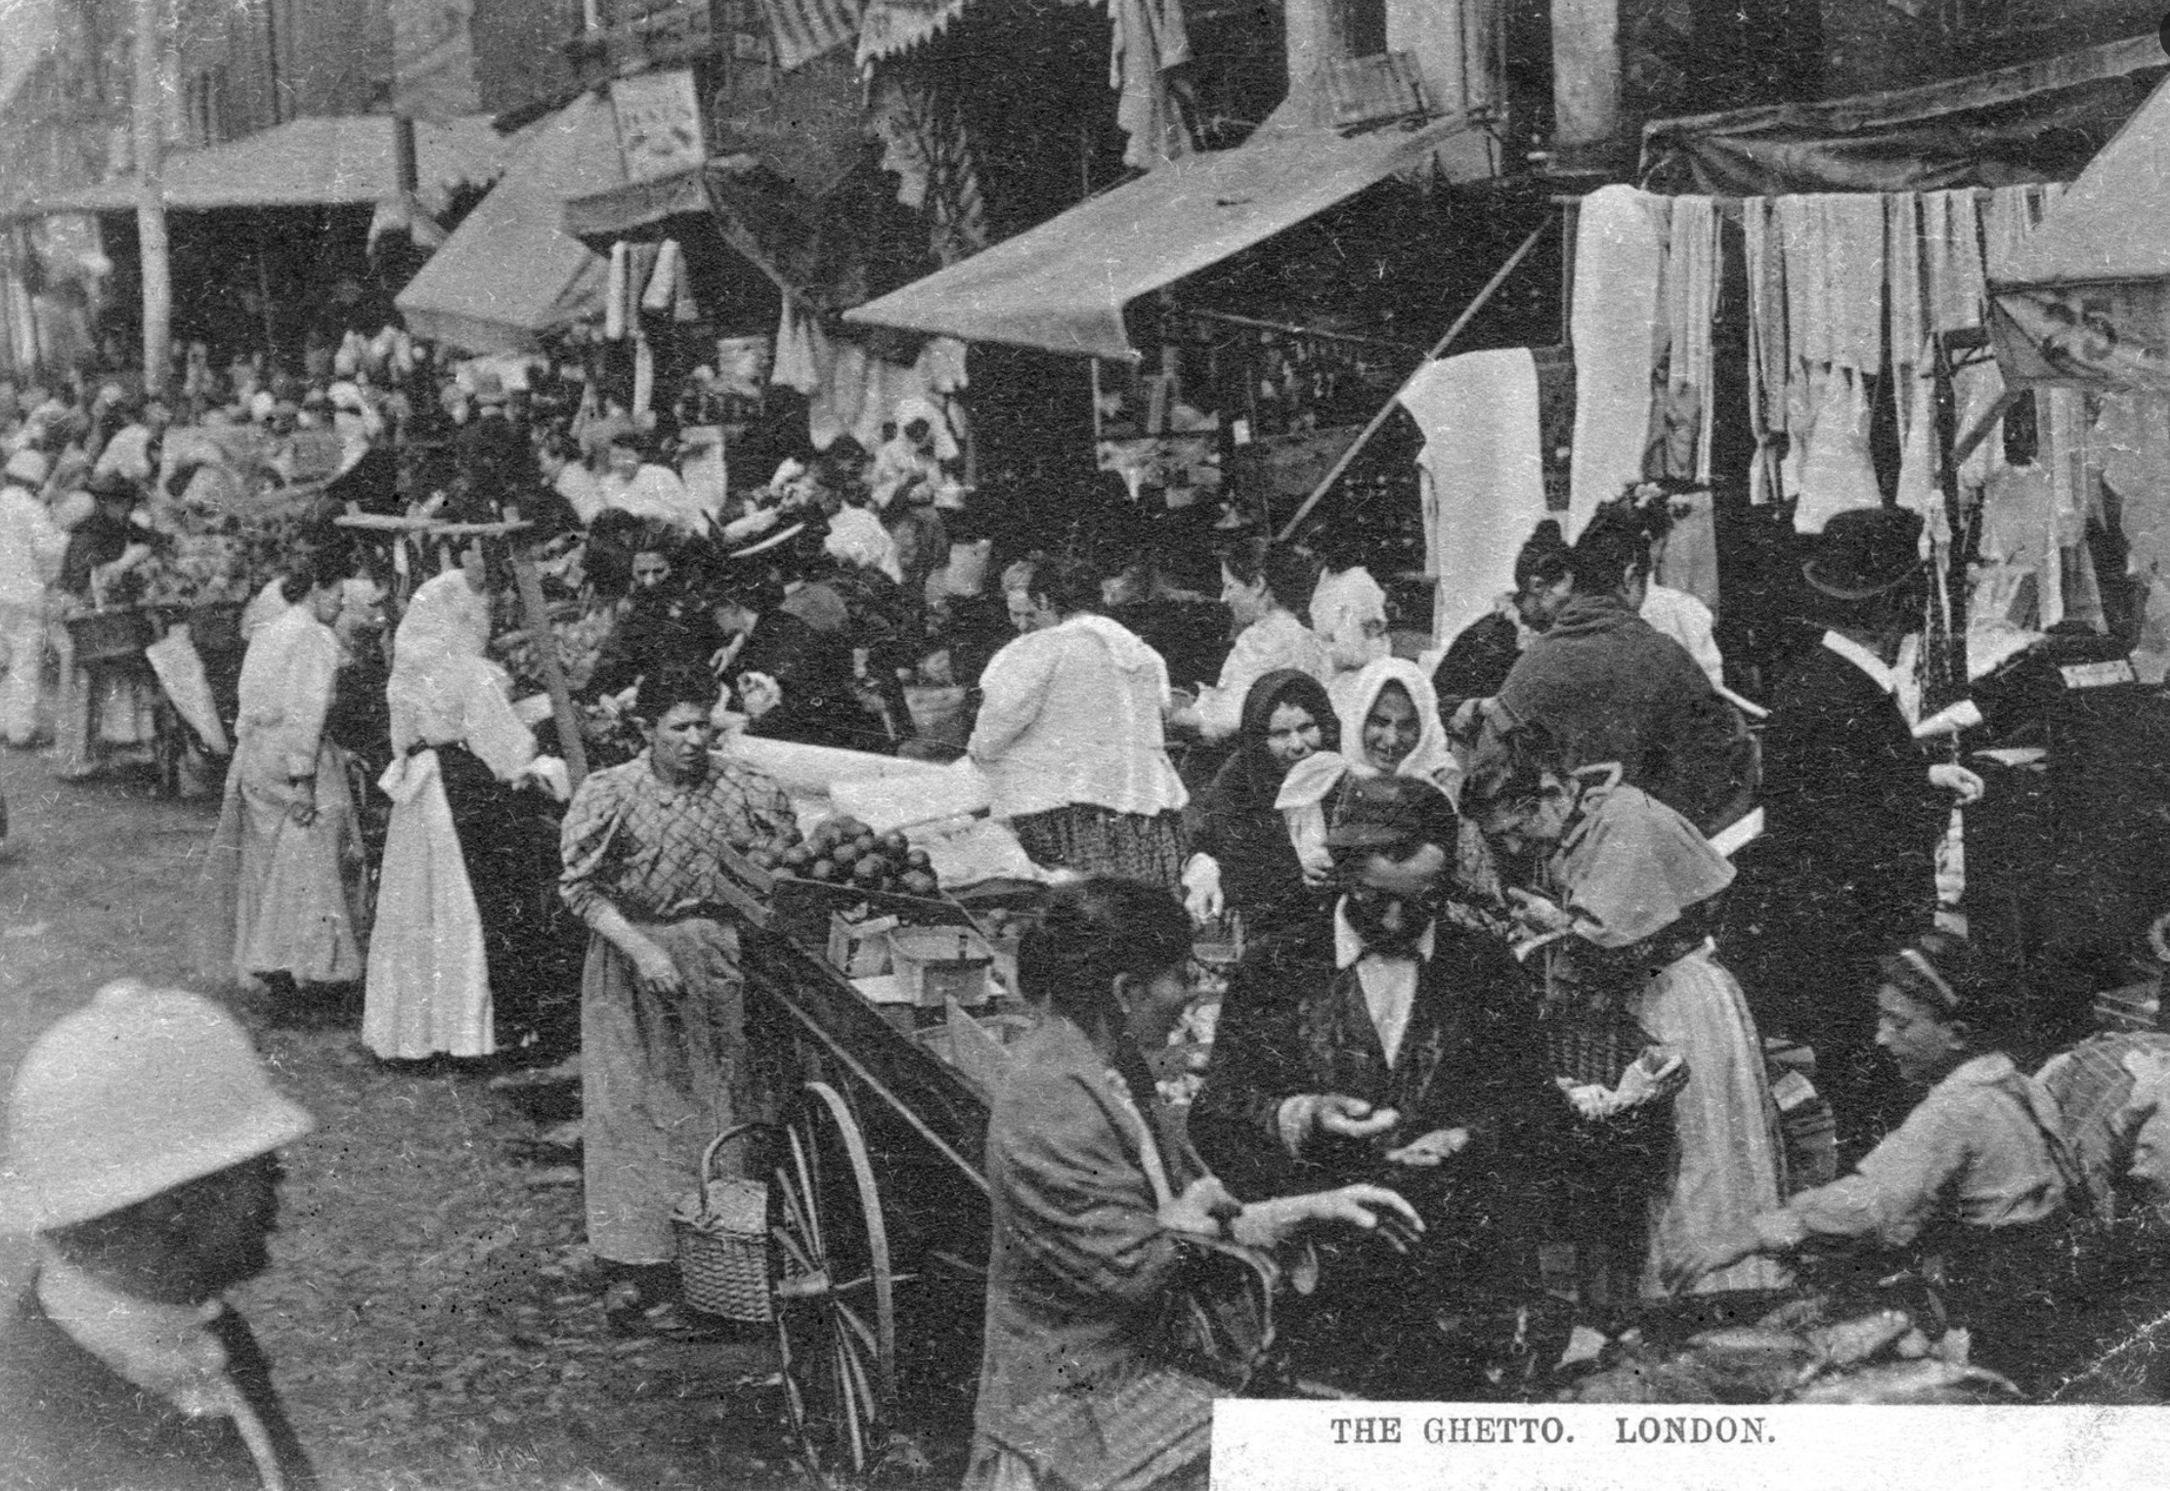
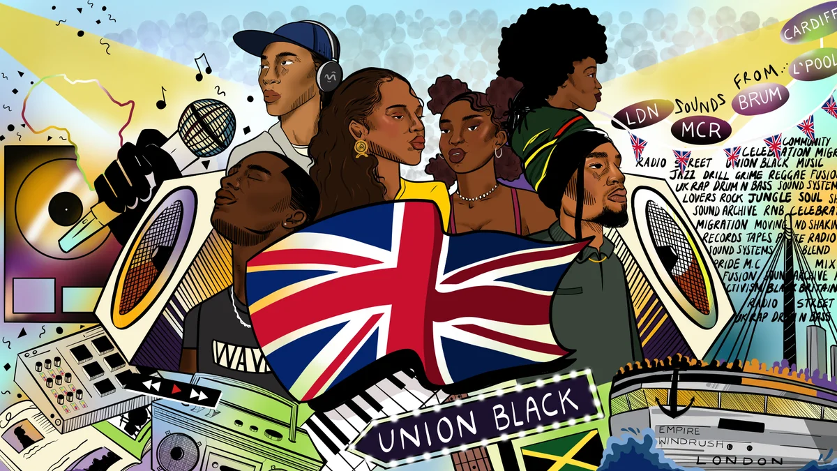
An estimated 150,000 Eastern European Jews settled in Britain between 1881 and 1914, in many cases after escaping persecution in pogroms across the Russian and Hapsburg empires. Credit...Jewish Chronicle/Heritage Images, via Getty Images

