Slide 1
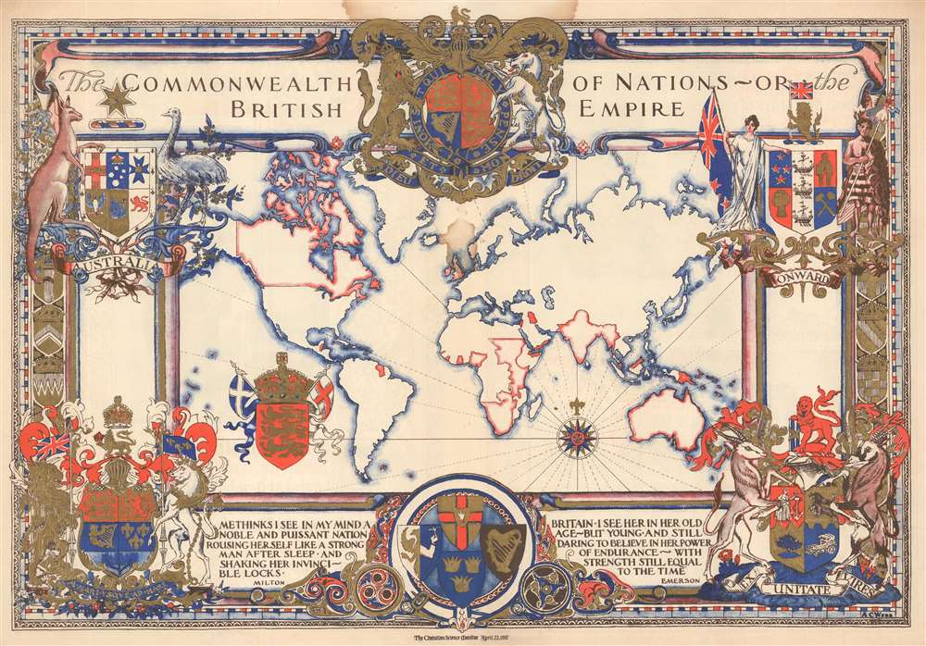
Constructing Citizenship within the British Empire
By Tom Walker

Slide 2
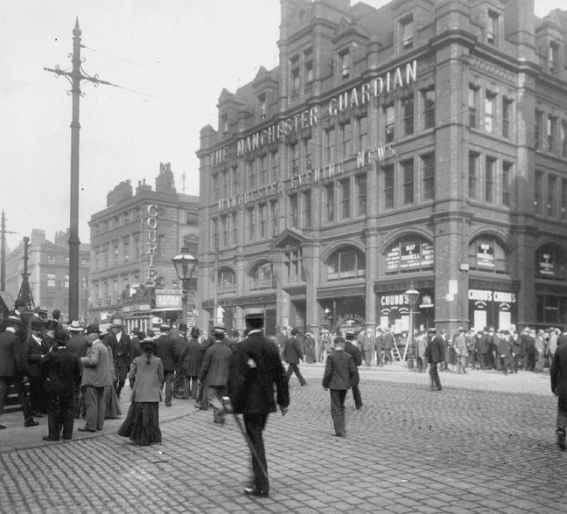
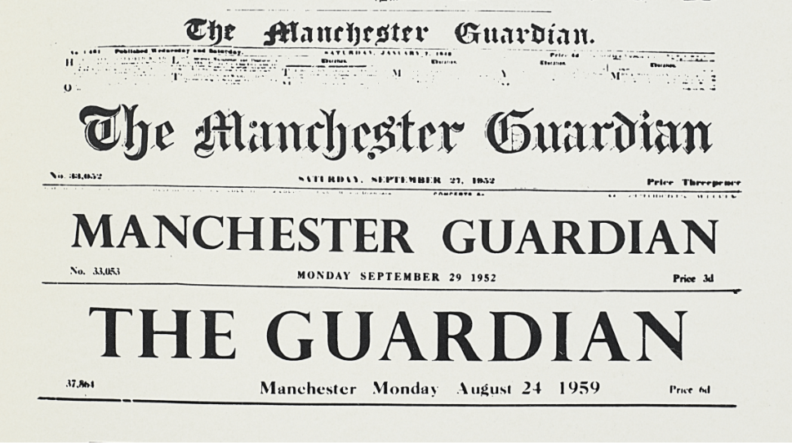
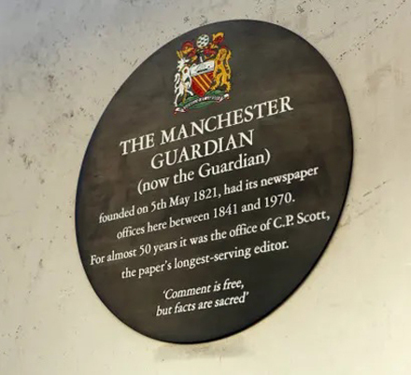
The Manchester Guardian:
Founded by John Edward Taylor in 1821 ‘to promote the liberal interest in the aftermath of the Peterloo Massacre, in the context of the growing anti-Corn Laws campaign’.
Achieved national and international status under C.P. Scott – editor from 1872-1929 and owner from 1907.
A newspaper characterised by ‘high-handed moral posturing and woolly (impartial?) leaders’.
Taken from ‘History of the Guardian’, Guardian, 11 December 2017 <https://www.theguardian.com/gnm-archive/2002/jun/06/1> [accessed 4 December 2025].

Slide 3
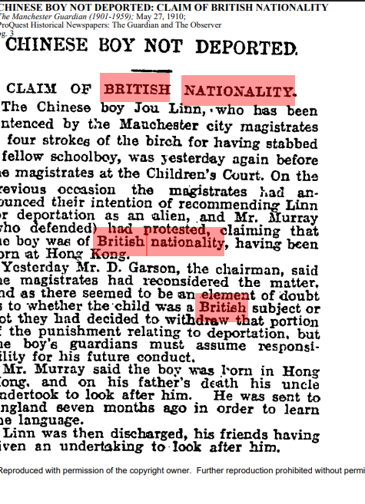
Article No. 1 (27 May 1910):
Jou Linn taken into custody by Manchester Police.
Children’s Court ordered his deportation.
It was raised that Linn was from Hong Kong – therefore having claim to British Nationality.
Deportation order withdrawn but confusion remained on his status as a British subject and his claim to British nationality.

Slide 4
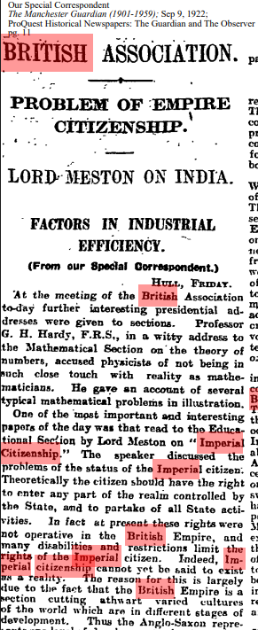
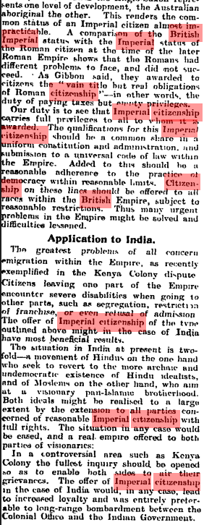
Article No. 2 (9 September 1922):
In theory, an ‘Imperial citizen’ should be able to move freely between state-controlled territories.
In practice, there was no ‘Imperial citizen’.
British Empire is culturally diverse – introduces racialised ideas of ‘development’.
Suggests creating Imperial citizenship for ‘all races within the British Empire’.
Created with a universal code of law, constitution and democratic administration.

Slide 5
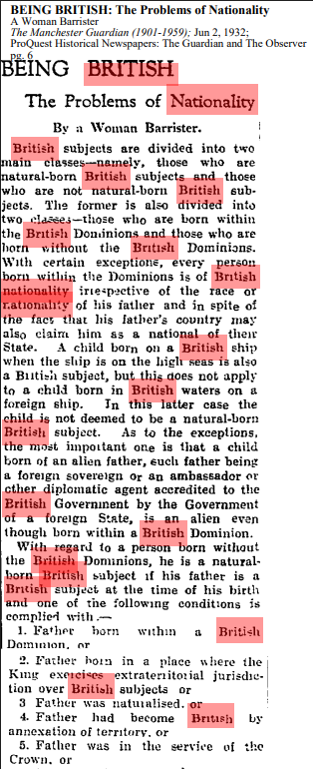
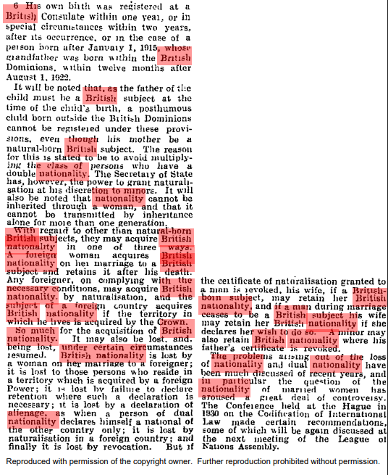
Article No. 3 (2 June 1932):
British subjects divided into different classes based on where in the Empire they were born and to whom.
Race does not determine British nationality.
There are exceptions on whether British nationality is granted.
Nationality cannot be inherited matrilineally.
Women lose citizenship if marrying a non-British husband.
Nationality can be acquired through naturalisation.

Slide 6
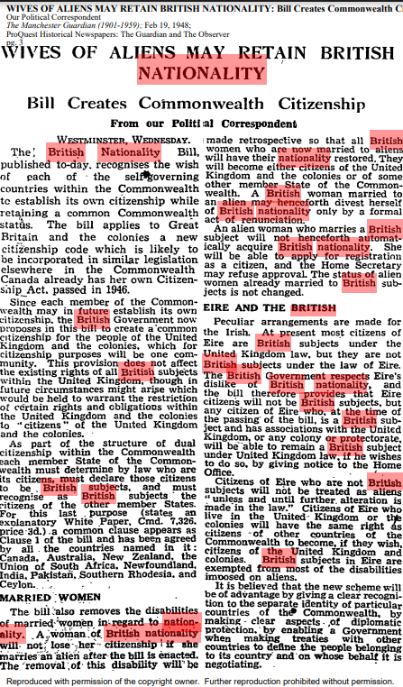
Article No. 4 (19 February 1948):
Citizenship of self-governing British Dominions recognised (e.g. Canada).
‘Common citizenship’ of people of United Kingdom and colonies – recognised as ‘one community’.
Commonwealth member states classified as ‘British subjects’.
Women restored citizenship after marrying non-British husbands and won’t lose citizenship if marrying non-British husbands in future.
Non-British wives of British men must apply for citizenship.
Irish are de facto recognised as British subjects (self ID).

Slide 7
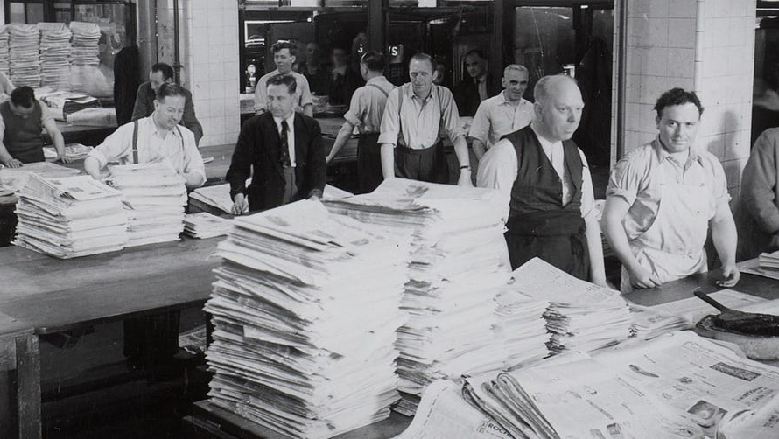
Links to the Articles:
Article No. 1 - https://www.proquest.com/hnpguardianobserver/docview/475054032/42CC6C7E2E043E5PQ/6?accountid=14888&sourcetype=Newspapers
Article No. 2 - https://www.proquest.com/hnpguardianobserver/docview/476642924/91F770F315524443PQ/2?accountid=14888&sourcetype=Newspapers
Article No. 3 - https://www.proquest.com/hnpguardianobserver/docview/478419564/42CC6C7E2E043E5PQ/1?accountid=14888&sourcetype=Newspapers
Article No. 4 - https://www.proquest.com/hnpguardianobserver/docview/478826586/42CC6C7E2E043E5PQ/9?accountid=14888&sourcetype=Newspapers

