Slide 1
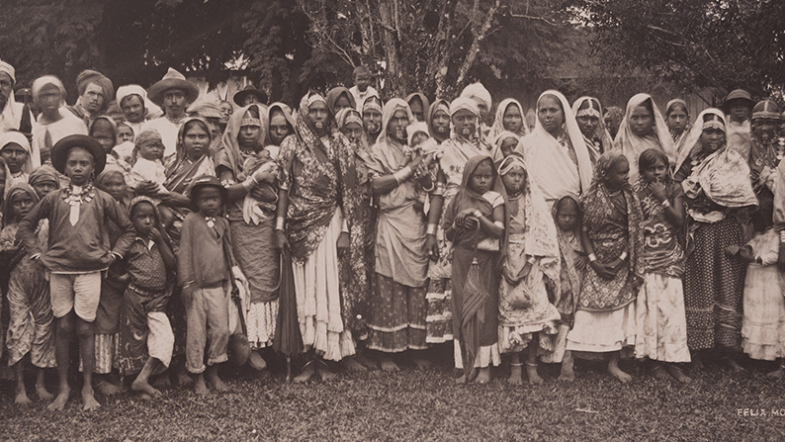
William Alexander Mackinnon’s Survey of Opinion
Houses of Parliament, 11 March 1841
East Indian Women, Men and Children (ca. 1890-1896), Trinidad.
Photograph by SMU Central University Libraries (DeGolyer Library). Posted online via Flickr, uploader “SMU_cul_digitalcollections.”

Slide 2
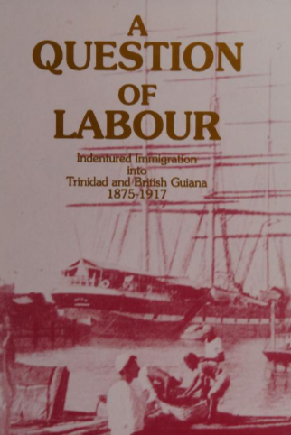
Keith Laurence, A question of labour: indentured immigration into Trinidad and British Guiana, 1875-1917 (St. Martin's Press, 1994).

Slide 3
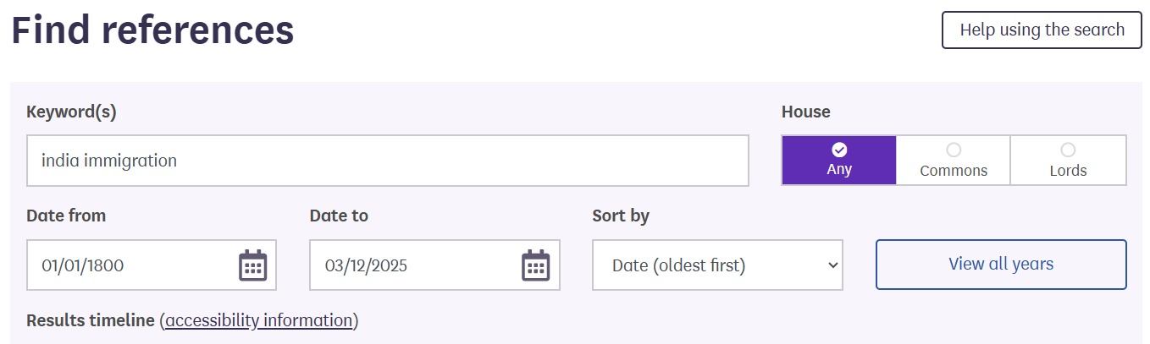
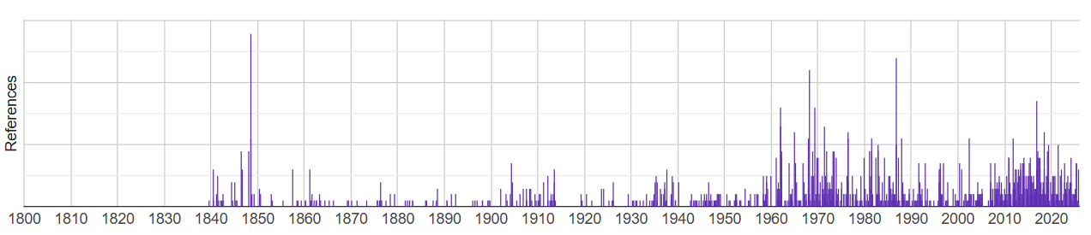
Hansard
Hansard is the transcripts of parliamentary debates in Britain and many Commonwealth countries.
Useful for opinions of policymakers (parliamentarians, representatives of constituents, and government figures)
Parliament as performance? USEFUL!

Slide 4
William Alexander Mackinnon’s Survey of Opinion Houses of Parliament, 11 March 1841
In rising on this occasion it is not my intention to dwell long on the subject or to enter into any lengthened details on what is well known. I have no interest whatever in this question, and if her Majesty's Government will take it up I will most readily give way, and certainly something ought to be done. The subject is one of great importance both to our colonies and to the mother country, and it ought to be brought to a final settlement. Either it is desirable to have labourers admitted into our foreign possessions, or it is not; if the former, let us take steps accordingly, if not advisable, let us proclaim that such is the ease. How can you propound any legislative enactments except by a committee? Let the proprietors of land in our colonies know their fate, and if they are to perish, let them perish in the face of day. In the present day, with a reformed Parliament, and a population out of doors quite equal in talent and information to any individuals in this House, how can you legislate on any important question but by the sanction and support of public opinion? How can this be obtained but by collecting all the information which can he produced before a committee of the House who can make their report, attach the evidence to it, and by that means lay it before the country? One is therefore at a loss to perceive why the Government should negative this proposition of mine, which I understand they will do this night. However, not frightened at this threat, I will at once come to the point, and show to the House why there is a necessity to have a committee on the subject. Nothing can prove this more than the discordant sentiments which are entertained on the subject, not only by the Secretaries for the colonies, by the local governors in India, but even by every third person that may be met who entertains a different sentiment from his neighbour on the importance of this question. I will just show the House the various sentiments which have been pronounced on this important question. The late Secretary for the Colonies writes a dispatch to Governor Light, governor
of Guiana, in which are the following words:—
October 29,1839.
"With regard to the introduction of labourers from India, more than enough has already passed to render her Majesty's Government decidedly hostile to every such project; and the laws now in force in the different presidencies would effectually prevent the execution of this part of the scheme. We are not less opposed to the plan of recruiting the negro population of the West Indies from Africa. Finally, I do not perceive that any provision is made to secure to the emigrants on their arrival a proper reception, or to determine in what manner they shall be settled amongst the different candidates for their services. For all these reasons, I have thought it my duty humbly to advise the Queen to disallow this ordinance, and I have received her Majesty's commands to acquaint you that it is disallowed accordingly have, &c.
(signed) NORMANBY.
Now what says the present Colonial Secretary, the noble Lord opposite me, in a letter dated February 15, 1840, in a dispatch that does him much honour, but yet is at direct variance with the directions of his predecessor in office.
"Having made these observations, I have to add, that I have no indisposition to allow the attempt to be made to recruit extensively the population of Guiana. I will state, in a separate despatch, the modifications I think necessary in an ordinance, to replace that which Lord Normanby advised her Majesty to disallow. Freedom of labour is the general principle, and restriction should be the exception. But in whatever degree I might be disposed to yield to the representations of the merchants and proprietors, whether in this country or in the colonies, I must enjoin upon you to bear in mind, that the happiness of the inhabitants of the colony you are appointed to govern is the chief object. Encourage religious instruction, let them partake of the blessings of Christianity, preserve order and internal peace." (signed) JOHN RUSSELL.
Now without wishing to detain the attention of the House longer on this correspondence, let us advert to the persons holding official situations in our colonies. What says Governor Light, the person directing the government in Guiana, and afterwards what says Sir Andrew Halliday?
"I am convinced that under proper regulations, as to sexes and location, the natives of India might safely be introduced here to the great amelioration of their own condition, and the undoubted benefit of the province, which only requires labourers to make it a second India."
Sir Andrew Halliday also writes as follows:—
"If all the West-India islands were swallowed up in the ocean, and British Guiana yet remained, it is sufficient of itself to supply the wants of the mother country with colonial produce."
Similar instances of a diversity of opinion may be found in all the correspondence that has taken place between the parties interested in the Government and management of various colonies, and perhaps a still greater discrepancy in opinion exists in the minds of various individuals on this subject, some assert that the Hill Coolies and others will be benefitted by a change, that the climate of Guiana is superior to that of India, that they receive in the latter five rupees a month in place of two rupees. That they are not subject to the devastating dearths, and famines peculiar to the dense population of India, that the climate in the Mauritius particularly is much superior to their native one of India, that they have the benefit of religious instruction in our colonies which they have not in their own country, that they have a day of rest on Sunday. In short, the advocates of immigration make out that all the advantages are in favour of such a permission sanctioned by the legislature. On the other hand, the opponents of the measure at the head of which stand conspicuous Mr. Sturge of Birmingham, and the Society of Friends all oppose such a measure, they assert that you will begin slavery again, that the immigrants into our colonies are little better than slaves, that the work is harder, and no care is taken of the hired labourer, and that in point of fact his condition is not an improvement on slavery. Now who can decide between these conflicting sentiments? how can the Government determine? the colonial Secretary has too much occupation to attend to these details, the Under-Secretary now by his side, cannot find time, as to the other hon. Gentleman, next to him; the Attorney-general, he too has no leisure, he has to attend to his duty in this House, to Westminster-hall, and besides, an occasional excursion to hunt after fees at York, and to pick up a stray case at Manchester. How is it possible, therefore, for the Government to prepare a bill, that can satisfy the country, and unless you satisfy public opinion on this subject, you do nothing, positively, and absolutely nothing. The only plan to pursue, is for you to obtain all the evidence you can on the subject, and lay it before the country, let them decide, and then legislate on the subject. What
an absurdity to frame in the Colonial Passengers Bill a clause in which you laid down the principle of emigration and yet after laying it down, you are afraid to bring it into operation ! Why did you give directions to the Governor-general of India to institute a committee on the emigration of the Coolies from Bengal, and yet when that committee, which was composed of most respectable individuals, reported in favour of sending out the Hill Coolies, why did you not take notice of that report, dated in October, 1839, from Bengal, when it was made by the express desire of her Majesty's Government. You have I expended millions and millions to extinguish the Slave Trade, an hon. Gentleman, late a Member of this House, asserts, that one hundred millions have been spent; on that question, and emancipation has been carried to the satisfaction of Great Britain and of the civilized world. You have done right. Let not this odious traffic be renewed, let it die for ever. If, however, you can by certain humane, considerate, and good enactments, promote the welfare of the inhabitants of India, or of any other country, that is over-peopled, if you can send labourers to Guiana or to any of our West-India possessions, if you can cultivate 100,000 square miles of land, of which that colony is composed, if you can ameliorate the condition of the sons of India or of Africa, if you can augment their happiness; in short, if by any means the condition of mankind can be ameliorated, or their situation improved, let us do our best in that great work, and unite together to ascertain whether or not it may be in accordance with the welfare of the human species, that labourers should be sent to our colonies. Do not forget, that the British public cannot exist without sugar, if this sugar cannot be obtained from our colonies, slave-made sugar will be required, and then, after all our expenditure in abolishing slavery, slavery will be encouraged. There are no bounds to the productions that may be obtained from Guiana, cotton, indigo, sugar, all the luxuries, all the enjoyments of European life, are found in those regions, if these can be obtained by laws consistent with humanity, well and good, if not, let them be discarded for ever.
Motion withdrawn.—House counted out.
Full Text

Slide 5
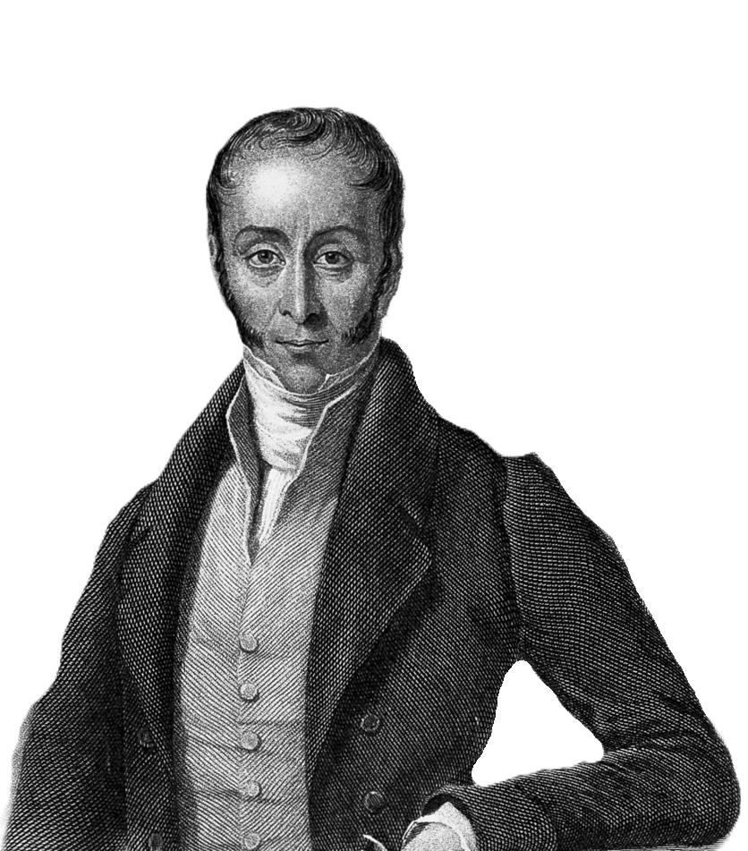
William Alexander Mackinnon’s Survey of Opinion Houses of Parliament, 11 March 1841
What is the source?
  Debate Contribution: argued for a parliamentary committee on allowing labourer (‘coolie’) immigration from India to colonies (e.g., British Guiana, West Indies).
Issue: addressing post-abolition labour shortages with ‘free labour’ instead of slavery (Slavery Abolition Act 1833).
Reason for support: matter was too important and divided for immediate decision.
Whig/Liberal MP from 1819-1865 (also a colonisation commissioner for South Australia)

Slide 6
William Alexander Mackinnon’s Survey of Opinion Houses of Parliament, 11 March 1841
CONTEXT: Colonial Passengers Bill...
  Seeks to regulate emigrant transportation to the colonies, aiming to prevent ‘abuses’ that had occurred during earlier mass (forced) migrations.
Mackinnon’s Critique: the bill sets out principles, but the government fails to apply them effectively, particularly regarding the welfare and settlement of Indian labourers.
Bill = never passed...
Whig/Liberal MP from 1819-1865 (also a colonisation commissioner for South Australia)

Slide 7
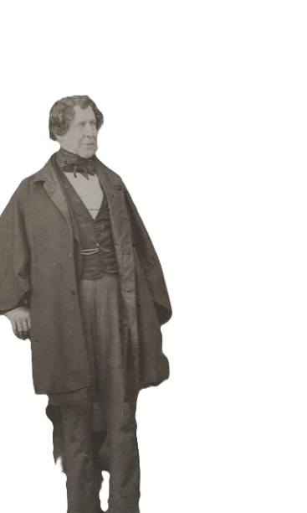
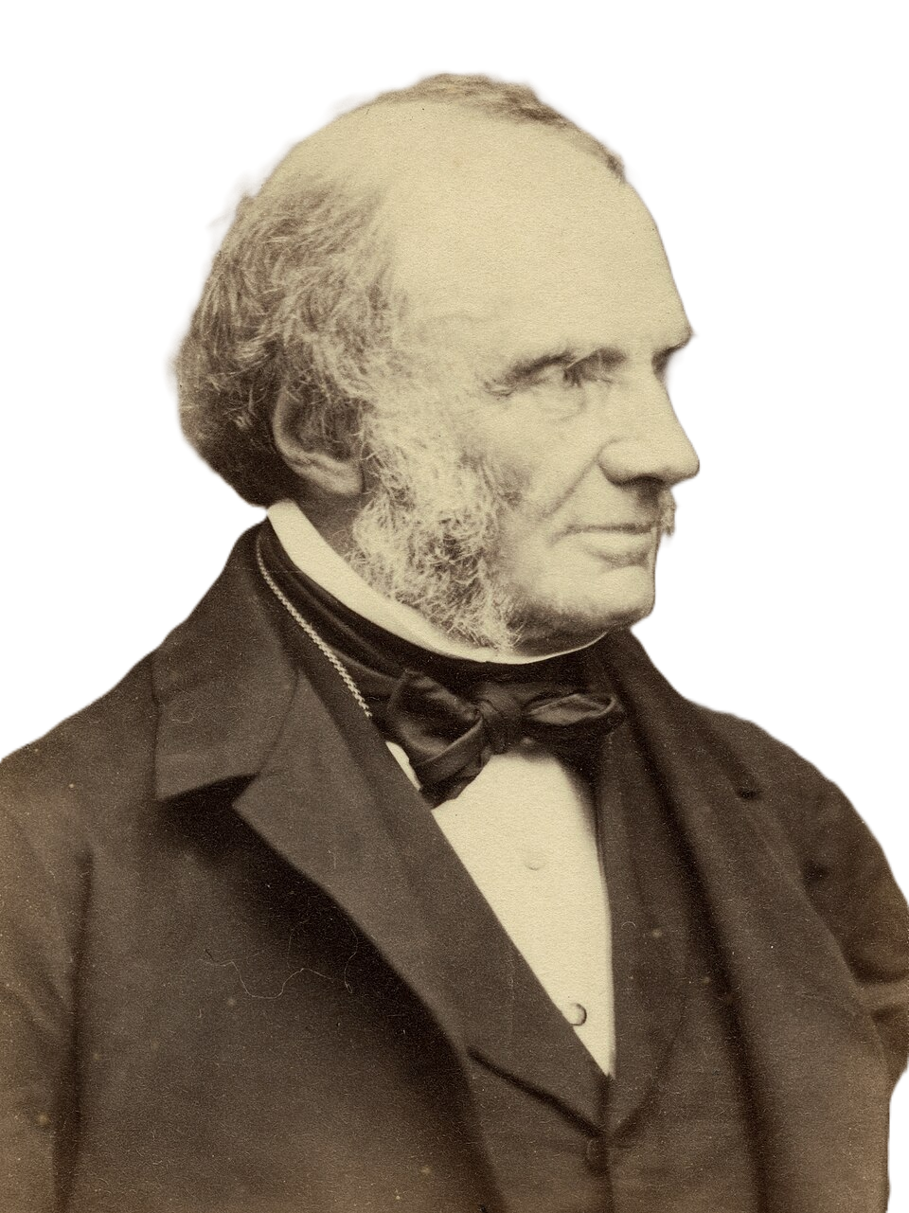
“We are not less opposed to the plan of recruiting the negro population of the West Indies from Africa… I do not perceive that any provision is made to secure to the emigrants on their arrival a proper reception, or to determine in what manner they shall be settled… I have thought it my duty… to advise the Queen to disallow this ordinance.” (October 1839)
Lord Russell, Colonial Secretary, 1839-41
“Freedom of labour is the general principle, and restriction should be the exception… the happiness of the inhabitants of the colony… is the chief object. Encourage religious instruction, let them partake of the blessings of Christianity, preserve order and internal peace.” (February 1840)
Lord Normanby, Colonial Secretary, 1839

Slide 8
William Alexander Mackinnon’s Survey of Opinion Houses of Parliament, 11 March 1841
“You have done right. Let not this odious traffic (slavery) be renewed, let it die for ever.”
“…if you can by certain humane, considerate, and good enactments, promote the welfare of the inhabitants of India… if you can ameliorate the condition of the sons of India or of Africa, if you can augment their happiness…”
Whig/Liberal MP from 1819-1865 (also a colonisation commissioner for South Australia)

Slide 9
William Alexander Mackinnon’s Survey of Opinion Houses of Parliament, 11 March 1841
“Do not forget, that the British public cannot exist without sugar… if this sugar cannot be obtained from our colonies, slave-made sugar will be required…”
“There are no bounds to the productions that may be obtained from Guiana… if these can be obtained by laws consistent with humanity, well and good, if not, let them be discarded for ever.”
Whig/Liberal MP from 1819-1865 (also a colonisation commissioner for South Australia)

Slide 10
William Alexander Mackinnon’s Survey of Opinion Houses of Parliament, 11 March 1841
Imperial Citizenship as:
  Theoretical / Imagined?
  Conditional
  Instrumental
  Regulated
Whig/Liberal MP from 1819-1865 (also a colonisation commissioner for South Australia)

