Slide 1
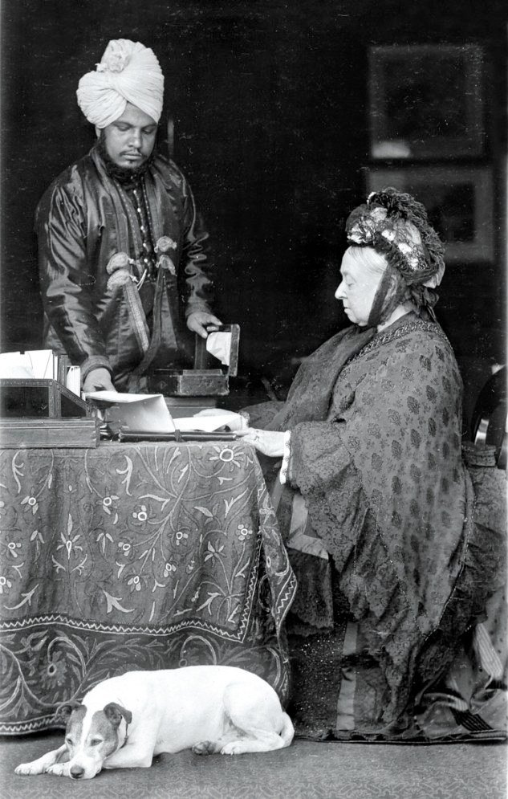
Queen Victoria and Abdul Karim.
16 October 1897 Taken in the Garden Cottage at Balmoral, 1897.

