Slide 1

From Prison Colony to White Australia
Archive Items
Group One

Slide 2
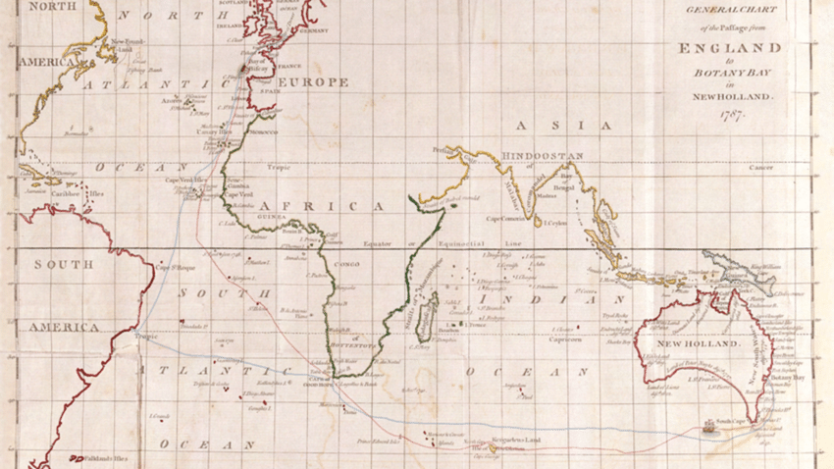
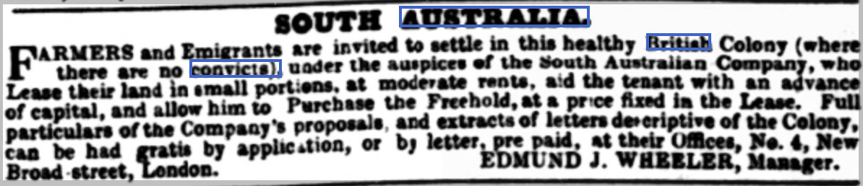
Weekly Dispatch (London) 17 May 1840
Notes:
An advertisement placed in the Sunday 17 May 1840 edition of the Weekly Dispatch newspaper, London, in which Edmund J. Wheeler, the Manager of South Australian Company, invites British farmers and others to settle into a new colony.
Background on South Australian Company – created in 1835 to see the implementation of the South Australia Act 1834 to make the newly created province an economic success and achieve self-dependency. Land sales were pursued and helped to achieve the establishment of South Australia. No direct links or funding from the British Government but instead set up and funded by philanthropists and businessmen.
Point on origin: Weekly Dispatch was the third-highest circulated newspaper in 1840, only behind the Times and Morning Chronicle, with 43,750 weekly issues (Victorian Periodicals: a guide to research, 1978, Modern Language Association of America). Therefore, wider readership base and one of the premier newspapers for the population to get their information. By placing an advertisement in the Weekly Dispatch, the South Australian Company was seeking to reach a large number of people, highlighting the funding that must be backing the organization (to afford an advertisement in such a large newspaper) to encourage emigration and reveals that a large enough portion of readers are considered to be wealthy enough to afford the required land purchases, alongside having certain training abilities/ educational attainments to contribute to the new province’s self-sufficiency – farmers for instance.
Content: immediate reference to the ”healthy British Colony”, highlighting the importance of medical well-health played in the colonisations and migration of Australia. The almost immediate reference to well-health here reinforces the idea that migration would only occur if medical expectations were met. People would not move to a place in which disease was rampant. The very mention of ”healthy” emphasizes that disease was so associated with Australian colonies that a “healthy” one was, perhaps, the exception.
Content: explicit mention of “where there are no convicts” - Australia had been used as a penal colony to such an extent that in the popular memory and perceptions of at least those who were literate and read newspapers/periodicals, this advertisement had to distance itself from this image. This mention, along with the eventual willing migration of British people to the province of South Australia, aided to remove the idea of Australia as solely a penal colony, but instead akin to the more modern colonies of Canada and New Zealand.
Content: Additional information is available through contacting the South Australian Company’s offices in central London. These would include the “Company’s proposals and extracts of letters descriptive of the Colony” which demonstrate the benefits of the Colony in the best manner possible – as viewing the Colony before moving would be impossible in 1840. Additionally, these proposals and descriptive letters would be “had by gratis by application, or by letter” further reinforcing the idea that the company itself had significant financial backing to invest in these materials to give out, freely, to interested Britons to encourage migration. Also opens up the exploration of migration to South Australia to those who are not considerably wealthy, such as farmers, due to the free materials and “pre-paid” letter.
Overall: the advertisement is a very interesting archive item as it demonstrates the concerted effort by a private, non-governmental organization to encourage, and provide the pathway to, migration to South Australia for the labouring classes, and wider British society. Further, it illuminates the existence of stereotypes of Australia in 1840 among British society, of disease and criminality, and highlights how there has already been an establishment of colonies in Australia, with the colony in question being an addition to Australian colonies.

Slide 3
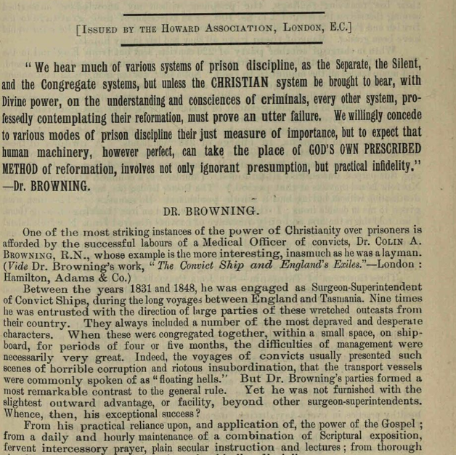
Christianity amongst Prisoners
Howard League of Penal Reform, Late 19th Early 20th Century
The Howard Association (formed 1866) campaigned on reducing the severity of punishment and promoting rehabilitation over punishment.
Transportation of prisoners to New South Wales ended 1840, to Tasmania 1853 and to Western Australia 1868.
The text is weighing the more humane policies for dealing with prisoners, it mentions the different methods being used around the empire, and that there is no consensus.
Separate System (Pentonville, solitary isolation), Silent System (Aurburn Prison, NY, Prisoners must maintain absolute silence), Congregate System (prisoners work and live together in groups).
The text uses the example of Dr Browning to highlight the importance of religion and education in Prisoner reform.
The text then goes to deliberate a policy of prison reform that aligns with religious and moral standards.
Notes:
Language used to describe prisoners to Australia, “wretched, outcasts” “corruption, insubordination”, The officers tasked with handling the prisoners at Tasmania referred to these men as the “the worst of men” “most wretched of society”
Dr Browning made 9 trips to and from Australia carrying prisons
He argues that the most important things is fervent religious instruction, as reform. Prisoners had a “most appalling ignorance of the bible and of redemption”
His party of 200 that left Woolwich, 135 were illiterate, 76 had learnt to write, all were supplied with a bible. The prisoners amassed £7.8s.
Another party of 220, he set up 39 schools and taught all men to read.
Notes success in managing female convicts, argues that they are more difficult to govern than the worst of men.
He reformed prison practices, i.e having some prisoners appointed as constables over the others.
Connect the teaching with the Faith, “like all good men, Dr. Bwowning had great faith in Prayer: “public private and intercessory prayer”
They them use Religion to form a prison system.
Social Law “Evil communications corrupt good manners”
Divine Law “it is not good for a man to be alone”
This they use to note that a separate prison system is important, but prolonged solitary confinement is prolonged, cruel and mischievous.
Officers for prison duties have powers of good and evil over their fellow men. Governors must select men of moral and religious character, and they should be trained by Chaplains.
Uses examples such as the Animals in the London zoological gardens did not like a certain attendant because he did not talk to them. To this extent superior prison officers such as the governor must directly engage with the wardens.

Slide 4
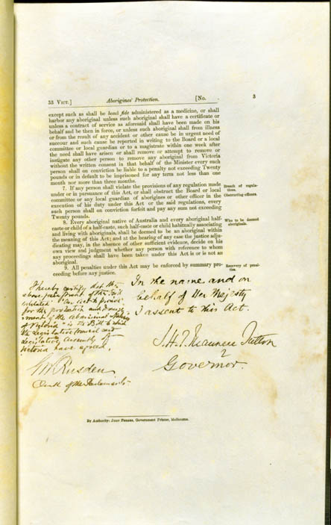
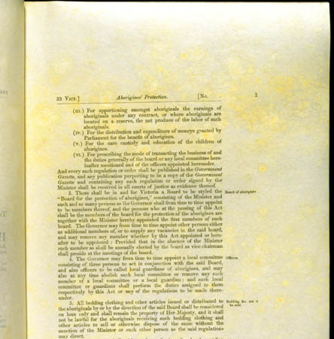
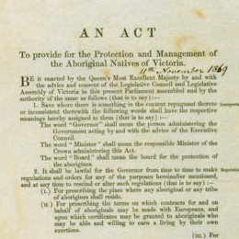
Aboriginal Protection Act of 1869
This Act was a restriction on the rights of the Aborignal people of Victoria
Coincided with other acts designed to extend rights for White men, in Australia
This act gave extensive powers to the Governor and the Board to restrict and control every aspect of Aboriginal life
From employment to freedom of movement marriage and where one could even reside
Furthermore, as the name suggests, it was an act of legislation which was quite controlling with implied paternalistic elements

Slide 5
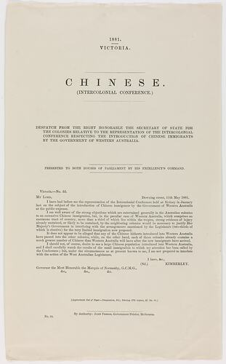
Chinese Intercolonial Conference, Government of Victoria: 1888
Meeting driven by Anti-China sentiment (Which can be seen to have a global consensus in the Western world at the time)
Anti-Chinese sentiment had been growing since thee 1850s, since Gold had been discovered in New South Wales and Victoria, which saw a rise in Chinese migration.
Key leaders in the conference such as Alfred Deakins drafted resolutions such as these to restrict Chinese immigration seeing them as a threat to the labour market and assimilation.
The goal of this was to present a united front to the British government to approve of limiting/restricting Chinese immigration.
It was such meetings as these which laid the groundworks for Australia's 1901 Immigration Restriction Act, creating the "White Australia Policy" and barring "prohibited" immigrants.

