Slide 1
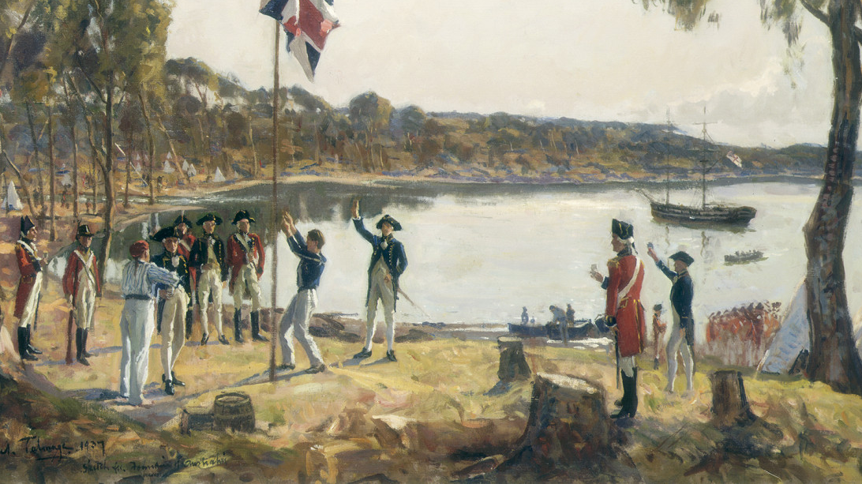
Empire Settlement Act, 1922
From Prison Colony to ‘White Australia’

Slide 2
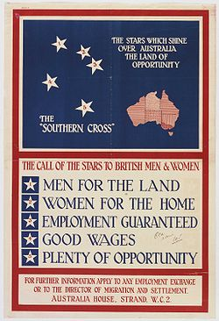
Context behind ‘Empire Settlement Act, 1922’
Australia consistently aimed to preserve a British national identity – This was after Australia adopted the ‘’White Australia Policy in 1901, excluding non white immigrants.
After convict transportation ended, Australia sought free settlers and used assisted passages and incentives, jointly funded by the colonial Australian and British government to attract mainly poorer British migrants.
Before WWI, immigration expanded and schemes emerged to bring specifically bring children and youths from Britain to Australia for rural labour. After the war, the Empire Settlement Act 1922 amplified this.

Slide 3
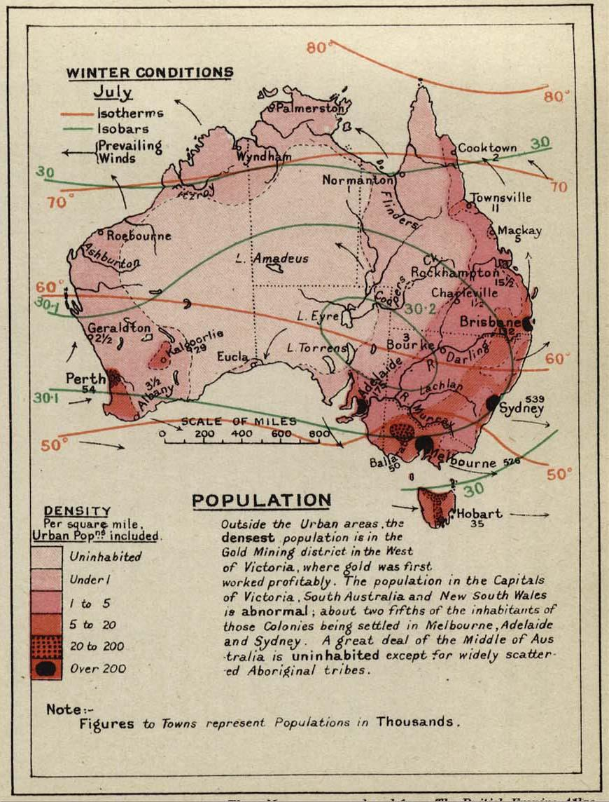
Source Description
1922, UK Parliament, Colonial Secretary: Leo Amery
Be it enacted by the King's most Excellent Majesty • It shall be lawful for the Secretary of State in association with the government of any part of His Majesty's Dominions or with public authorities or public or private organisations either in the United Kingdom or in any part of such Dominions to formulate and co-operate in carrying out agreed schemes for affording joint assistance to suitable persons in the United Kingdom who intend to settle in any part of His Majesty's Overseas Dominions. • An agreed scheme under this Act may be either: a development or a land settlement scheme; or a scheme for facilitating settlement in, or migration to, any part of His Majesty's Overseas Dominions by assistance with passages, initial allowances, training, or otherwise.
The joint schemes (British and Australian governments) could:
settle people on land or in development projects, or
help people migrate by paying for ship fares, giving starting money, training, or other support.
The British government agreed to spend large amounts of money on this:
up to £1.5 million in 1922, and
£3 million per year for the next 14 years.

Slide 4
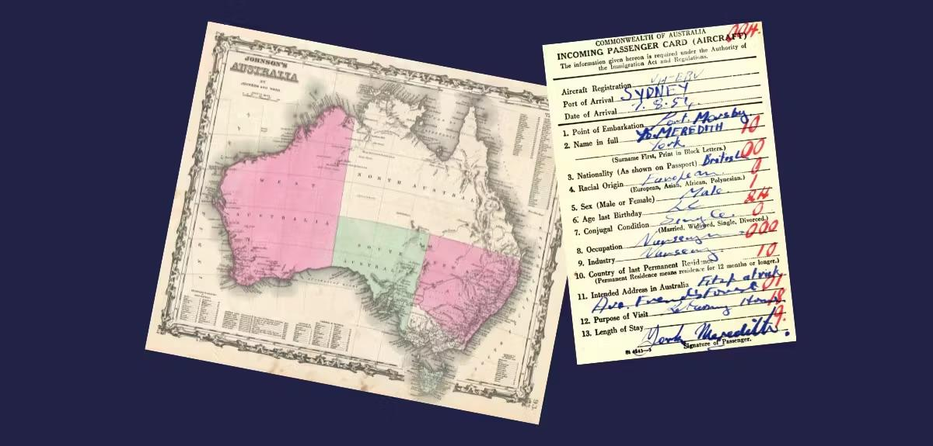
Debate Analysis
Order of the Day for the Second Reading read.
House of Lords (Formally introduced and defended by the Earl of Crawford)
Hansard.
1922
The Bill was deliberately broad, allowing many types of schemes.
“It is drafted, and deliberately drafted, in very wide and general terms.”
Relevance to Australia - Australia seen as the most urgent case.
“I think there is no case so urgent as that of Australia at the present time.”
Australia’s “great distance which separates [it] from Europe” limited spontaneous migration.
Migration as an imperial, not national solution.
“transfer her surplus population from those spots which are already overcrowded to those in which there is… abundant open space.
Aim to send “the finest specimens of our congested population to the empty spaces of the Empire.”

Slide 5
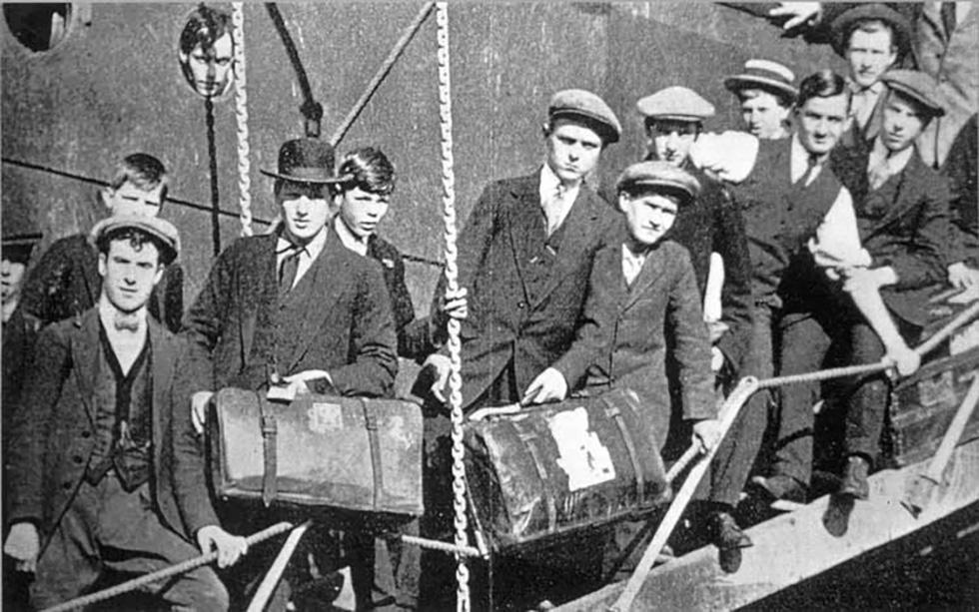
Impacts and Ideas
Key Ideas:
State-directed migration
Coordinated migration within the Empire.
Revealed racialised outlook on migration within the Empire.
Who was impacted?
Britain: Migrants, children, government, treasury, ex-servicemen and officers.
Australia: Commonwealth government, rural communities, indigenous.
Non-European peoples.

