Slide 1
Foreign Bodies: From prison colony to ‘White Australia’
Professor Roberta Bivins
Centre for the History of Medicine
University of Warwick
peopleshistorynhs.org

Slide 2
Seeing White Australia
Voice of the People: The White Australia Policy 1962
Bringing Them Home Australian Human Rights Commission (1997)

Slide 3
Discussion
In your own archive groups, distil the main ideas you want to share about the readings you covered for this week.
Archive finds: This week’s archive groups will share contributions in our module gallery, and relate it to your readings for this week.

Slide 4
What defines the ‘ideal’ Australian migrant?
Overarching question:
What does the history of colonial settlement in Australia tell us about models of the ‘ideal migrant’ and their intersections with national myth?
Specific Questions:
What were convicts ‘good’ for? Could they be the ‘germs of nations’?
What were the ‘ethical dilemmas of empire’? P. 81
How did the model of convict transportation fit with and/or deviate from ideals about the British empire, free movement, and the primacy of Westminster?
Why ‘White Australia’ – and why (or when) does the ‘White’ continent have a ‘Black’ history?

Slide 5
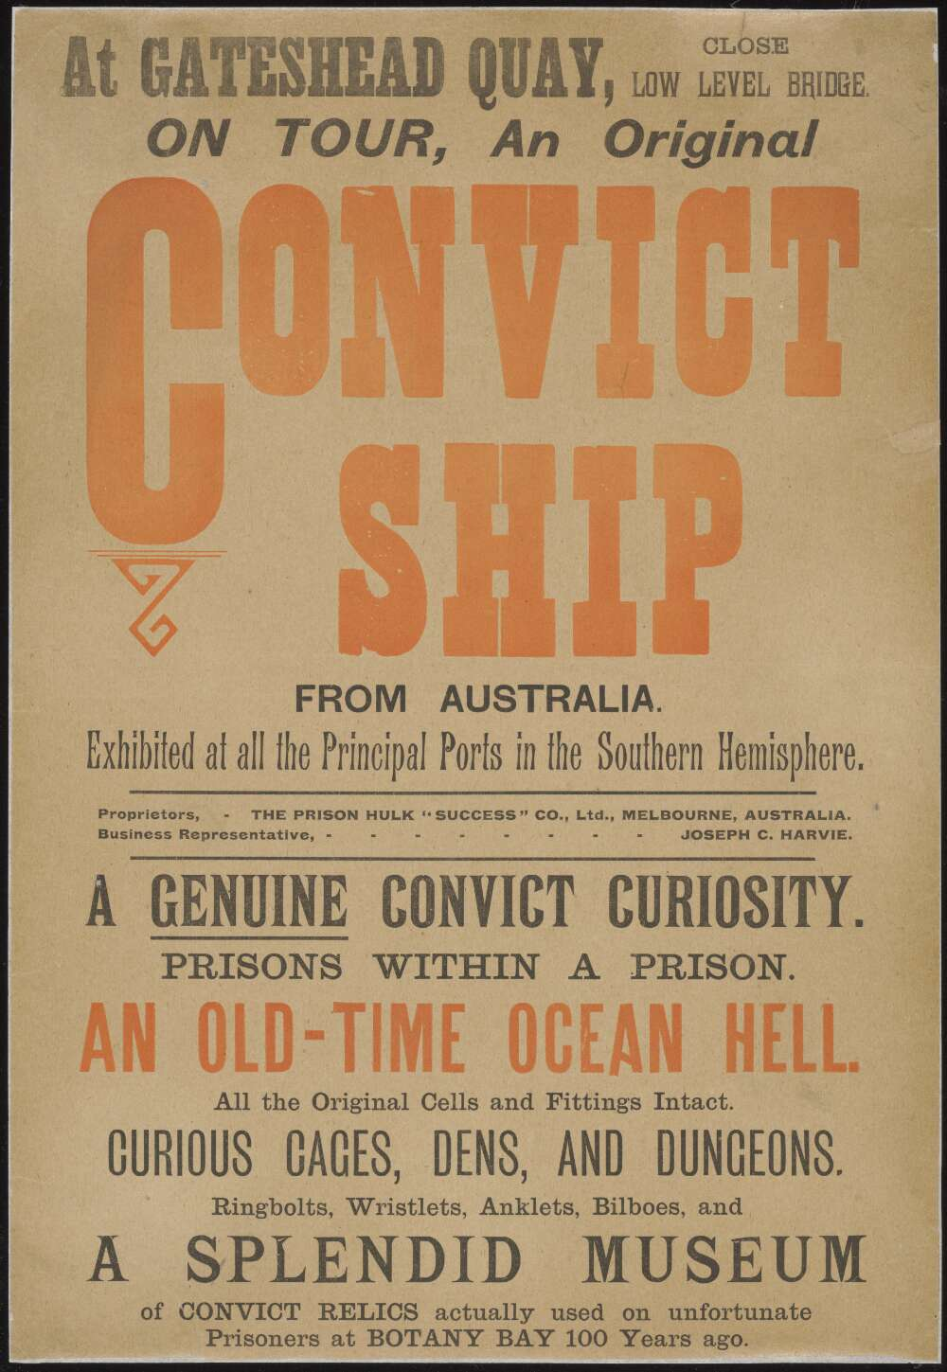
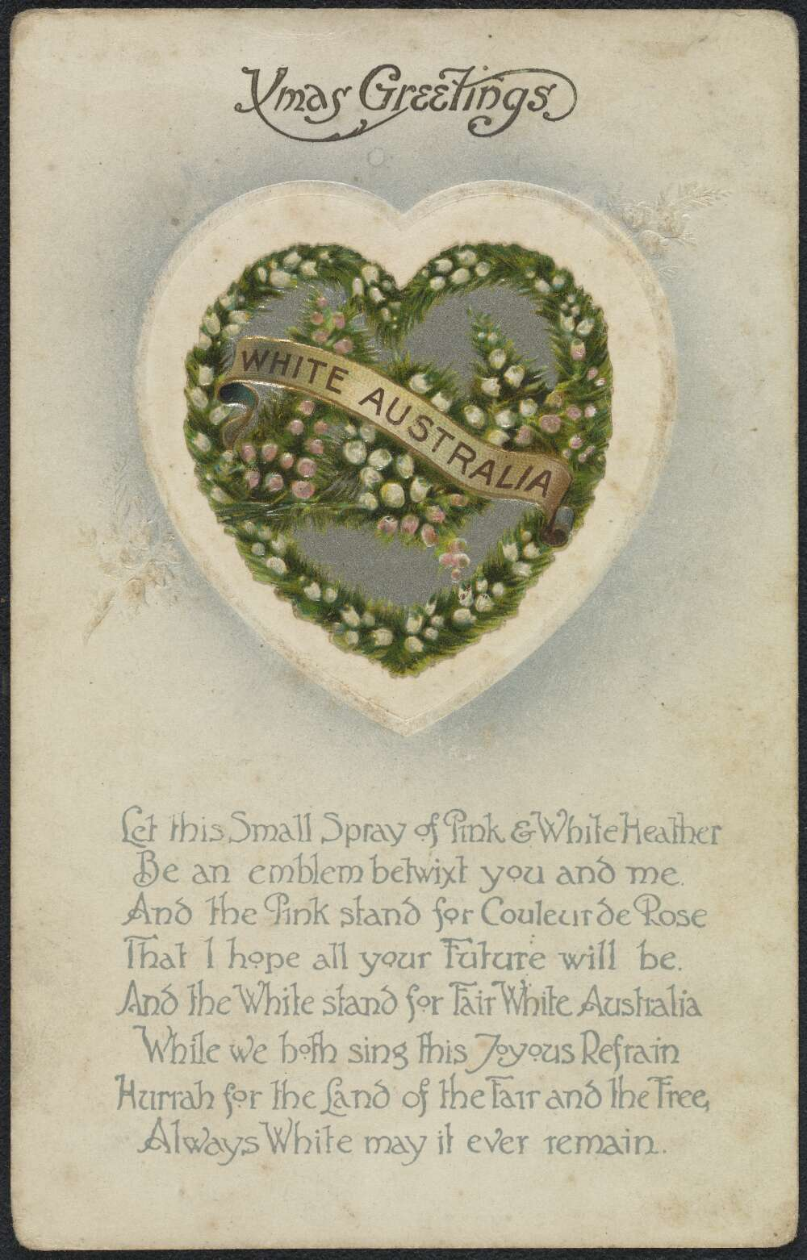
Archive Treasure Hunt
Using the resources below, work in your groups to find:
A relevant political or editorial cartoon about ‘White Australia’
A primary source exploring the indigenous experience of colonisation and/or migration
A visual representation of ‘convicts’ or ‘migrants’ that speaks to their place in Australian national myth.
Digital panopticon
Trove, National Library of Australia

