Slide 1
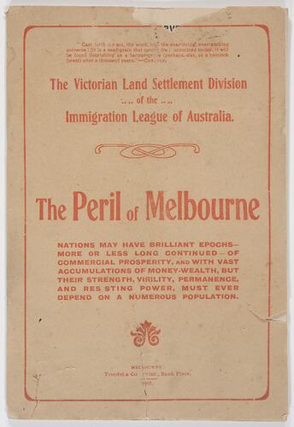
Booklet - 'The Peril of Melbourne', Victorian Land Settlement Division, Immigration League of Australia, 1907
Immigration League of Australia
A pressure group, not a government department
Formed to encourage and expand immigration, especially to Victoria
Closely aligned with:
Business interests
Landowners
Urban commercial elites
Worked to influence public opinion and policymakers through pamphlets, speeches, and reports
The pamphlet was produced by the Victorian Land Settlement Division of the Immigration League of Australia. This places it firmly within the pro-immigration lobbying networks that operated in Australia in the late 19th and early 20th centuries.
The pamphlet’s purpose is persuasive, not informative.
It aims to pressure governments and the public to support increased immigration.
It frames immigration as an urgent necessity, not a long-term option.
The title “The Peril of Melbourne” deliberately uses alarmist language to create fear and urgency.
This suggests the source was part of a coordinated lobbying effort, not a neutral assessment of Melbourne’s situation.
Significance in Australian immigration history
This pamphlet is significant because it shows that:
Immigration was actively engineered, not passive
Population growth was framed as a matter of national survival
Economic and security arguments were used to override social concerns
It helps explain why Australia:
Encouraged immigration while simultaneously enforcing racial exclusion
Linked immigration tightly to nation-building and land settlement
A 1915 Royal Commission later revealed major flaws in the settlement scheme:
Poor infrastructure (water, roads, sewerage, schools)
Farming blocks too small to be economically viable
By 1916, around 1000 homes had been built, but many residents struggled for years without basic services.
Overall, the pamphlet highlights how immigration, settlement, and nation-building ideals were promoted enthusiastically, often without adequate planning or support, revealing the gap between ideology and lived experience.
Museums Victoria Collections https://collections.museumsvictoria.com.au/items/1423706 Accessed 12 December 2025

