Slide 1
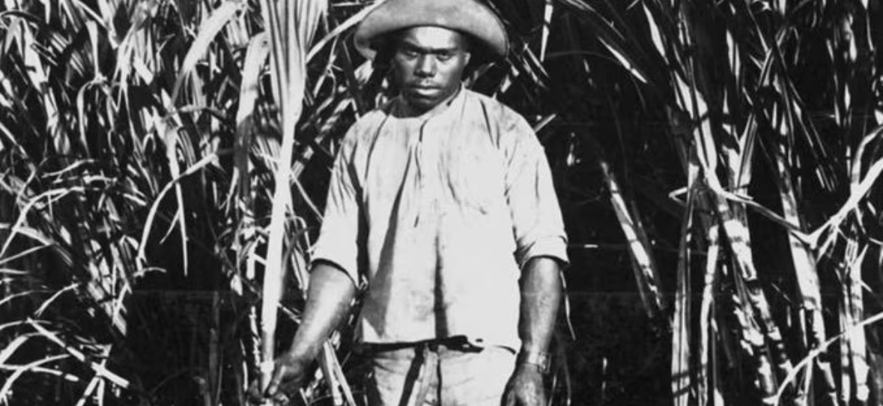
I wanted to begin with these two images because together they capture the racial logic of early Federation. On the left is a Pacific Islander cane worker, one of the thousands whose labour built Queensland’s sugar industry.
On the right is a White Australia badge: The badge was created by the Australian Natives’ Association (ANA), a powerful organisation made up of Australian-born white men. This badge shows how whiteness also functioned as a popular cultural identity, circulated and normalised through everyday objects.
Seen together, the contrast visualises the transition that Alison Bashford describes: from an economy dependent on Black and Islander labour, to a national identity that insisted Australia must be white. The, whilbadge literally maps whiteness onto the shape of the continente the worker’s image reminds us that this ‘white nation’ was built on the removal of racialised people who were already present.
.

Slide 2
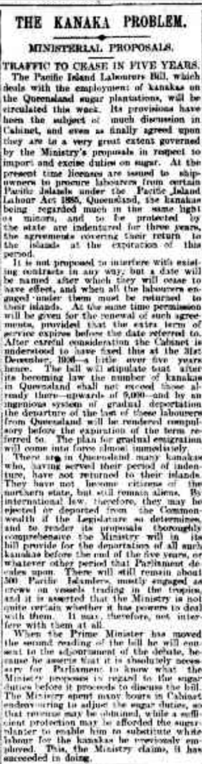
The Argus article (“THE KANAKA PROBLEM”, 26 Sept 1901) - https://trove.nla.gov.au/newspaper/article/9609837#
My primary source 1901 Argus article on deporting Pacific Islander labourers (original headline used outdated/offensive terminology)
It discusses the Pacific Island Labourers Bill, which required the mass deportation of approximately 6,000 Pacific Islanders from Queensland's sugar industry by 1906.
In terms of context, this occurred at an important moment in the new Commonwealth's identity as a white nation
Islanders had played an important role in the sugar economy for decades, but after Federation, they were reclassified as racially unsuitable for Australia's future.
This source documents the shift from reliance on Black labour to a national project of racial purification.
The article comes from a mainstream Australian newspaper and is aimed at a white settler audience. Its language is closely aligned with government thinking.
Islanders are referred to as 'aliens', like'minors' who require state control, and their removal is portrayed as 'ingenious system of gradual deportation’.
This suggests that media coverage helped normalise deportation as responsible governance rather than a human cost of nation-building.
The source reveals how racial exclusion was implemented through bureaucracy and economic policy.
Deportation is linked to lowering sugar tariffs so that white workers can replace Islander workers.
The article views the presence of Pacific Islanders as a policy issue rather than a community.
It perfectly demonstrates Bashford's point (from today's reading) that early Australia combined race, labour, and national health, removing non-white populations to create the imagined body of a white nation.
CONTEXT:
THE KANAKA PROBLEM. -A. MINISTERIAL PROP OSWALD.
TRAFFIC TO CEASE IN FIVE YEARS. The Pacific Island Labourers Bill, which deals with the employment of kanakas on the Queensland sugar plantations, will be circulated this week Its provisions have been the subject of much discussion in Cabinet, and even as finally agreed upon they are to a very great extent governed by the Ministry's proposals in respect to import and excise duties on sugar At the present time licenses are issued to ship owners to procure labourers from certain Pacific islands under the Pacific Island Labour Act 1885, Queensland, the kanakas being regarded much in the same light as minors, and to be protected by the state are indentured for three years, the agreements covering their return to the islands at the expiration of this period It is not proposed to interfere with existing contracts in any way, but a date will be named after which they will cease to have effect, and when all the labourers on gaged under Hiern must be returned to their islands At the same time permission will be given for the i mew al of such agreements provided that the extra term of service expires before the date referred to After careful consideration the Cabinet is understood to li ive fixed this nt the 31st December 1906 a little over five years hence 'The lull will stipulate that after its becoming law the number of kanakas in Queensland shall not exceed those already there-upwards of 6,000 and by an ingenious system of gradual deportation the departure of the last of these labourers from Queensland will be rendered compulsory before the expiration of the term referred to. The plan for gradual emigration will come into force almost immediately There amending Queensland Many thanks who, having served their period of in ten turf, have not returned to their islands they have not become citizens of the northern state, but still remain aliens By international law, Therefore, they may be ejected on deported from the Common- ave with if the Legislature so determines, and to render its proposals thoroughly comprehensive the Ministry will in its bill provides for the deportation of all such kanakas before the end of the five years, or whatever other period that Parliament decides upon There will still remain about 500 Pacific Islanders mostly engaged as crews on vessels trading in the tropics, and it is asserted that the Ministry is not quite certain whether it has powers to deal with Allen It may therefore, not interfere with them at all When the Prime Minister has moved the second reading of the bill he will consent to the adjournment of the debate, because he asserts that it is absolutely acces sin for Parliament to know what the Ministry proposes in regard to the sugar duties before it proceeds to discuss the bill The Ministry spent many hours in Cabinet endeavouring to adjust the sugar (allies, so that revenue may be obtained while a sufficient protection may be afforded the sugar in water to enable him to substitute white labour for the kanakas he previously employed This the Minister claims, it has succeeded in doing

