Slide 1
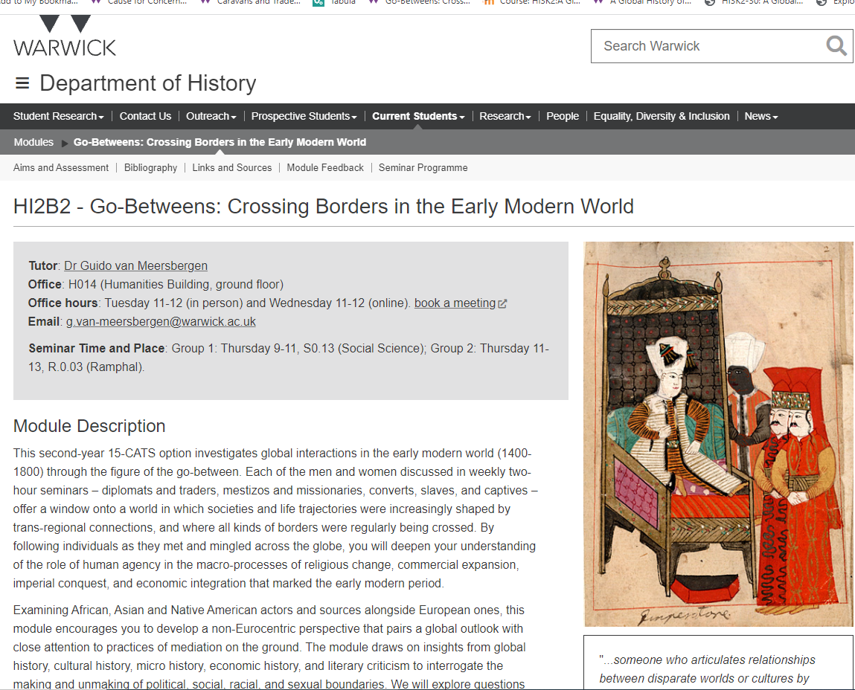
Go-betweens ‘were instrumental in inventing, reinforcing or reconfiguring connections between different parts of a globalised world’
- Schaffer, Roberts, Raj, and Delbourgo, The Brokered World, xii
https://www.youtube.com/watch?v=C65Phu_EAEs

Slide 2
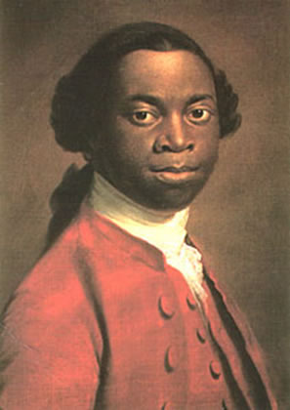
What are Go-Betweens?
How can one define an early modern “go-between”?
Why did go-betweens exist?
What did go-betweens go between?
In what kind of spaces did go-betweens operate?

Slide 3
Some Definitions
‘The go-between […] is thus not just a passer-by or a simple agent of cross-cultural diffusion, but someone who articulates relationships between disparate worlds or cultures by being able to translate between them.’
- Schaffer, Roberts, Raj, and Delbourgo, The Brokered World, p. xiv
‘Go-betweens […] exist because there are transactions, and, in particular, because there is friction in those transactions. This friction – a barrier of language, knowledge, skill or material resource that takes some work to overcome – requires mediation, and the go-betweens mediate.’
Ogborn, ‘”It’s not what you know…”’, p. 170
‘A liminal figure […], forever crossing borders and thereby problematizing the notion of borders itself, the go-between inhabits a zone of double alienation, [a] kind of ‘third space’.’
- Höfele and Koppenfels, Renaissance Go-Betweens, p. 6

Slide 4
Historiographical Context
Instead of “the common, classical methodology of comparativism, which constitutes its objects in contrasting, dualistic, terms, with clear boundaries between them”, scholarly attention increasingly turns “to global interconnections, intercultural encounter, and negotiation”
- Raj, ‘Go-Betweens, Travelers, and Cultural Translators’, p. 39
“…new approaches have striven to bring out the enmeshed nature of cultures across the world, the commonalities on which intercultural contact is constructed and the ways people or groups of people cross cultural barriers”
- Raj, ‘Go-Betweens, Travelers, and Cultural Translators’, p. 40
“…the crucial need for mediation, brokerage, and cross-cultural communication in establishing sustained exchange between disparate and different cultures and the role that “cross-cultural brokers”, or go-betweens, have played in this context”
- Raj, ‘Go-Betweens, Travelers, and Cultural Translators’, p. 40

Slide 5
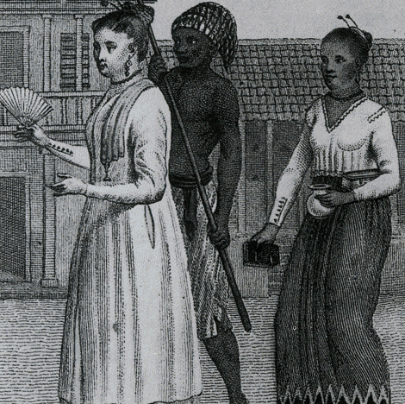
Studying Go-Betweens
How does a focus on go-betweens help us understand the early modern world?
What are the limitations of the go-betweens perspective?

Slide 6
Studying Go-Betweens
How does the perspective of the go-between challenge Eurocentric narratives?
How does an interest in go-betweens connect to present-day concerns?

Slide 7
Go-Betweens in the Present

Slide 9
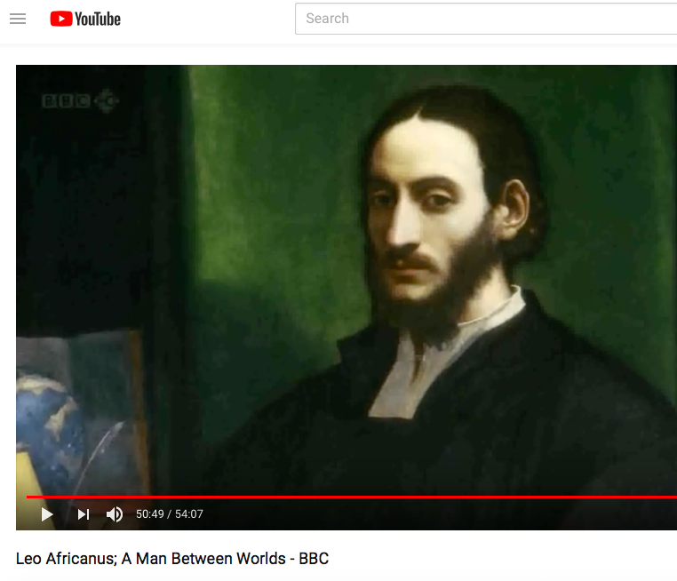
Leo Africanus: A Man Between Worlds - BBC

