Slide 1
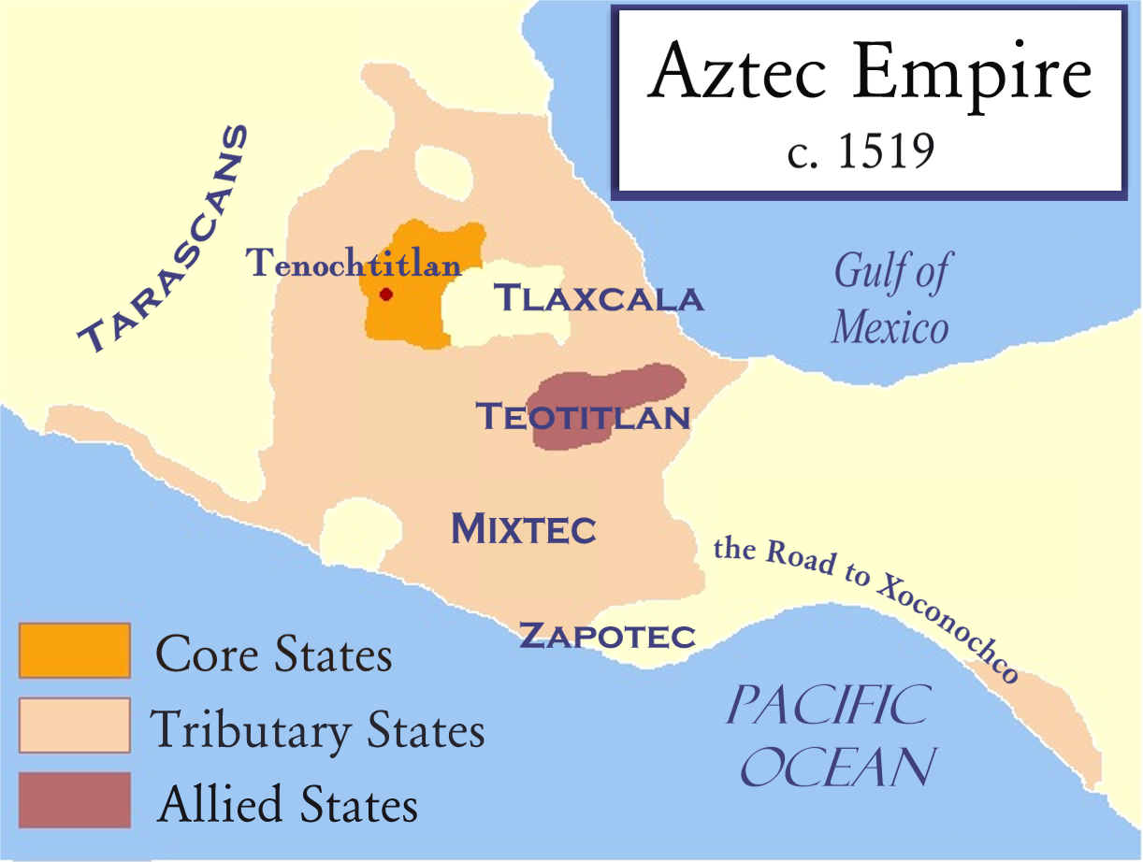
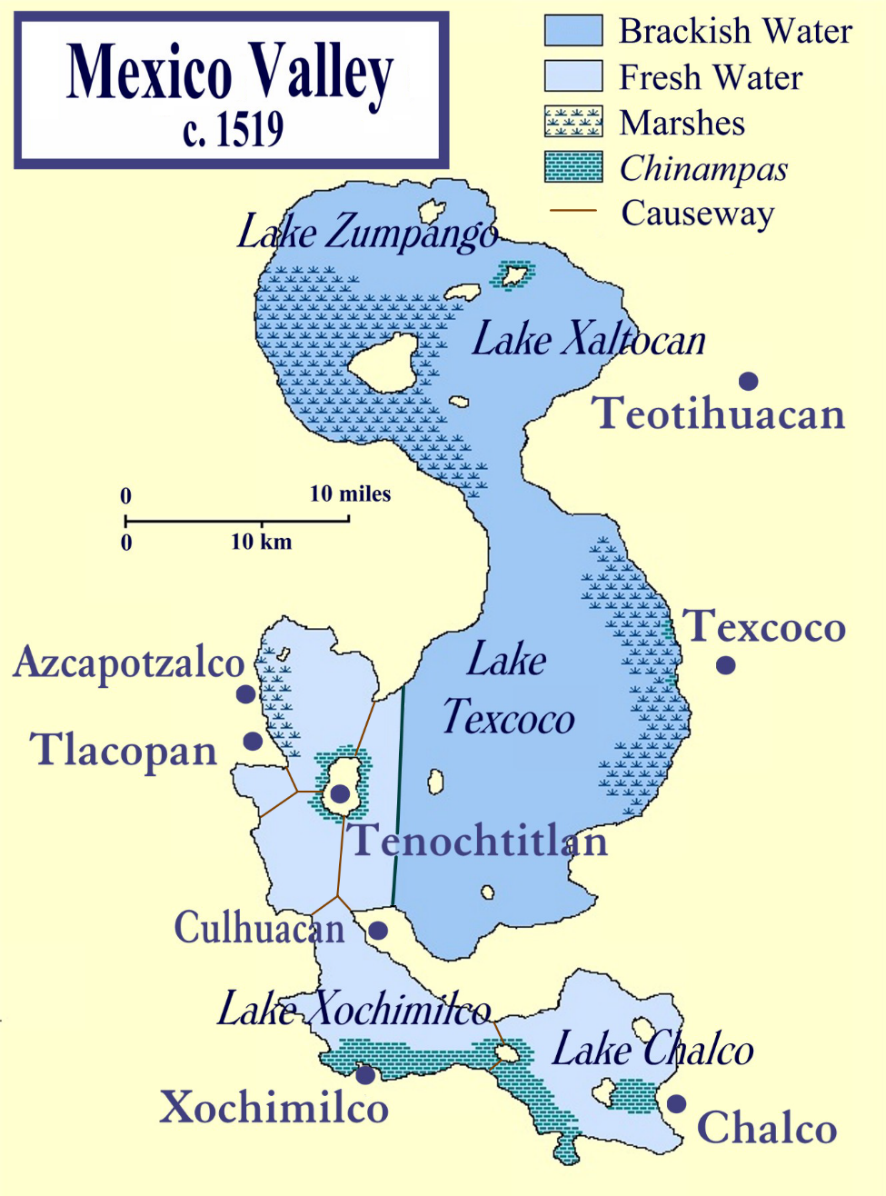

Slide 2
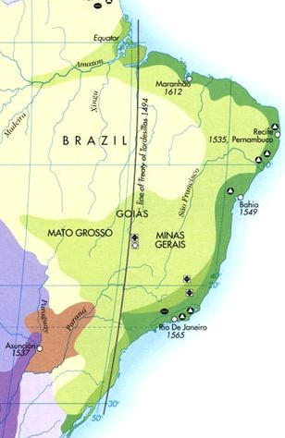

Slide 3
Go-betweens and the Colonization of Brazil
How does Alida Metcalf define go-betweens?
Do you find her definition useful? Why/why not?
How do the go-betweens we’ve studied so far fit in Metcalf’s typology?

Slide 4
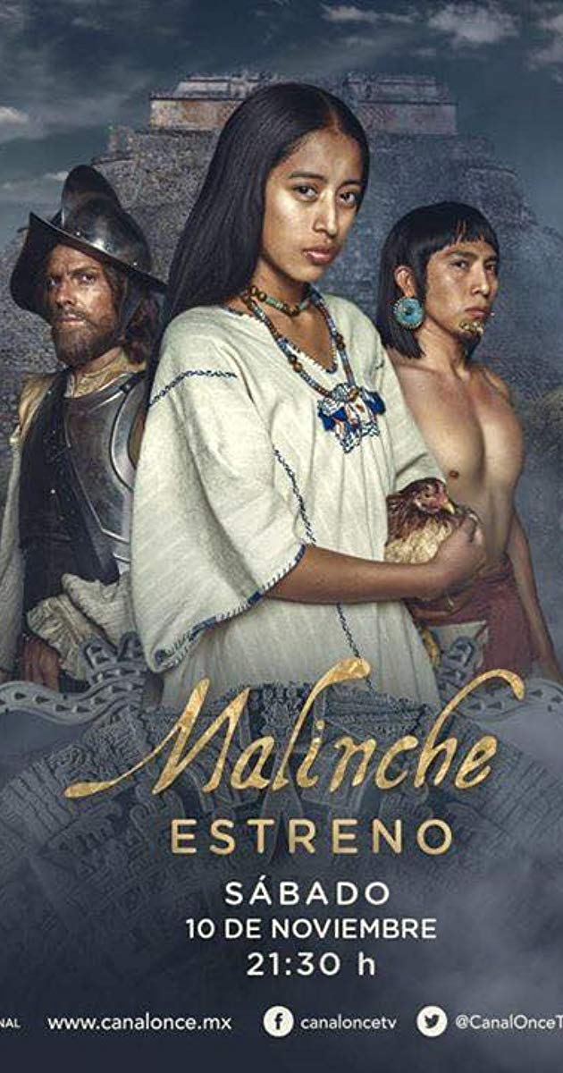

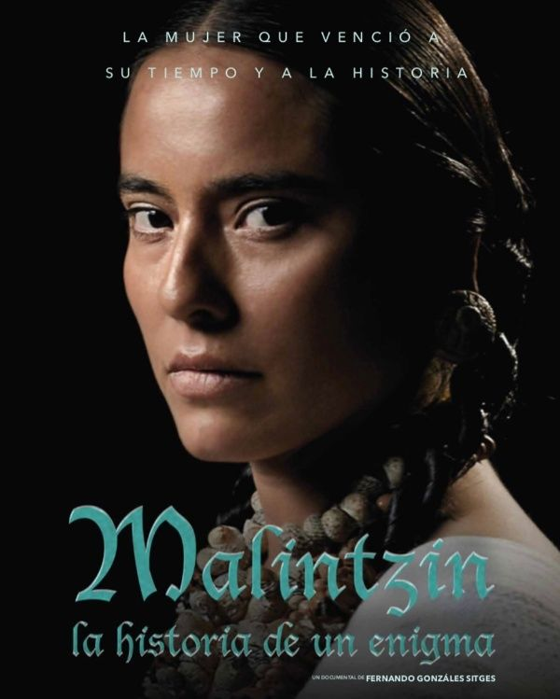
Malinche – TV series (2018)
Hernán – TV series (2019)
Malintzin: la historia de un enigma (2019)

Slide 5
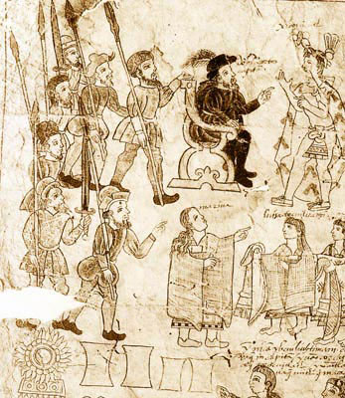
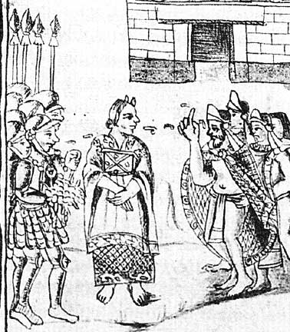
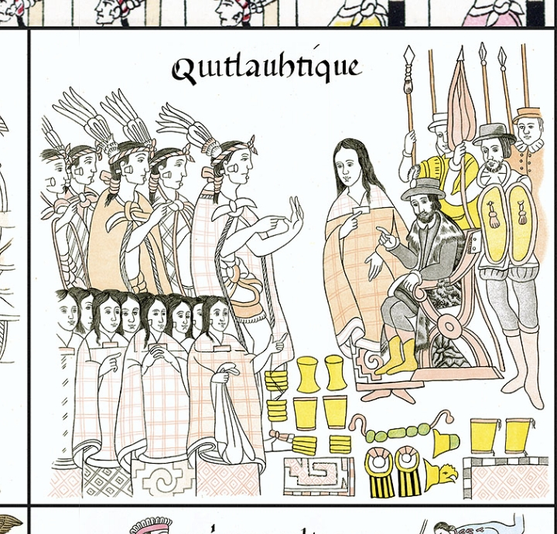
From: Lienzo de Tlaxcala (before 1585)
From: Codex Tizatlán (16th c.)
From: Florentine Codex (before 1590)

Slide 6
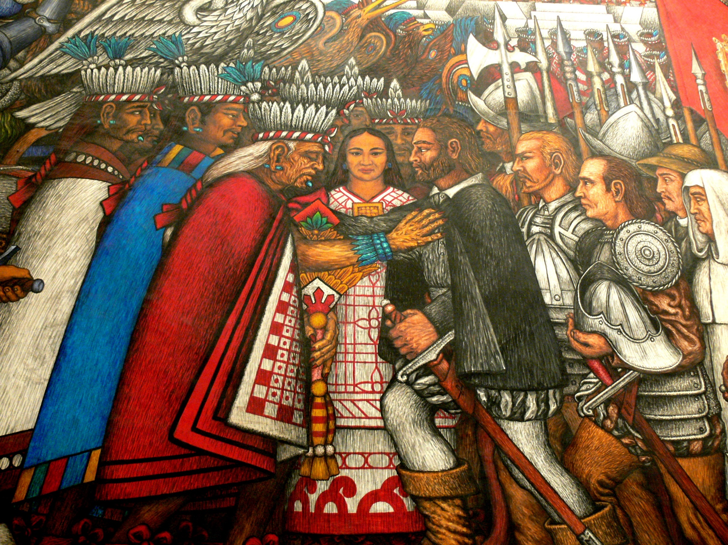
Palacio do Gobierno, Tlaxcala city, Mexico. Artist: Desiderio Hernández Xochitiotzin (1922-2007).

Slide 7
‘If the Chingada is a representation of the violated Mother, it is appropriate to associate her with the Conquest, which was also a violation, not only in the historical sense but also in the very flesh of Indian women. The symbol of this violation is Doña Malinche, the mistress of Cortés. It is true that she gave herself voluntarily to the conquistador, but he forgot her as soon as her usefulness was over. Doña Marina becomes a figure representing the Indian women who were fascinated, violated, or seduced by the Spaniards. And as a small boy will not forgive his mother if she abandons him to search for his father, the Mexican people have not forgiven La Malinche for her betrayal.’
Octavio Paz, ‘The Sons of La Malinche’ (1950)

Slide 8
‘En México, tras la independencia, se ha tendido a denigrarla hasta convertirla en el arquetipo de la traidora. Todo lo contrario que el último emperador, Cuauhtémoc, elevado a encarnación de la mexicanidad por su resistencia frente a los españoles [...] nos encontramos ante el personaje más odiado de la conquista. Por eso, el término “malinchismo” designa a todos los que traicionan a su país. Marina no sería otra cosa que un monstruo, la encarnación de todos los vicios.’
La Vanguardia, 21-4-2017
Victim? Survivor? Traitor? Heroine? Mother of Mexico?
How should we interpret Malintzin’s role?
What does she teach us about go-betweens and their predicament?
3) How do you see Townsend’s role in ‘making the concubine speak’?

Slide 9
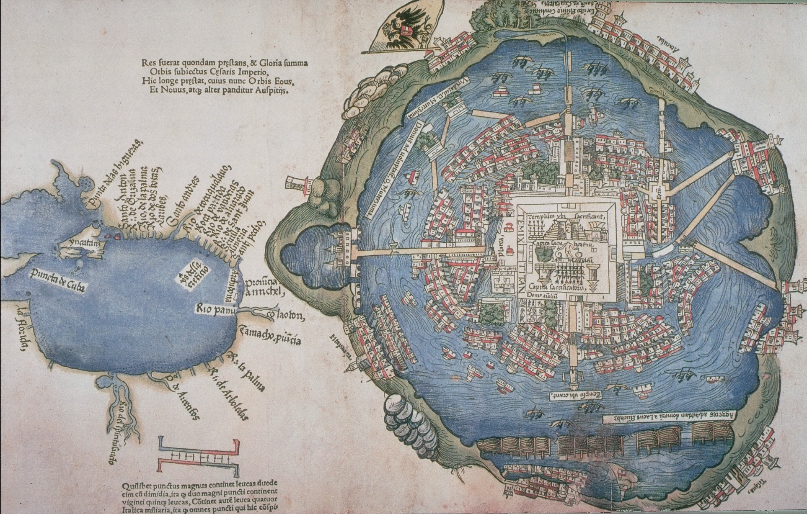
How does Hernán Cortés “translate” foreign realities in his Letter to Charles V?
Hernán Cortés’ map of Tenochtitlan, 1524

Slide 10
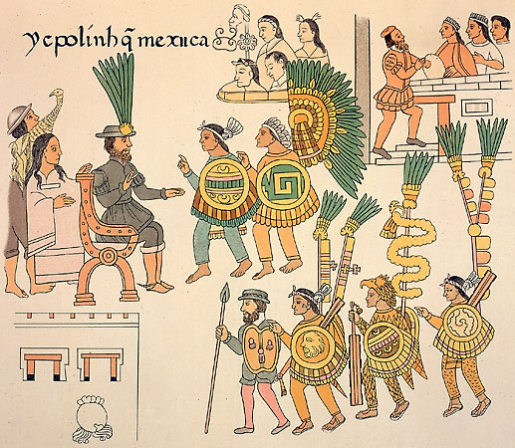

Slide 11
“Civilizations in Conflict”
Identify elements in The Florentine Codex (Victors and Vanquished; The Broken Spears) that support and challenge a reading of ‘two worlds colliding’
Can you suggest reasons for each?
How have readings of the European-Amerindian encounter changed over time and why?

Slide 12
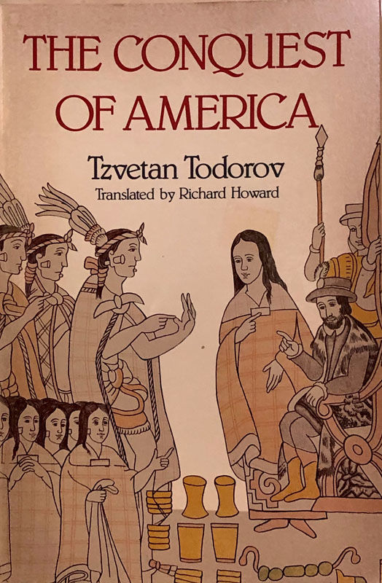

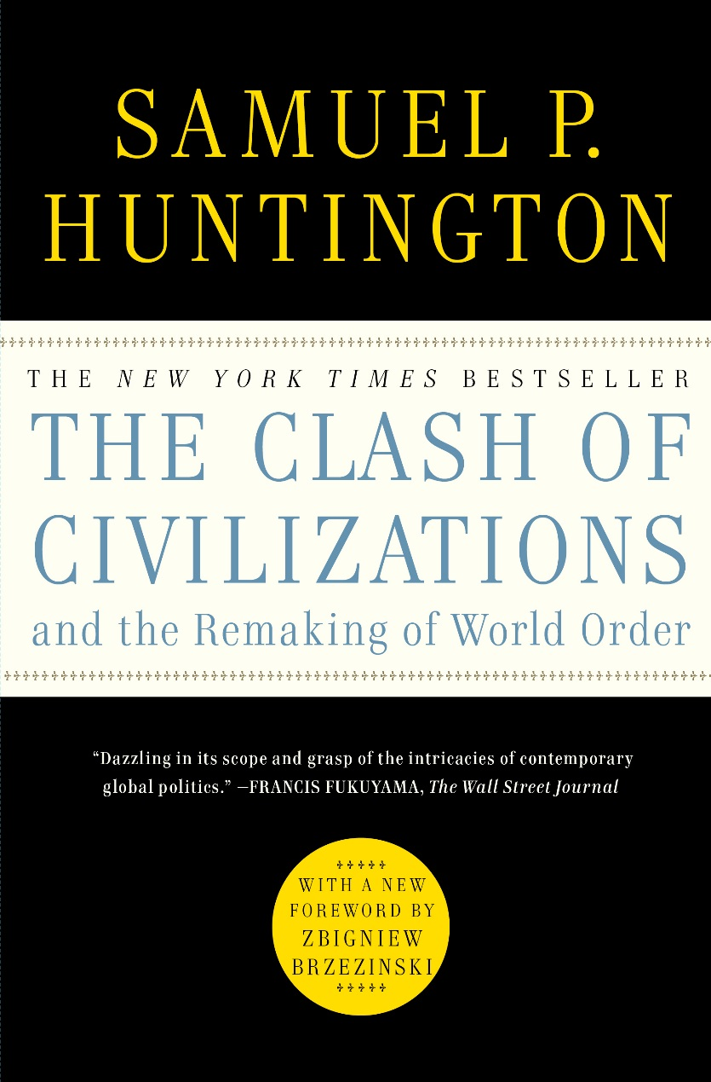

Slide 13
