Slide 1
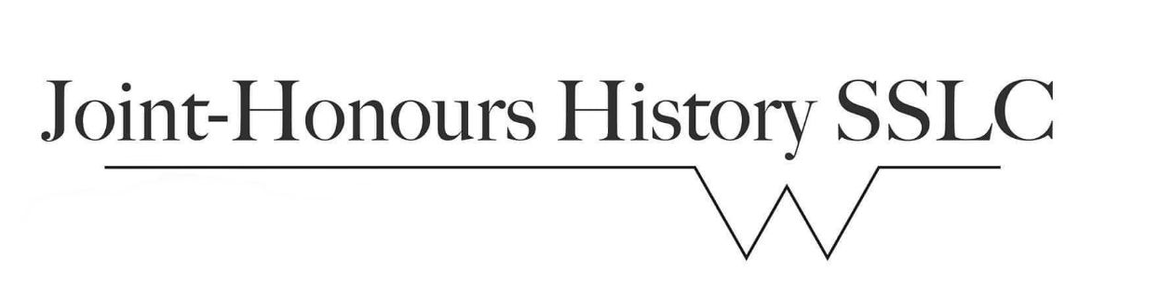




What do you think about the new curriculum?
Google form:
https://forms.gle/zk5PoUvbQsLZKogW7

Slide 2
Essay Writing Tips (1/2)
Organisation
1. Always make sure you address all aspects of the assignment
2. Stick to the assignment (word limit, submission date, format…)
3. Structure your essay clearly (introduce the topic and its relevance; make and support your case; highlight main conclusions)
Presentation
4. Ensure effective communication of ideas: accurate, relevant, to-the-point – language needs to be up to academic standards but avoid overly complex syntax and terminology!
5. Be precise about historical detail, use concepts properly, be sensitive about language use, reference facts and ideas properly
6. Proof-read: be precise with editing of text and footnotes

Slide 3
Essay Writing Tips (2/2)
Argumentation
7. Document/support your claims: it is not enough to simply argue something, it needs to be grounded in analysis (of secondary literature and primary sources) and demonstrated
8. Pick your battles: it’s better to make a limited number of points clearly and convincingly than to try to bring in too many things that cannot be sufficiently supported by the evidence you present
9. Be precise when representing other people’s ideas, particularly when it’s second-hand -> misrepresenting other people’s work shows lack of understanding, while presenting it as your own constitutes plagiarism
Footnotes (See departmental website)
Natalie Zemon Davis, Trickster Travels: A Sixteenth-Century Muslim Between Worlds (New York: Hill & Wang, 2006), p. 3. [Monograph]
Kapil Raj, 'Go-Betweens, Travellers, and Cultural Translators', in A Companion to the History of Science, ed. by Bernard Lightman (Chichester: John Wiley, 2016), pp. 39-57. [Chapter in edited collection]
Eric R. Dursteler, ‘Fatima Hatun née Beatrice Michiel: Renegade Women in the Early Modern Mediterranean’, The Medieval History Journal, 12.2 (2009), 355-382. [Article in Journal]
Lady Mary Wortley Montagu, The Turkish Embassy Letters, ed. Theresa Heffernan and Daniel O’Quinn (London: Broadview press, 2012). [Published Primary Source]

Slide 4
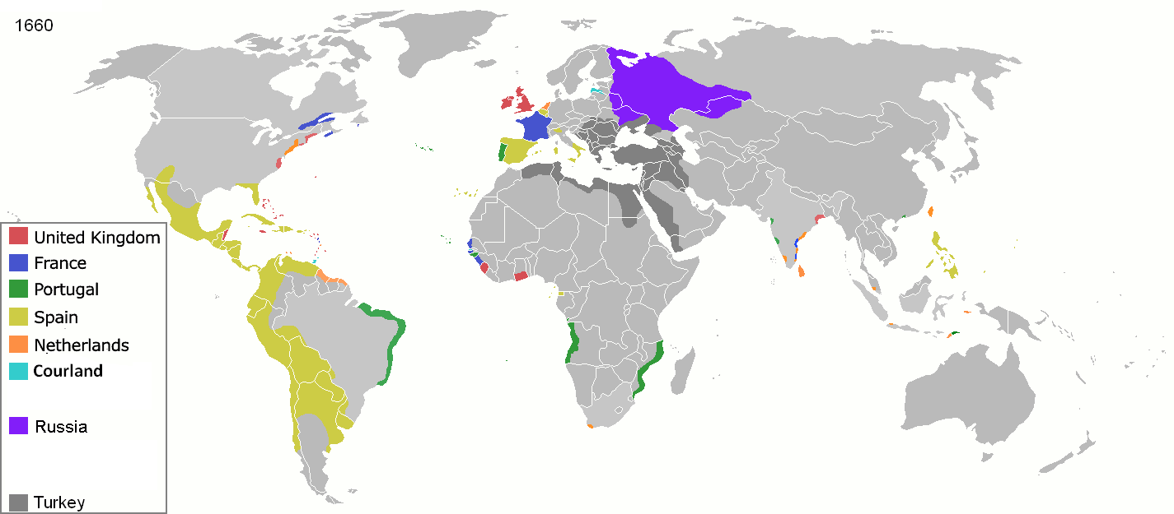

Slide 5
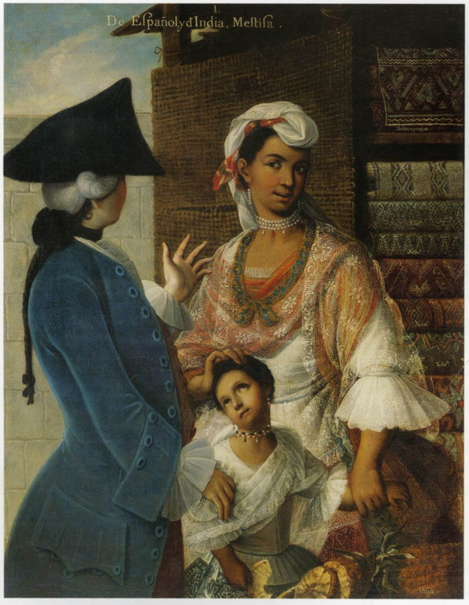
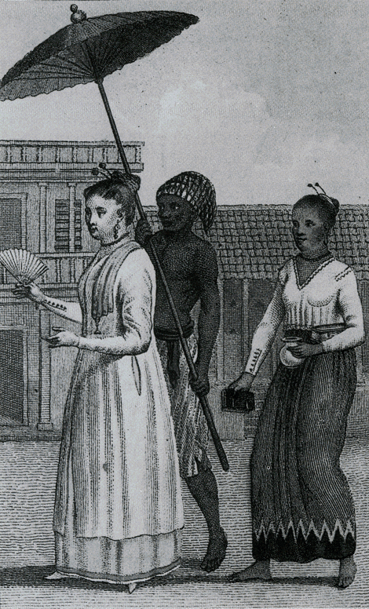

Slide 6
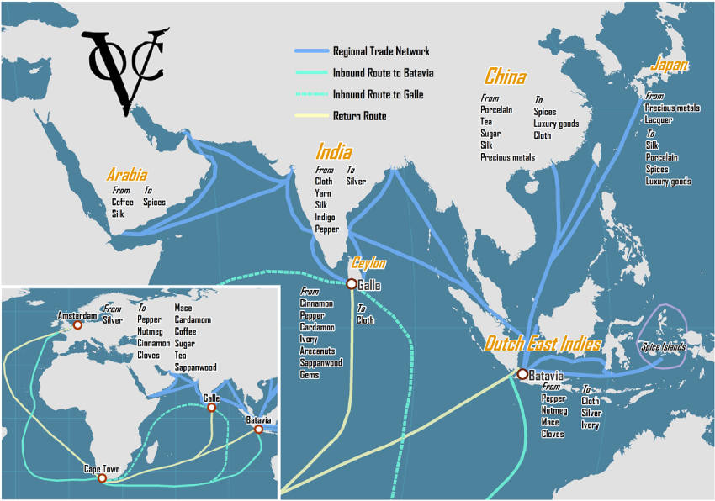

Slide 7
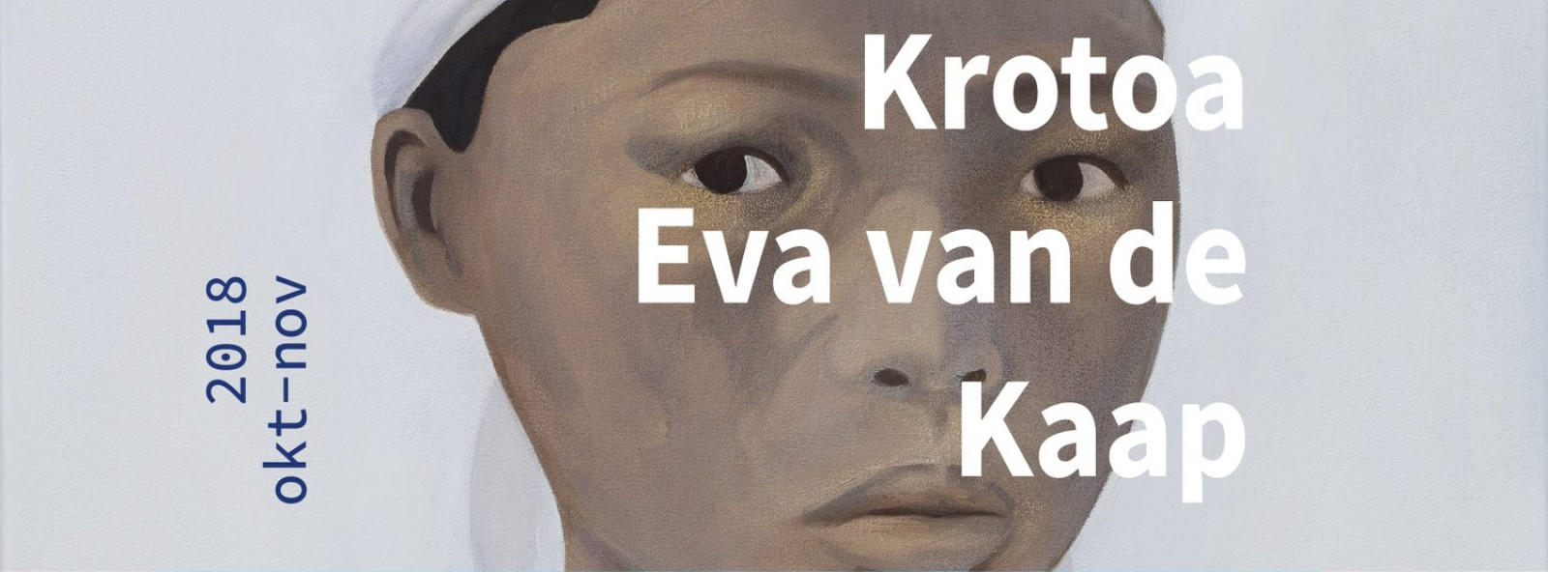
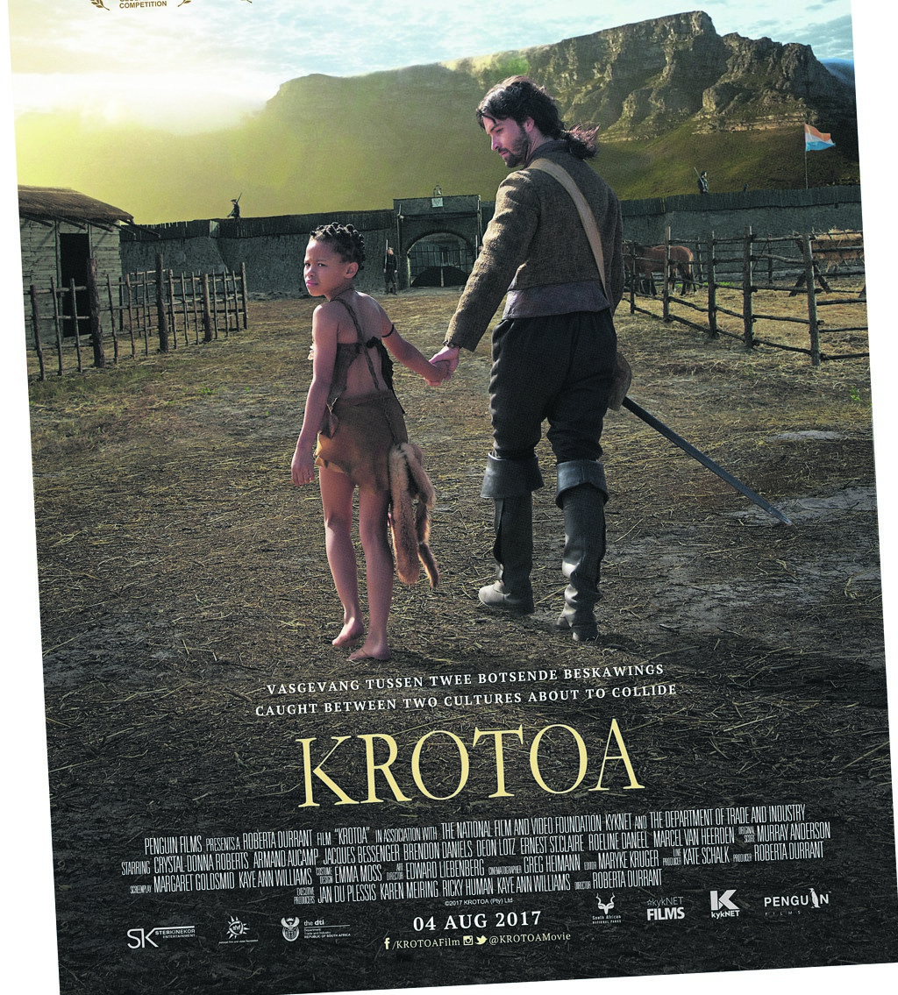
How did contemporaries view Eva/Krotoa and how has her story been read by modern audiences?
What are the larger themes Krotoa/Eva’s life shines light on?

Slide 8
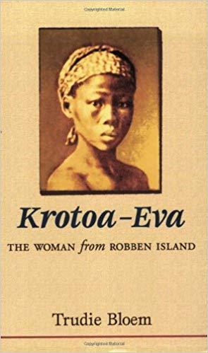
‘What killed Eva off was not simply her inability to adapt to Dutch society, as some believe, but rather the dynamic within colonialism which so soon made bridging, trans-cultural people like her and Pieter redundant.’
Julia C. Wells, ‘Eva’s Men’ (1998), p. 436.
What are the conclusions Julia Wells draws?
Can you relate them to other cases we’ve examined?
What, if anything, can Krotoa’s case teach us about ‘transcultural’ people more generally?

Slide 9
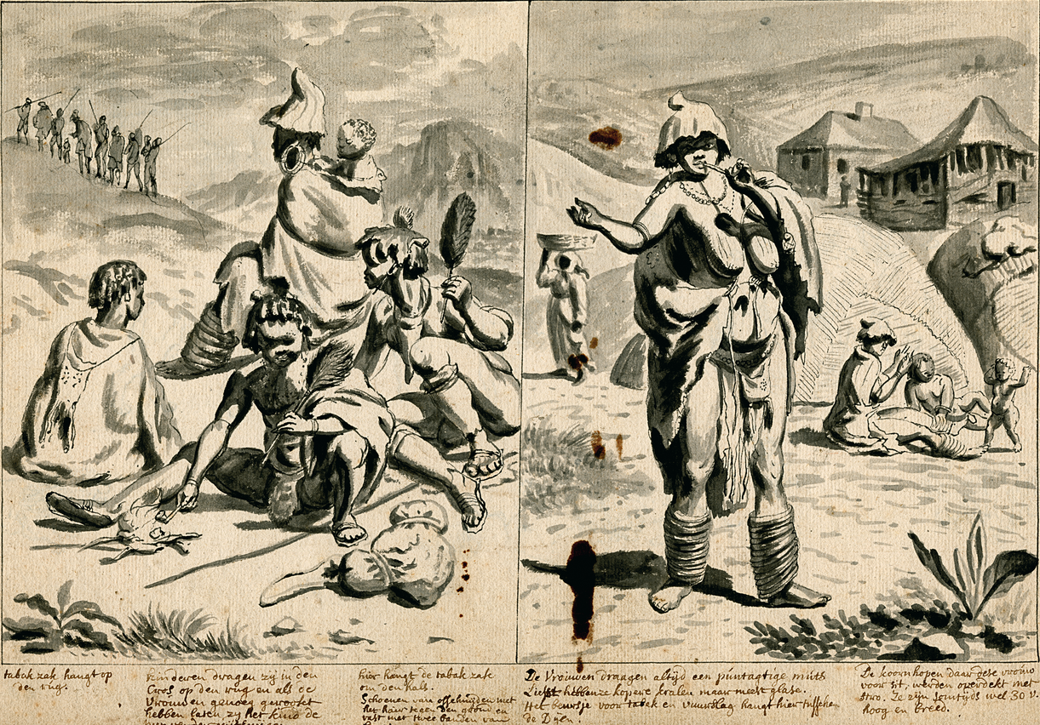
‘the thoughtless wench has played us the same trick before, throwing aside her clean, neat clothing and resuming the old stinking skins of animals, like all the other filthy Hottentoo women.’
Journal of Zacharias Wagenaar, Cape of Good Hope, 22 November 1663

Slide 10
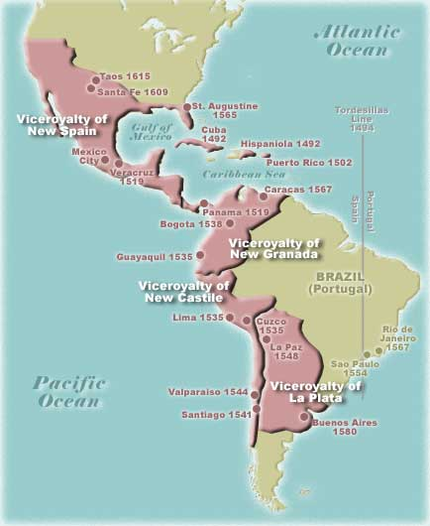
Compare the nexus of violence and intimacy in Krotoa's story to that of the cases recounted by Van Deusen: what accounts for the similarities and differences?
What do the sources studied by Van Deusen reveal about the roles and agency of indigenous women in early Spanish colonial society?

Slide 11
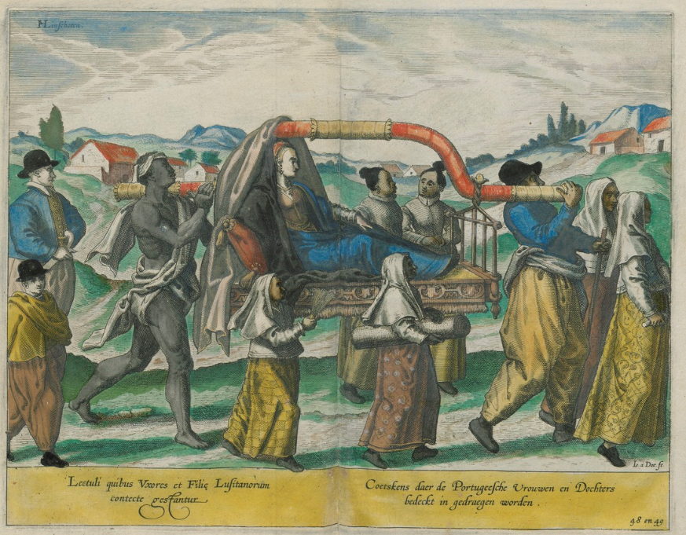

Slide 12
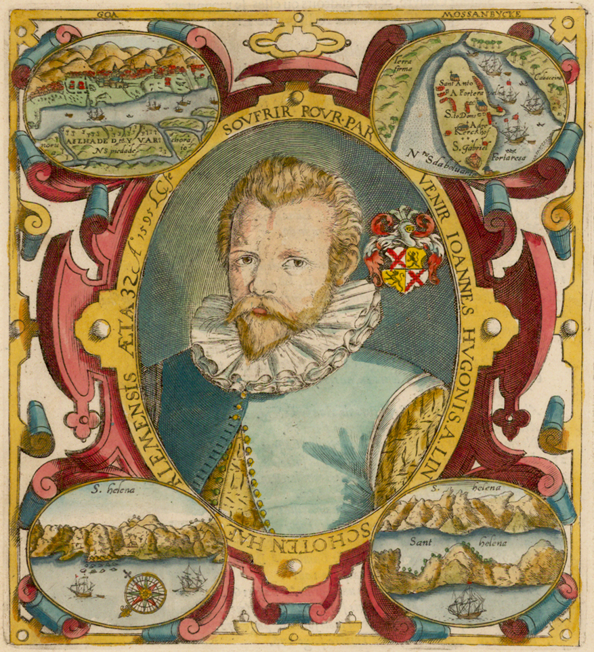
‘Of the customes of the Portingales, and such as are issued from them called Mestiços’
These Mestiços are commonlie of yelowish colour, notwithstanding that there are manie women among them, that are faire and well formed. The children of the Portingales, both boyes and gyrls, [which are] borne in India, are called Castisos, and are in all things like [unto] the Portingales, onely somewhat differing in colour, for they draw towards a yealow colour: the children of those Castisos are yealow, and altogether [like the] Mestiços, and the children of Mestiços are of colour and fashion like naturall borne Countrimen or Decaniins of the countrie, so that the posteritie of the Portingales, both men and women being in the third degree, doe séeme to be natural Indians, both in colour and fashion’.

Slide 13
How does Jan Huygen van Linschoten represent the Lusophone community of Goa?
What message does he convey regarding mixed-race communities?
-> cite examples from text
Can you relate Linschoten’s 16th c. text on Goa to 18th c. Casta paintings from Mexico?

Slide 14
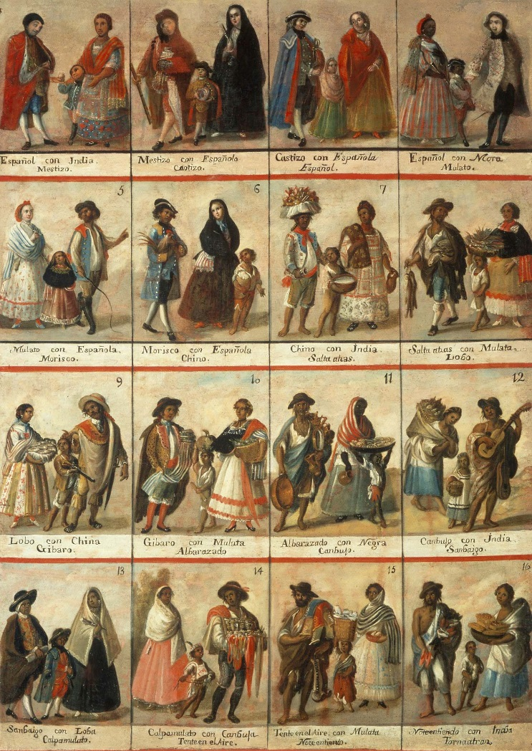
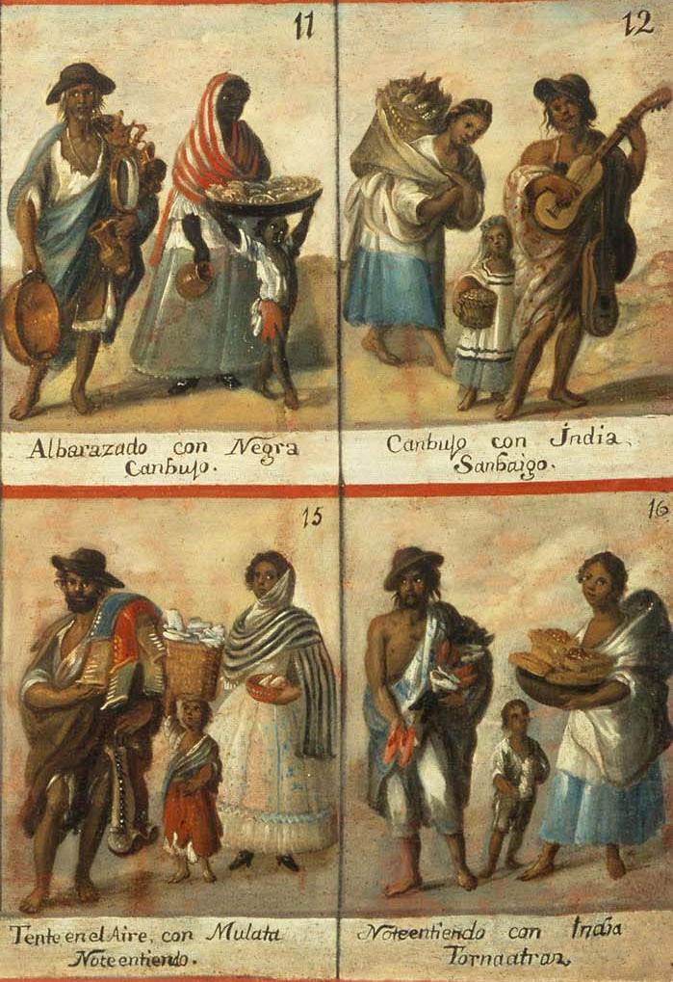

Slide 15
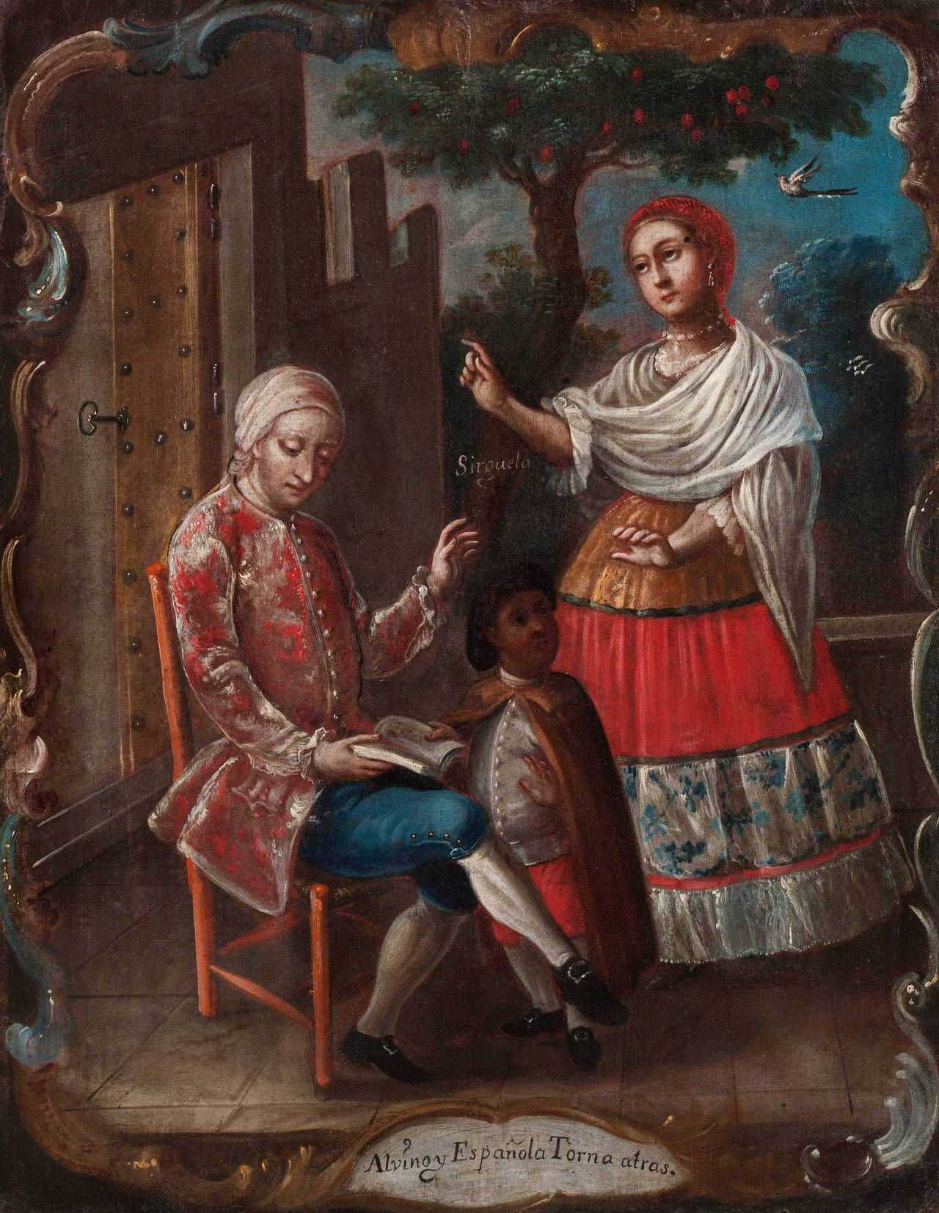
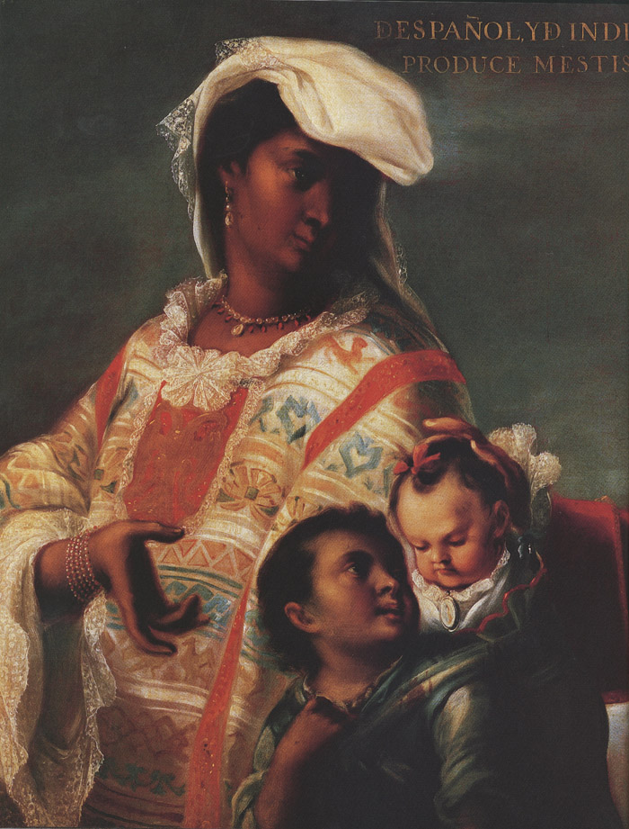
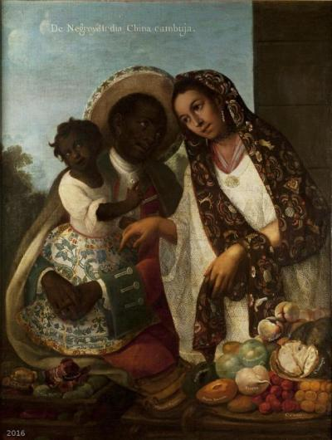
What messages about interracial intimacy and mixed race societies can you identify in casta paintings?

Slide 16
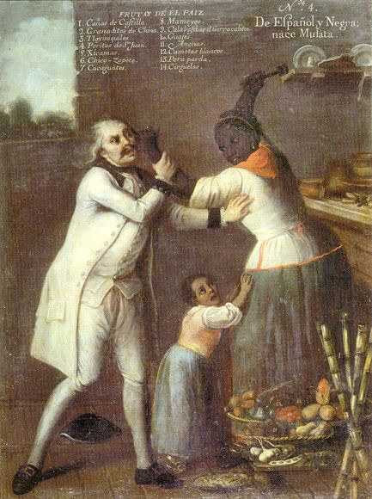
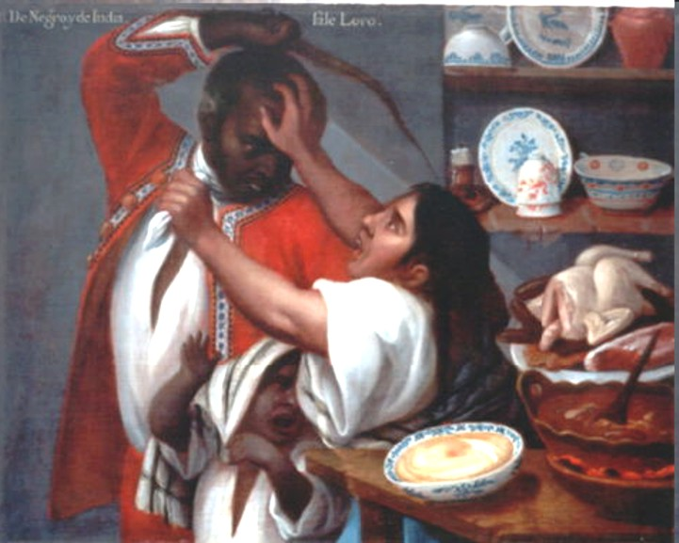

Slide 17
