Slide 1
The Consequences of Colonialism
HI3K3 TERM 1WEEK 3

Slide 2
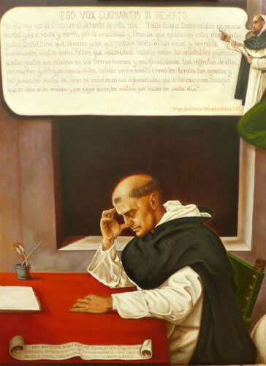
Antonio de Montesinos, Christmas Eve Sermon, 1511
“Tell me by what right of justice do you hold these Indians in such a cruel and horrible servitude? On what authority have you waged such detestable wars against these people who dwelt quietly and peacefully on their own lands? Wars in which you have destroyed such an infinite number of them by homicides and slaughters never heard of before. Why do you keep them so oppressed and exhausted, without giving them enough to eat or curing them of the sicknesses they incur from the excessive labor you give them, and they die, or rather you kill them, in order to extract and acquire gold every day.”

Slide 3
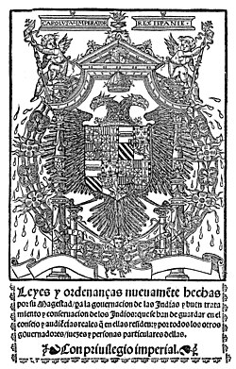
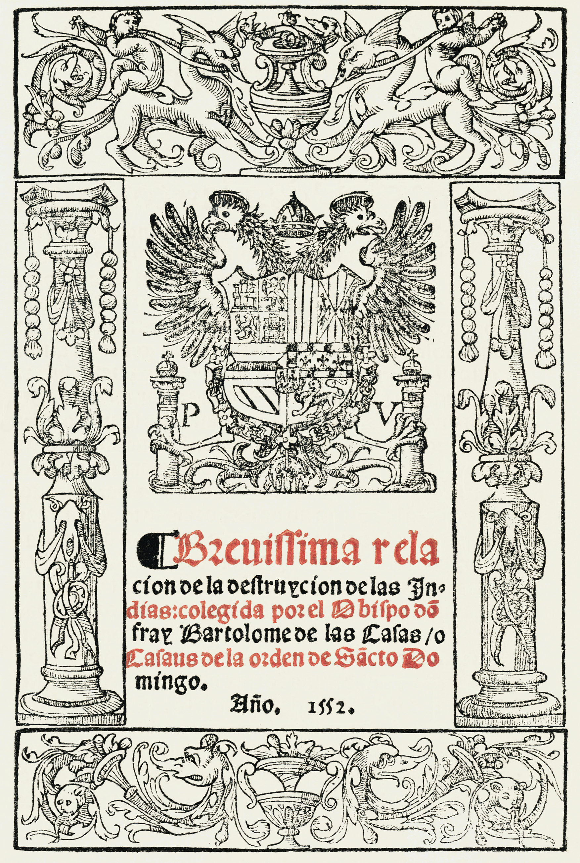
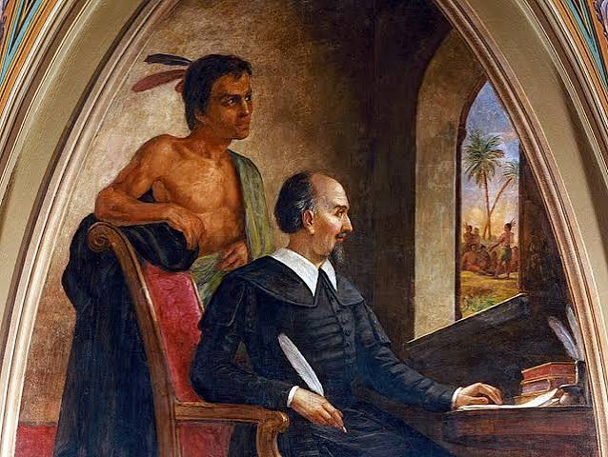
Bartolomé de las Casas
“Protector of Indians”
A Short Account of the Destruction of the Indies
The New Laws (1542)
The Valladolid Debate (1550-51)

Slide 4
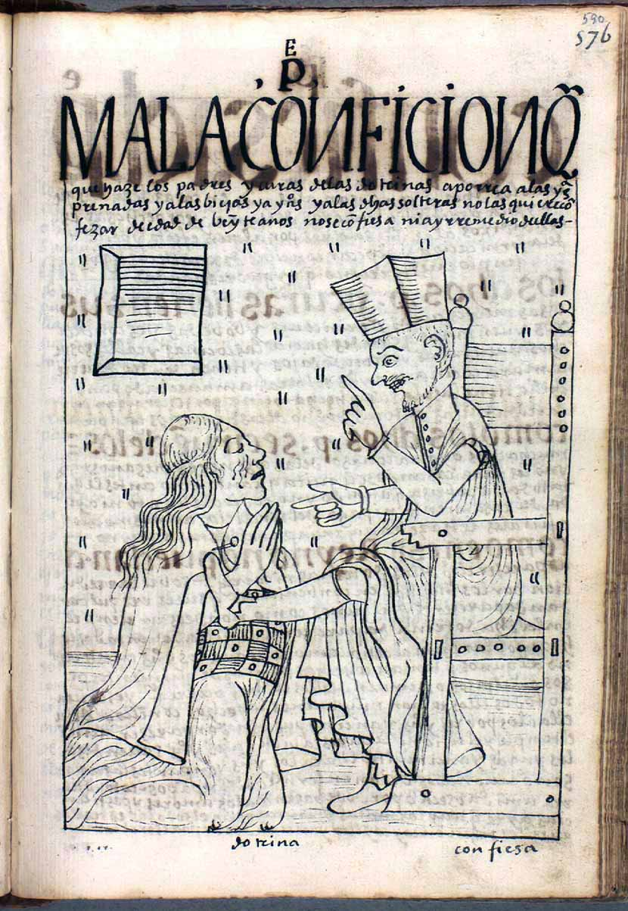
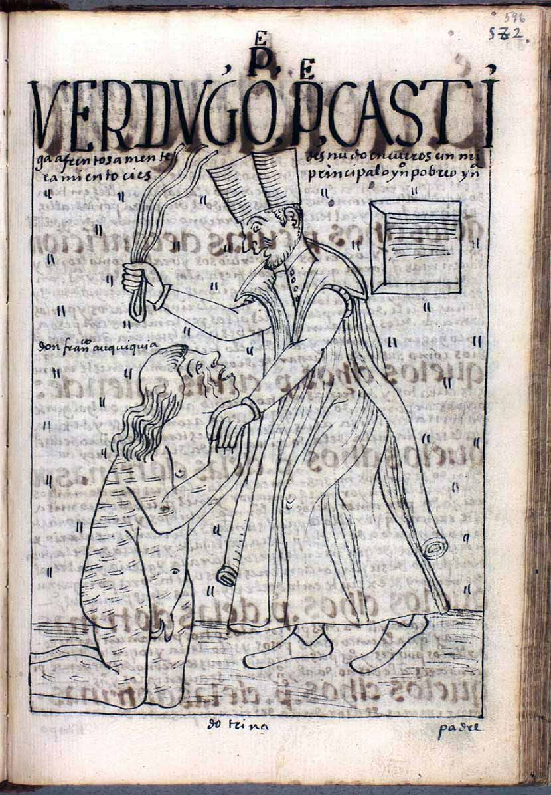
Guaman Poma de Alaya, El primer nueva corónica y buen gobierno, 1615
Bad confession. Page 590 from Felipe Guaman Poma de Ayala, The First New Chronicle and Good Government c. 1615 (image from The Royal Danish Library, Copenhagen)
Executioner: the cruel parish priest metes out punishment indiscriminately. Page 596 from Felipe Guaman Poma de Ayala, The First New Chronicle and Good Government (or El primer nueva corónica y buen gobierno, c. 1615 (image from The Royal Danish Library, Copenhagen)

Slide 5
Seminar Questions
To what extent can we trace thinking on human rights back to Hispanic Scholasticism and the early colonial experience? How has writing about this changed over time?
How did sixteenth century Europeans make sense of the New World and the people of the America? How did the peoples of the America make sense of the early colonial experience? What was the nature of the philosophical debate regarding the relationship between the people of the Old and New Worlds? How was citizenship imagined for different groups? How was this reflected in legislation? How did people use the law to resist and/ or negotiate to protect their interests?

