Slide 1
A History of Human Rights in
Latin America
Final Year Advanced Option 1 (Applied)
Dr Rosie Doyle R.Doyle.1@warwick.ac.uk
Office FAB3.77 Office Hours: Tues 13:00-14:00, Weds 11:30-12:30
or make an appointment

Slide 2
We Were Here: The Untold History of Black Africans in Renaissance Europe is an internationally acclaimed documentary that explores the presence and contributions of Africans in Europe during the Renaissance, challenging familiar narratives about European history and culture.
The event will feature:
  A screening of the documentary, An introduction from filmmaker Fred Kudjo Kuwornu
  A panel discussion with academic colleagues from the Faculty., Audience Q&A
The film draws on art history, archival research and contemporary scholarship to tell stories that have often been omitted from mainstream accounts of Renaissance Europe.
Whether your interests lie in history, literature, languages, culture, media, race and identity, or simply expanding your understanding of the past, this promises to be a thought-provoking and engaging evening.
Date: Wednesday 21st October Time: 5.00pm Venue: Cinema Room, FAB.
Register to attend here.

Slide 3
Mexico's Watchdog Journalists: Reporting on Crime Syndicates and the Corrupt
Join the Latin America at Warwick Network for our first event of the year, featuring Professor Andrew Paxman of CIDE, Mexico City.
When?: Monday, 19 October, 2-3:30 pm, Where?: S1.50 (Social Sciences)
Over the past two decades, Mexico has been the most dangerous country for journalists outside a war zone. The phenomenon broadly correlates to the spiralling homicide rate detonated by President Calderón’s 2006 declaration of “war” against the “drug cartels”, but the reasons are more complex. A growing body of research ascribes as much blame to agents of the state, from governors to local police. There is also a gubernatorial culture of violent repression and discursive nonchalance towards the press, which has roots in the late 19th century and persists with the aid of a parallel culture of impunity, recently bolstered by presidential hostility towards the press. Andrew Paxman considers factors past and preset behind the murder of Mexico’s media workers.
https://warwick.ac.uk/fac/arts/schoolforcross-facultystudies/research/centre_and_networks/lawn/activitieslawn/

Slide 4
Introduction
Why did you choose the course?
What are you expecting from the course?
What subjects and themes are you particularly interested in?
What degree are you doing? What other options are you doing? Have you noticed connections between this and other modules or previous modules that you have studied?
Do you have any relevant work experience/ year abroad experience?
Do you have any questions concerns about the course content assessment etc?

Slide 5
Human Rights
What types of rights exist?
Which particular rights do you hold dear?
What do you think about your role and position as a citizen including your rights and duties?
What elements of citizenship are important to you?
How do you think this relates to your social positioning (eg. your race, class, gender, work, educational background, age etc. and what this means for your position in society)?
Have you had any particular experiences that have led you to change the way you think about issues of rights and citizenship?

Slide 6
Assessment for the course.
Final Year Advanced Option 1 (Applied)
Assessment
Assignment 1: Oral presentation/ Workshop convening (10%)-In the week of your chosen seminar.
Assignment 2: 1,500 word essay/ source analysis/review (10%) Term 1 Week 5
Assignment 3: Practical written assignment 3,000 words (40%) Term 2 Week 7
Assignment 4: 3,000 word essay (40%) Term 3 Week 2
Marking scales and descriptors are in the undergraduate hub.

Slide 7
Oral: Presentation/ Workshop convening
The presentation or activity should be designed to get the discussion going and problem solving.
Formal short presentation (15 mins max)
An activity based on sources. Facilitating the discussion or debate.
Groups or individual.
Ongoing seminar participation.

Slide 8
Written:
The Practical Assignment (3,000 words)
Blog
Campaign page/ leaflet/ project
Proposal
Policy brief
Game
Podcast
Article
For the practical written assignment, here are some examples of writing about rights for a general audience:
https://warwick.ac.uk/fac/soc/law/research/centres/chrp-old/projects/rightingwrongs/
Warwick Writing Wrongs Lacuna Magazine

Slide 9
Dissertation
Proposal (required for allocation of supervisor) Term 1
Presentation (10%):
Delivered to supervisor (and possibly their other dissertation supervisees) Term 2 weeks 1-5, by arrangement with supervisor.
Length: approximately 5 minutes (and absolutely no more than 7 minutes)
Instructions: to build on your dissertation proposal by explaining the following:
  The topic of your dissertation and the question you are intending to answer.
  The historiographical significance of your research.
  Your (preliminary) findings and argument.

Slide 10
9,000 word Dissertation: Term 3 Week 1
Content
The dissertation should be your own research, developed through the proposal, the presentation, and meetings with your supervisor.
The dissertation must be a new piece of work - you should not have published it previously in whole or in part in any other outlet, which includes web-publications.
Submission
You submit your dissertation via Tabula by the deadline.
Guidance and Support
You are encouraged to meet with your supervisor by appointment or in office hours to discuss your dissertation, and/or to email with queries.
Further guidance on writing the dissertation is available on Moodle.
Marking
Detailed marking criteria is available on the Undergraduate Hub.
Your dissertation will be first marked by your supervisor, and second marked by another member of staff in the department.- Use all the expertise!

Slide 11
Dissertation
Watch final year and dissertation meetings and lectures with the, director of final year and do the moodle course and listen to the lecture capture.

Slide 12
Sources and Bibliography
Reading list
Session with the Modern Records Centre.
Department Seminar Series: Researchers on relevant topics.
Q and A sessions with academics working on human rights in Latin America.
Library resources

Slide 13
FAQs on assessment and the module
Q: Does the assessment model for this module change if I do my History dissertation attached to this module?
A: No, it stays the same.
Q: Can I repeat material from the shorter assessments (oral presentation and 1,500 word essays) to the longer assessments (3,000 word essay and practical assignment)?
A: You can present on something that you’d like to write about. The shorter written assignments are formative in the sense that you will get thorough feedback on themes, approach, writing style, use of sources etc. rather than content. This will allow you to write about and engage with a full range of options.

Slide 14
Human Rights in History
What do we mean by human rights?
What different types of rights exist?
Where should we look for the origins of human rights?
Is there anything unique about the Latin American tradition of human rights?
Can human rights be universal?

Slide 15
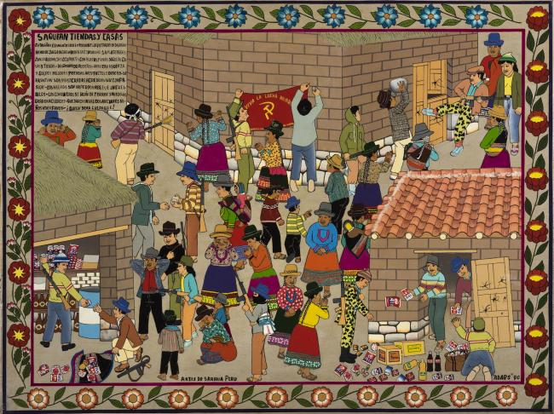
Asociación de Artistas Populares de Sarhua, "Saquean Tiendas y Casas (Looting stores and homes)". Serie Piraq Causa (¿quién es causante?), 1990, Painted wood, 60 X 80 cm., Museo de Arte de Lima. Donated by Asociación CON/VIDA Popular Arts of the Americas. Photography: Daniel Giannoni. Archi, Archivo Digital de Arte Peruano

Slide 16
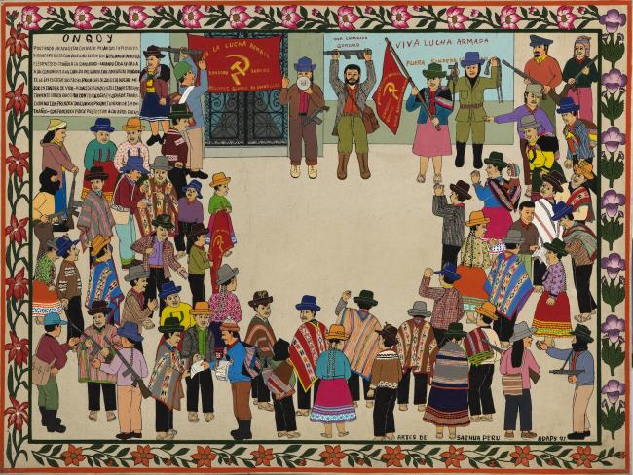
Asociación de Artistas Populares de Sarhua, "Onqoy (Sickness/Terrorists)". Serie Piraq Causa (¿quién es causante?), 1991, Painted wood, 60 X 80 cm Museo de Arte de Lima. Donated by Asociación CON/VIDA Popular Arts of the Americas. Photography: Daniel Giannoni. Archi, Archivo Digital de Arte Peruano

Slide 17
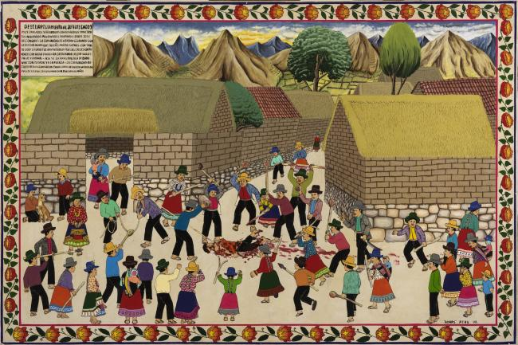
Asociación de Artistas Populares de Sarhua, "Descuartizamiento al jefe del 'Onqoy,' (Dismembering the leader of the 'Onqoy')." Serie Piraq Causa (¿quién es causante?), 1992, Painted wood, 80 X 120 cm., Museo de Arte de Lima. Donated by Asociación CON/VIDA Popular Arts of the Americas. Photography: Daniel Giannoni. Archi, Archivo Digital de Arte Peruano

Slide 18
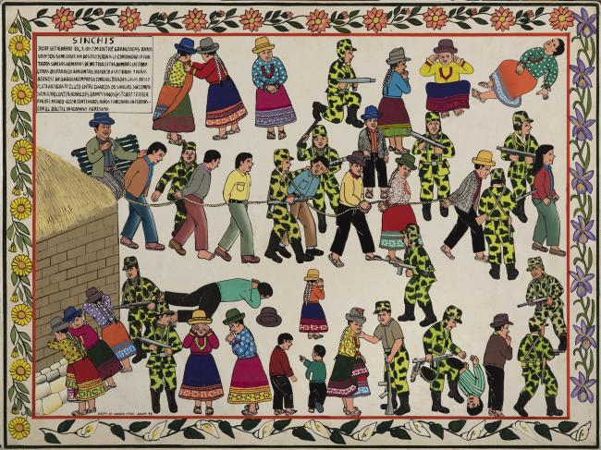
Asociación de Artistas Populares de Sarhua, "Sinchis (Counterinsurgency Police)". Serie Piraq Causa (¿quién es causante?), 1998, 60 X 80 cm., Museo de Arte de Lima. Donated by Asociación CON/VIDA Popular Arts of the Americas. Photography: Daniel Giannoni. Archi, Archivo Digital de Arte Peruano

Slide 19
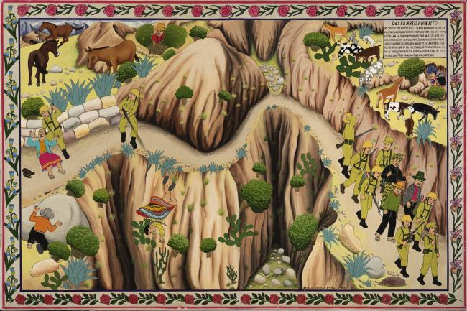

Slide 20
Sahrua Tablas
All images are from
Olga González, “Art under Attack”, NACLA, August 2018

Slide 21
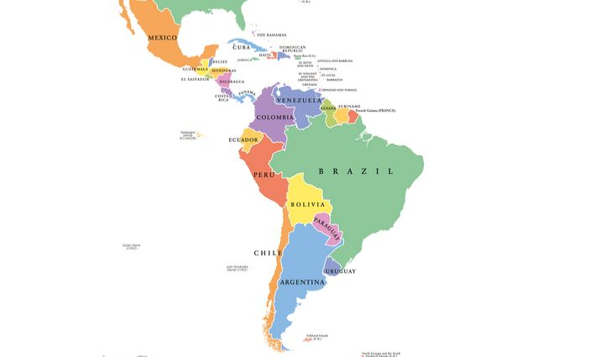
What do you know about Latin America?

Slide 22
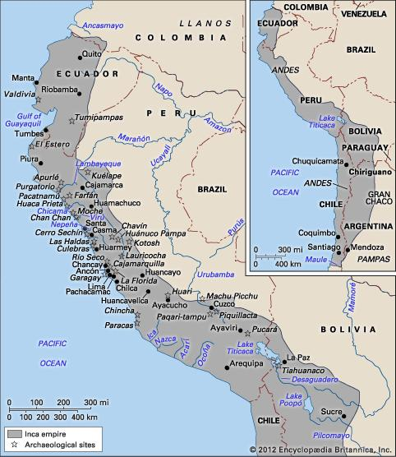
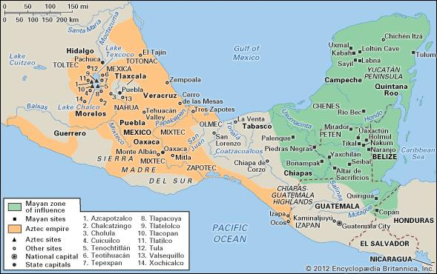
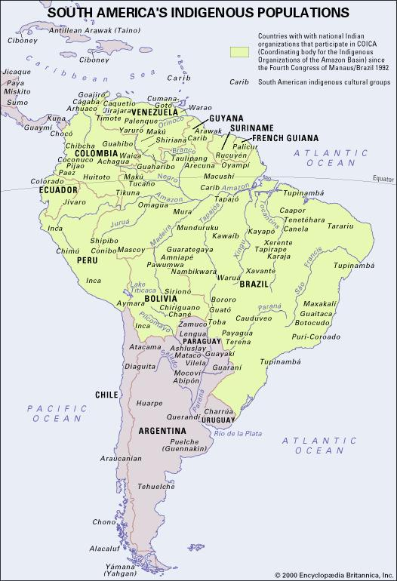
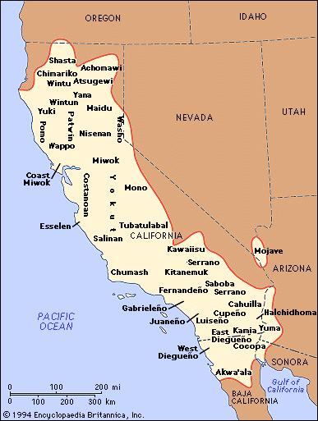
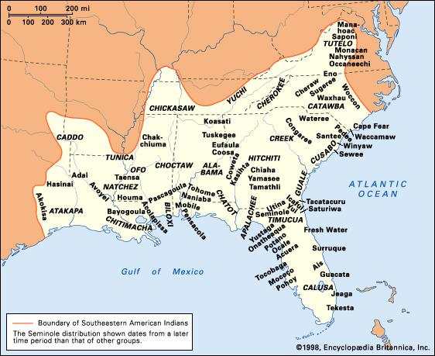
(Some) Pre-Columbian peoples of the Americas
Languages
Encyclopædia Britannica
Online. Web. 31 Oct. 2012.
Diverse geographically,
politically, socially,
linguistically

Slide 23
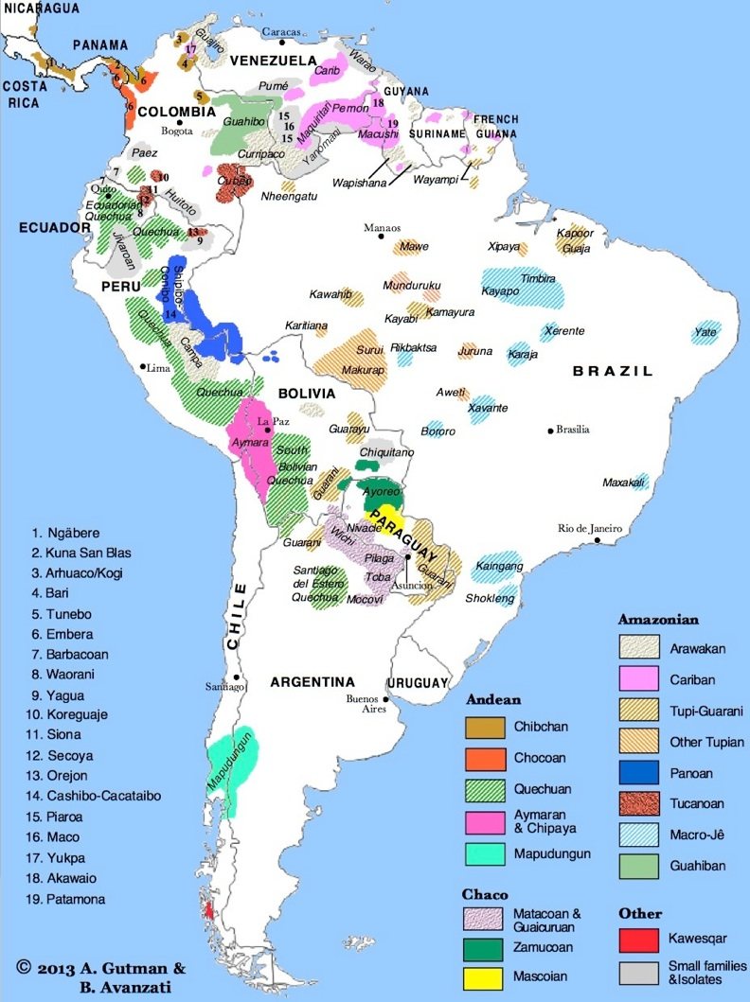
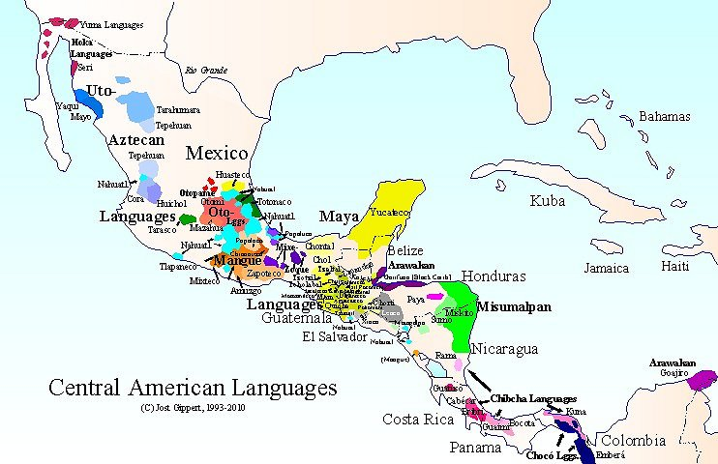

Slide 24
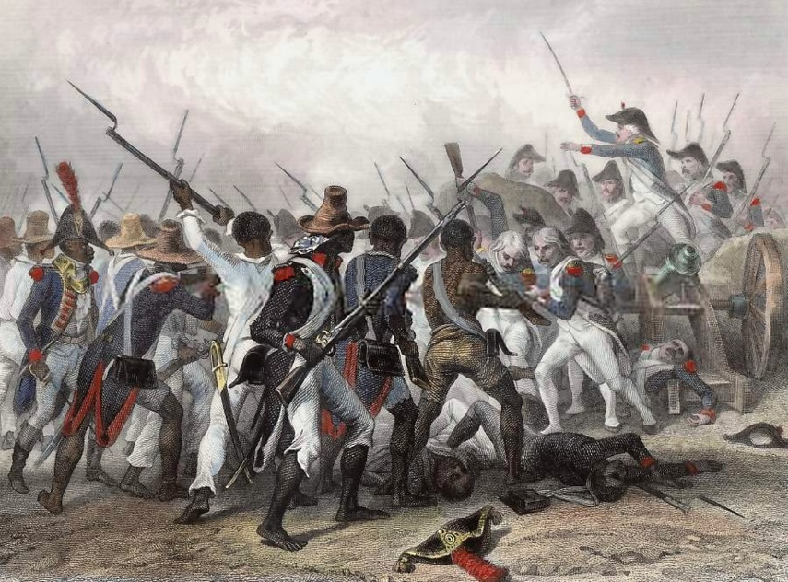
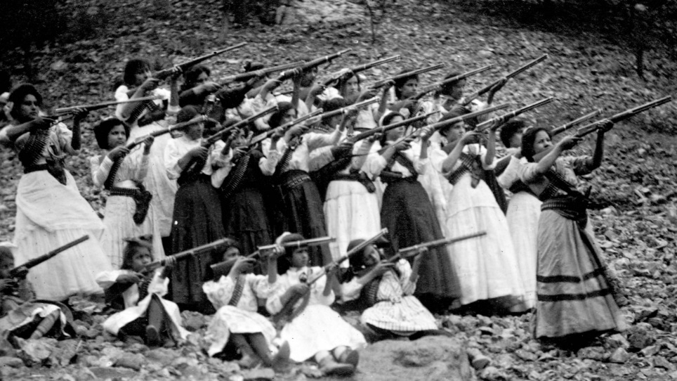
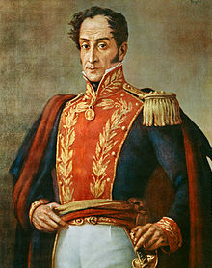
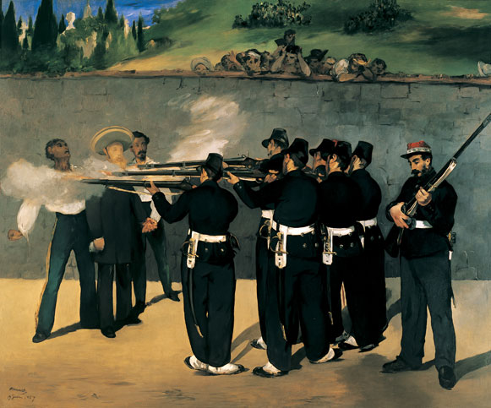
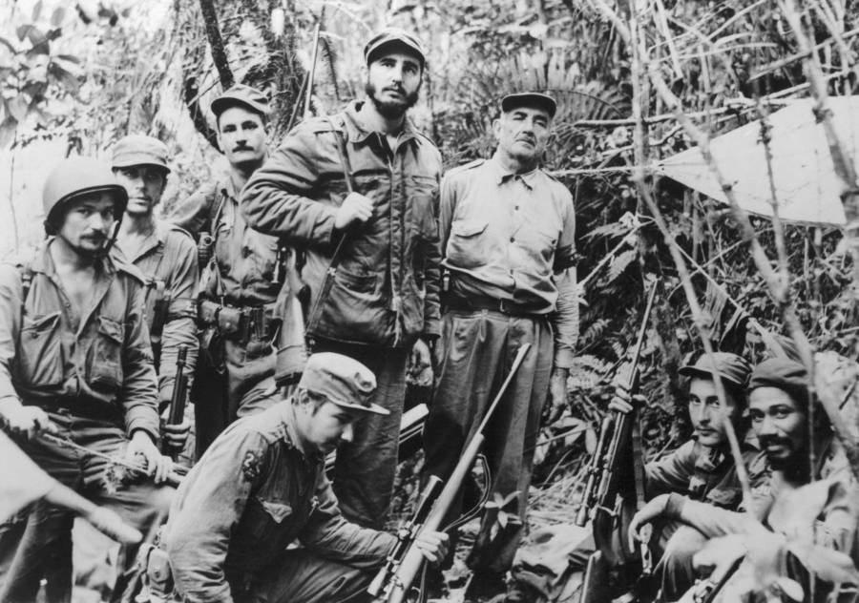
Revolutions

Slide 25
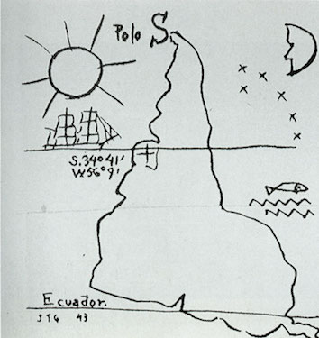
Latin America?
Torres García, Inverted America, 1943

