Slide 1
Week 9: The abolition of the slave trade to Brazil (and, week 8, Britain…)

Slide 2
Week 8: Britain and 1807…
Why did Britain eventually abolish the trade in 1807 and slavery itself in 1833-8?
What was the effect of British slave trade abolition on Brazil and Cuba?

Slide 3
Week 8 readings: causes and consequences of British abolition of the trade in 1807
Davis, David Brion. Inhuman Bondage: The Rise and Fall of Slavery in the New World. Oxford University Press, 2006.
  Chapter 12, “Explanations of British Abolitionism"
Christopher Brown Moral Capital, introduction (e-book @ Library)
Beatriz Mamigonian, "In the Name of Freedom: Slave Trade Abolition, the Law, and the Brazilian Branch of the African Emigration Scheme (Brazil-British West Indies, 1830s-1850s), Slavery & Abolition

Slide 4
Readings : Week 9 on abolition of the trade to Brazil
Conrad, Robert, World of Sorrow: the African slave trade to Brazil. LSU Press 1986. Chapter 1; chapter 3.
Dale Graden, “Slave Resistance and the Abolition of the Transatlantic Slave Trade to Brazil,” História Unisinos, 2010
Sidney Chalhoub, “The Politics of Disease Control: Yellow Fever and Race in Nineteenth-Century Rio de Janeiro.” 1993

Slide 5
Further reading on the abolition of the Brazilian trade
Jeffrey Needell, “The Abolition of the Brazilian Slave Trade in 1850: Historiography, Slave Agency and Statesmanship” Journal of Latin American Studies, 2001.
Conrad, Robert E. The Destruction of Brazilian Slavery, 1850-1888
Dale Graden, Disease, Resistance and Lies: The Demise of the Transatlantic Slave Trade to Brazil and Cuba. Louisiana State University Press, 2014.
Bethell, Leslie. The Abolition of the Brazilian Slave Trade: Britain, Brazil and the Slave Trade Question, 1807-1869. Cambridge University Press, 1970.

Slide 6
General reading on the Brazilian trade
Ferreira, Roquinaldo. Cross-Cultural Exchange in the Atlantic World: Angola and Brazil during the Era of the Slave Trade. 2012.
Walter Hawthorne, From Africa to Brazil: Culture, Identity and Atlantic Slave Trade, 1600-1830. 2010.
Mariana Candido, An African Slaving Port and the Atlantic World: Benguela and its Hinterland. CUP, 2013
Mariana Candido and Adam Jones, eds. African Women in the Atlantic World: Property, Vulnerability, and Mobility, 1660-1880. Boydell & Brewer, 2019

Slide 7
General reading on the Brazilian trade (2)
Robert Conrad, ed, Children of God's Fire: A Documentary History of Black Slavery in Brazil [primary sources]
The Biography of Mahomma Gardo Baquaqua: His Passage from Slavery to Freedom in Africa and America, eds Robin Law & Paul Lovejoy, 2001.
Pierre Verger, Trade Relations between the Bight of Benin and Bahia, 17th to 19th Century, 1976.
_______. Bahia and the West African Trade, 1549-1851. 1964. [and photographic collections, see Pierre Verger Foundation website]

Slide 8
Discussion questions
How did the slave trade to Brazil change from 1807 to 1850? How effective were British efforts?
Was the trade similar or different to Atlantic slave trades to other parts of the Americas?
Why was the Brazilian slave trade abolished in 1850?
What were the consequences for Brazilian slave society of the abolition of the trade in 1850?

Slide 9
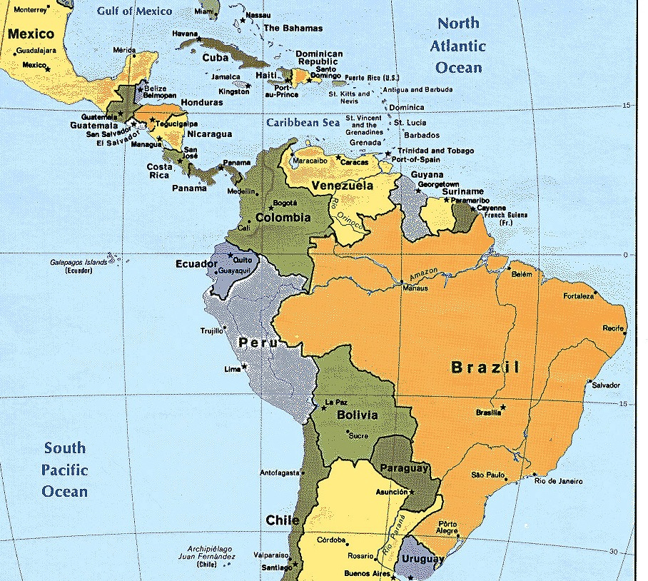

Slide 10
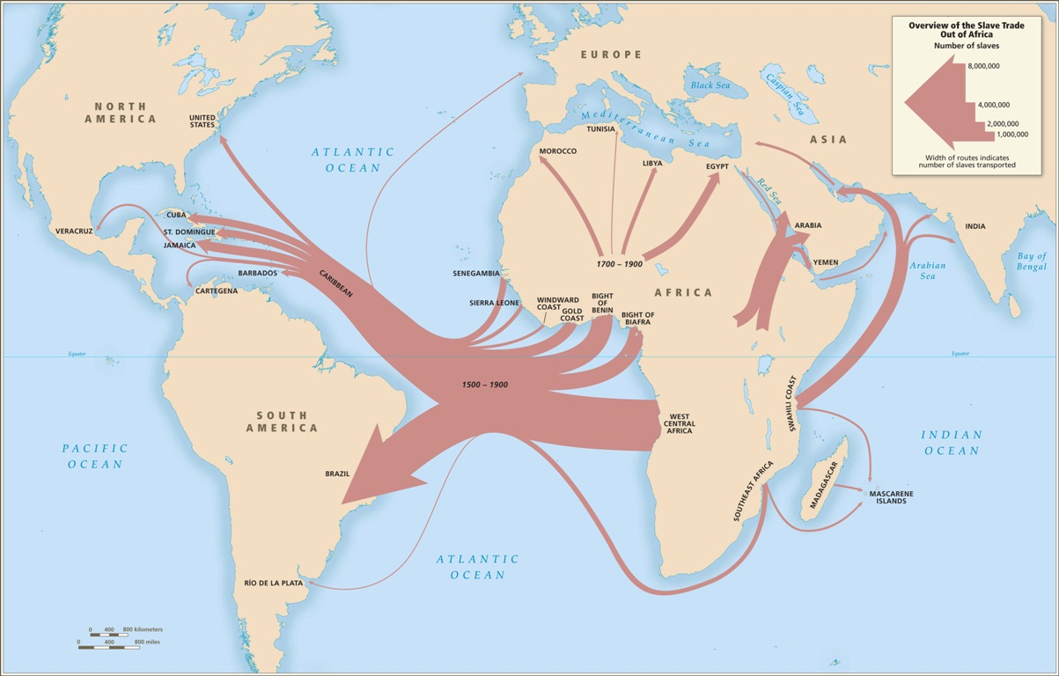

Slide 11
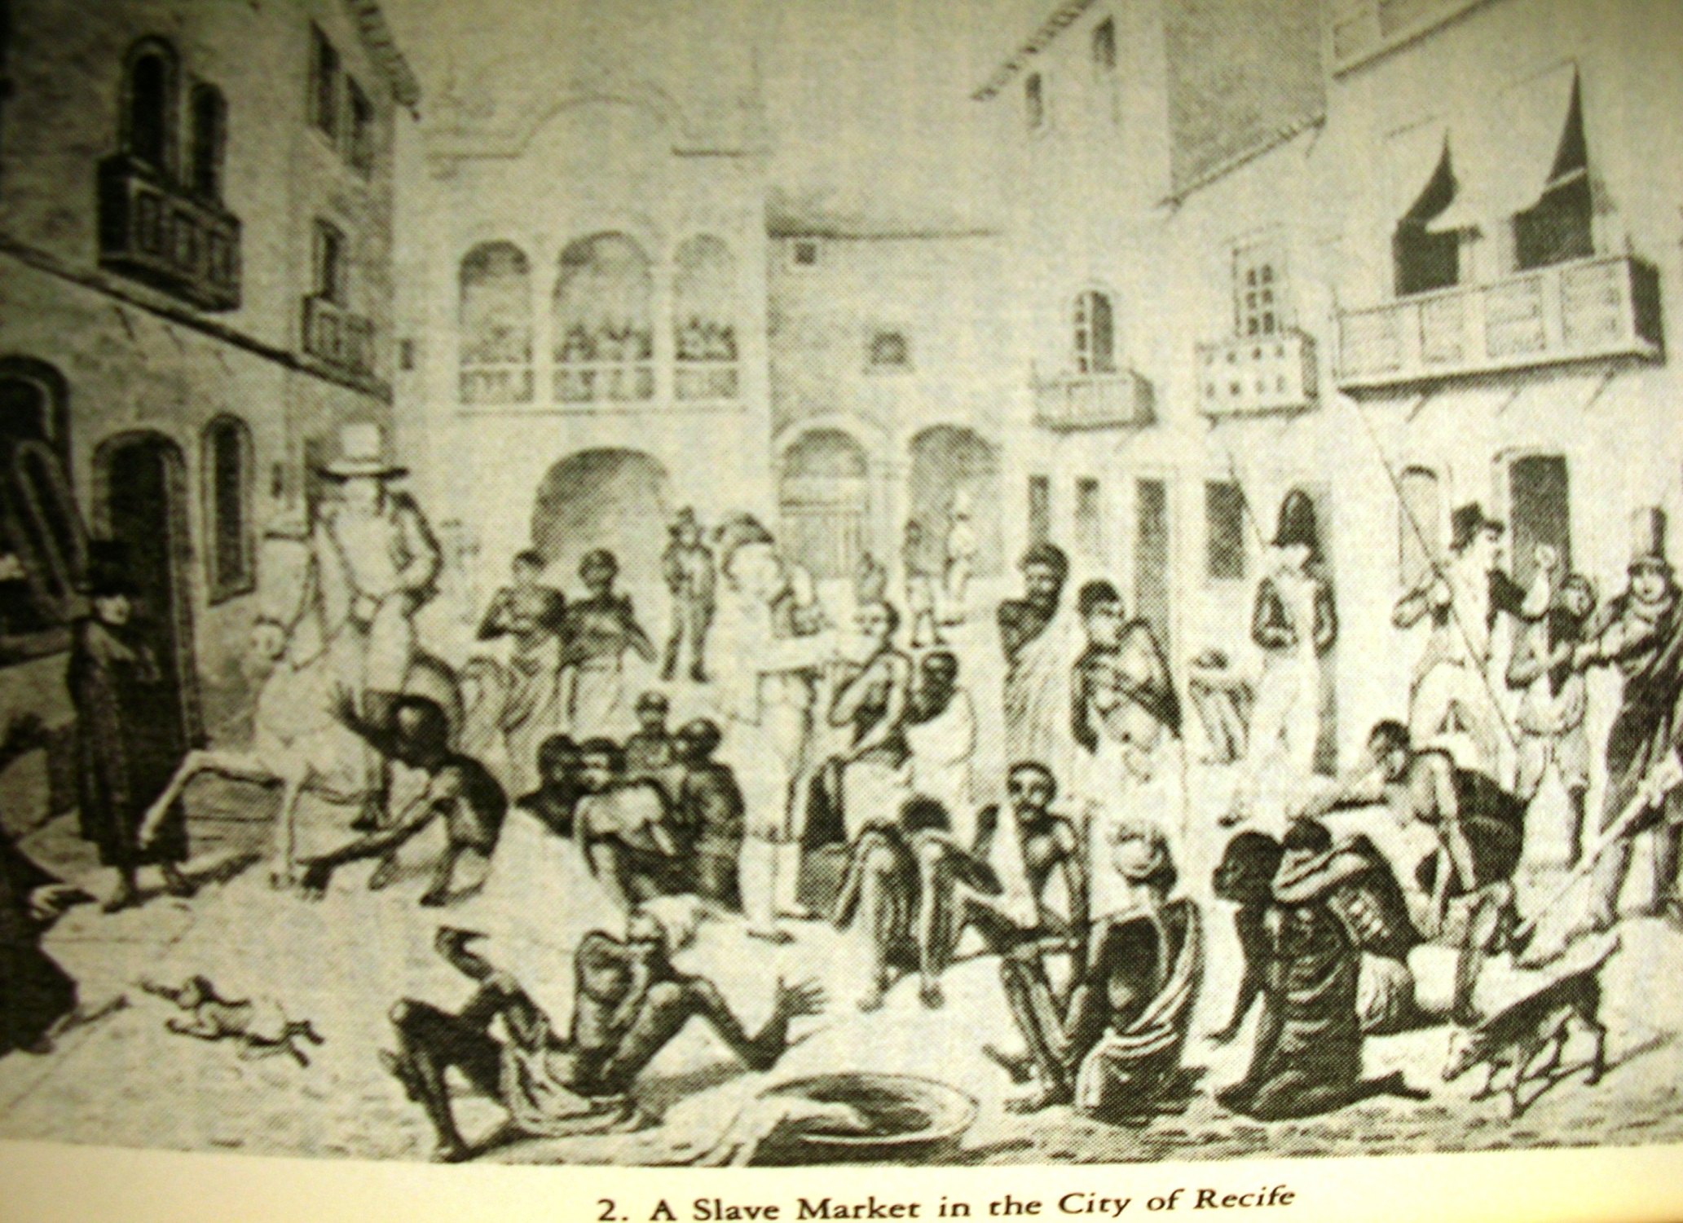
Notes:
Slave market, Recife (Conrad, Children of God’s Fire)

Slide 12
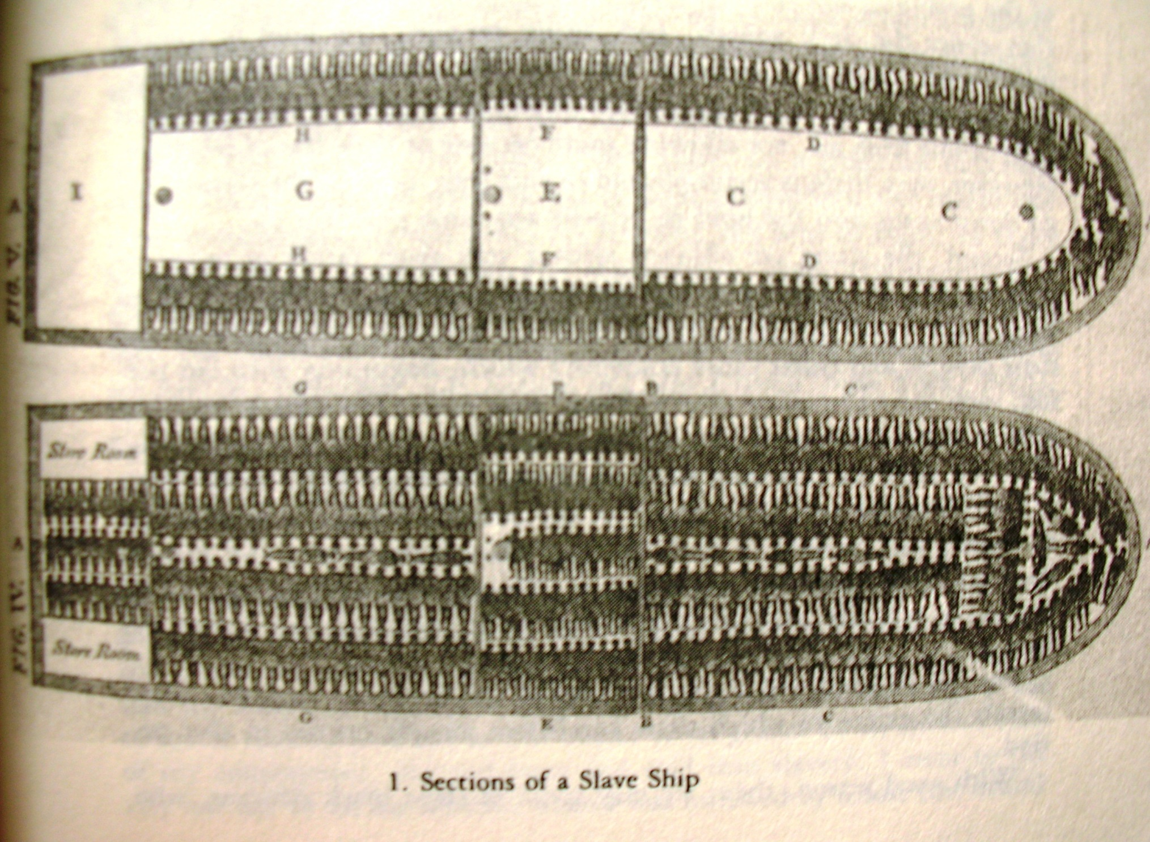
Notes:
Slave ship 1 (Conrad, Children of God’s Fire)

Slide 13
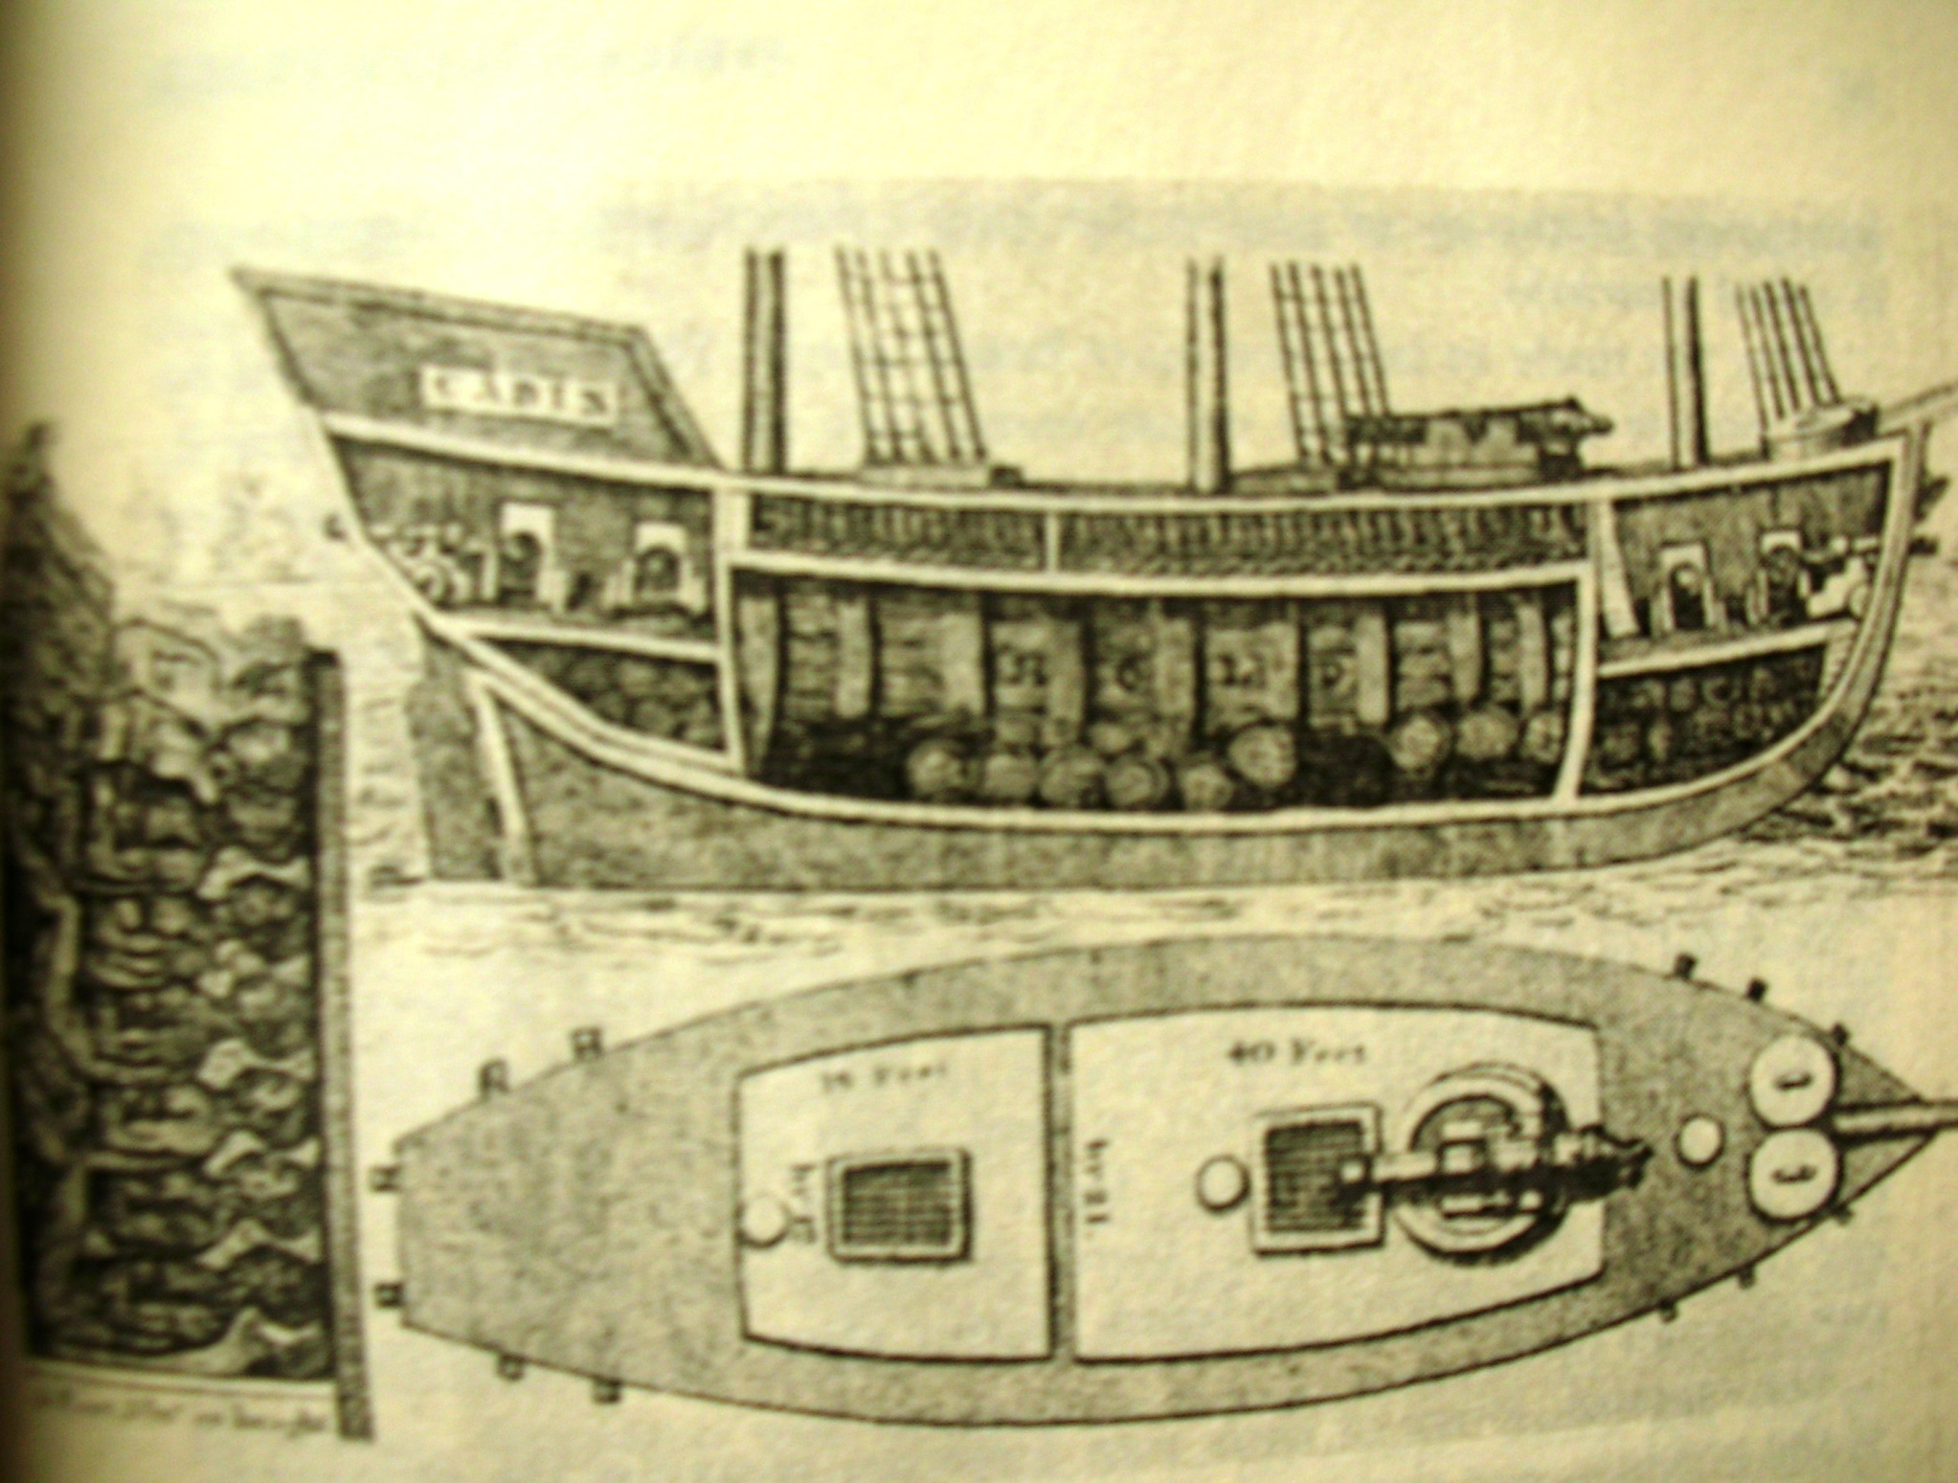
Notes:
Inside of slave ship 2

