Slide 1
Week 8: Abolition of Slavery in Brazil

Slide 2
Readings
[General overview: Thomas Skidmore, Brazil: Five Centuries of Change, chapter 4, "Making Brazil 'Modern': 1870-1910“]
Barbara Weinstein, "The Decline of the Progressive Planter and the Rise of Subaltern Agency: Shifting Narratives of Slave Emancipation in Brazil" 2001
Drescher, Seymour. “Brazilian Abolition in Comparative Perspective” 1988
Walter Fraga Filho, Crossroads of Freedom: Slaves and Freed People in Brazil 1870-1910 "Introduction"
Cowling, Camillia. “Debating Womanhood, Defining Freedom: The Abolition of Slavery in 1880s Rio de Janeiro.” 2010

Slide 3
Questions (1)
What main reasons have historians given for the abolition of slavery in Brazil?
What was the role of: gradual legal emancipation; the Paraguayan War; ideas about backwardness/ 'progress’?
Was abolition ‘inevitable’?
How has the historiography changed over about the last 3 decades?

Slide 4
Questions (2)
Where were the centres of the abolition movement?
What role did enslaved people/ free Afro-Brazilians/ women play?
Was abolitionism similar or different to other Atlantic abolitionist movements?
How much changed in 1888?

Slide 5
Slave society after 1850
Closing of Atlantic trade in 1850
Slave prices rise; slaveholding becomes more concentrated (although still widespread)
Gradual decline of North-East; slaves sold SOUTH in major internal trade
Provinces end up with different degrees of investment in institution of slavery

Slide 6
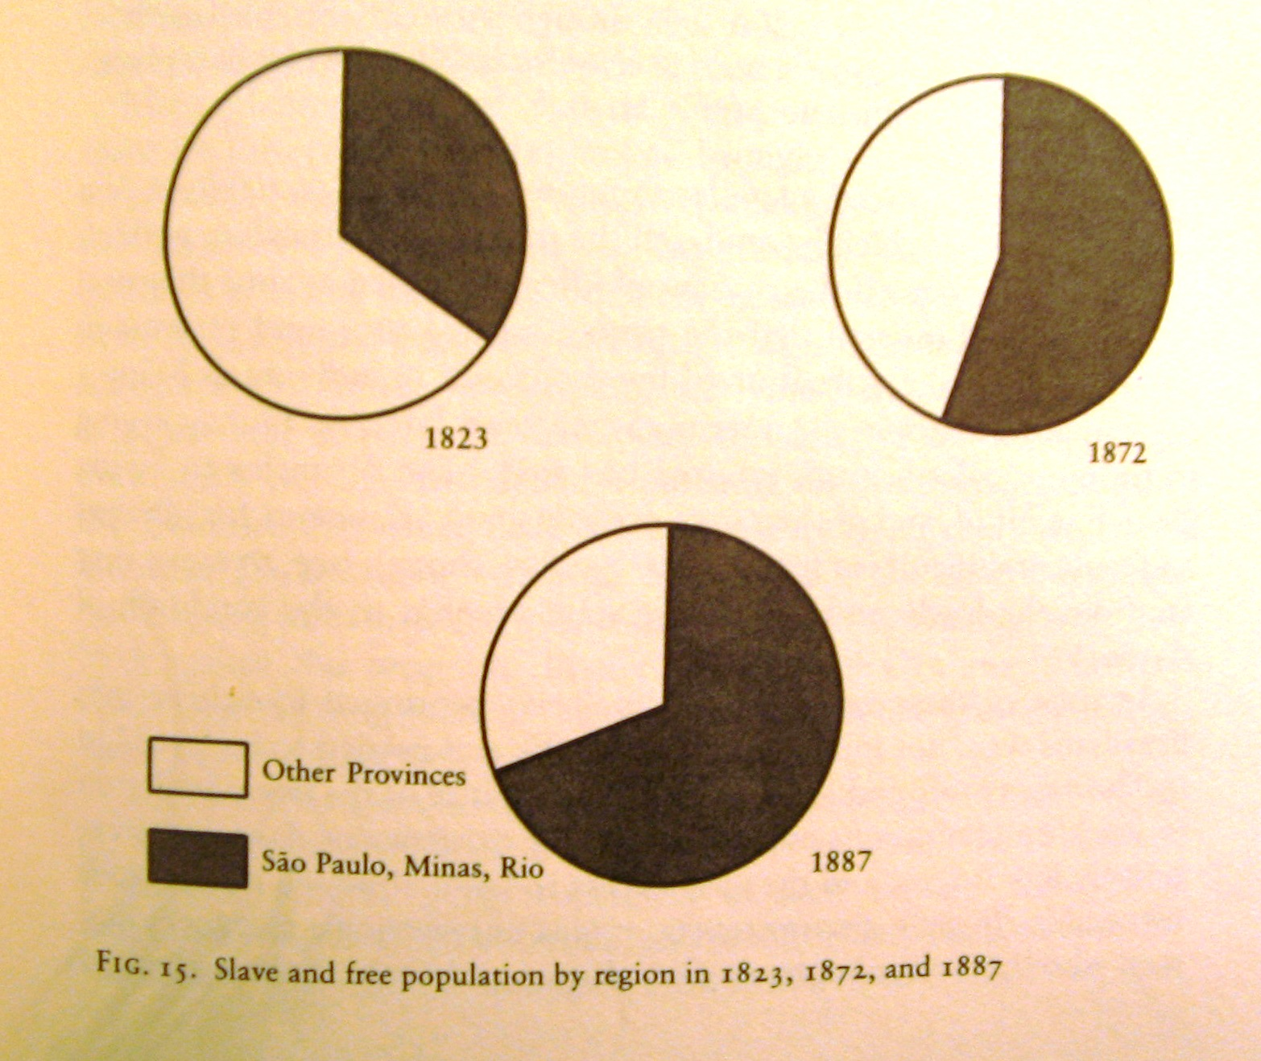
Notes:
From Viotti, Empire.

Slide 7
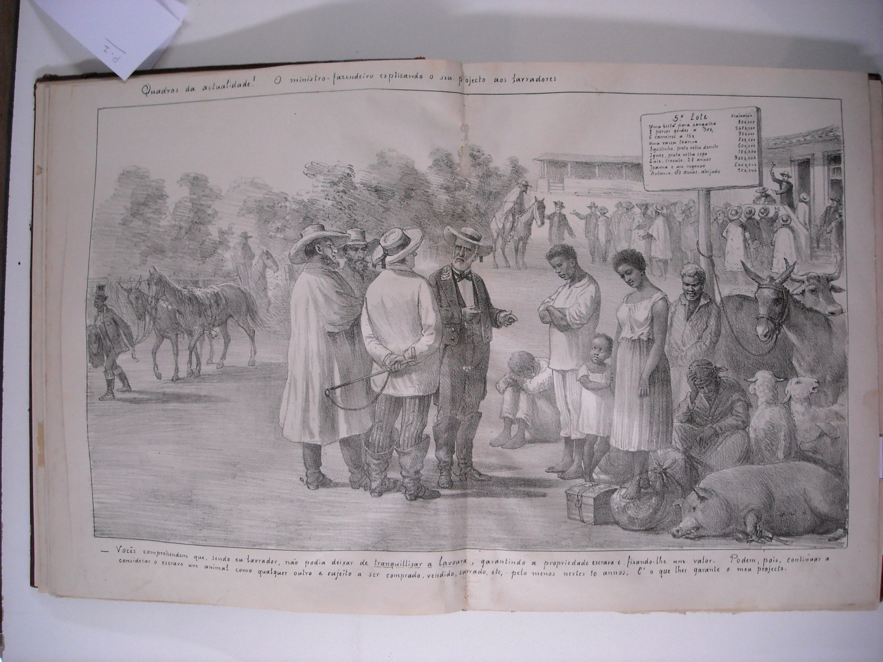

Slide 8
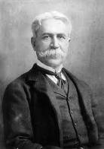
Notes:
Joaquim Nabuco

Slide 9
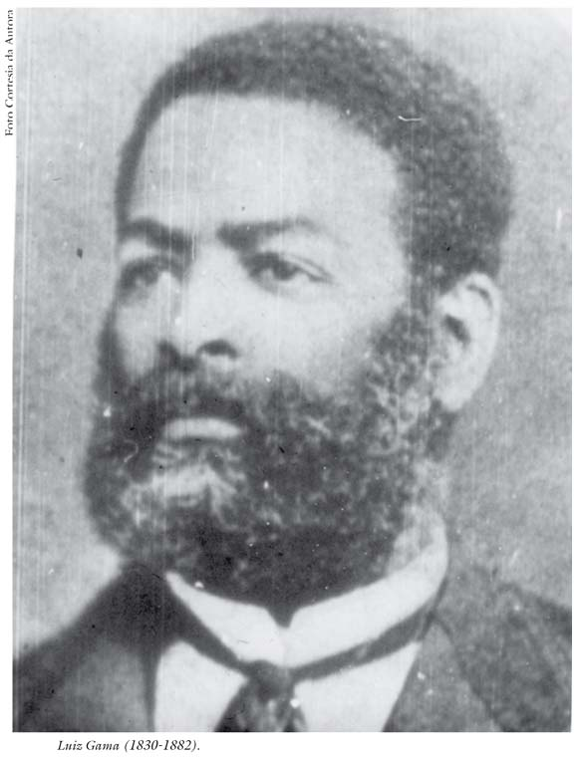
Notes:
Luiz Gama

Slide 10
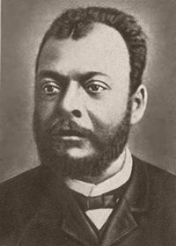
Notes:
Jose do Patrocinio

Slide 11
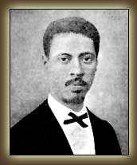
Notes:
Andre Reboucas

Slide 12
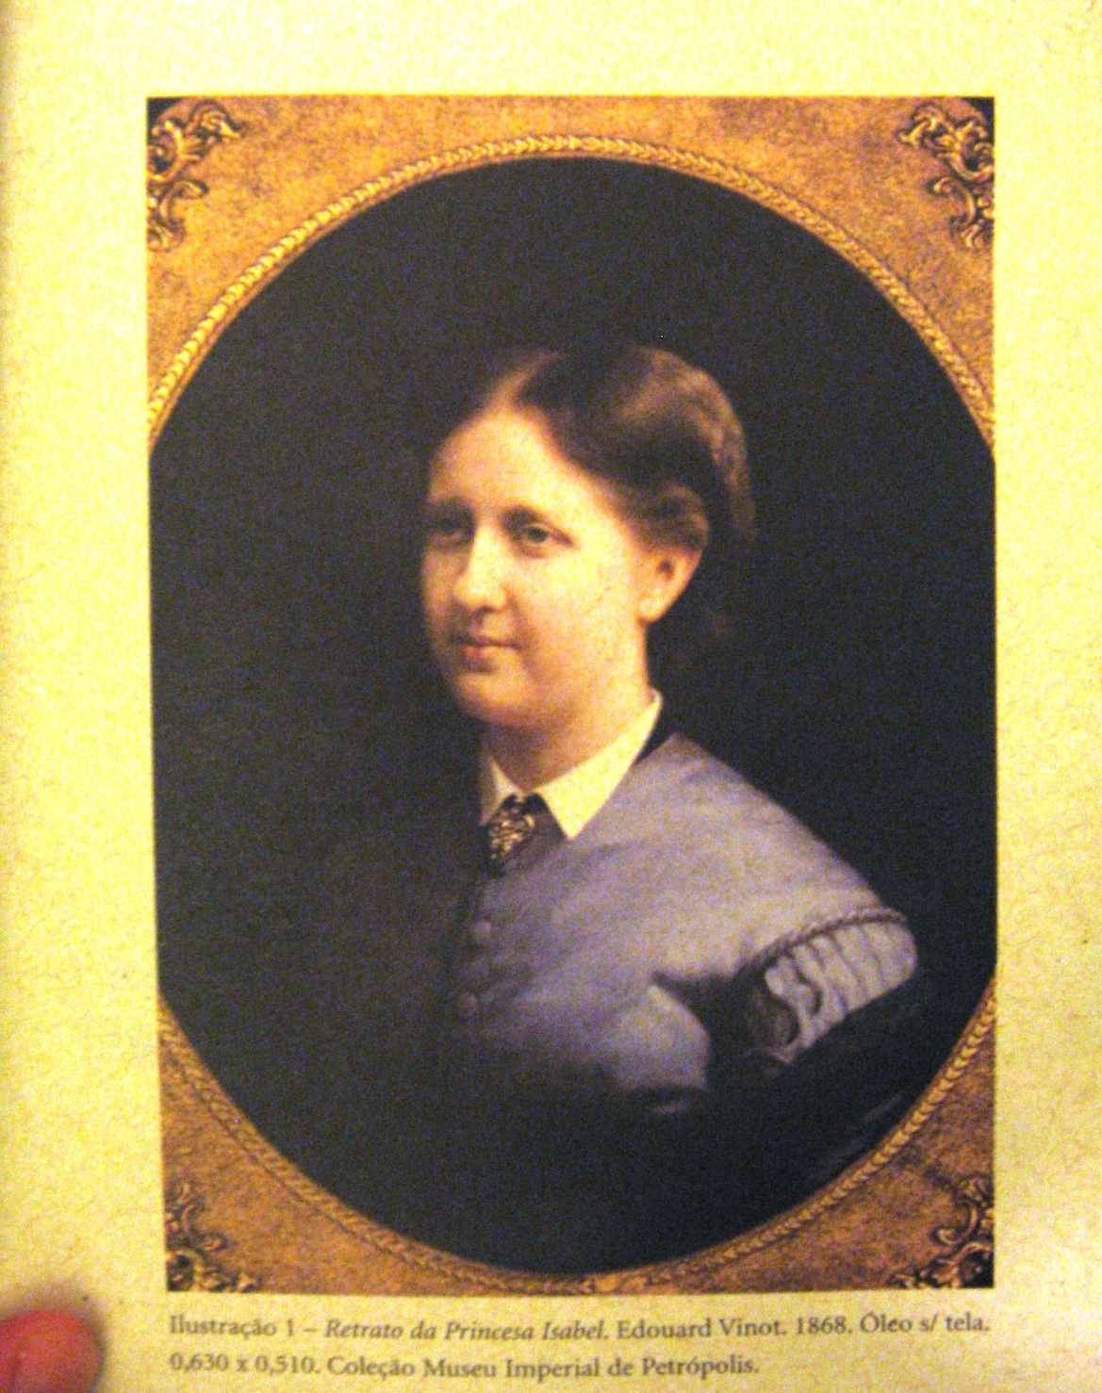
Notes:
Princess Isabel. From Daibert Junior’s book.

Slide 13
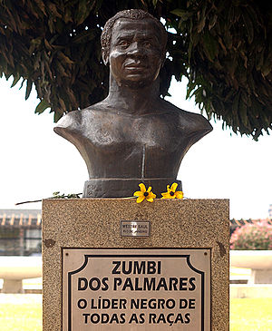
Zumbi, last leader of quilombo of Palmares

Slide 14
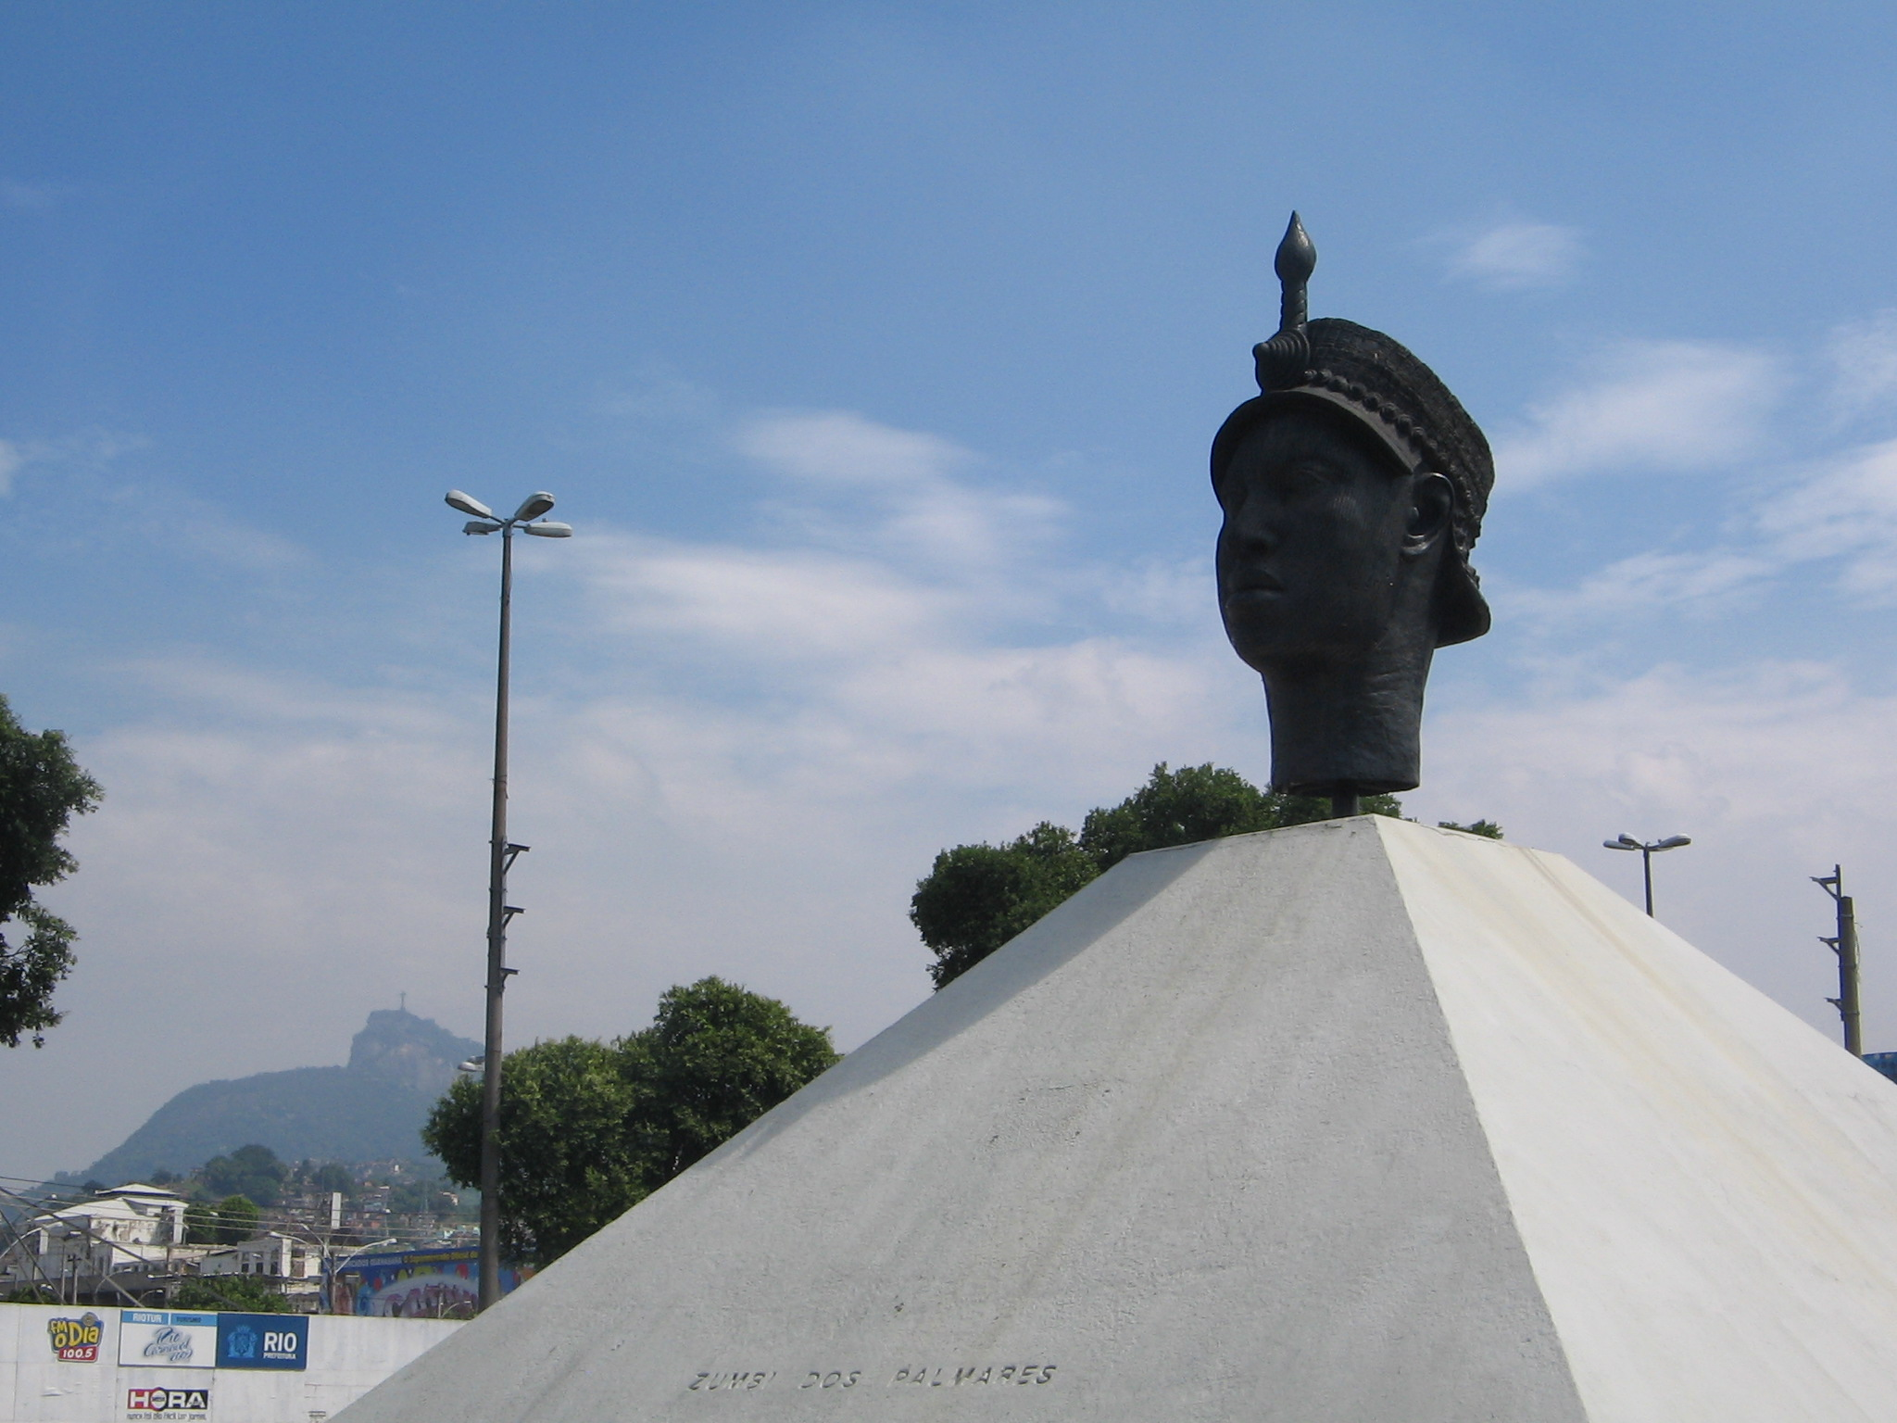
Notes:
Zumbi monument Rio

Slide 15
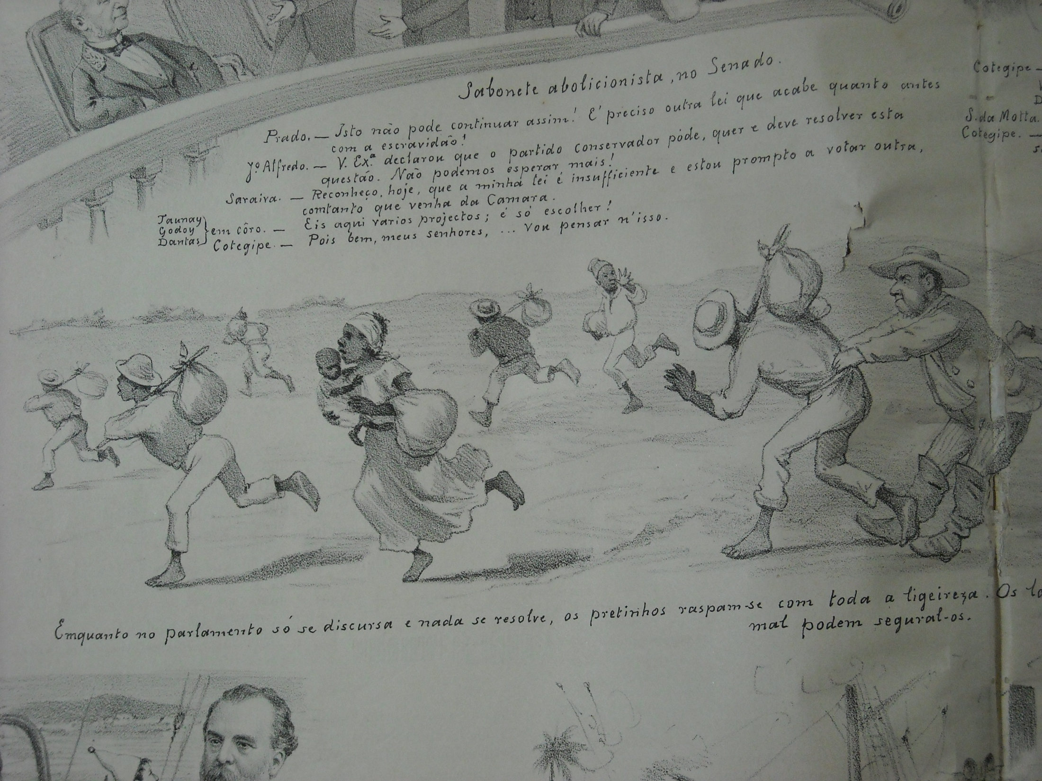

Slide 16
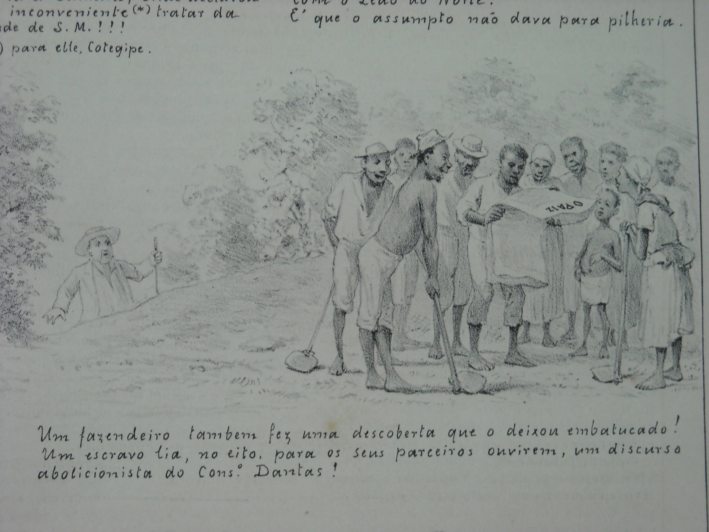

Slide 17
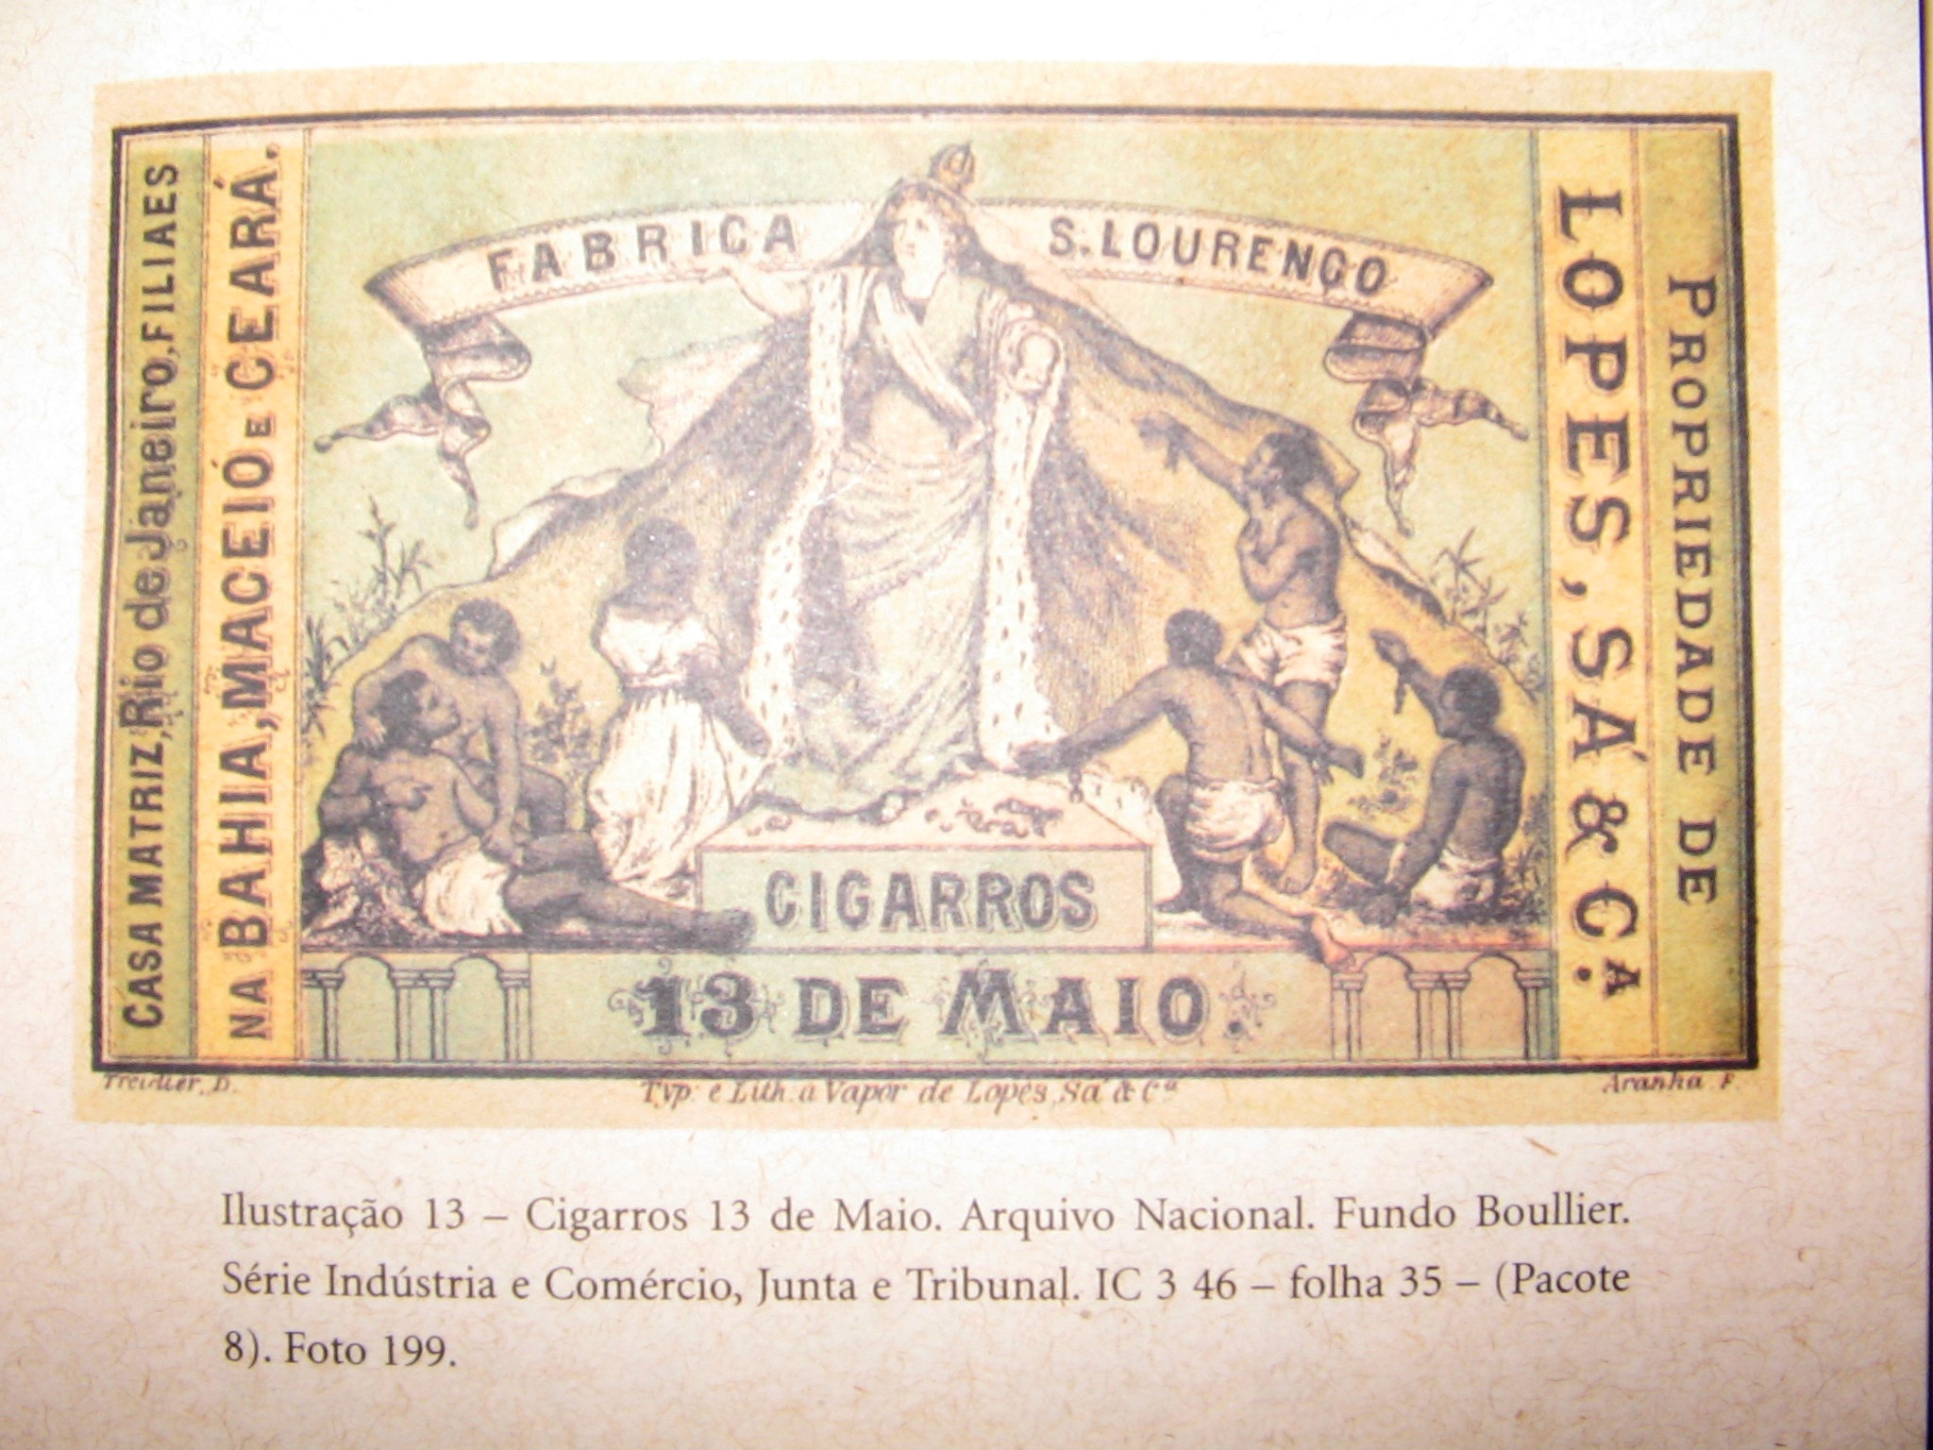
Notes:
Commemorative box of cigars for abolition with Isabel as “Redeemer” of slaves

Slide 18
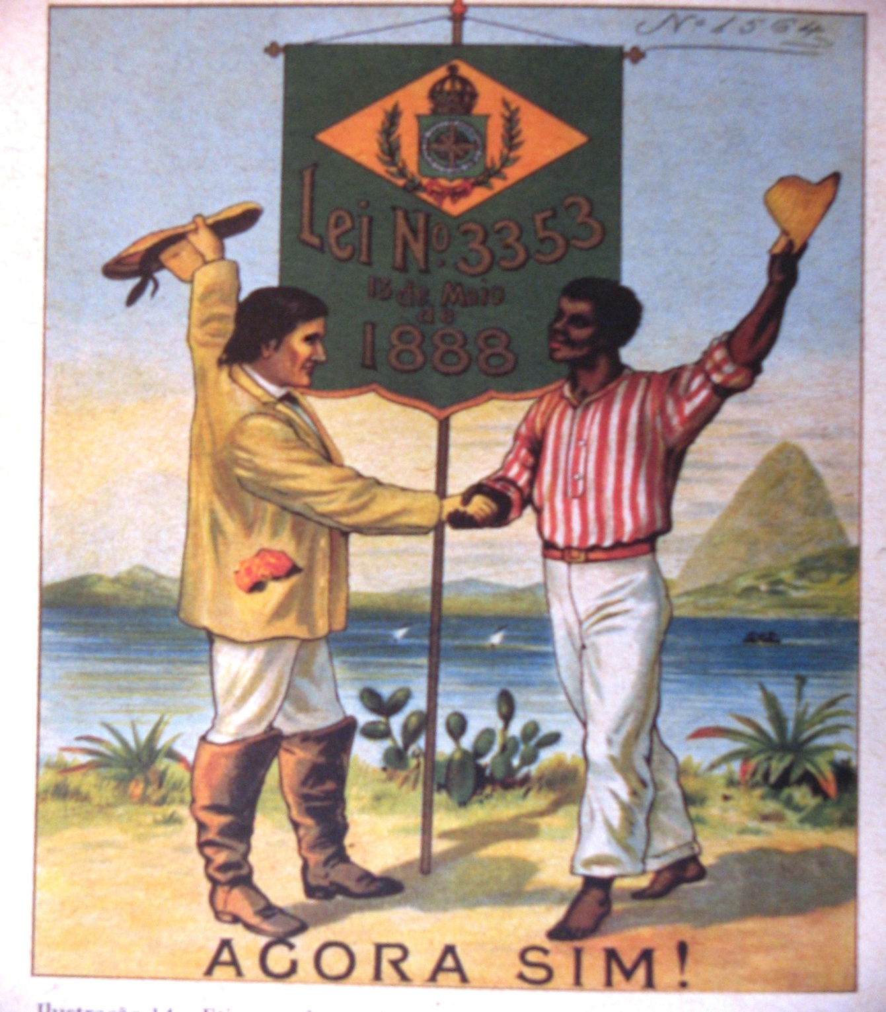
Notes:
Etiqueta de tecido, commemoration of abolition, from Daibert Junior’s book

Slide 19
Memories of Captivity, 2005 English subtitles, LABHOI, UFF, Brazil [documentary made by team of historians at Universidade Federal Fluminense, on the basis of oral testimonies with descendants of enslaved people in rural Rio de Janeiro; this one is based on memories of slavery, abolition, and the trade]
The others in this series are now listed on the Bibliography under Primary Sources → Oral sources.

