Slide 1

Interesting event this week on Brazilian feminisms – I will hopefully go along, maybe see some of you there!

Slide 2
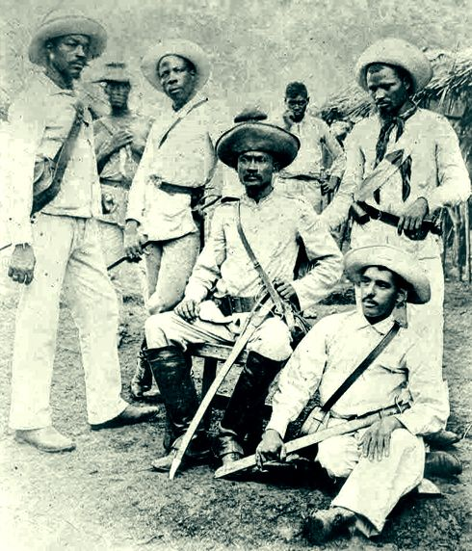
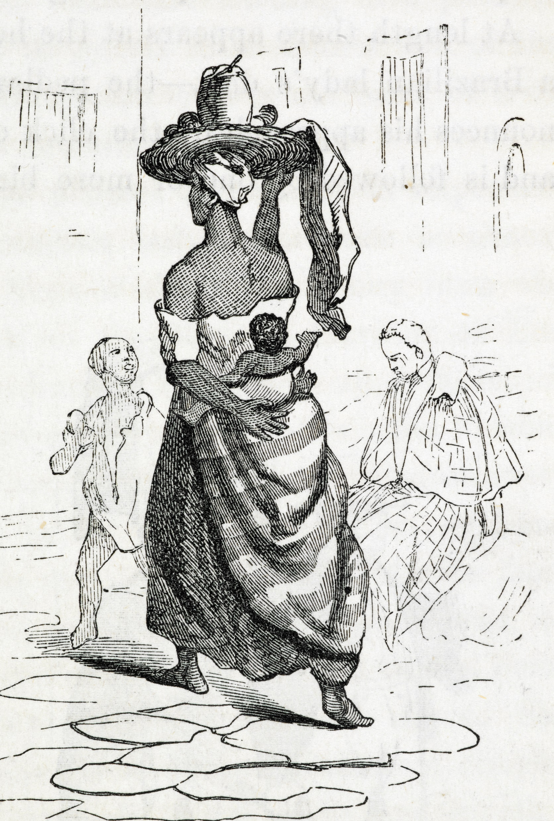
Week 10: Abolition of slavery in Cuba

Slide 3
Readings
Scott, Rebecca. Slave Emancipation in Cuba: The Transition to Free Labour. Princeton University Press, 1985.
Introduction
Ada Ferrer, Insurgent Cuba: Race, Nation and Revolution, 1868-1898(Chapel Hill: University of North Carolina Press, 1999)
“Introduction"
Schmidt-Nowara, Christopher. Empire and Antislavery: Spain, Cuba, and Puerto Rico, 1833-1874. Pittsburgh: University of Pittsburgh Press, 1999.
“Introduction”
Chapter 5: “The Colonial Public Sphere: The Making of the Spanish Abolitionist Society,”100-125

Slide 4
Questions
Why was slavery abolished in Cuba?
Who contributed (free people of colour? Creole elites? Women? The enslaved? Spanish abolitionists..?)
How did antislavery and anticolonial movements intersect (or clash)?
What were the intersections between Spanish colonial power and slavery? Was it possible to have one without the other?
Why does it matter how the story of Cuban abolition is told?

Slide 5
Emancipation in Brazil and Cuba: Comparable, connected, or neither?
In what ways did the ending of slavery in Cuba and Brazil look similar?
In what ways was it different?
In what ways might we see the two as connected?
In each case, what challenges came next?

Slide 6
Last questions: So what?
After doing the course, how might you talk about the history of slavery and emancipation to other people - friends/ family? In public/ professional settings that you might be speaking to after university?
Think back to your distant schooldays! (A-levels or similar). How much did you learn about Atlantic slavery? What insights from your reading and our discussions might have been useful to you back then? What primary sources would you have liked to have?

Slide 7
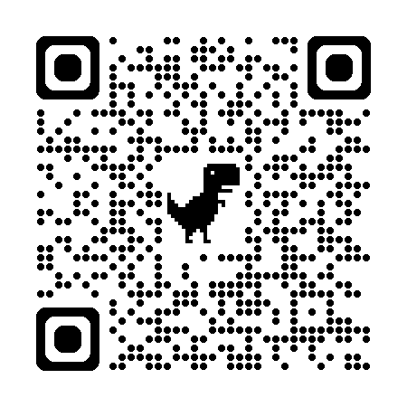
History Module Feedback
Please complete the History Department Module Feedback Form: https://warwick.ac.uk/fac/arts/history/students/currentug/modulefeedbackform
Group 1 meets on Tuesdays
Group 2 meets on Wednesdays
Thank you for your feedback!

