Slide 1
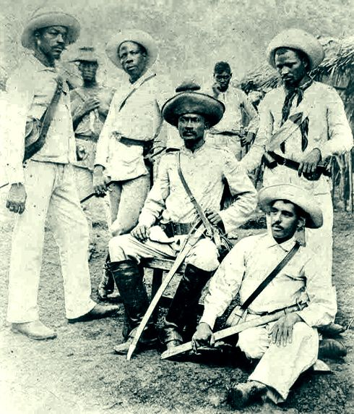
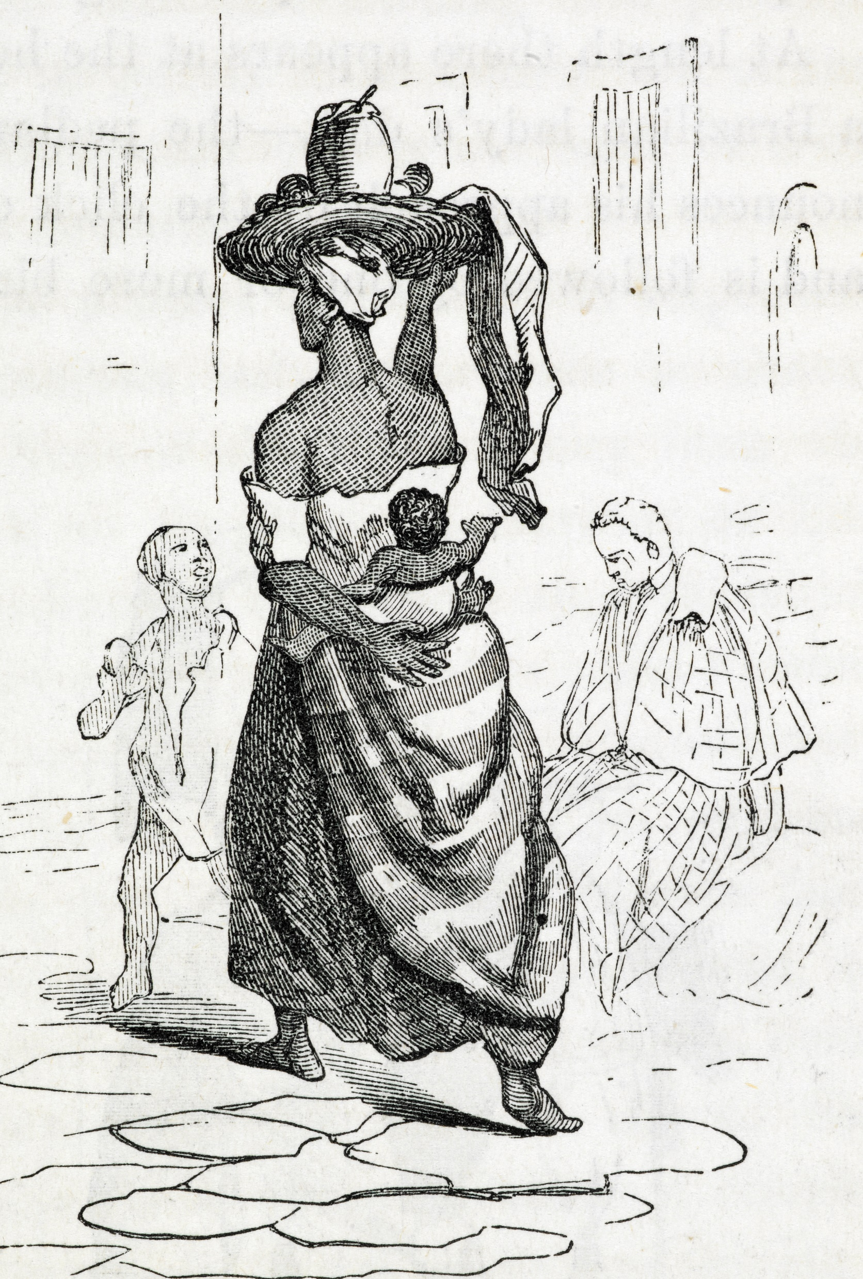
Week 10: Abolition of slavery in Cuba

Slide 2
Have you thought about doing an MA? There’s a discount for all Warwick alumni..
Also see: Warwick Taught Masters Scholarships – deadline Friday 31st May
The University of Warwick will be offering the Warwick Taught Masters Scholarship Scheme to support eligible postgraduate students in 2024/2025. The Scheme has £500,000 to allocate and we expect to make a minimum of 50 awards. Awards are set up to £10,000 per student and available to eligible Home fee status students from under-represented groups who wish to start a postgraduate taught masters course in 2024/2025.
Further information and guidance on eligibility can be found here: https://warwick.ac.uk/study/outreach/scholarships/wtmss/ and any queries can be sent to wtmss@warwick.ac.uk.

Slide 3
Readings
Scott, Rebecca. Slave Emancipation in Cuba: The Transition to Free Labour. Princeton University Press, 1985.
  Introduction
Ada Ferrer, Insurgent Cuba: Race, Nation and Revolution, 1868-1898(Chapel Hill: University of North Carolina Press, 1999)
  “Introduction"
Schmidt-Nowara, Christopher. Empire and Antislavery: Spain, Cuba, and Puerto Rico, 1833-1874. Pittsburgh: University of Pittsburgh Press, 1999.
  “Introduction”
  Chapter 5: “The Colonial Public Sphere: The Making of the Spanish Abolitionist Society,”100-125

Slide 4
Questions
Why was slavery abolished in Cuba?
Who contributed (free people of colour? Creole elites? Women? The enslaved? Spanish abolitionists..?)
How did antislavery and anticolonial movements intersect (or clash)?
What were the intersections between Spanish colonial power and slavery? Was it possible to have one without the other?
Why does it matter how the story of Cuban abolition is told?

Slide 5
What next?
What primary sources have been most useful to deepening your own understanding during the course? What kinds of sources would you have liked more of, and why?
Think back to your schooldays (A-levels or similar). What insights from this course (if any) would have been useful to you back then? What primary sources would you have liked to have?
After doing the course, how might you talk about the history of slavery and emancipation to others beyond Warwick - friends/ family?

