Slide 1

Wednesday 19 November: two events about the history of Congo at Warwick!
5-6pm, FAB4.79 will focus on EXTRACTION through Sammy Baloji’s documentary L’Arbre de l’authenticité [The Tree of Authenticity] (2025).
Pierre-Philippe Fraiture, SMLC Professor of French Studies, who is currently working on a Leverhulme-funded project entitled ‘The Democratic Republic of the Congo: Culture and Resource Extraction’, will lead this session.
AND:

Slide 2
Week 5: The Atlantic Slave Trade: From Numbers to Life Histories

Slide 3
The transatlantic slave trade in numbers
Eltis, David. “The Volume and Structure of the Transatlantic Trade: A Reassessment.” William and Mary Quarterly, 58: 1 (2001): 17-47.

Slide 4
This week’s reading: choose 1
Lovejoy, Paul. Transformations in Slavery: A History of Slavery in Africa. Chapter 1: “Africa and Slavery.” CUP 2012 (third edition).
Paton, Diana. "Gender History, Global History, and Atlantic Slavery: On Racial Capitalism and Social Reproduction." American Historical Review, 127:2 (June 2022): 726-754
Dorsey, Joseph. Dorsey, Joseph C. “It Hurt Very Much at the Time: Rape Culture, Patriarchy, and the Slave Body-Semiotic.” In The Culture of Gender and Sexuality in the Caribbean, ed. Linden Lewis, 294-322. Gainesville: University Press of Florida, 2003
Rediker, Marcus, The Slave Ship: A Human History. London: John Murray, 2007: “Introduction,” pp. 1-13.
Mary Hicks, Captive Cosmopolitans: Black Mariners and the World of South Atlantic Slavery. Omohundro Institute, 2024. Introduction

Slide 5
The Atlantic slave trade in numbers
How has the Voyages.org database shaped what we know about the Atlantic slave trade?
Which were the dominant slave trading powers, when?
What features did Brazil and Cuba share within the world of the Atlantic slave trade? Which were different?
What were the patterns of trading along African coasts and why?
What are the advantages and disadvantages of qualitative and quantitative approaches? What does the project not tell us?

Slide 6
Beyond the numbers: questions
How was the trade shaped by gendered power and reproductive labour (Paton)?
What were the functions of the slave ship, according to Rediker/ Dorsey?
What are the advantages or disadvantages of qualitative and quantitative approaches?
What was the relationship between the Atlantic slave trade and the institution of slavery in Africa itself (Lovejoy)?
What new perspectives on the world of the slave trade does Hicks’ book offer?

Slide 7
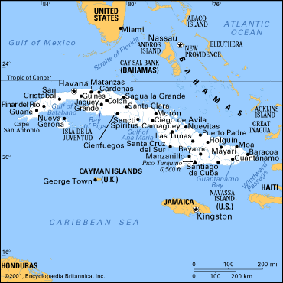

Slide 8
