Slide 1
Week 5: The Atlantic Slave Trade: From Numbers to Human Histories

Slide 2
Doing an MA at Warwick
On Monday of Week 7, we will be running an information session for any final year students interested in staying on for the MA.
We’ll be giving students an overview of the programme, the application process and funding opportunities. It’s a great opportunity to hear what the MA is like and ask any questions they might have.
The session will run from 12-1pm in FAB3.57 (the large social learning space). Any students who can’t make that session are invited to get in touch with pghistoryoffice@warwick.ac.uk for more information about the MA.

Slide 3
This week’s reading
Eltis, David. “The Volume and Structure of the Transatlantic Trade: A Reassessment.” William and Mary Quarterly, 58: 1 (2001): 17-47.
Lovejoy, Paul. Transformations in Slavery: A History of Slavery in Africa. Chapter 1: “Africa and Slavery.” CUP 2012 (third edition).
Paton, Diana. "Gender History, Global History, and Atlantic Slavery: On Racial Capitalism and Social Reproduction." American Historical Review, 127:2 (June 2022): 726-754
Dorsey, Joseph. Dorsey, Joseph C. “It Hurt Very Much at the Time: Rape Culture, Patriarchy, and the Slave Body-Semiotic.” In The Culture of Gender and Sexuality in the Caribbean, ed. Linden Lewis, 294-322. Gainesville: University Press of Florida, 2003
Rediker, Marcus, The Slave Ship: A Human History. London: John Murray, 2007.
“Introduction,” pp. 1-13.

Slide 4
Questions (all together)
Who/what shaped the volume and nature of the transatlantic slave trade?
How was the trade shaped by gendered power and reproductive labour (Paton)?
What were the functions of the slave ship, according to Rediker/ Dorsey?
What are the advantages or disadvantages of qualitative and quantitative approaches?
What was the relationship between the Atlantic slave trade and the institution of slavery in Africa itself (Lovejoy)?

Slide 5
Questions (1)
Who/what shaped the volume and nature of the transatlantic slave trade?
How does Paton argue the trade was shaped by gender?
What features did Brazil and Cuba share within the world of the Atlantic slave trade? Which were different?
What was the relationship between the Atlantic slave trade and slavery in Africa itself?

Slide 6
Questions (2)
What were the functions of the slave ship, according to Rediker/ Dorsey?
What are the advantages and disadvantages of qualitative and quantitative approaches?
What are the challenges of writing a more ‘human’/ person-centred history of the trade?

Slide 7
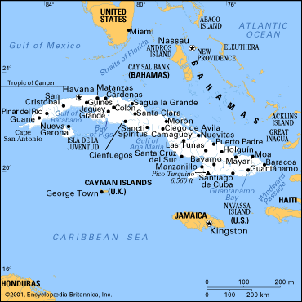

Slide 8
