Slide 1
Week 1: West Central Africans and the diaspora

Slide 2
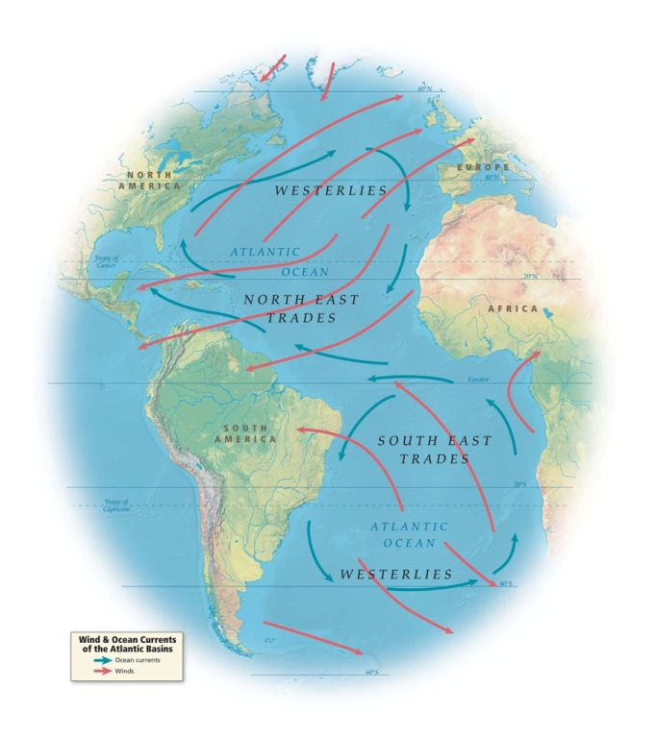
Atlantic winds (red) and currents (blue)
From SlaveVoyages.org “Introductory Maps”
“In the age of sail, winds and ocean currents shaped the direction of the trans-Atlantic slave trade, effectively creating two separate slave-trading systems, one in the north with voyages originating in Europe and North America, the other in the south with voyages originating in Brazil.”

Slide 4
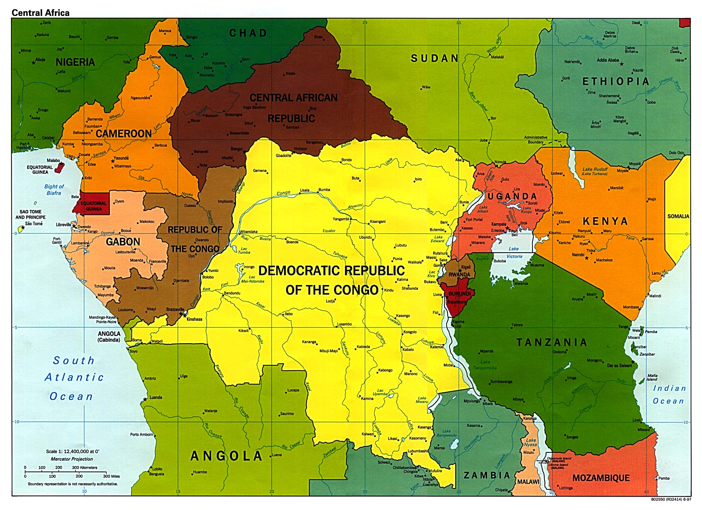
Notes:
Modern Central West Africa

Slide 5
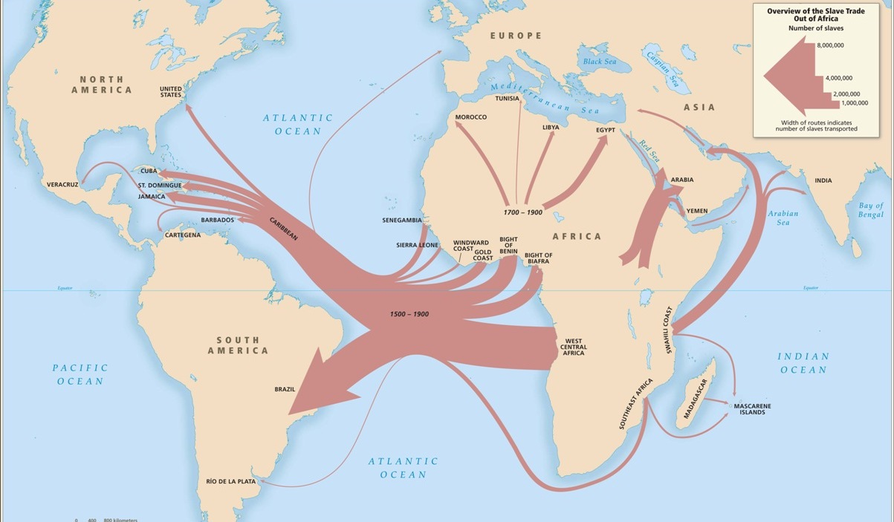

Slide 6
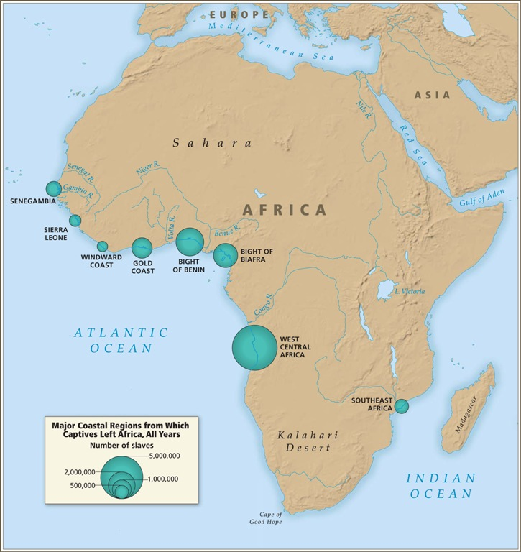

Slide 7
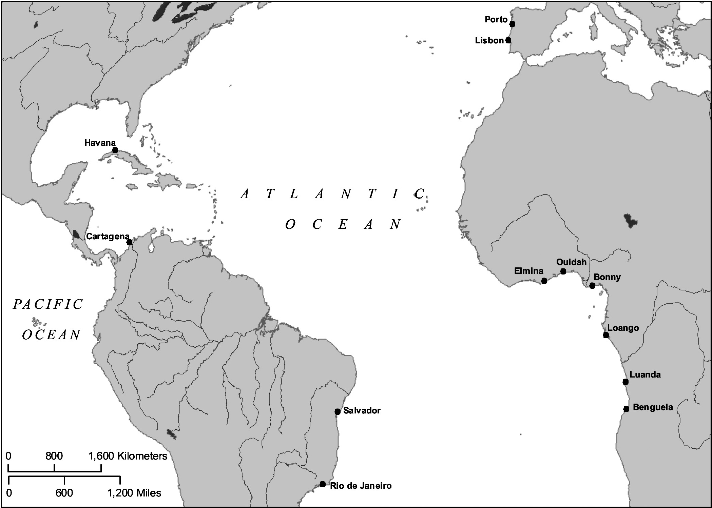
Notes:
From Mariana Candido’s book on Benguela

Slide 8
Initial questions
What do you know the connections between the longer histories of West Central Africa (especially today’s Angola) and Brazil?
[by way of recap] What distinguished West Central Africans from West Africans in Brazil? where in Brazil did most West Central Africans go by the mid-C18, and why? (Check Lauderdale Graham's article and also the 'Nago and Mina' pieces from last week on the Yoruba)

Slide 9
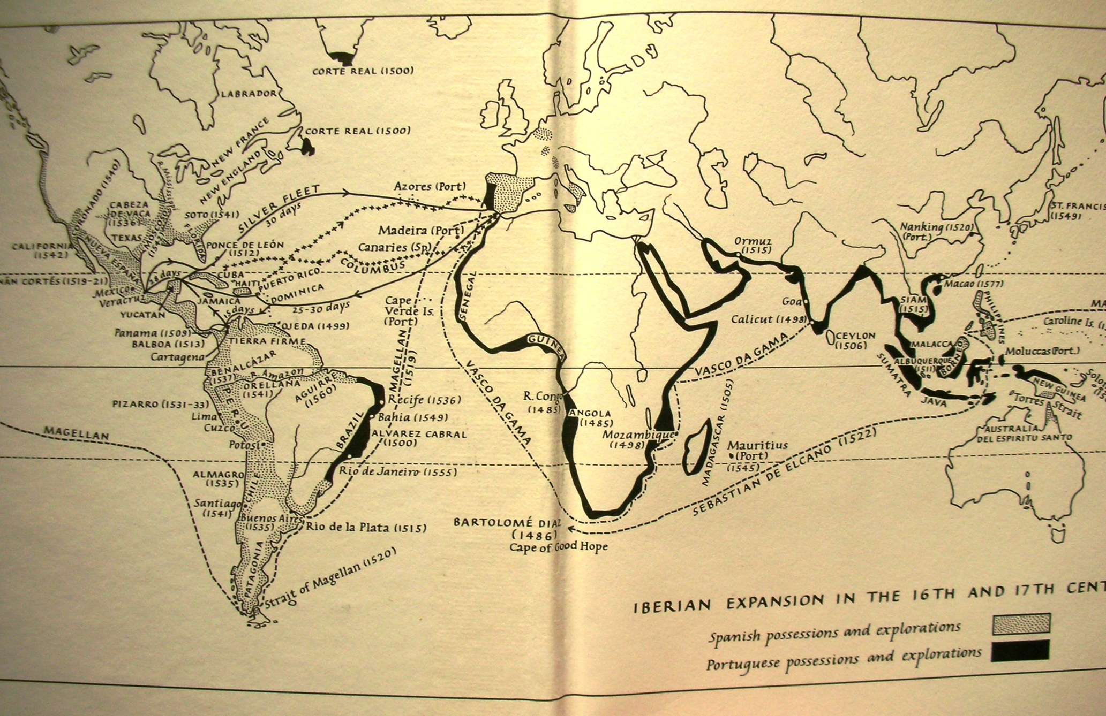
Notes:
Iberian expansion in 16th / 17th centuries (J Elliott, Imperial Spain)

Slide 10
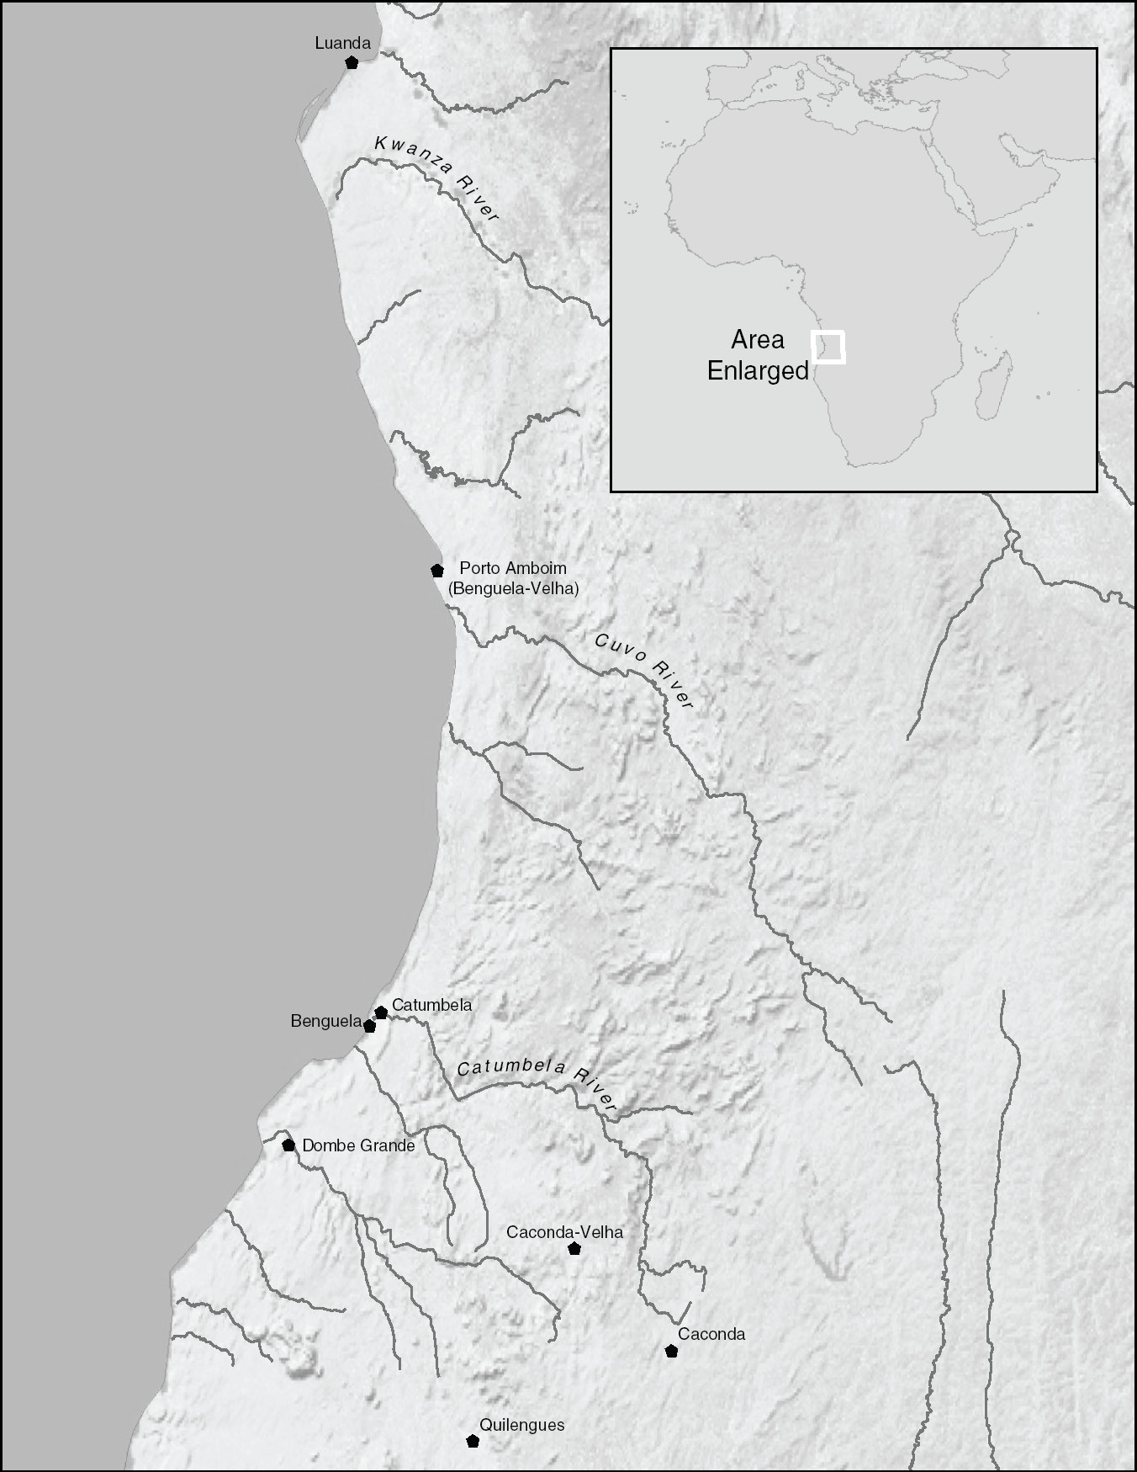
Portuguese fortresses south of the Kwanze River
Notes:
From Mariana Candido’s book on Benguela

Slide 11
Further reading on the Brazil/ South Atlantic connections
Luis Felipe Alencastro, The Trade in the Living: The Formation of Brazil in the South Atlantic in the Sixteenth and Seventeenth Centuries 2018)
Jose Lingna Nafafe, Lourenco da Silva Mendonca and the Black Atlantic Abolitionist Movement in the Seventeenth Century, CUP 2022
Roquinaldo Ferreira, Cross-Cultural Exchange in the Atlantic World: Angola and Brazil during the Era of the Slave Trade
Mariana Candido, Wealth, Land, and Property in Angola: A History of Dispossession, Slavery, and Inequality (CUP 2022)
Toby Green, A Fistful of Shells: West Africa from the Rise of the Slave Trade to the Age of Revolution. 2019
Joseph Miller, Way of Death: Merchant Capitalism and the Angolan Slave Trade, 1730-1830, 1988.

Slide 12
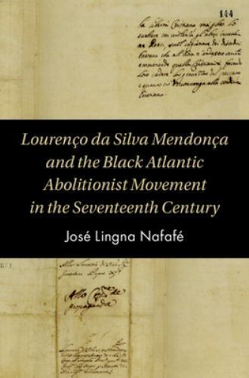
Lourenço da Silva Mendonça
Angolan prince who travelled to the Vatican in 1680s to start an international campaign against the institution of slavery - some 100 years before European abolitionism first developed
José Lingna Nafafé, CUP 2022

Slide 13
Notes:
Modern Central West Africa

Slide 14
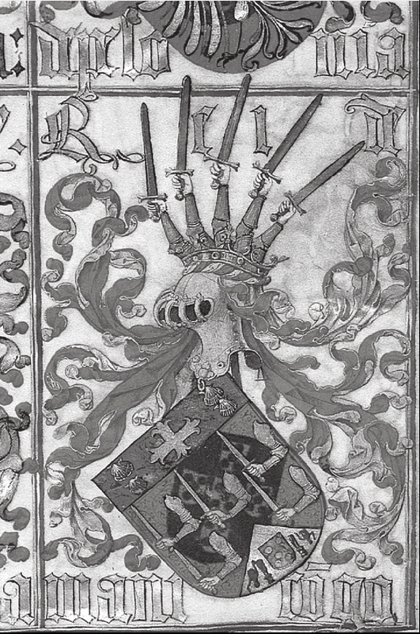
African states’ diplomatic relations with early modern Europe…
Coat of arms of the Kingdom of Manicongo (c.1530).
King Nzinga Nkwuwu, ruler of the kingdom of Congo, converted to Christianity at the turn of the C15. An independent kingdom with a bishopric at its capital, Sao Salvador, the Congo boasted diplomatic ties with Lisbon, Madrid, and Rome, and sent embassies to other European capitals.
Source: Luis Felipe Alencastro, The Trade in the Living

Slide 15
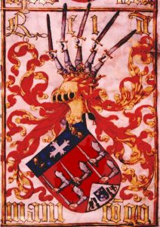
Kingdom of Kongo, 15th century coat of arms
For a great introduction to the history of this major African kingdom see:
https://africankingdoms.co.uk/kongo/

Slide 16
Reading
Mariana P Candido, An African Slaving Port and the Atlantic World: Benguela and its Hinterland (CUP 2013): "Introduction," pp. 1-30.
Aisha Finch, Rethinking Slave Rebellion in Cuba, chapter 7, "African Cuban Traditions and the Making of an Insurgency"
Robert Slenes, "Metaphors to Live By in the Diaspora: Conceptual Tropes and Ontological Wordplay among Central Africans in the Middle Passage and Beyond," in Tracing Language Movement in Africa, eds. Ericka A. Albaugh and Kathryn M de Luna (OUP, 2018)

Slide 17
Further reading on central African politics & culture in Africa and the diaspora (for essays etc)
Heywood, Linda, ed., Central Africans and Cultural Transformations in the American Diaspora. CUP 2009
John Thornton, "I am the Subject of the King of Congo:" African Political Ideology and the Haitian Revolution." 1993 (& see Thornton on Kongo more generally)
Todd Ochoa, The Society of the Dead: Quita Manaquita and Palo Praise in Cuba. 2010.
Gladys Gonzalez Bueno, Description of a palo monte ceremony, in Stubbs, Jean, and Pedro Perez Sarduy,AfroCuba: An Anthology of Cuban Writing on Race, Politics and Culture, 1993.
Gomez, Michael Exchanging our Country Marks: The Transformation of African Identity in the Colonial and Antebellum South, ch 6
Miguel Barnet, The Autobiography of a Runaway Slave (descriptions of palo rituals)

Slide 18
Questions about the reading
How does Mariana Candido suggest that a study of Benguela can change the way we write the history of the Atlantic World?
* How, according to Slenes, did language help west central Africans build "metaphors to live by" across the Atlantic?
* What was the role of West Central Africans in religious practices, warfare, and subversive geographies in rural Matanzas, Cuba, according to Finch?
* What methods do these historians use to uncover West Central Africans' cultural and political lives? How successful are they, in your view?

Slide 19
Notes:
Central Africa in the nineteenth century. From Reid, A History of Modern Africa

Slide 20
Notes:
Africa in the C19, from Reid, History of Modern Africa

