Slide 1
Week 10: A Case Study: The Yoruba Diaspora

Slide 2

History Module Feedback
Please complete the History Department Module Feedback Form: https://warwick.ac.uk/fac/arts/history/students/currentug/modulefeedbackform
Group 1 is the Tuesday group
Group 2 is the Wednesday group
Thank you for your feedback!

Slide 3
Two important references:
The classic reference on mixture and creolisation: Sidney W. Mintz and Richard Price, The Birth of African-American Culture: An Anthropological Perspective. Boston, 1992
On African continuities: John Thornton, Africa and Africans in the Making of the Atlantic World, 1400-1680. New York, 1992

Slide 4
Questions
Why were so many Yoruba speakers trafficked to Brazil and Cuba during the nineteenth century?
What did being Yoruba mean in terms of daily enslaved experience in nineteenth-century Cuba and Brazil?
What institutions helped shape identification along ethnic lines?
What were the implications for enslaved resistance?
What differences existed between the Cuban and Brazilian contexts?

Slide 5
Readings
Henry Lovejoy, Prieto: Yoruba Kingship in Cuba during the Age of Revolutions (2019): Introduction and a chapter of your choosing.
Falola, Toyin, and Childs, Matt, eds. The Yoruba Diaspora in the Atlantic World, 2004. Ch. 5: João José Reis and Beatriz Mamigonian, “Nagô and Mina: the Yoruba Diaspora in Brazil”
Graham, Sandra Lauderdale. “Being Yoruba in Rio de Janeiro.” 2011
Joao Jose Reis, Divining Freedom: The Story of Domingos Sodre, an African Priest in Nineteenth-Century Brazil, 2015. Choose the chapter that most interests you.

Slide 6
The Yoruba diaspora in the Atlantic World
Who were the Yoruba? How and when did they end up featuring significantly in the Atlantic slave trade?
Why did the Yoruba seem to become so culturally dominant in Cuba and Brazil in the nineteenth century? (Were they also numerically dominant?)
What institutions and networks supported this?
What was the region with the highest Yoruba concentration in Brazil historically and why?
what features of Afro-Brazilian and Afro-Cuban religious and cultural practice have recognisably Yoruba features today?
What were the implications for enslaved resistance?

Slide 7
Further useful reading
David Eltis, “The Diaspora of Yoruba Speakers, 1650 - 1865: Dimensions and Implications,” in The Yoruba Diaspora in the Atlantic World, eds Falola & Childs [and the whole volume!]

Slide 8
On Afro-Cuban religion (with a significant Yoruba influence):
George Brandon, Santeria from Africa to the New World: The Dead Sell Memories (1998) [paper copy @ library]
David H Brown, Santeria Enthroned: Art, Ritual, and Innovation in an Afro-Cuban Religion. Routledge, 2003
Stephan Palmie, Wizards and Scientists: Explorations in Afro-Cuban Modernity and Tradition. Duke 2002

Slide 9
West Africa c. 1865
Notes:
From Richard Reid History of Modern Africa

Slide 10
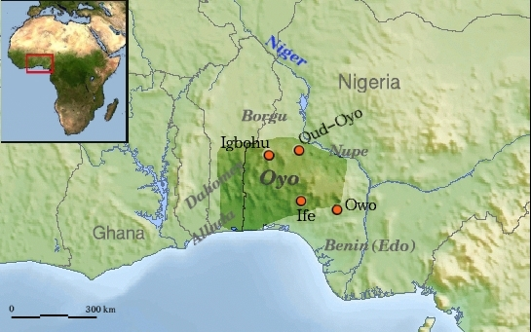
The Oyo Empire

Slide 11
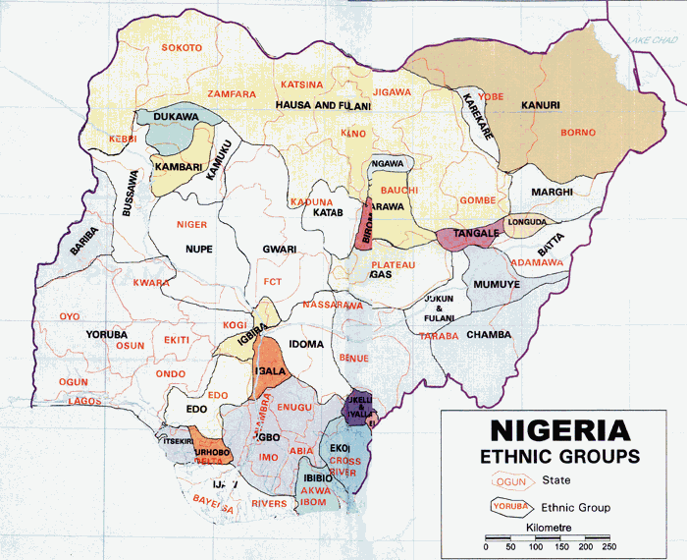

Slide 12
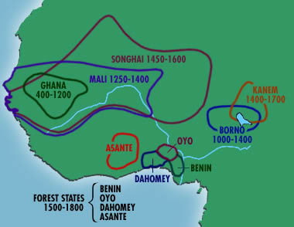

Slide 13
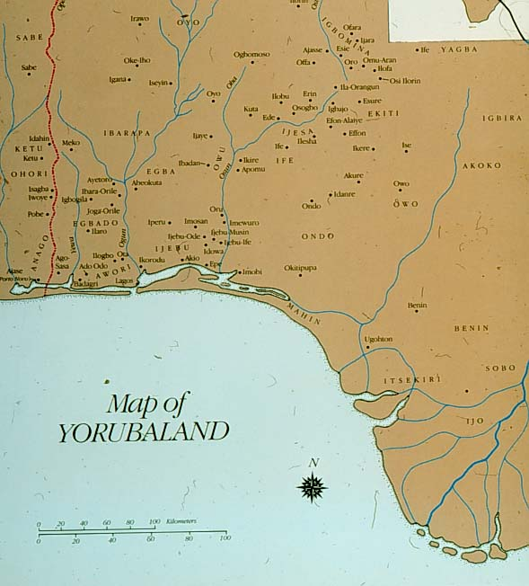
Notes:
From: https://coursewikis.fas.harvard.edu/aiu18/?title=File:Yorubaland.jpg&limit=500

Slide 14
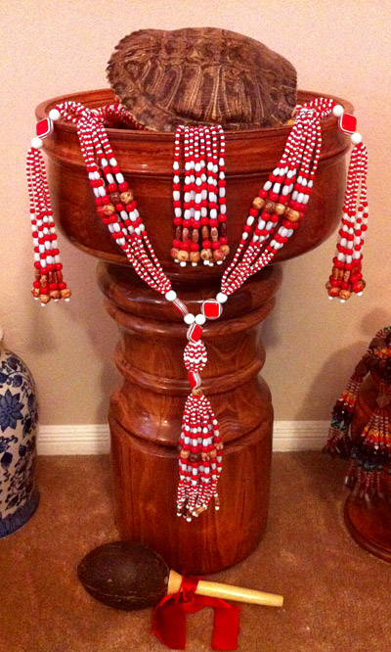
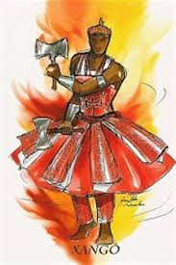
Orixás (Orishas): Changó/ Xangó

Slide 15
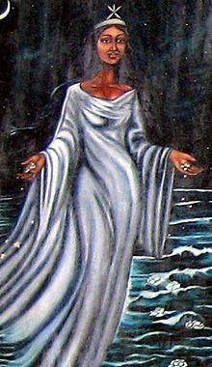
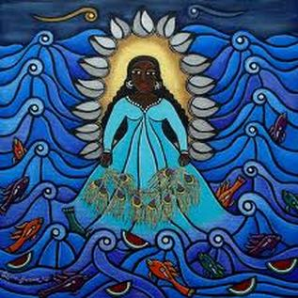
Yemayá/ Iemanjá

Slide 16
Pierre “Fatumbi” Verger and Afro-Brazilian religious life in 1940s Bahia and Benin/ Nigeria https://pierreverger.org/o-fotografo-fluxo-e-refluxo/

Slide 17
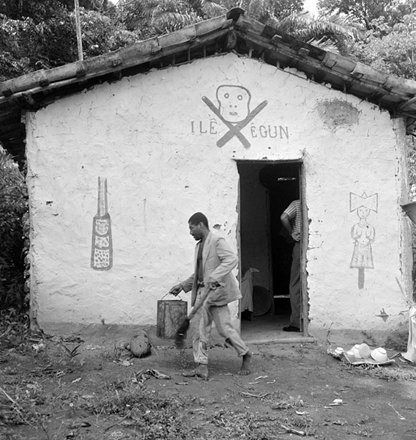
A candomblé terreiro (religious house)

Slide 18
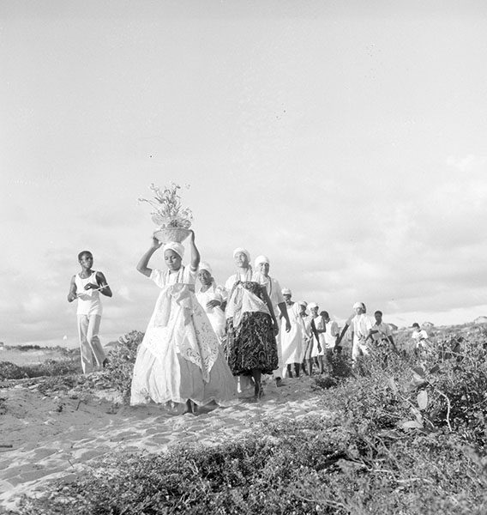

Slide 19
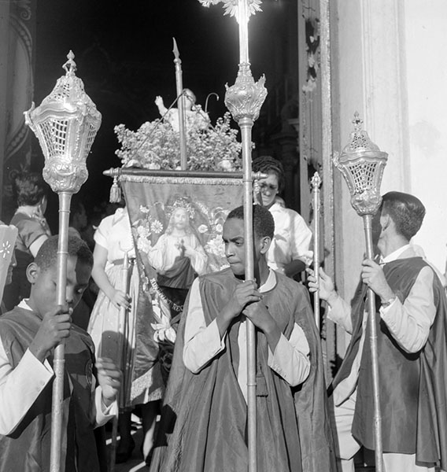

Slide 20
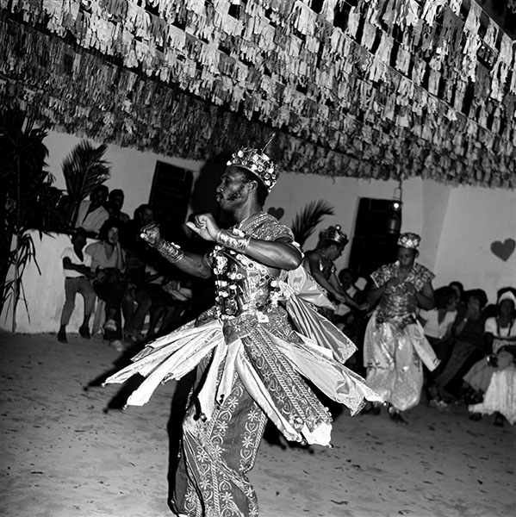

Slide 21
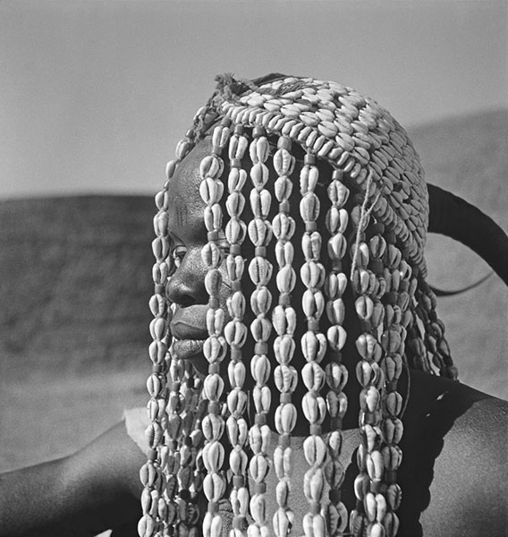
Cowrie shells

Slide 22
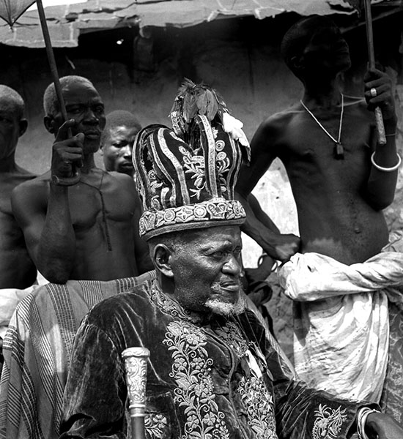

Slide 23
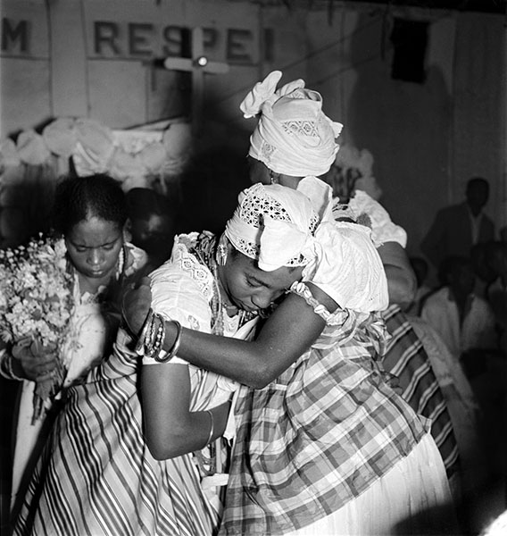

Slide 24
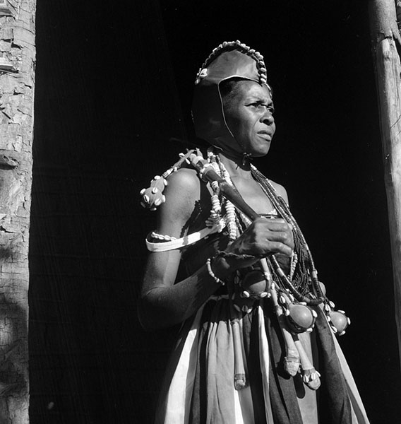

Slide 25
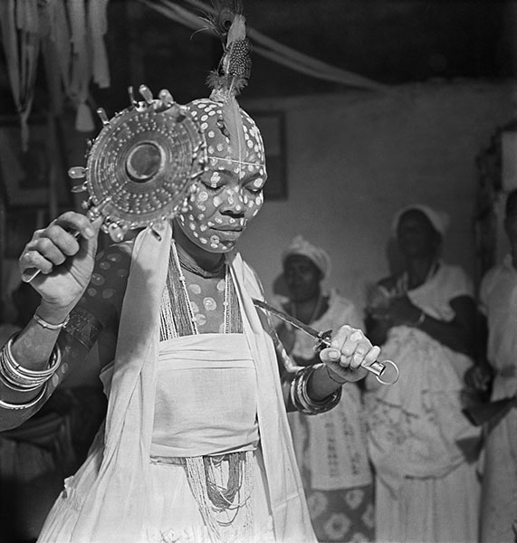

Slide 26
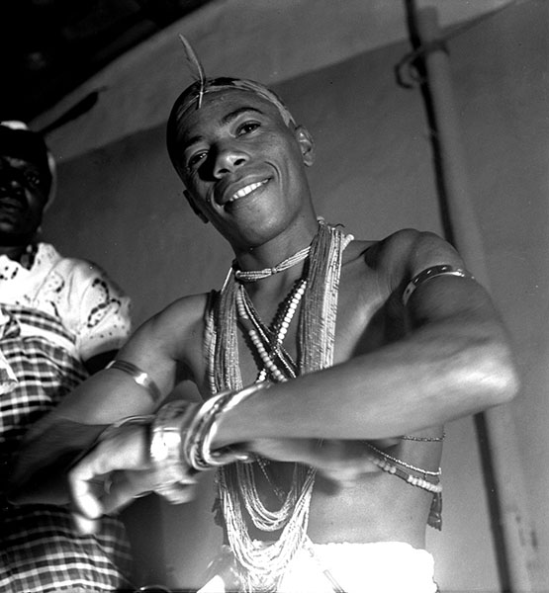

Slide 27
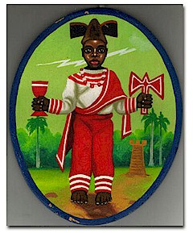
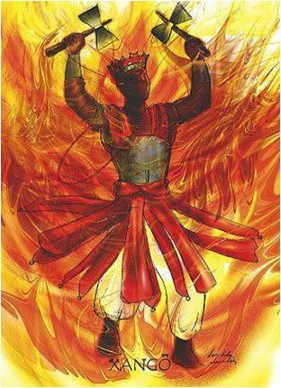
Yoruba-derived religion: the orisha Changó (Xangó) (Santa Barbara)

Slide 28
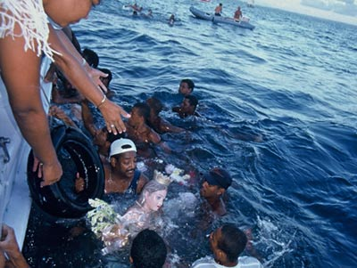
Yoruba religion: Yemayá/ Iemanjá
Notes:
Representation of Yemaya; ceremony of worship

Slide 29
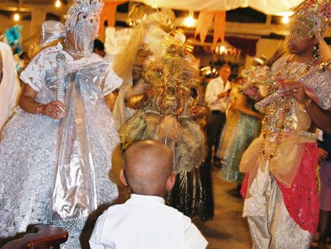
Candomblé in Brazil: initiation ceremony for a child
Notes:
The boy being presented to the general public watches the deities that will protect him in the future. Once a priest has determined which orixa belongs to the new initiate, which is done by the casting of cowry shells, a string of beads are consecrated to that deity and placed round the initiate's neck. The initiate spends up to a month in seclusion, participating in other important rituals, before being presented to the general public. [bbc candomble site]

Slide 30
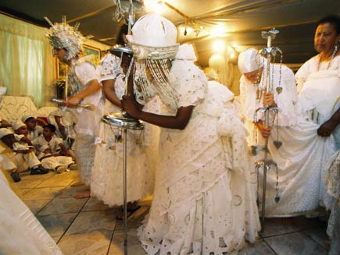
Candomblé in Brazil: worshipping the supreme deity Oxalá

Slide 31
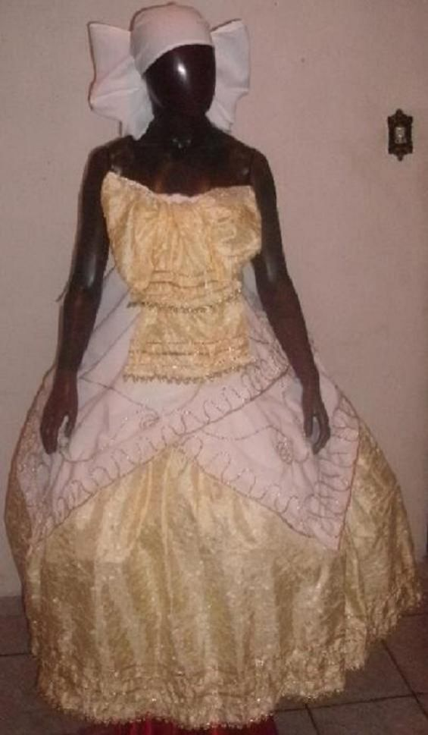
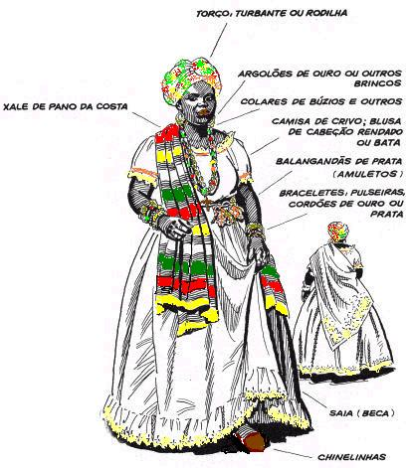
Pano da Costa

