Slide 1
Week 7: ‘Resistance’ and Rebellion in Brazil, Cuba, and the Atlantic World

Slide 2
Readings
Ada Ferrer, “Cuban Slavery & Antislavery,” in Josep M. Fradera and Christopher Schmidt-Nowara, eds., Slavery & Antislavery in Spain’s Atlantic Empire (Oxford: Bergahn, 2013).
Manuel Barcia, The Great African Slave Revolt of 1825: Cuba and the Fight for Freedom in Matanzas (LSU Press, 2012), introduction [we have e-book but restricted to 1 user at a time]
Aisha Finch, Rethinking Slave Rebellion in Cuba: La Escalera and the Conspiracies of 1843-4, chapter 5, “And the Women Also Knew: The Gendered Terrain of Insurgency”
Reis, João José. "Slave Resistance in Brazil: Bahia, 1807-1835." Luso-Brazilian Review, 25:1 (1988), pp. 111-144.

Slide 3
Questions
What is ‘resistance’? What kinds of resistance did enslaved people employ? Why does it matter so much (to historians and perhaps constituencies you can think of)?
How have historians of gender problematised definitions of resistance?
What was the impact of the Haitian Revolution on Cuba?
Was enslaved rebellion and warfare in Brazil and Cuba an African or a creole phenomenon?
What was the background for the Malê revolt in Bahia? What was its significance after 1835?
What is Reis' diagnosis of the role of ethnic divisions? Do you agree?
Are there any circumstances under which we could think of manumission as resistance?

Slide 4
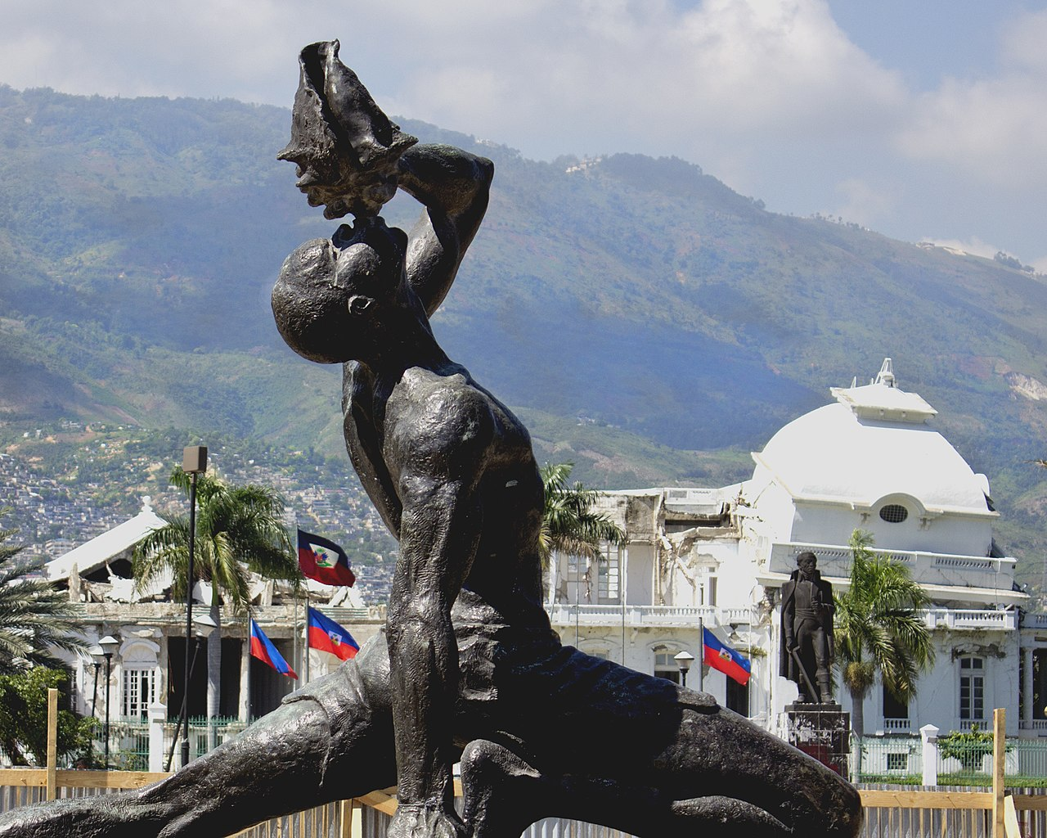
“The Unknown Maroon,” Port-au-Prince, Haiti

Slide 5
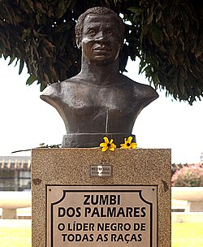
Zumbi dos Palmares, Brasilia

Slide 6
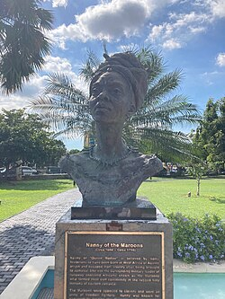
Nanny of the Maroons, Jamaica

Slide 7
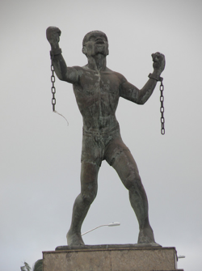
Emancipation Monument, popularly called “Bussa” after famous rebel leader, Barbados

Slide 8
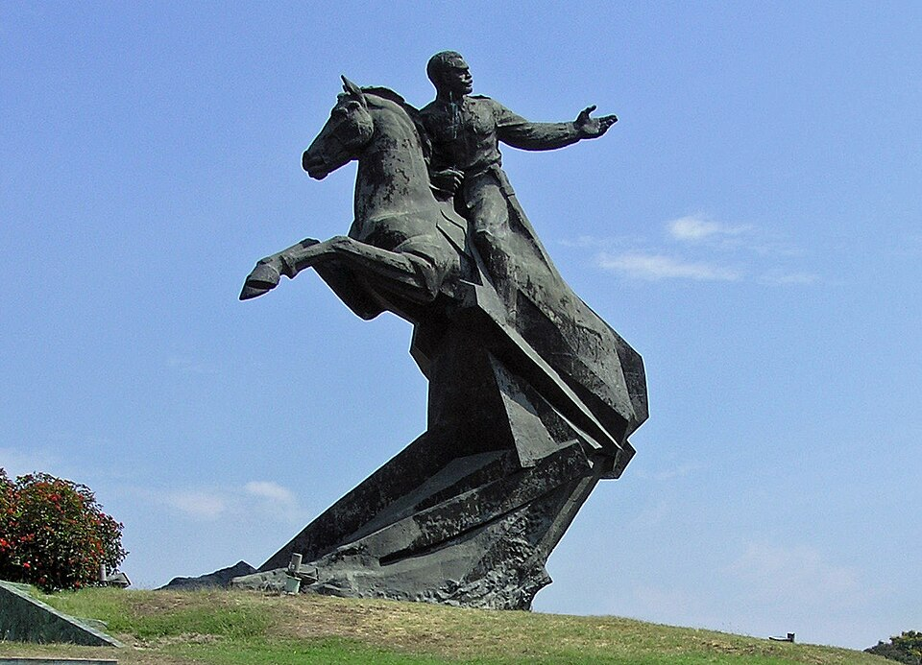
Antonio Maceo, Santiago de Cuba

Slide 9
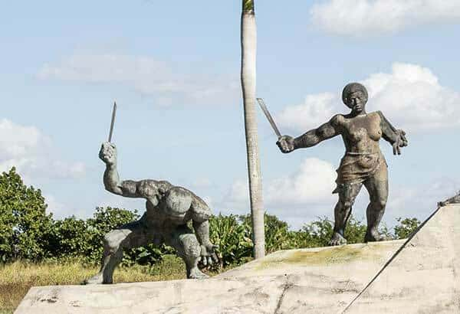
Carlota, Cuba

Slide 10
Some documentary films you might be interested in (for essays?)
Produced on the basis of interviews with descendants of enslaved communities in coffee plantations in Brazil’s south-east (Rio de Janeiro) by team of researchers based at Universidade Federal Fluminense in Rio [all on youtube with English subtitles]
A Present Past: Afro-Brazilian Memories in Rio de Janeiro [on memories of the trade, among other things]
Verses and Cudgels: Stick-Playing in the Afro-Brazilian Culture of the Paraiba Valley (Rio de Janeiro, Brazil)
Memorias do cativeiro [Memories of Slavery]
Jongos, calangos and folias [on dance, song, musical and oral culture]

