Slide 1
Week 9: Cultures and Societies in the Diaspora

Slide 2
Questions
What cultural and religious institutions and practices undergirded Afro-American life in the Iberian world? Do these seem different from other slaveholding territories of the Americas?
Did the Middle Passage represent cultural change or cultural continuity for enslaved Africans and their New World descendants?
What sources did the piece(s) you read use? What challenges / possibilities are there for historians working on African Diaspora cultural history?

Slide 3
Readings
Matt D. Childs, The 1812 Aponte Rebellion in Cuba and the Struggle against Atlantic Slavery (2006): chapter 3, "Organising the Rebellion: The Overlapping Worlds of the Militia and the Cabildos de Nacion".
Barcia, Manuel. Seeds of Insurrection: Domination and Resistance on Western Cuban Plantations, 1808-1848, 2008. Ch 1: “The African Background of Cuban Slaves”
Morgan, Philip D. “The Cultural Implications of the Atlantic Slave Trade: African Regional Origins, American Destinations and New World Developments.” Slavery & Abolition, 1997
Castillo, Lisa Earl, and Luis Nicolau Parés. “Marcelina da Silva: A Nineteenth-Century Candomblé Priestess in Bahia.” Slavery & Abolition, 2010
Matthias Rohrig Assuncao, "From Slave to Popular Culture: The Formation of Afro-Brazilian Art Forms in Nineteenth-Century Bahia and Rio de Janeiro," Iberoamericana, 2003

Slide 4
Two important references:
The classic reference on mixture and creolisation: Sidney W. Mintz and Richard Price, The Birth of African-American Culture: An Anthropological Perspective. Boston, 1992
On African continuities: John Thornton, Africa and Africans in the Making of the Atlantic World, 1400-1680. New York, 1992

Slide 5
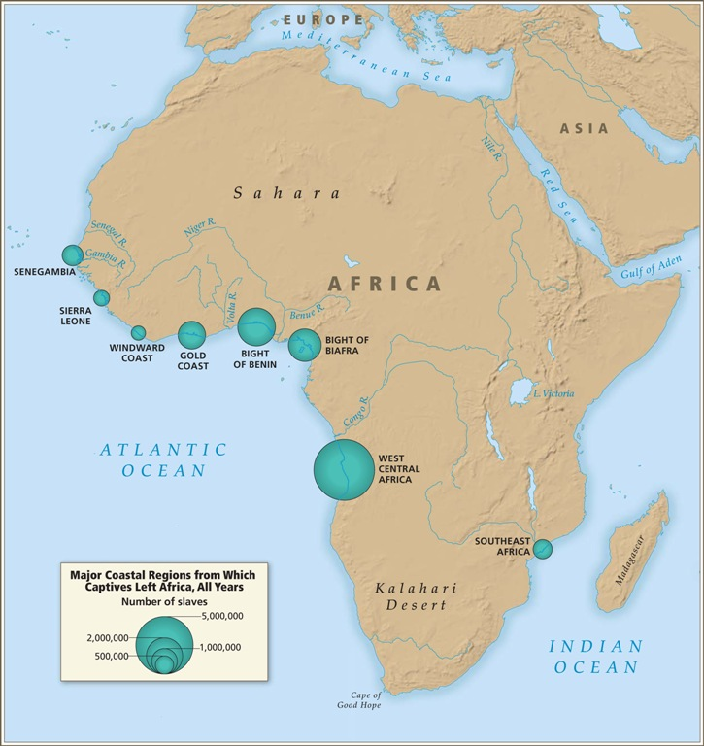

Slide 6
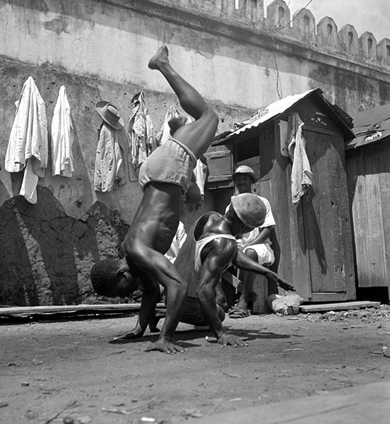
Capoeira in Bahia in the 1940s

Slide 7
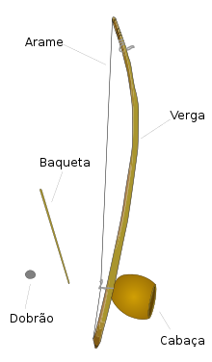
Berimbau (Brazilian instrument, Angolan origins)
https://en.wikipedia.org/wiki/File:Toque-de-angola.ogg

Slide 8
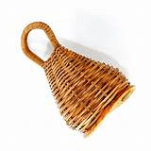
Caxixi – used with the berimbau, but probably West African not Central African

Slide 9
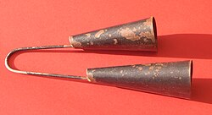
Agogô
Yoruba name; but similar bells used across West Africa

Slide 10
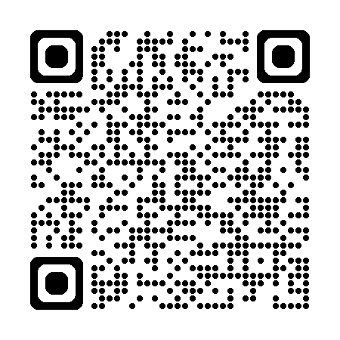
History Module Feedback
Please complete the History Department Module Feedback Form: https://warwick.ac.uk/fac/arts/history/students/currentug/modulefeedbackform
Group 1 is the Tuesday group
Group 2 is the Wednesday group
Thank you for your feedback!

