Slide 1
Week 2: Cultures and Societies in the Diaspora

Slide 2
Initial questions
What cultural and religious institutions and practices undergirded Afro-American life in the Iberian world?
How can historians (including you, in your essays) work with the history of cultural practices to understand life in the past? What challenges are there?

Slide 3
Questions
What cultural and religious institutions and practices undergirded Afro-American life in the Iberian world?
Did the Middle Passage represent cultural change or cultural continuity for enslaved Africans and their New World descendants?
Is change/ continuity a useful distinction?
What differences might we identify between Brazil and Cuba as case studies?

Slide 4
Readings [choose 2]
Barcia, Manuel. Seeds of Insurrection: Domination and Resistance on Western Cuban Plantations, 1808-1848, 2008. Ch 1: “The African Background of Cuban Slaves”
Morgan, Philip D. “The Cultural Implications of the Atlantic Slave Trade: African Regional Origins, American Destinations and New World Developments.” Slavery & Abolition, 1997
Castillo, Lisa Earl, and Luis Nicolau Parés. “Marcelina da Silva: A nineteenth-Century Candomblé Priestess in Bahia.” Slavery & Abolition, 2010
Matthias Rohrig Assuncao, "From Slave to Popular Culture: The Formation of Afro-Brazilian Art Forms in Nineteenth-Century Bahia and Rio de Janeiro," Iberoamericana, 2003

Slide 5
Two important references:
The classic reference on mixture and creolisation: Sidney W. Mintz and Richard Price, The Birth of African-American Culture: An Anthropological Perspective. Boston, 1992
On African continuities: John Thornton, Africa and Africans in the Making of the Atlantic World, 1400-1680. New York, 1992

Slide 6
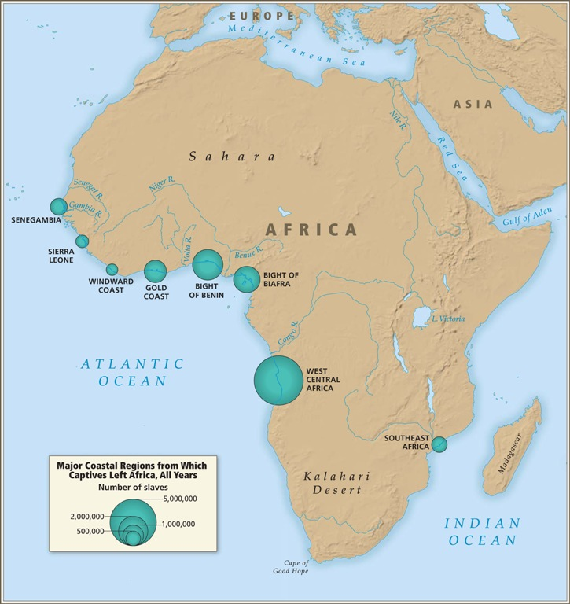

Slide 7
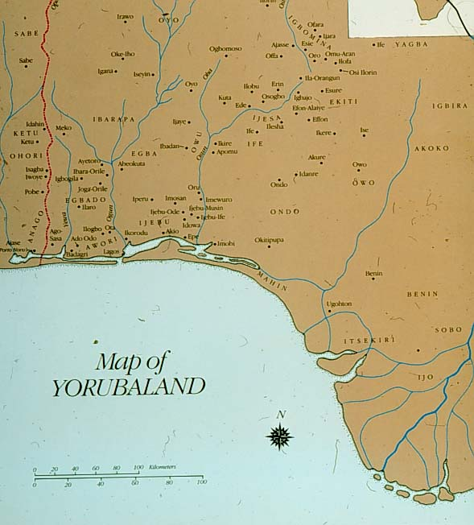
Notes:
From: https://coursewikis.fas.harvard.edu/aiu18/?title=File:Yorubaland.jpg&limit=500

Slide 8
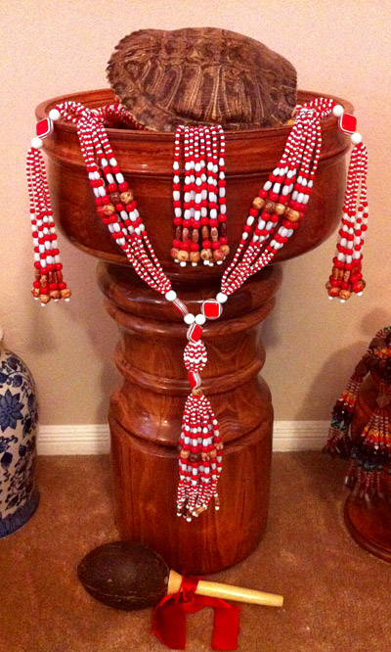
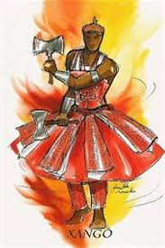
Orixás (Orishas): Changó/ Xangó

Slide 9
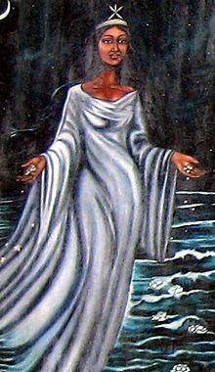
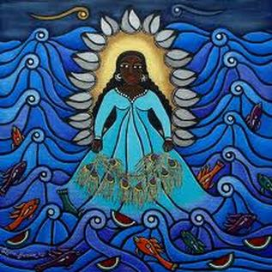
Yemayá/ Iemanjá

Slide 10
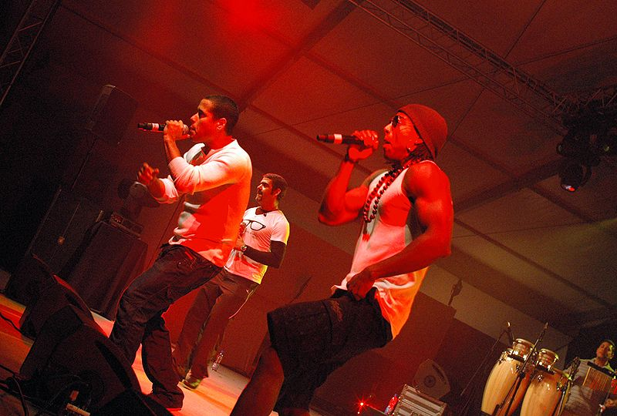
Cuban rap group Orishas

Slide 11
Pierre “Fatumbi” Verger and Afro-Brazilian religious life in 1940s Bahia (see www.pierreverger.org)

Slide 12
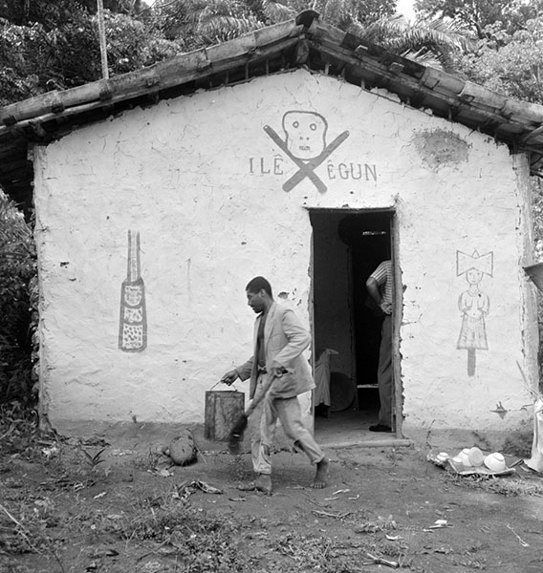
A candomblé terreiro (religious house)

Slide 13
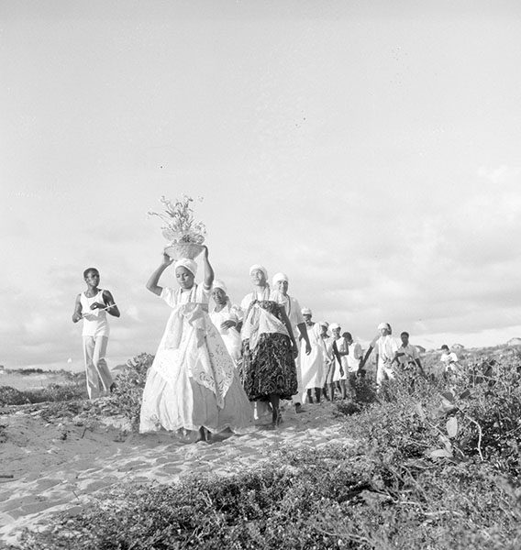

Slide 14
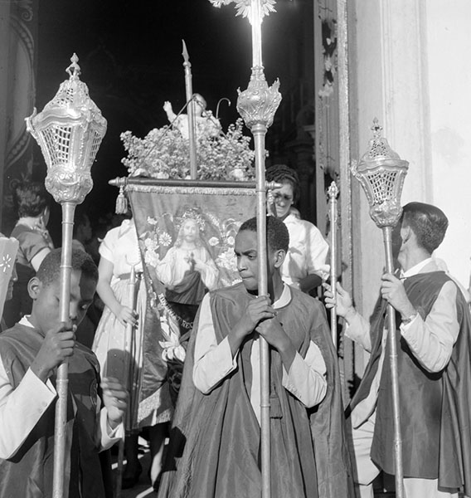

Slide 15
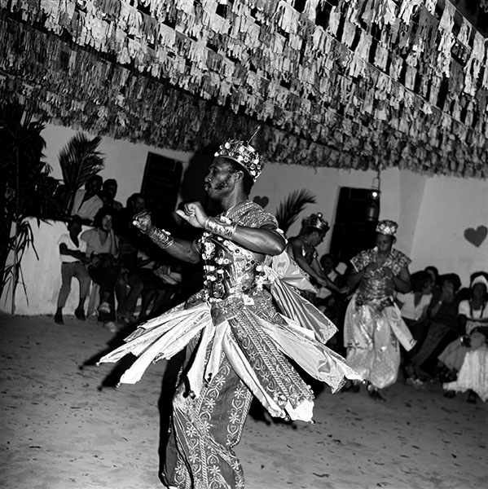

Slide 16
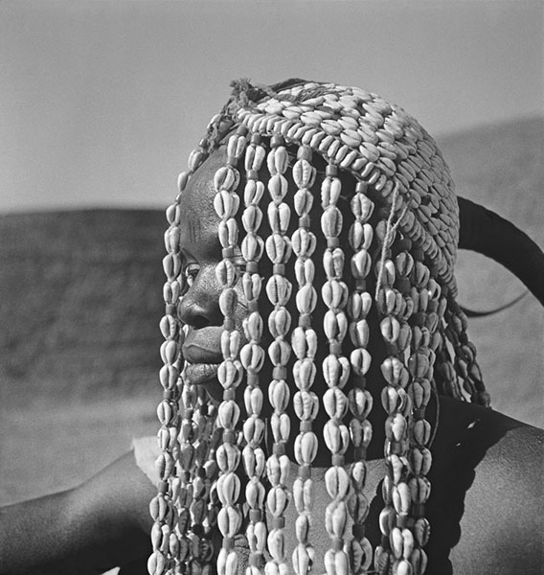
Cowrie shells

Slide 17
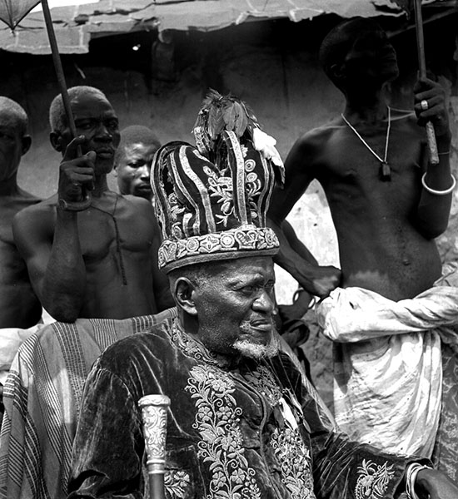

Slide 18
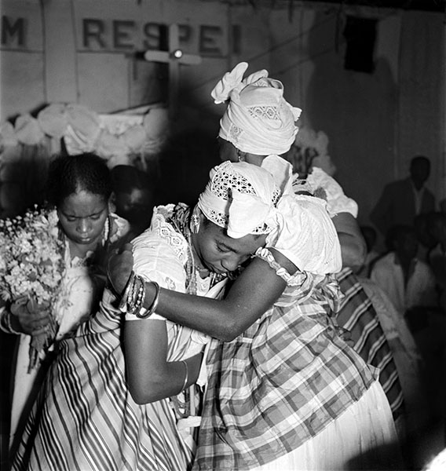

Slide 19
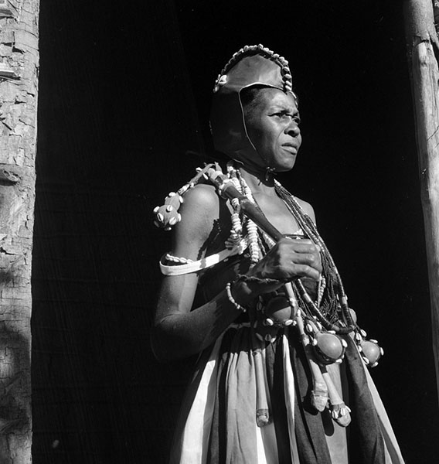

Slide 20
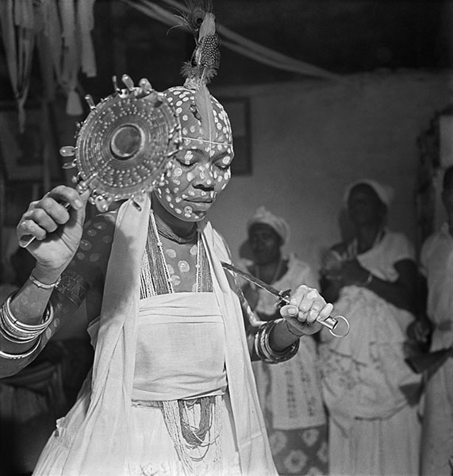

Slide 21
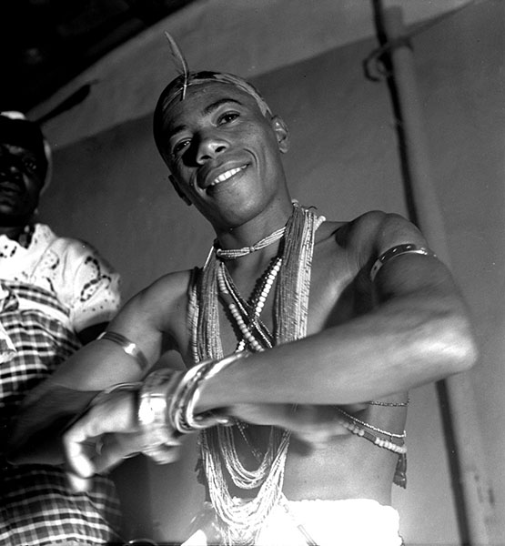

Slide 22
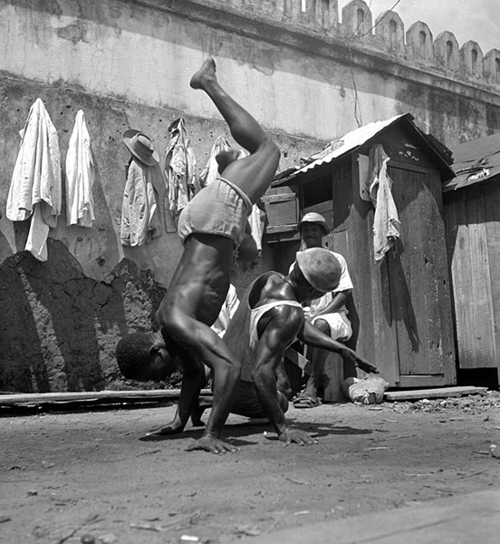
Capoeira in Bahia in the 1940s

Slide 23
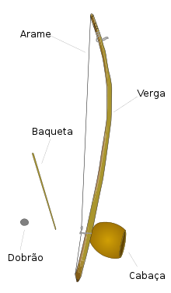
Berimbau (Brazilian instrument, Angolan origins)
https://en.wikipedia.org/wiki/File:Toque-de-angola.ogg

Slide 24
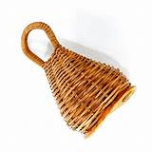
Caxixi – used with the berimbau, but probably West African not Central African

Slide 25
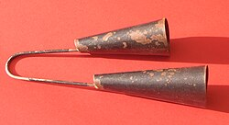
Agogô
Yoruba name; but similar bells used across West Africa

