Slide 1
Week 4: Groundings (2): The African Diaspora; doing spatial history

Slide 2
Readings
Mann, Kristin. “Shifting Paradigms in the Study of the African Diaspora and of Atlantic History and Culture,” 2001
Dale Tomich, et.al. Reconstructing the Landscapes of Slavery: A Visual History of the Plantation in the Nineteenth-Century Atlantic World
Marisa Fuentes, Dispossessed Lives: Enslaved Women, Violence, and the Archive. Chapter 1: Jane: Fugitivity, Space, and Structures of Control in Bridgetown [and the intro if you are interested / have time]
Singleton, Theresa A. “Slavery and Spatial Dialectics on Cuban Coffee Plantations.” World Archaeology, 33:1 (June 2001): 98-114.

Slide 3
In-class participation
Seminars are better if we get a wider range of ideas, knowledge, experience. You all have great things to say.
better to hear something from everyone
If you don’t tend to speak much: try out a short “low-stakes” comment first. Research shows: speaking once helps you feel confident to do so again.
If you offer lots of comments: thank you! ☺ Try the 10-second rule to make space for others
Assessment criteria: about actively listening and making space for others as well as reading/ speaking yourself
Voluntary questionnaire on participation, end of term 1: how can we help you get the most out of class and boost your mark?

Slide 4
Look at the image (“Fazenda do Bom Retiro,” 1881, by Georg Grimm) and talk about…
How/ why do you think the image might have been produced?
Whose interests do you think it serves?
What does it tell us about planter uses of space in the Vale do Paraíba (south-eastern Brazil) in the late C19?
What is visible, and what is invisible, in the image?
Do you think other kinds of information, beyond the image, could help us to fill in the ‘gaps’ / ‘silences’ the image creates? How?

Slide 6
Questions
What is the “African diaspora?” What approaches have scholars taken to defining it? Does it look different from different places?
How can studying how people in the past used space help us address some of the “archival silences” described by Fuentes?
How do Fuentes’, Tomich et al.’s, and Singleton’s approaches to studying spaces of slavery differ?

Slide 7
Spatial histories of slavery
Theresa Singleton, Slavery Behind the Wall: An Archaeology of a Cuban Coffee Plantation (2015)
Tezanos Toral, Lorena. "The Architecture of Nineteenth-Century Sugar Mills: Creole Power and African Resistance in Late Colonial Cuba." PhD diss, CUNY, 2015.
J.G. Cantero and E. La Plante, Los ingenios de Cuba: coleccion de vistas de los principales ingenios de azucar de la isla de Cuba 1857. [in Spanish but full of PLANTATION IMAGES (lithographs) which present a 'master narrative' of slaveholding spaces - you can do a lot with this source without the actual text
Dale Tomich, et.al. Reconstructing the Landscapes of Slavery: A Visual History of the Plantation in the Nineteenth-Century Atlantic World [visual 'master narratives' created by enslavers in Brazil, Cuba and the US South.
Aisha K. Finch, Rethinking Slave Rebellion in Cuba: La Escalera and the Insurgencies of 1841-44UNC Press 2015

Slide 8
Spatial history beyond Brazil and Cuba: some good starting-points
Stephanie Camp, Closer to Freedom: Enslaved Women and Everyday Resistance in the Plantation South. UNC 2004. a fundamental reference for social and gender historians of slavery taking spatial approaches
Vincent Brown, Tacky's Revolt: The Story of an Atlantic Slave War. Harvard University Press, 2020; see accompanying interactive map, Slave Revolt in Jamaica, 1760-1761
McKittrick, Katherine. Demonic Grounds: Black Women and Cartographies of Struggle (2006) (founding text of ‘black geographies’ approaches)
Tim Cresswell, Place: A Short Introduction. Blackwell, 2004.
Mimi Sheller and John Urry, "The New Mobilities Paradigm,"Environment & Planning A (38:2): 2006.

Slide 9
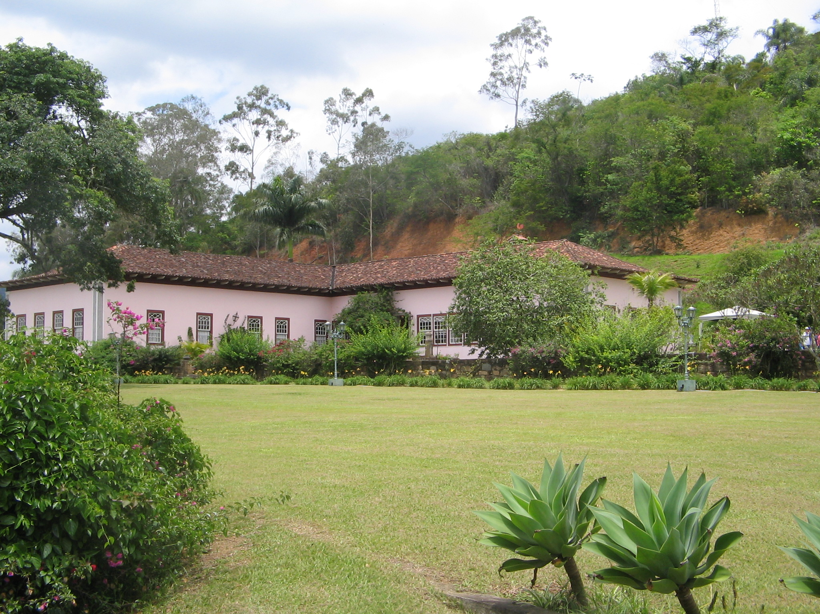
Notes:
Brazil: Vassouras, restored great house of coffee plantation

Slide 10
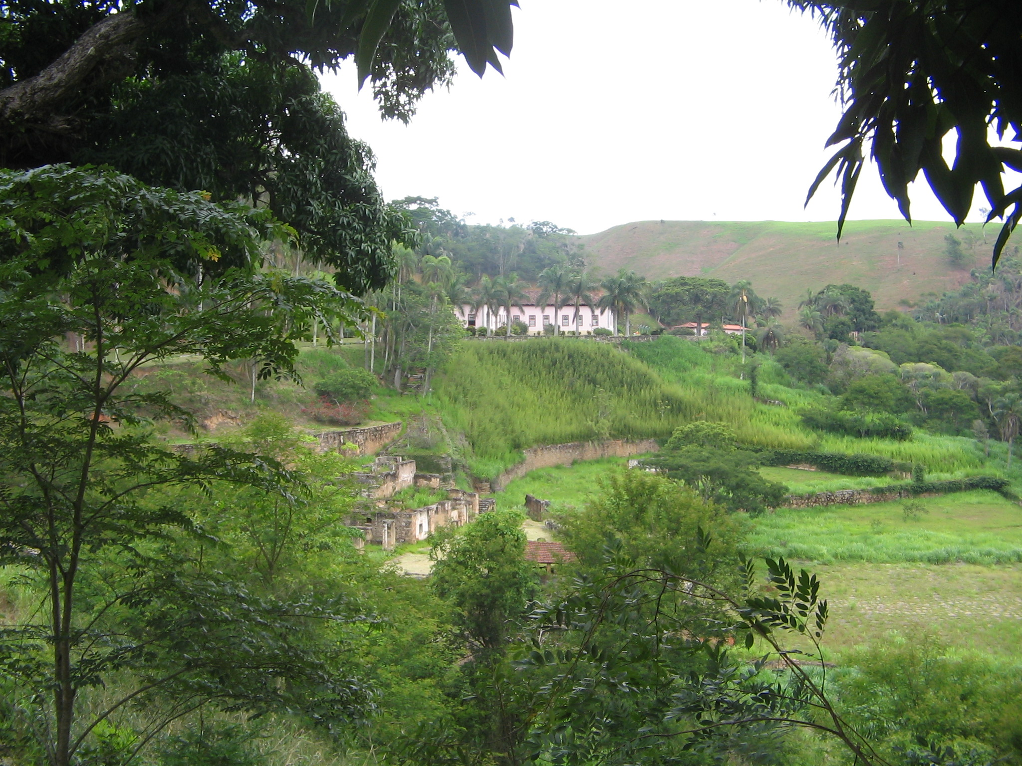
Notes:
Brazil, Vassouras, view of terraces/ drying area from great house

Slide 11
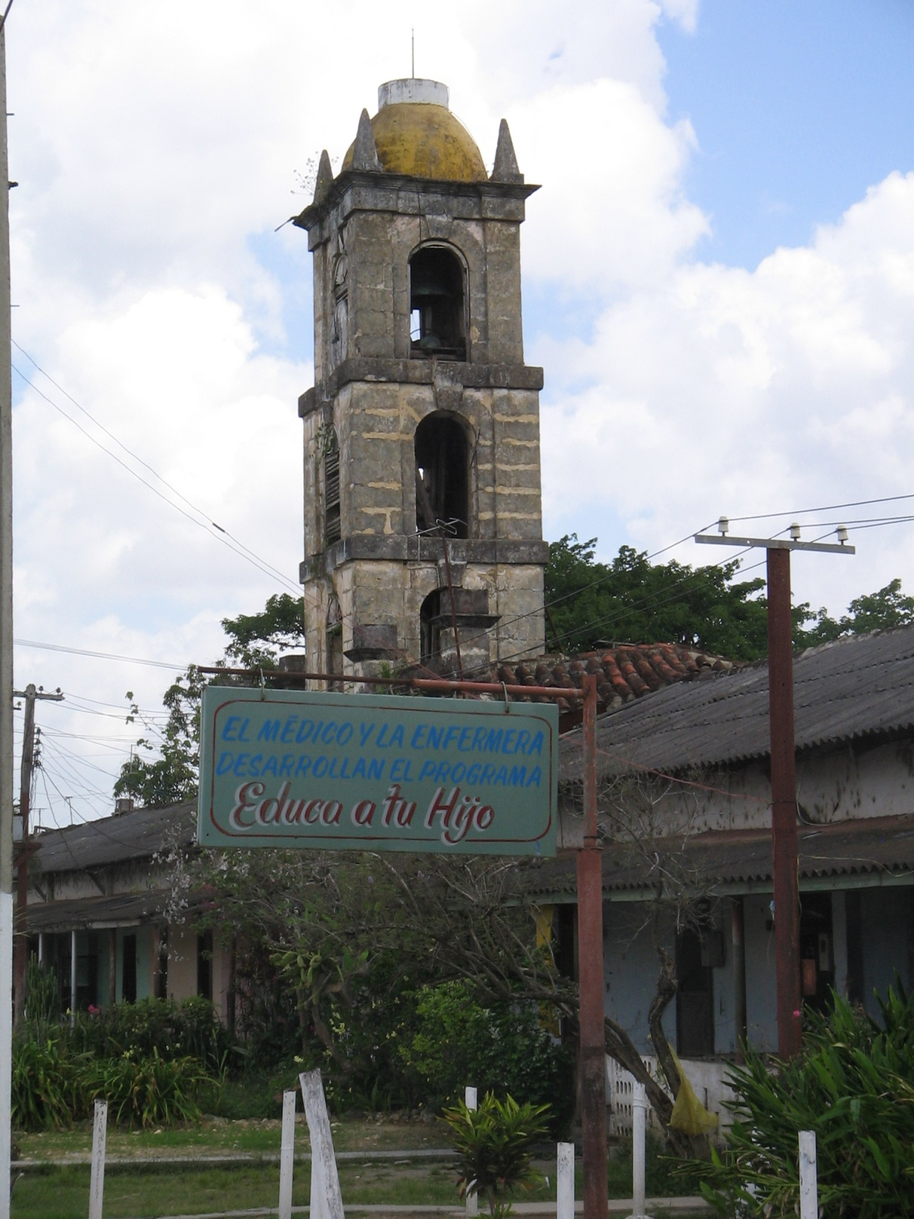
Notes:
Ingenio Alava, Matanzas

Slide 12
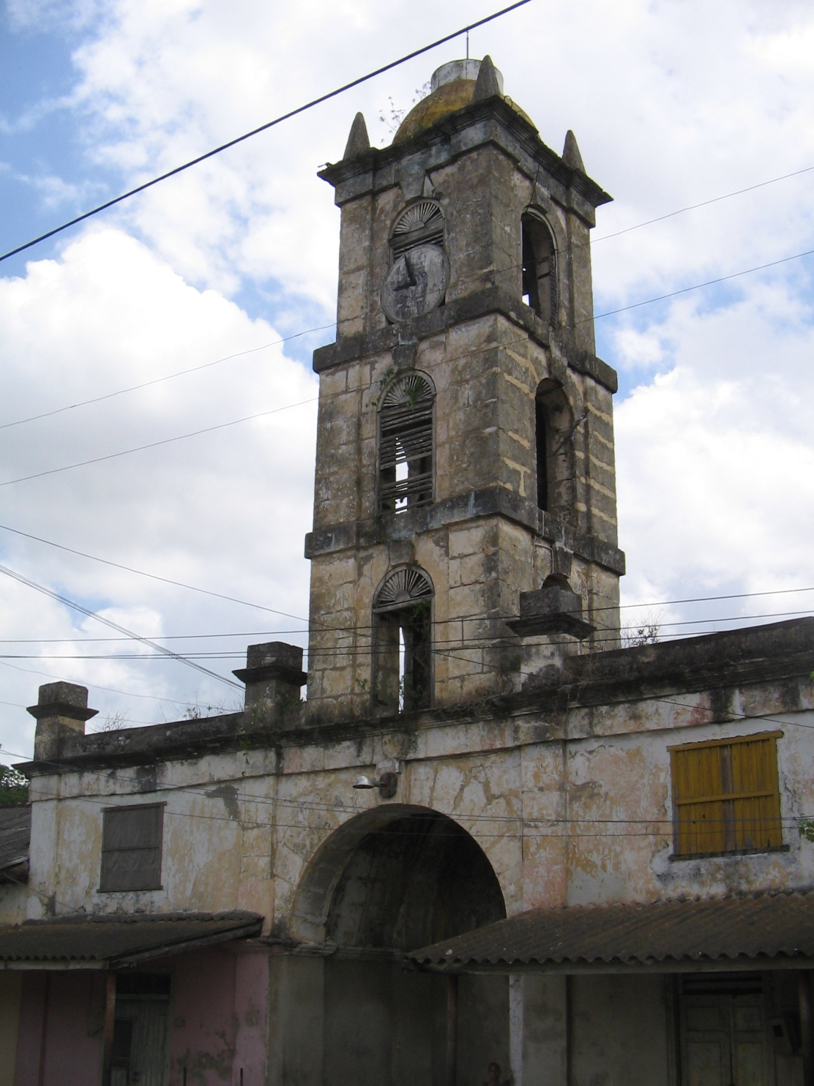
Notes:
Ingenio Alava, Matanzas

Slide 13
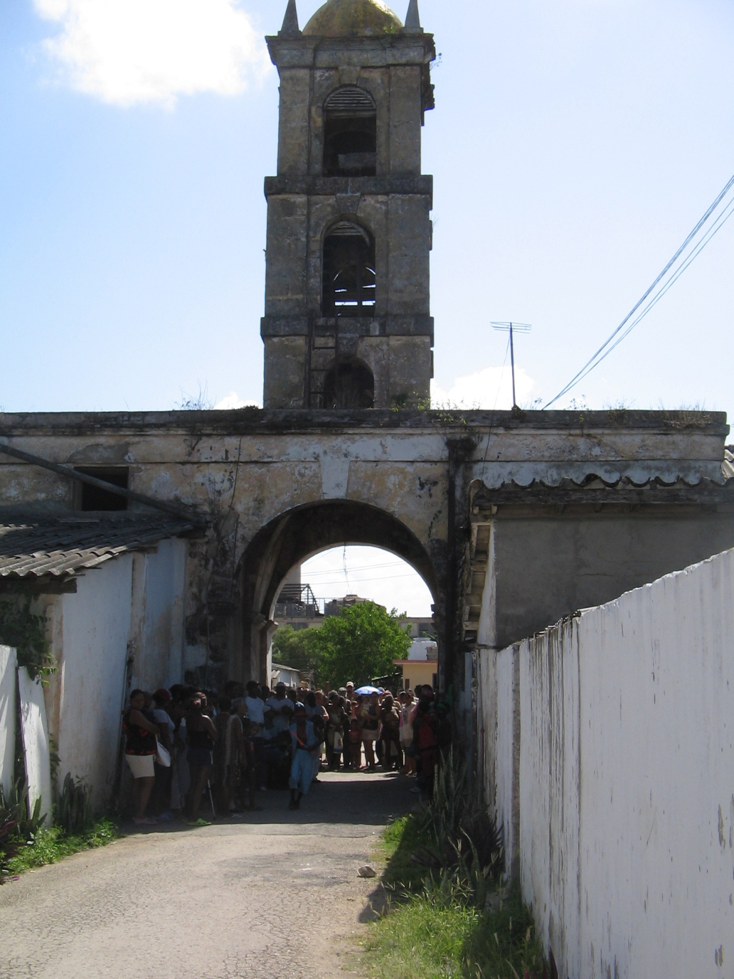
Notes:
Ingenio Alava, Matanzas

Slide 14
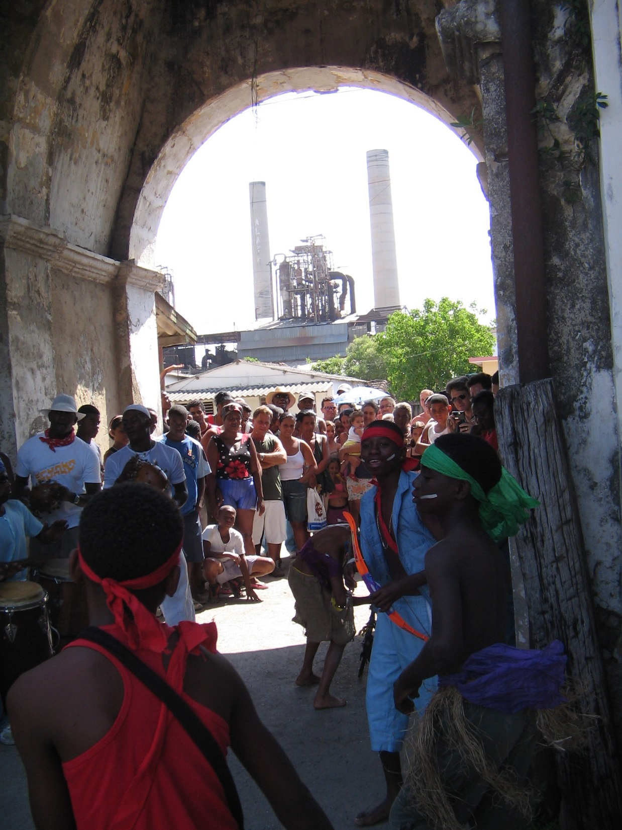

Slide 15
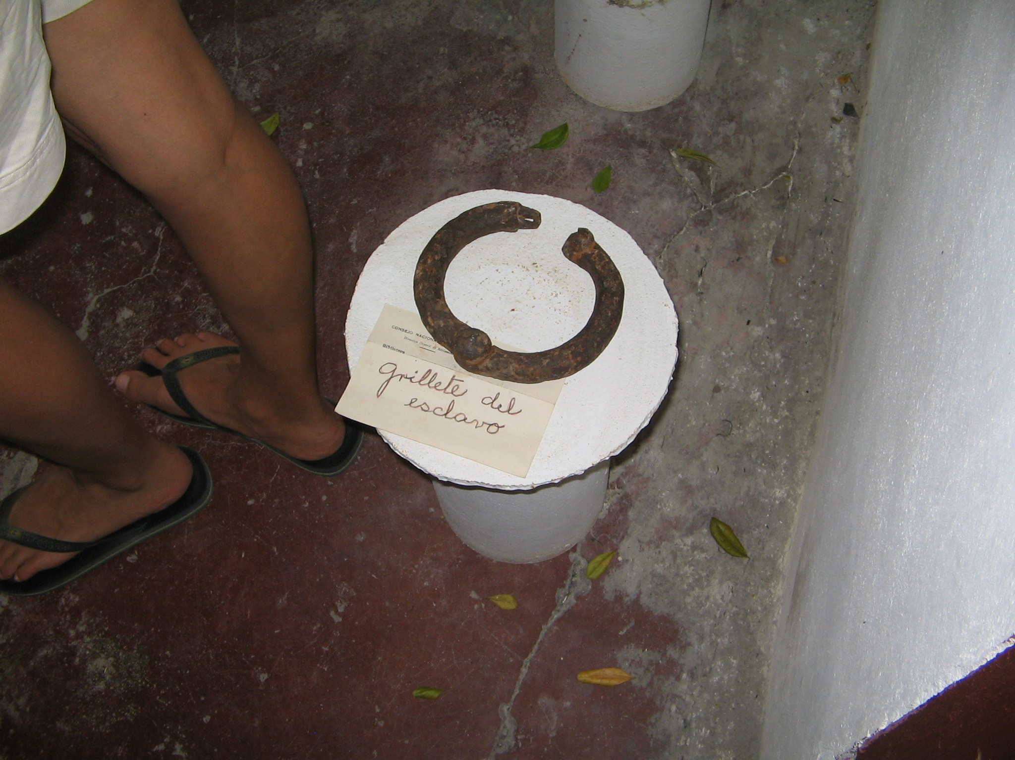
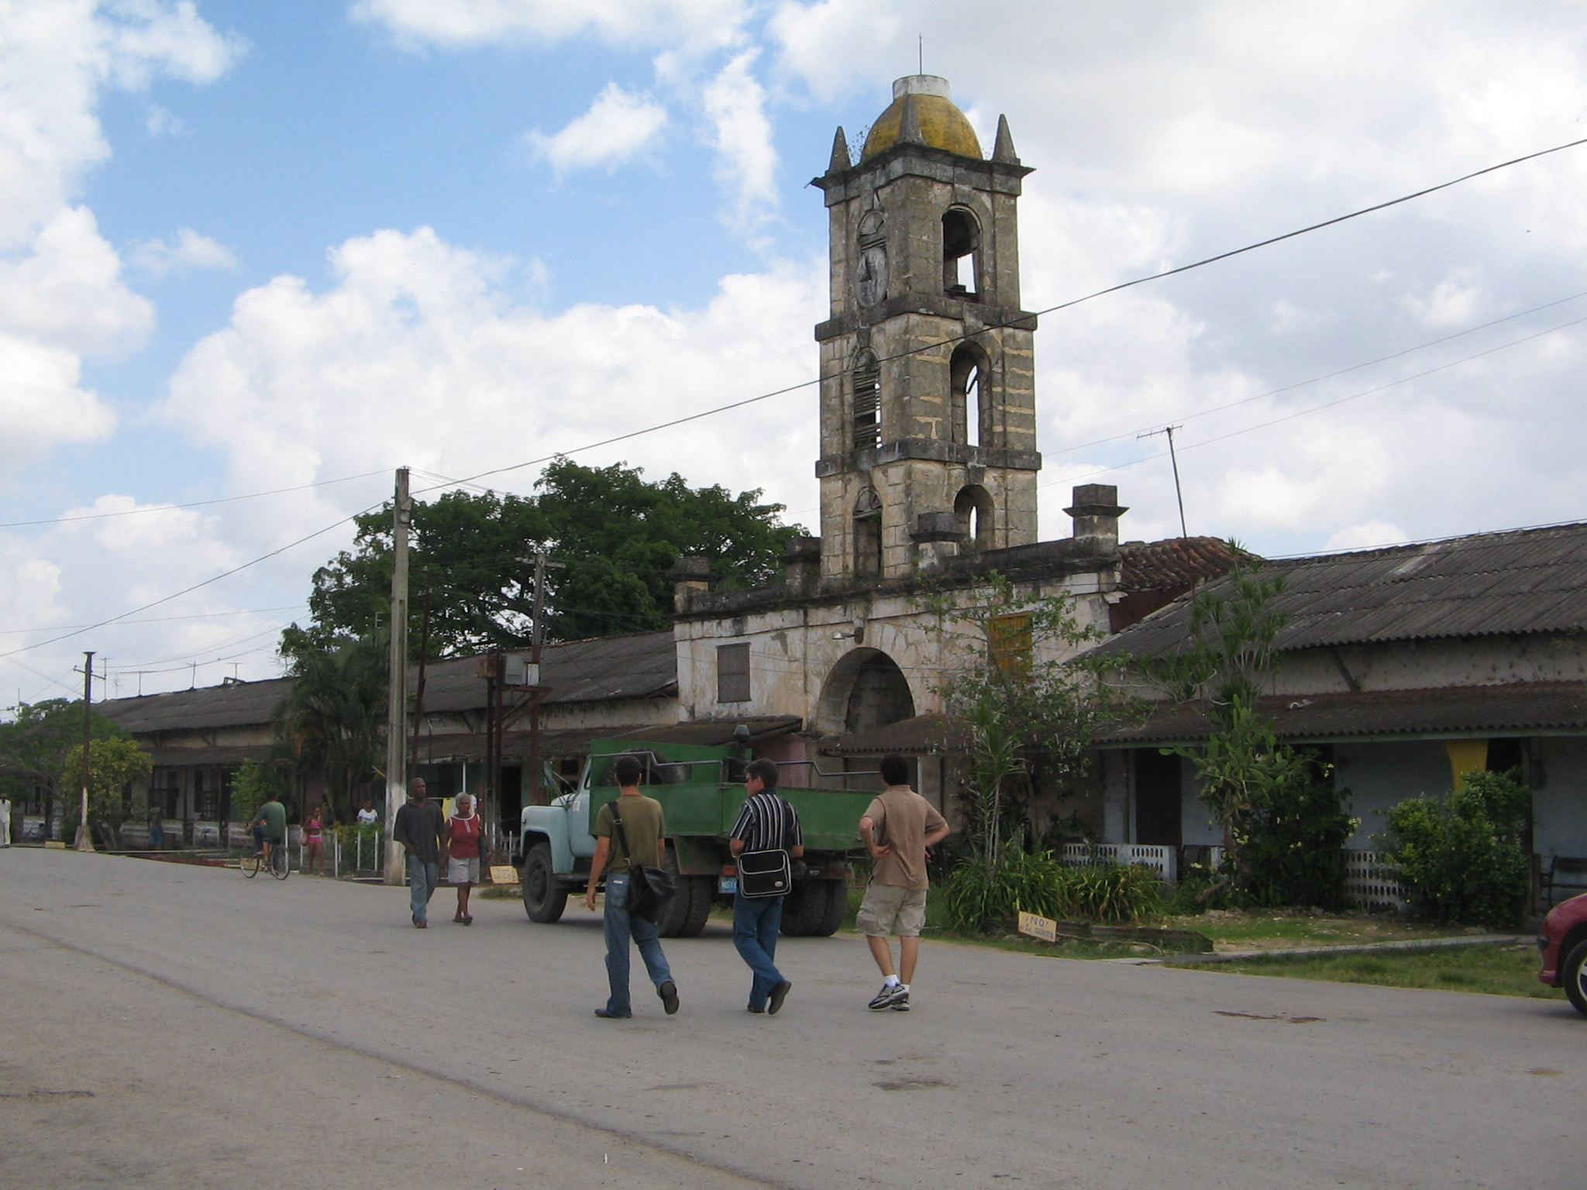
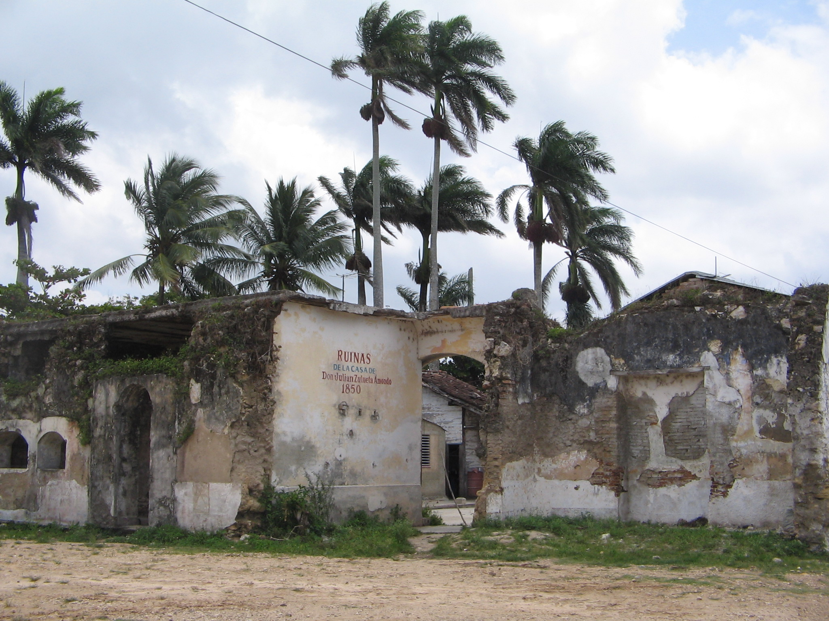
Notes:
Ingenio Alava, Matanzas

Slide 16
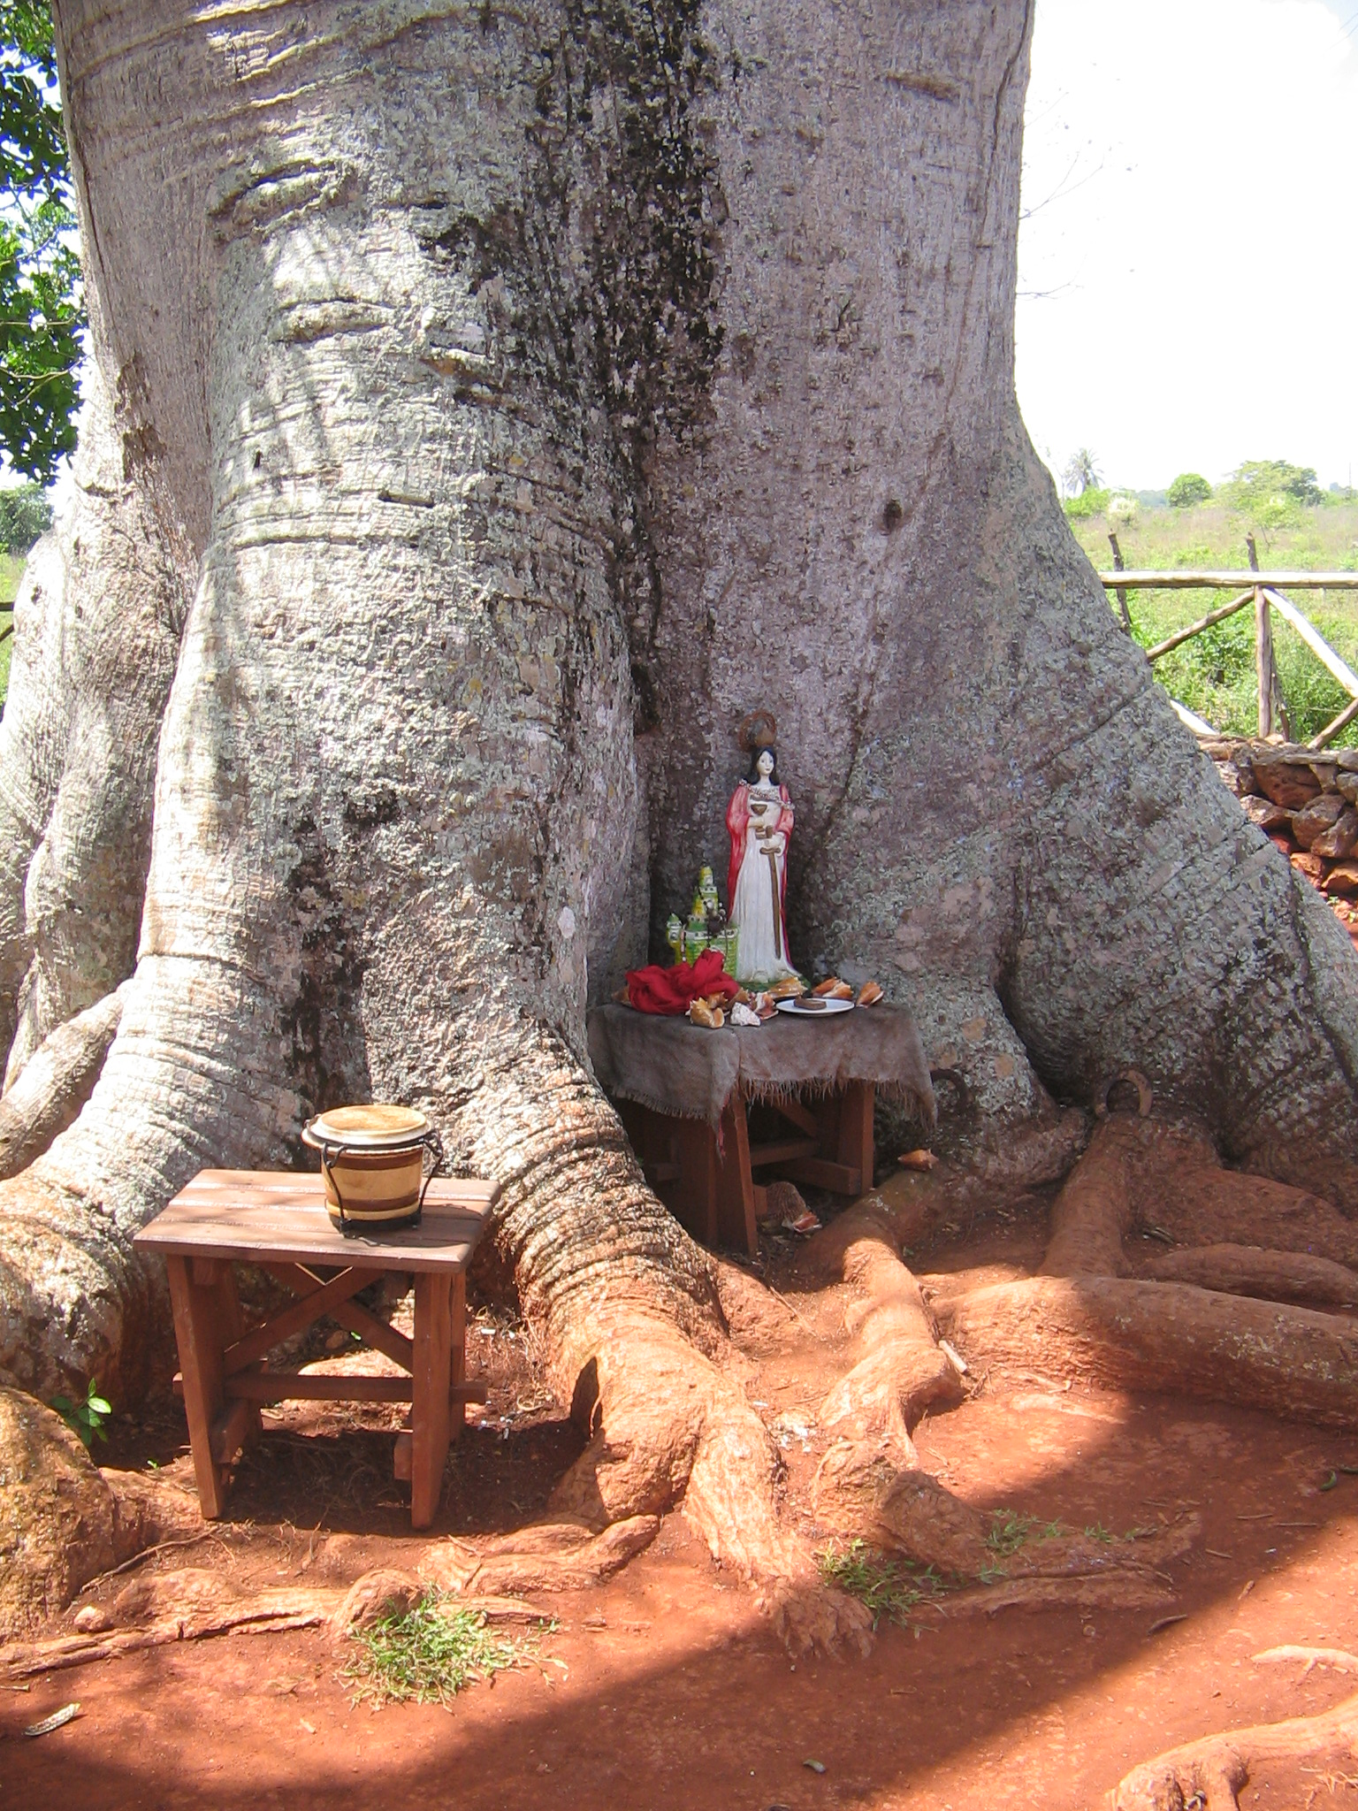
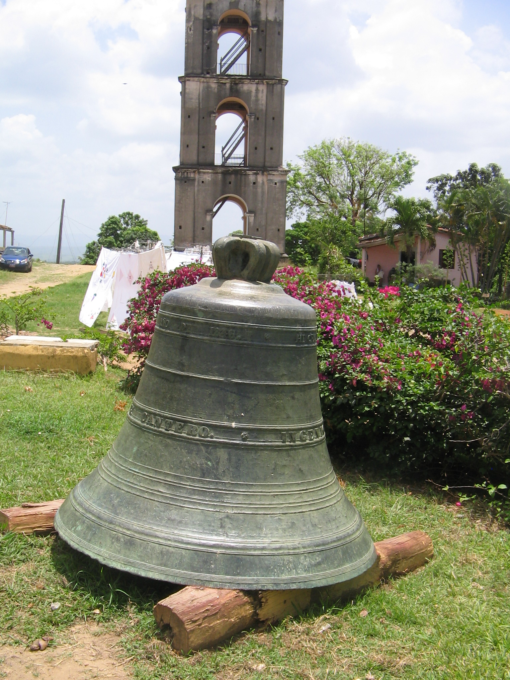
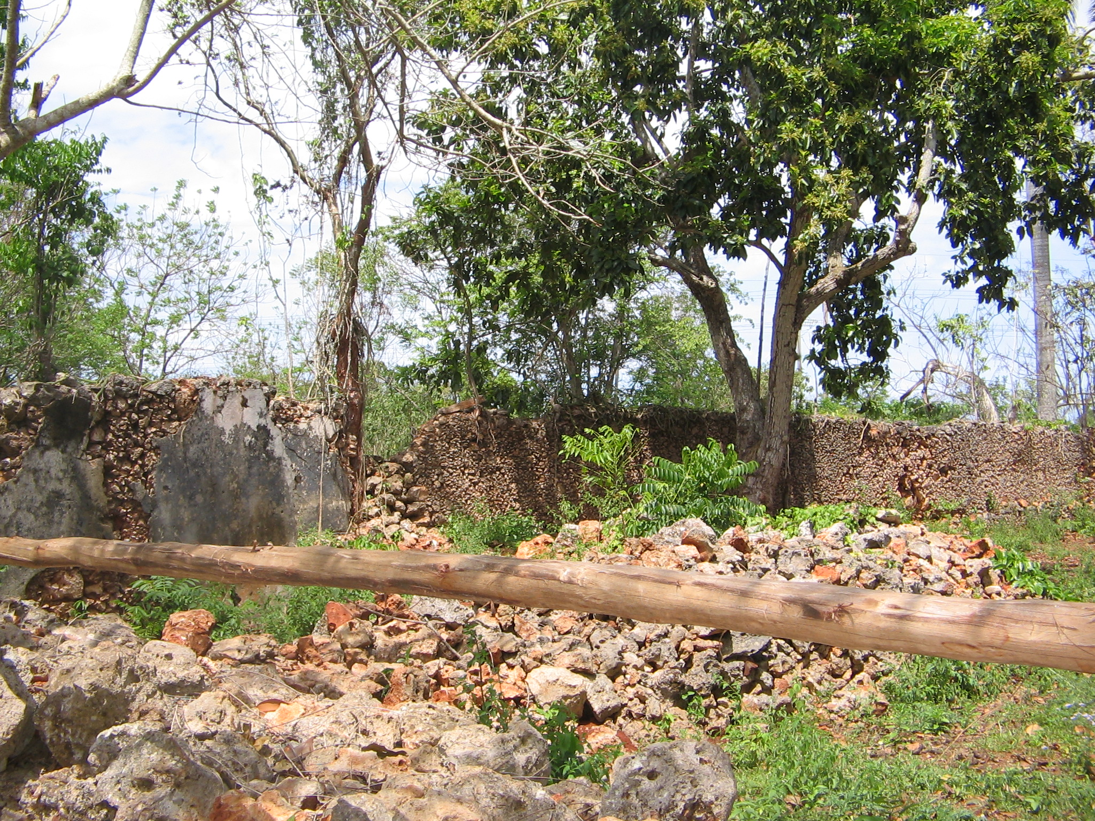
Notes:
Manaca Iznaga ingenio, Valle de los Ingenios, Trinidad. Bell and watch-tower

Slide 17
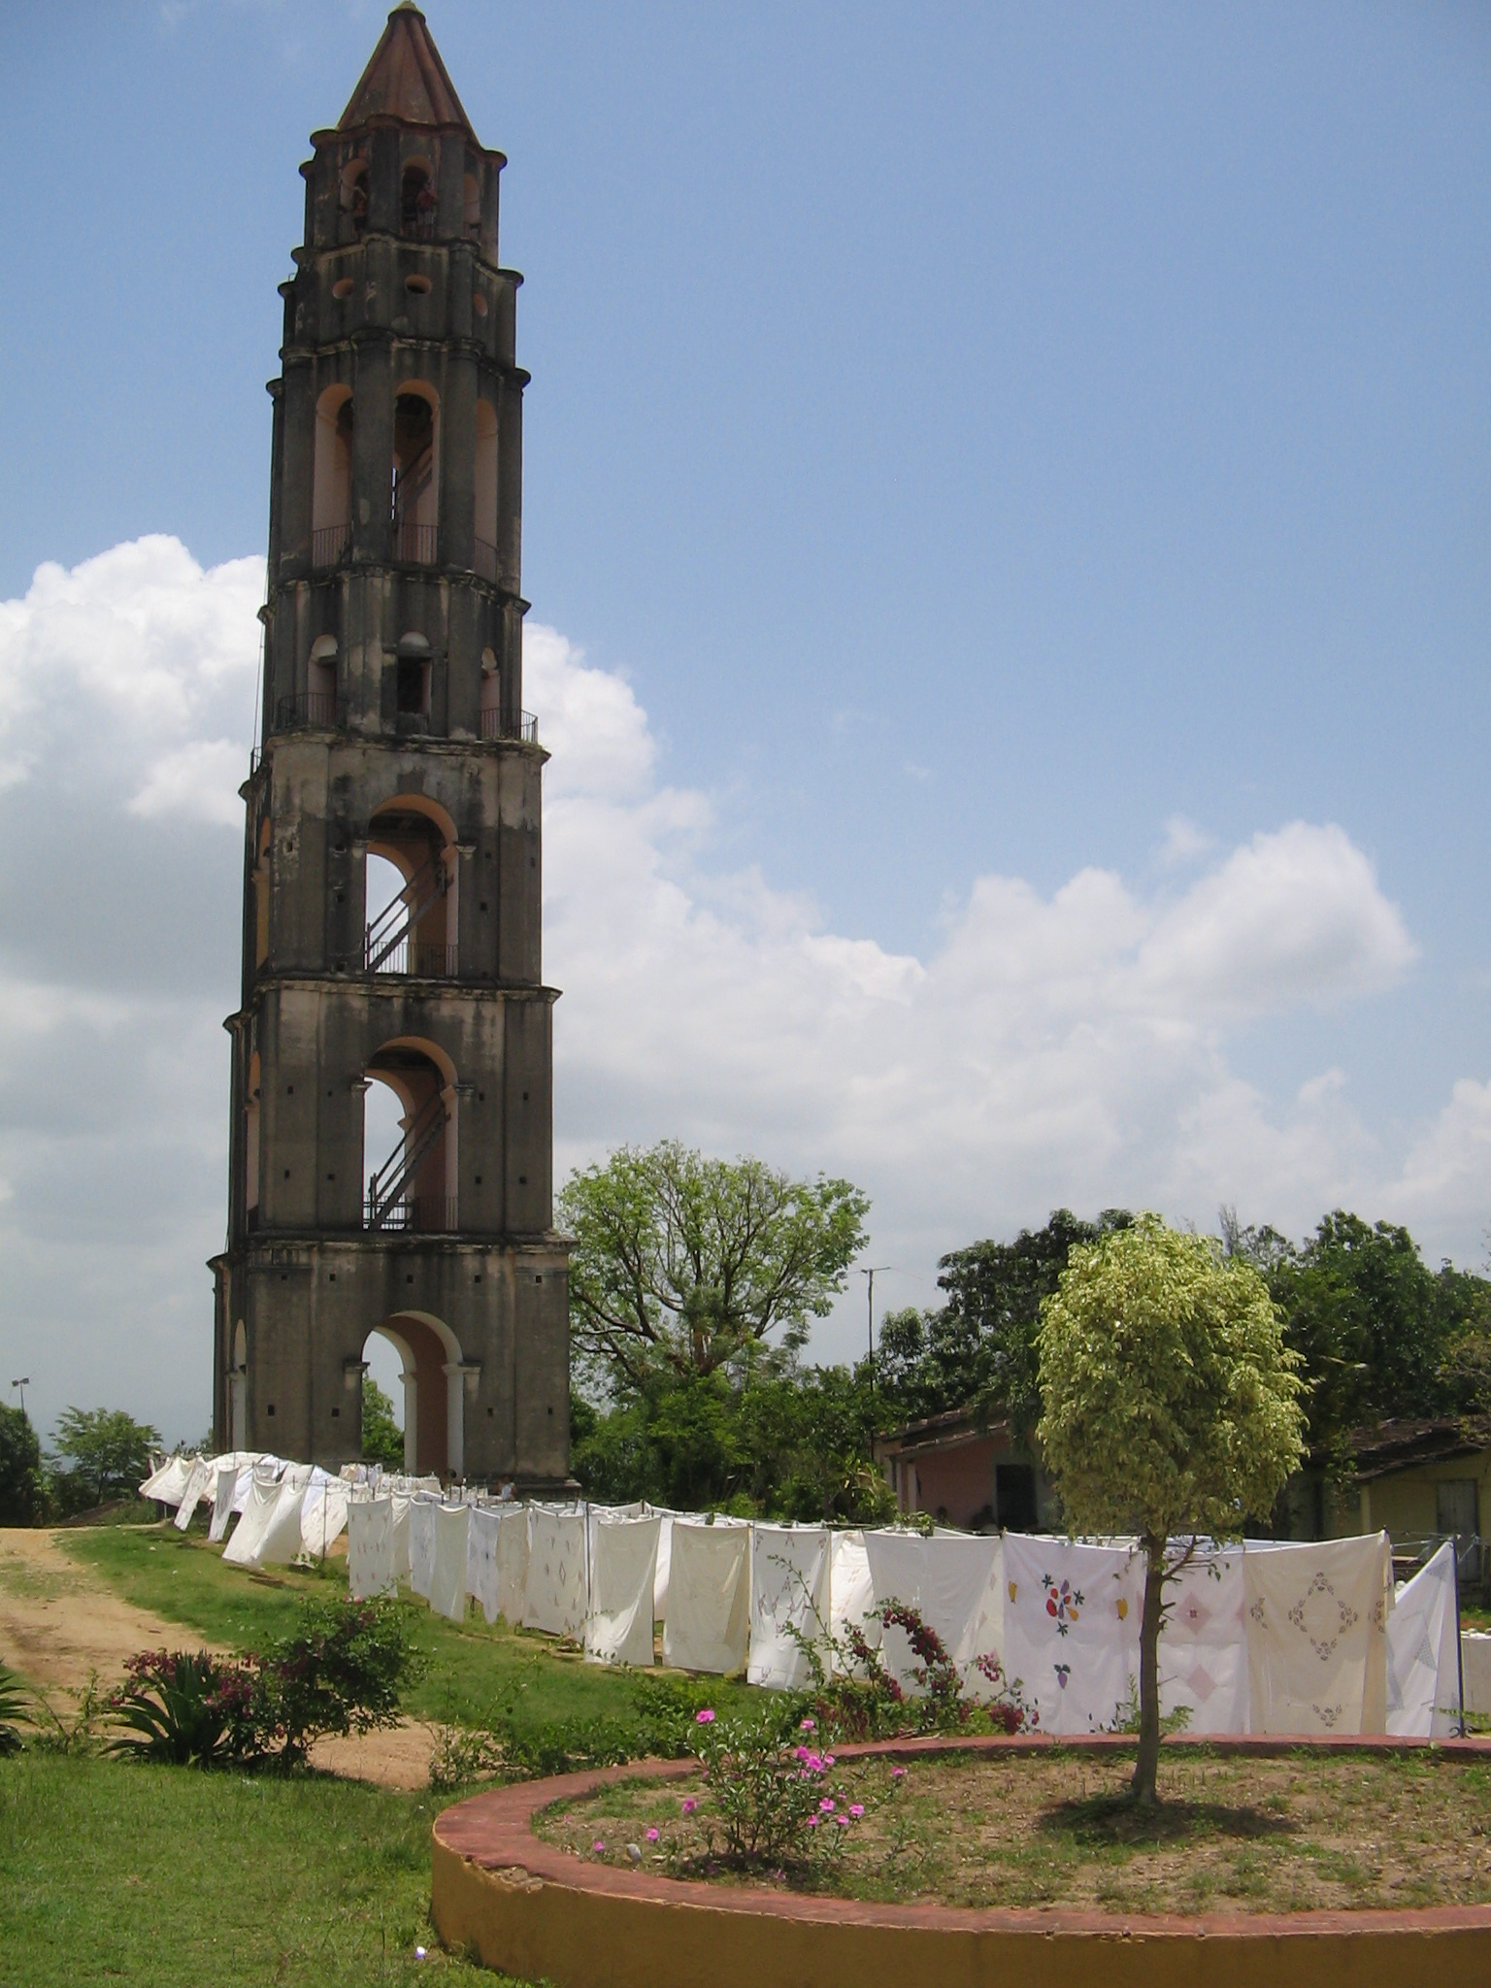
Notes:
Tower at Manaca Iznaga

Slide 18
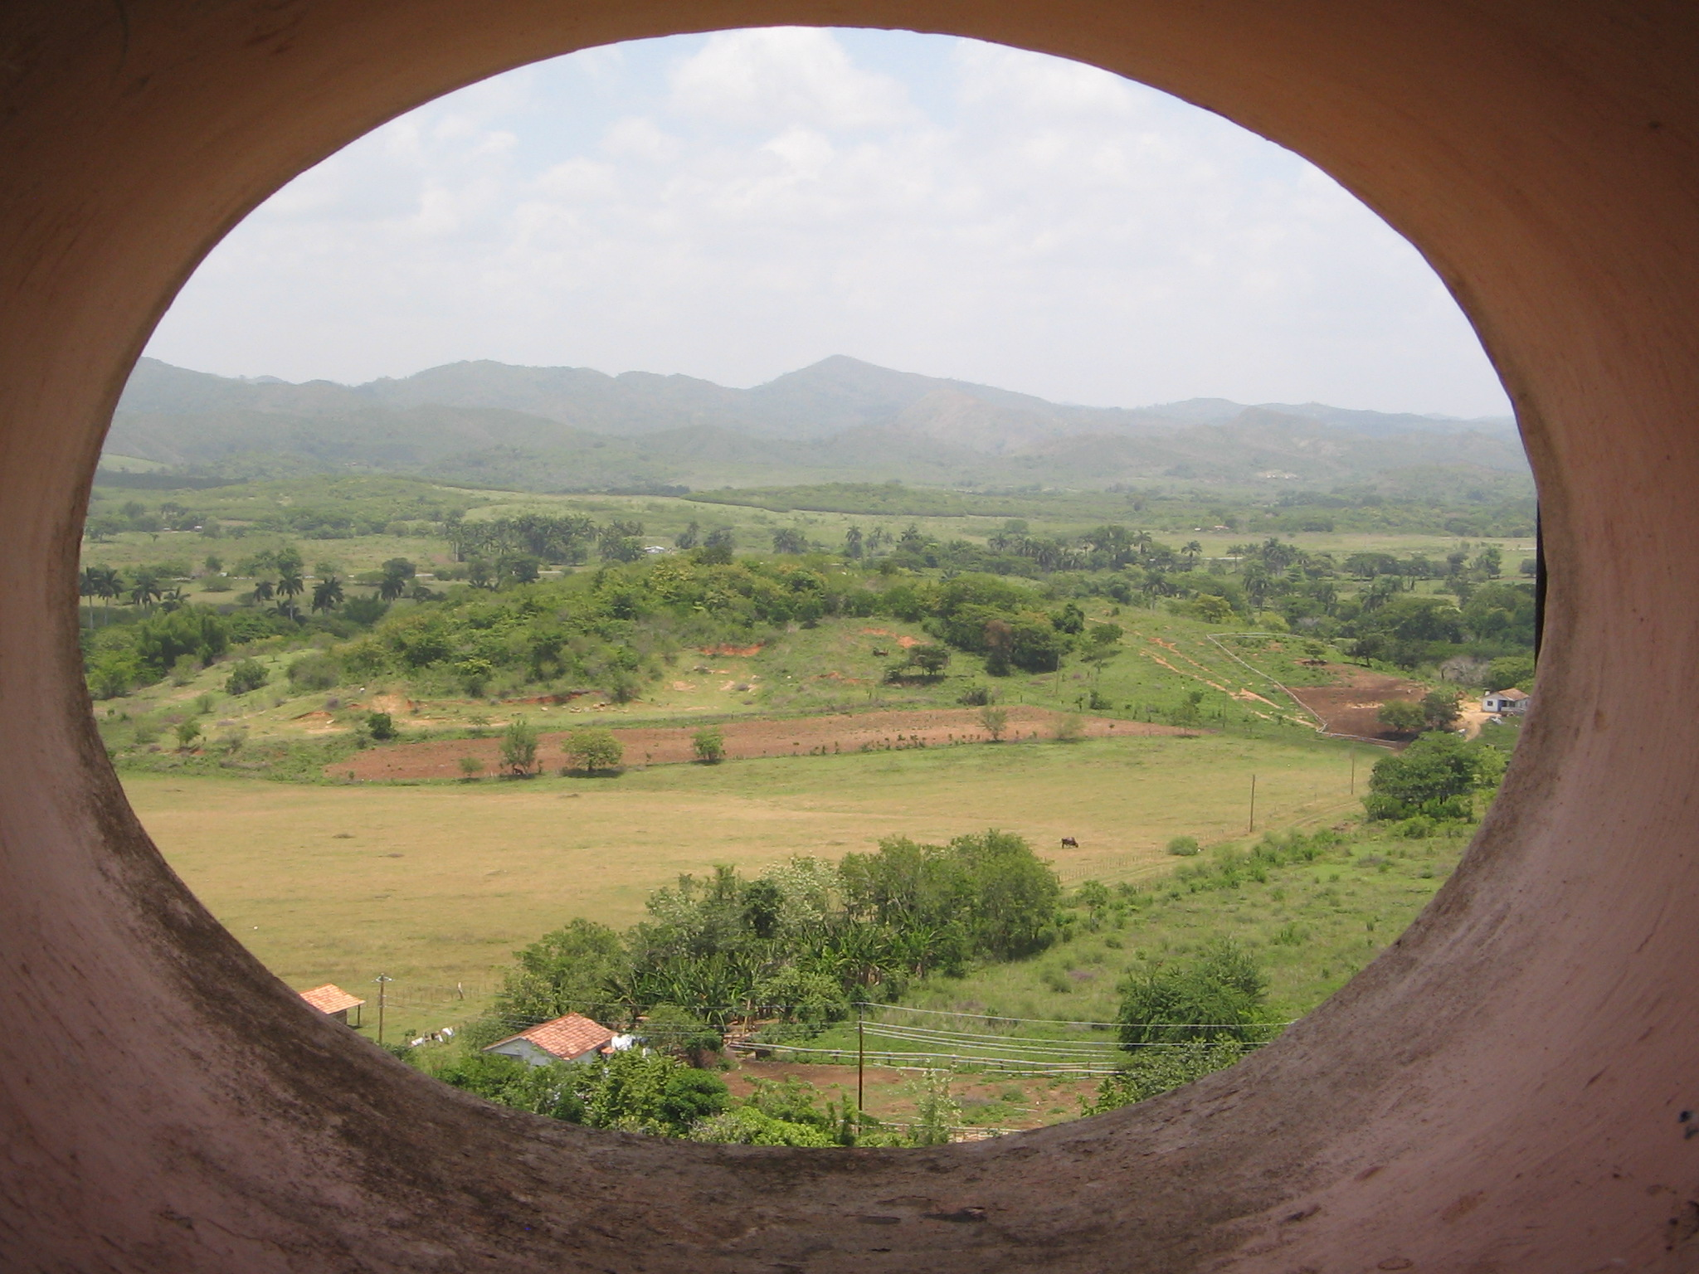
Notes:
Manaca Iznaga plantation, Trinidad, view from tower

Slide 19
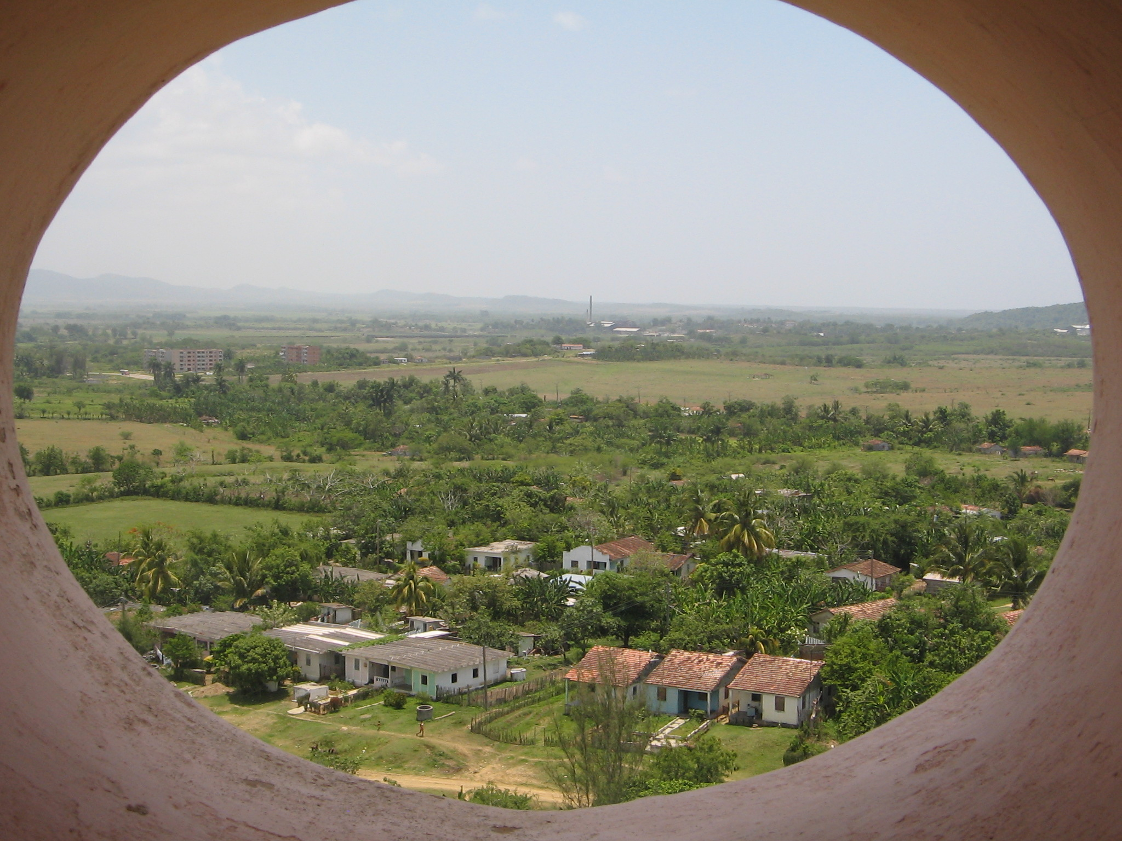
Notes:
Manaca Iznaga plantation, view from tower

Slide 20
Marc Ferrez, enslaved people and barracks, c.1885. Museu AfroBrasil, Sao Paulo

Slide 21
Going to the fields. Marc Ferrez, c.1885, Museu AfroBrasil, Sao Paulo

Slide 22
Coffee harvest. Marc Ferrez, c. 1885. Museu Afro Brasil, Sao Paulo.

